Slide 1
EQUITY AND ACCREDITATION
David Morse, ASCCC President
Adrienne Foster, ASCCC South Representative
John Stanskas, ASCCC Secretary
Accreditation Institute
February 19, 2016

Slide 2
Equity and Accreditation
The term “equity” in the context of accreditation standards includes many areas:
academic quality, student services, institutional integrity, human resource practices,
disaggregation of student learning outcomes assessment data and other areas. This
breakout with the ASCCC Equity and Diversity Action Committee will focus on
institutional practices intended to increase equity and how to leverage student
equity initiatives to meet accreditation standards, focusing on efforts to diversify
faculty hiring.
Outcomes: Attendees will review standards related to equity and learn practices for
addressing them, especially in light of the student equity initiates statewide.

Slide 3
Equity, a definition?
eq·ui·ty
[ˈekwədē]
NOUN
the quality of being fair and impartial: "equity of treatment"synonyms: fairness · justness · impartiality · egalitarianism
Notes:
Not sure of the thought behind this slide.

Slide 4
Equity – A National and Statewide Interest
Why focus on equity?

Slide 6
Statewide Remedial English Equity Completion

Slide 7
Statewide Remedial Math Equity Completion

Slide 8
Under-Represented Minority* Percentages by Student and Employee Types Fall Terms 2005 - 2014 FIRST-TIME HIRES

Slide 9
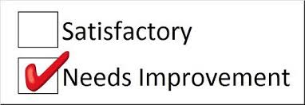
Equity – Reflection of National and Statewide Interest in the Accreditation Standards
A. Using Data to Determine Effectiveness (I.A.2)

Slide 10
Equity – Reflection of National and Statewide Interest in the Accreditation Standards
B. Disaggregate Data regarding student achievement
(IIB.2, II A.7, I.B.6, I.B.1)

Slide 11
Equity – Reflection of National and Statewide Interest in the Accreditation Standards
C. Supports a diverse personnel (III.A.12)

Slide 12
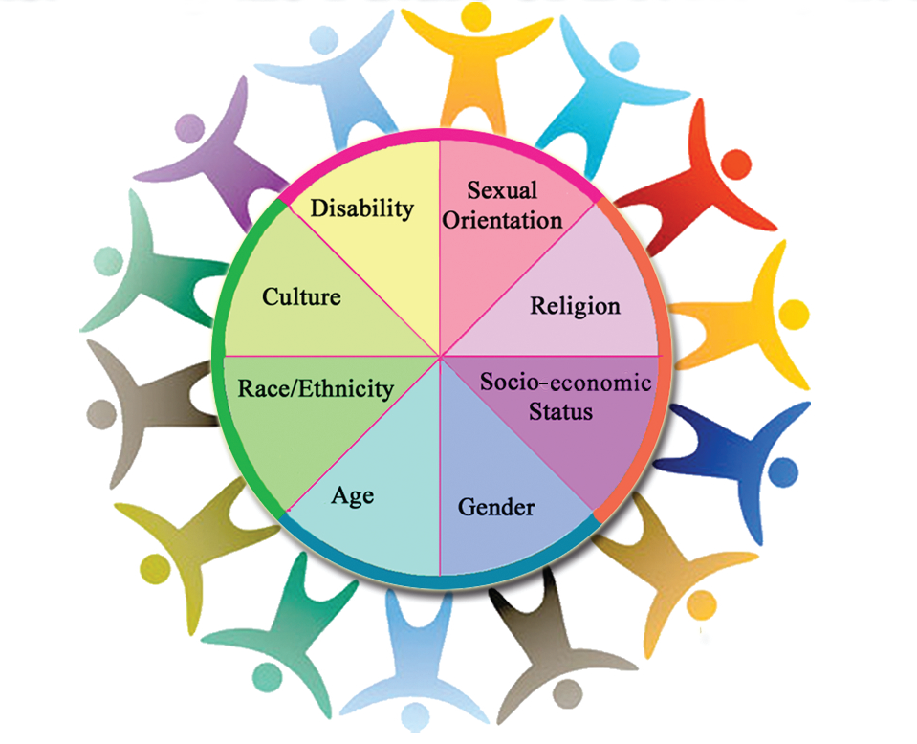
Equity – Reflection of National and Statewide Interest in the Accreditation Standards
C. Supports a diverse personnel (III.A.12)

Slide 13
Equity – How the Chancellor’s Office and ASCCC are responding to this issue
Equity and Diversity Action Committee (EDAC)
The Academic Academy is planned to focus on equity
issues beyond our focus of accreditation.
Breakouts will focus on strategies that promote a
disciplined approach to seeing our colleges living and
acting on the hope expressed in our equity plans and
in our students’ continued arrival at our doors.

Slide 14
Equity – How Colleges can use the Chancellor’s Office Initiatives to help address Accreditation Standards
Student Equity Plans
Student Support and Services Program
EEO and Diversity Advisory Committee

Slide 15
“
Questions?
Thanks for coming!
fosteraa@wlac.edu
dmorse@lbcc.edu
jstanskas@valleycollege.edu

