Slide 1
Supporting the Work of the Academic Senate for California Community Colleges
Ginni May
AS Foundation President
Curriculum Institute 2016
Double Tree Hilton Anaheim, July 7-9
Notes:
Or do you want to have a picture of the real trophy?

Slide 2
Our Mission
The mission of the Academic Senate Foundation for California Community Colleges is to enhance the excellence of the California community colleges by sustained support for professional development of the faculty in the furtherance of effective teaching and learning practices.

Slide 3
Board of Directors
President:
Ginni May
mayv@scc.losrios.edu
ASCCC North Representative
Secretary:
Adrienne Foster
fosteraa@wlac.edu
ASCCC South Representative
Treasurer:
Craig Rutan
rutan_craig@sccollege.edu
ASCCC Area D Representative
Director:
Lorraine Slattery-Farrell
lfarrell@msjc.edu
Mt. San Jacinto College
Executive Director:
Julie Adams
julie@asccc.org
ASCCC Executive Director
Director Seats Vacant:
3 – Information will follow

Slide 4
What Do We Do?
Within our Mission, we:
Conduct research;
Develop and communicate effective practices to promote effective teaching and learning in CCC;
Provide a variety of activities to advance teaching and learning.
Notes:
The specific purposes of this corporation are to benefit, support, and enhance the excellence of California community colleges; to support, design and implement professional development for California community college faculty; to research, develop and communicate effective practices to promote effective teaching and learning in the California community colleges; and to promote a variety of activities and strategies to advance teaching and learning.

Slide 5
How Do We Do It?
Advance Teaching and Learning
Literature Review and Grant funded Research
Professional Development College (PDC)
Scholarships
Fundraising
Receptions
Area Competition
Spring Fling
Donations (10 +1 Campaign)

Slide 6
Research
Impact of Full-time Faculty on Student Success:
In partnership with the Faculty Association for California Community Colleges (FACCC).
Effective Practices for Hiring Diverse Faculty:
Initiated by ASCCC’s Equity and Diversity Action Committee (EDAC).
Efficacy of Student Learning Outcomes Research:
Initiated by ASCCC Accreditation and Assessment Committee in partnership with The Research and Planning Group for California Community Colleges (The RP Group)
Interested… email info@asccc.org.
Notes:
Conduct a research project to ascertain the usefulness of student learning outcomes assessment research for improving student success with a focus on the viability and value of reviewing outcomes data disaggregated by student subpopulations

Slide 7
Professional Development College (PDC)
What is it?
A resource to assist faculty in developing the knowledge and skills necessary to become strong academic leaders for their colleges and districts as well as for the California Community College system
What does it do?
Provides opportunities for faculty to:
expand and improve their skills;
gain valuable insight into their chosen position on their own campuses;
receive certification and/or continuing education units; and
develop a cohort of fellow learners and leaders.
Notes:
Reformatted for larger font

Slide 8
Professional Development College (PDC)
Leadership Academy
Curriculum 101
In the works:
New Faculty Orientation
Governance 101
Teaching in Prisons
Effective Evaluations
10 + 1
And more….
Notes:
Added an “and”

Slide 9
Scholarships
Scholarships are available for part time faculty members to Senate Institutes and Plenary Sessions.
Each local senate may nominate one part time faculty who has shown an interest in college governance and participated locally in professional activities.

Slide 10
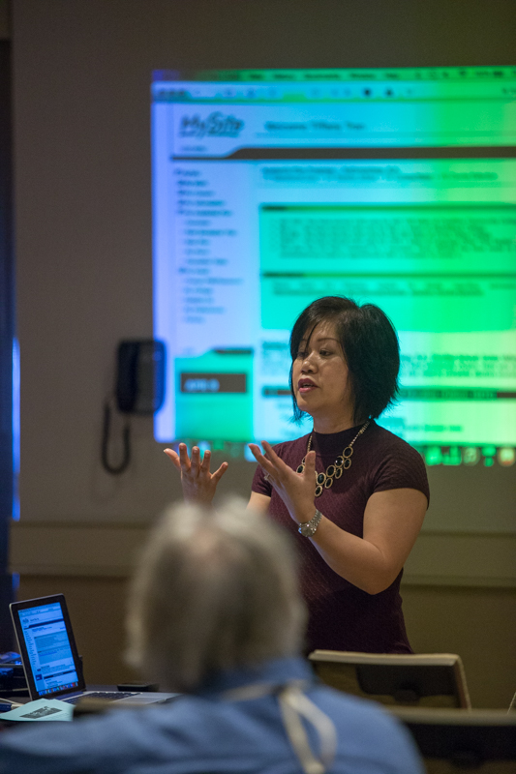
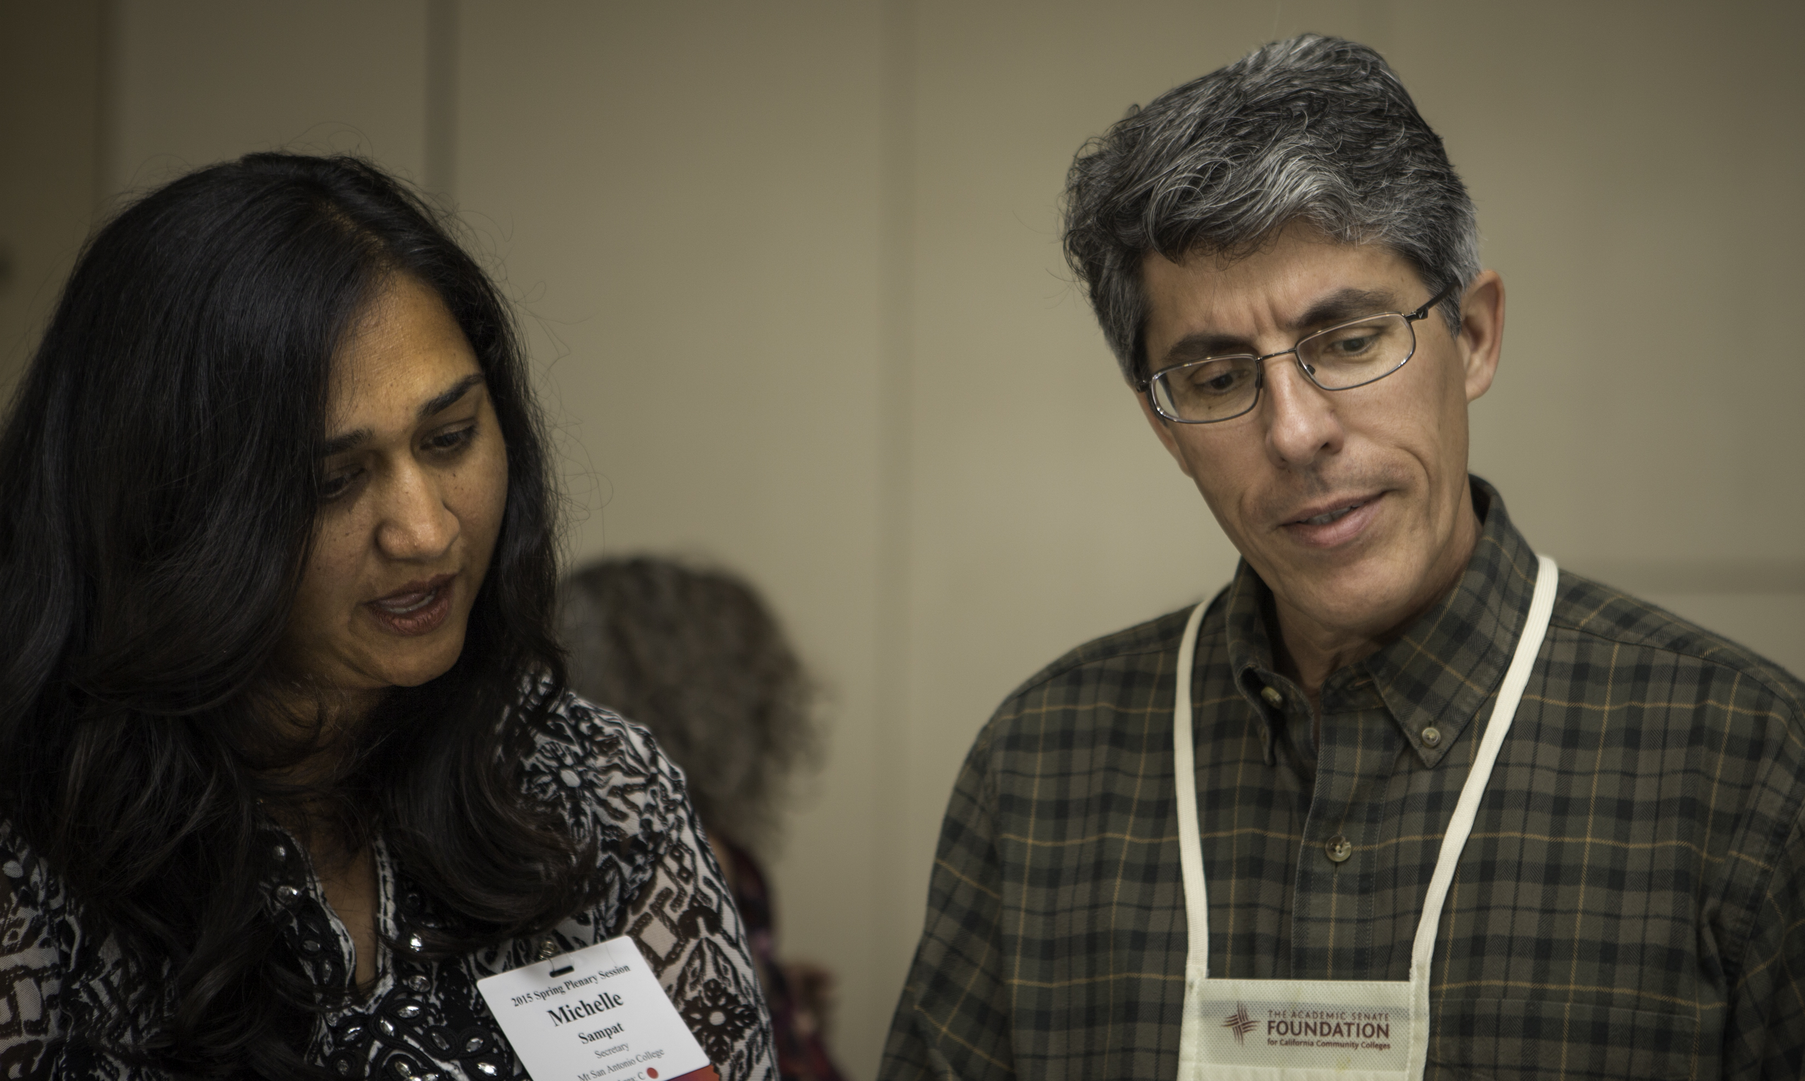
Support the AS Foundation
Your generosity empowers faculty voice, facilitates ongoing professional development, and supports the broad engagement of the Academic Senate on issues facing our colleges and students.

Slide 11
How Can You Support the Foundation?
Purchase Raffle Tickets.
Sign up today to contribute $10 + $1 to our mission and purpose.
Donate one time and receive a t-shirt, lanyard, or ASCCC pin.
Remember, we can only continue to do good work with your support!
Notes:
I removed all the other merchandise because it seems to be selling – play up this campaign.

Slide 12
Raffle Tickets
Prizes include:
Grand Prize: One night stay at Wyndham Anaheim Hotel
Wine!!
Curriculum T-Shirt Bundles
Foundation bags
iPad covers and ASCCC pins
Problem Child, a novel by Robb Lightfoot
Ceramic plates and cups
Free entry to Curriculum Institute 2017
Miscellaneous hotel goodies: slippers, blankets, bags
Tickets:
1 for $5
5 for $20

Slide 13
Foundation Reception
Light refreshments
No host bar
Thursday, July 7
5:30 pm – 7:00 pm
Veranda Room

Slide 14
Spring Fling 2016
Notes:
I don’t want to advertised this because we already ordered food and it’s closed.

Slide 15
Spring Fling 2015

Slide 16
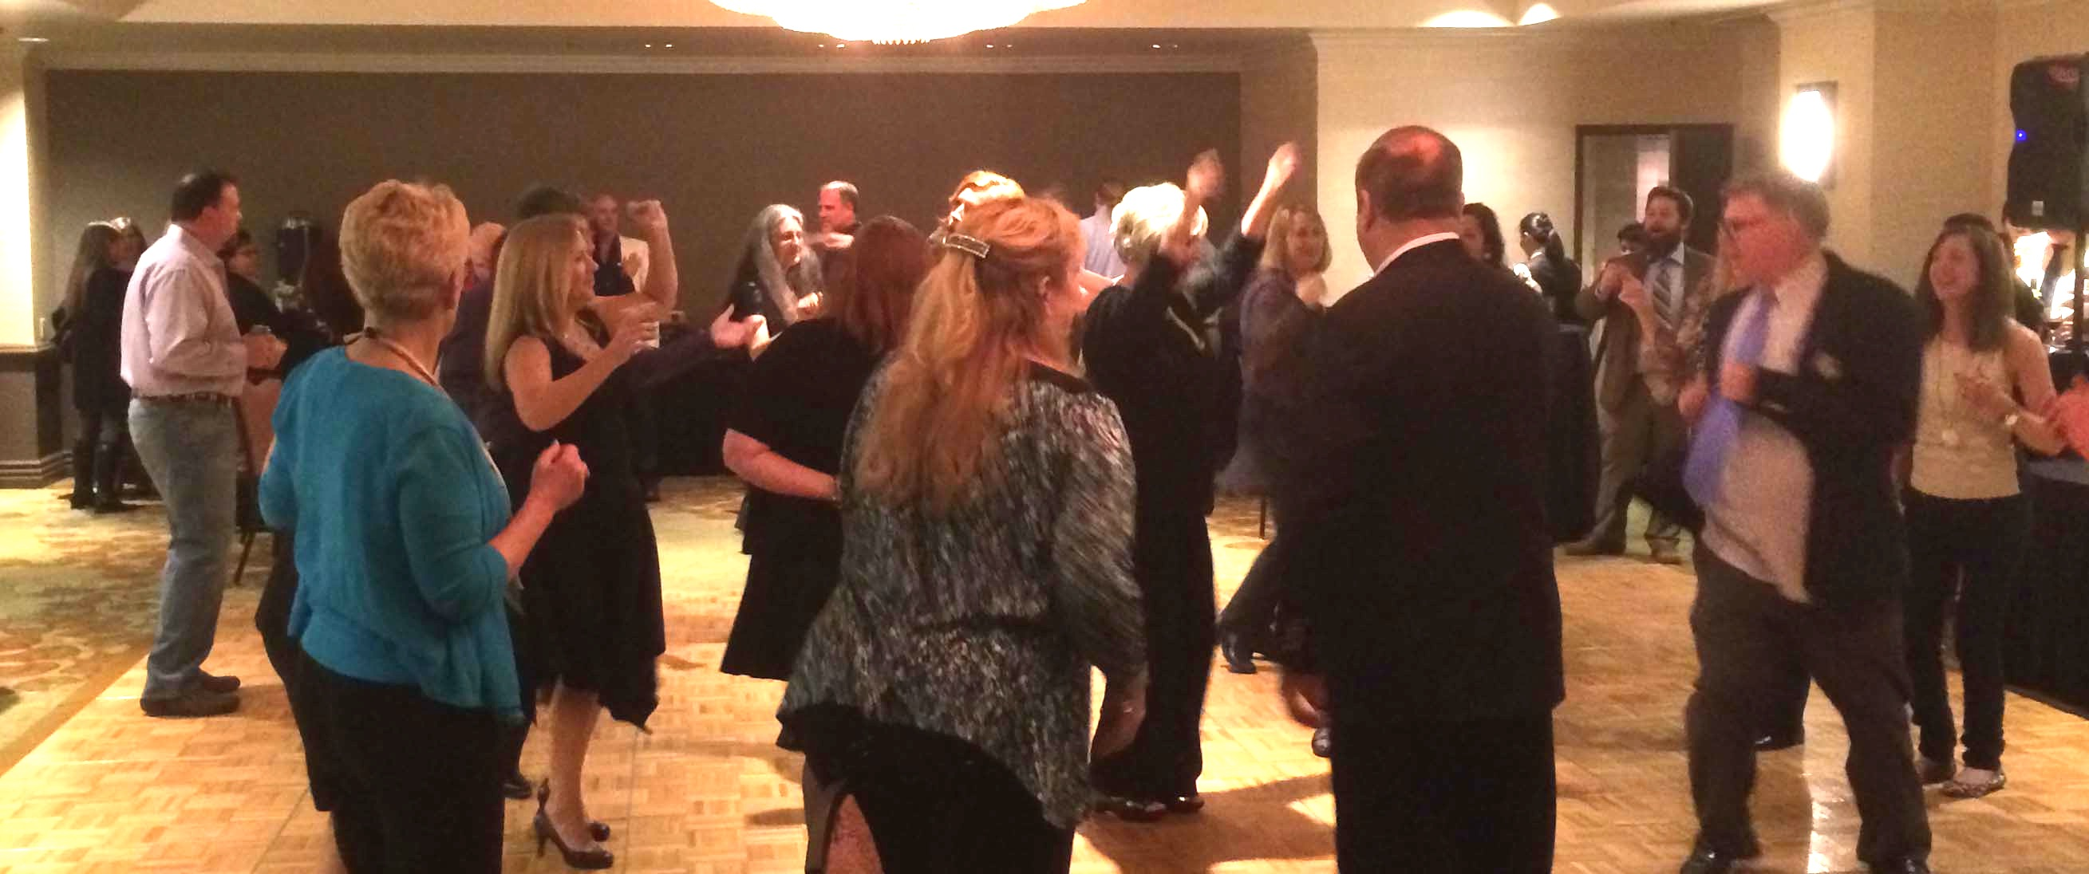
Spring Fling 2014

Slide 17
Thank you!
On behalf of the AS Foundation Board of Directors, thank you for your generous support and contributions!

