Slide 1
The New Standards: Conversations and Reflections
John Stanskas, ASCCC Secretary, Facilitator
María del Rosario C. Biddenback, Napa Valley College
Merideth Randall, Vice President of Instruction, Shasta College
Norv Wellsfry, Associate Vice President, ACCJC Commissioner

Slide 2
As more and more colleges are held accountable for the newly revised standards, dialog and conversation among community college faculty and staff is essential to help colleges interpret the new standards and take actions now to address them. In this breakout, faculty and staff from colleges such as Napa Valley College and the Los Angeles Community College District will discuss their experiences with the new standards to date.

Slide 3
Outcomes
Attendees:
Will discuss the newly revised 2014 ACCJC standards with faculty and staff from colleges that have been visited or will soon be visited by a site team to learn tips and advice for their own district.

Slide 4
Evolving Federal Focus
60’s – Resources
70’s and 80’s – Process (Program Review and Planning)
90’s – SPREs – focus on data
00’s – Sec Spelling – Student outcomes as measure of quality
08 – HEA – Student Achievement Standards, 2 year rule enforcement, increasing focus on compliance with Regulations and Rule Making

Slide 5
Timeline for Changes to Standards and Practices
2011 – ACCJC announces review of Standards, appoints Committee of Commissioners and staff-
Commissioners Frank Gornick and Mike Rota co-chair
2012 – ACCJC conducts hearings, solicits written input, and more than 300 people comment on what needs to be changed in Standards
Commissioner Committee discusses and drafts standards language
Staff writers draft, redraft, and add federal regulatory requirements
ACCJC appoints work groups including staff from member colleges to help define GE requirements, and SLO language

Slide 6
Timeline for Changes to Standards and Practices – 2
2013-14 ACCJC drafts new Accreditation Standards and vets them, holds hearings, then adjusts as per input from field
June 2014, ACCJC adopts new Accreditation Standards
2014-15, ACCJC adopts new practices and policy language
ACCJC still responsive to comments from members

Slide 7
Summary of Changes to the Standards
Simplified format
Reduced redundancies and clarified language
Standards linked to related Eligibility Requirements
New emphasis on outcomes (Student Achievement)
Improvement throughout the institution
New Standard on Institutional Integrity (I.C)
Incorporated federal regulatory requirements

Slide 8
New Practices - 1
Comprehensive ISER eliminates section on response to prior team Recommendations, takes “clean Slate” approach to new Standards
ISER includes a Quality Focus Essay
Actionable Improvements Plans (coming from the institution’s comprehensive self evaluation)
Incorporated into existing institutional planning processes;
Improvements made are reported in Midterm

Slide 9
Quality Focus Essay
Essay (QFE)
Two or three “quality improvement projects”
Potential for Sustainable Improvement of Student Outcomes - academic quality, institutional effectiveness, and excellence
Realistic – based on Assessment data analysis in ISER
QFE topics selected during self-evaluation process
“Accreditation Asks for a Focus beyond Compliance to Quality Improvement”
ACCJC Newsletter – Spring/Summer 2015

Slide 10
New Practices - 2
ISER must include longitudinal data presentation and analyses from annual report data colleges prepare each year for ACCJC.
Institutions must include institution-set standards for student achievement (federal requirement) and college’s own analysis of what the data means, along with plans to try to improve student outcomes
7-Year Cycle for Reaffirmation of Accreditation

Slide 11
New Practices - 3
Seven-Year Cycle with Midterm in year 4
Quality Focus Essay
Actionable Improvements Plans (coming from the institution’s comprehensive self evaluation)
Incorporated into existing institutional planning processes;
Improvements made should be noted
Continued

Slide 12
New Practices – 4
Individual College self Monitoring and Follow-Up of Data Indicators in Annual Reports (required by USDE)
ACCJC provides the templates in the Annual Report – Component of Midterm
Additional data elements for Institution-Set Standards (ISS) should be described

Slide 13
New Practices – 5
Types of recommendations:
Compliance
Improvement
Separated in action letters
Standards are met or not met (no “partial” compliance)
Non-compliance resolved in two years; improvement efforts continue throughout the 7-year cycle

Slide 14
Changes to Policy
Policy on Commission Actions on Institutions
√ Reaffirmation for limited term (new option)
√ Requirement of compliance within two years
(federal two-year rule)
√ Changed timeline for Commission follow-up
(generally 18 months)
√ Common definitions for sanctions across all
all regional accreditors

Slide 15
Changes to Trainings
Spring 2015 Symposium
ACCJC Annual Conference (Spring 2017)
Conference session on Developing a Self Evaluation Report one year before evaluation visit
Conference sharing session on “What Happens After the Evaluation Visit”

Slide 16
Evaluating Institutions With the 2014 Accreditation Standards
Eligibility Requirements 1-5
USDE Regulatory requirements in 8 areas including:
Institution Set Standards
Accreditation Standards
Quality Focus Essay

Slide 17
Accreditation Standards
Standard I: Mission, Institutional Effectiveness and Integrity (new)
Standard II: Educational Programs – Instruction, Library and Learning Services, and Student Support Services
Standard III: Institutional Resources – Human Resources, Physical Resources, Technology and Financial Resources
Standard IV: Leadership and Decision Making, and Governance

Slide 18
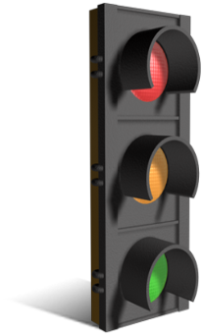
Institution-Set Standards The institution must demonstrate that it:
Establishes standards for its own performance in student achievement (Institution-set standards)
Analyzes how well it is meeting its own standards
Makes results available to all constituent groups
Plans to improve in areas where its own performance is less than adequate
Standard I.B.3
3.3 in Manual for Institutional Self Evaluation (pg.12)
Notes:
See 3.3 in the Manual for Institutional Self Evaluation (page 12)

Slide 19
Institution Set Standards Student Achievement Data
Course completion rates
Degree/Certificates awarded (numbers or rates)
College Scorecard IPEDS Data requirements* of accreditors
Transfer rates to four-year institutions
For CTE program completers:
Licensure/certification exam pass rates
Job Placement Data

Slide 20
Student Achievement Data
Other measures of student achievement relevant to the institutional mission
Check out College Scorecard at USDE website
Measures of student achievement relevant to a particular program
Trend Data over multiple years
Disaggregated by relevant sub-population

Slide 21
Standard II: Student Learning Programs and Support Services
A. Instructional Programs:
Distinguishes College level and pre-collegiate curricula;
Sets various requirements for the baccalaureate degree, including 60 units for Associate, 120 for baccalaureate
Timely completion
Learning/mastery of knowledge, skills set appropriate for the (AA or BA) degree level
C. Student Support Services
Student Understanding of academic requirements, graduation, and transfer policies
Pathways to degrees, certificates, and transfer goals

Slide 22
Standard III.A Human Resources
Faculty qualifications appropriate to degree level of assigment
Faculty job descriptions include development and review of curriculum, including assessment of learning
Integration of part-time and adjunct faculty into life of the institution
Use of SLOs in evaluation – refined language III.A.6: The evaluation of faculty, academic administrators, and other personnel directly responsible for student learning includes, as a component of that evaluation, consideration of how these employees use the results of the assessment of learning outcomes to improve teaching and learning.

Slide 23
III.D. Financial Resources:
Reordered for clarity
Planning (1-3)
Fiscal Responsibility and Stability (4-10)
Liabilities (including coming into compliance when federal government identifies deficiencies) (11-15)
Contractual Agreements (16)

Slide 24
Standard IV: Leadership and Governance
A. Decision-Making Roles and Processes – The institution:
Documents and distributes Decision making processes and decisions
Establishes and evaluates the effectiveness of governance structures and processes
Ensures that governance supports student learning and improves institutional effectiveness
Chief Executive Officer
Primary Leadership for Accreditation

Slide 25
C: GOVERNING BOARD
Reviews key indicators of student learning and achievement and institutional plans for improving academic quality
D. Multi-College Districts or Systems
System planning integrated into college planning – improve student learning achievement and institutional effectiveness

Slide 26
Self-Evaluation Process
Getting started…
Preparation
Coordination
ALO
Faculty Co-chair
Steering Committee
Writing Teams vs Writer

Slide 27
Writing Teams
Administrative staff
Classified staff
Faculty
Student Representative
Committees
Academic Senate
Shared Governance Committees
District Committees

Slide 28
Time lines
Set up schedule
Back up plan
Forums for feedback
Approval timelines
Reporting schedule (drafts, final)

Slide 29
New Standards and Previous Standards
Review previous accreditation report
Review mid-term report
Self-evaluation
Evidence
Requirements

Slide 30
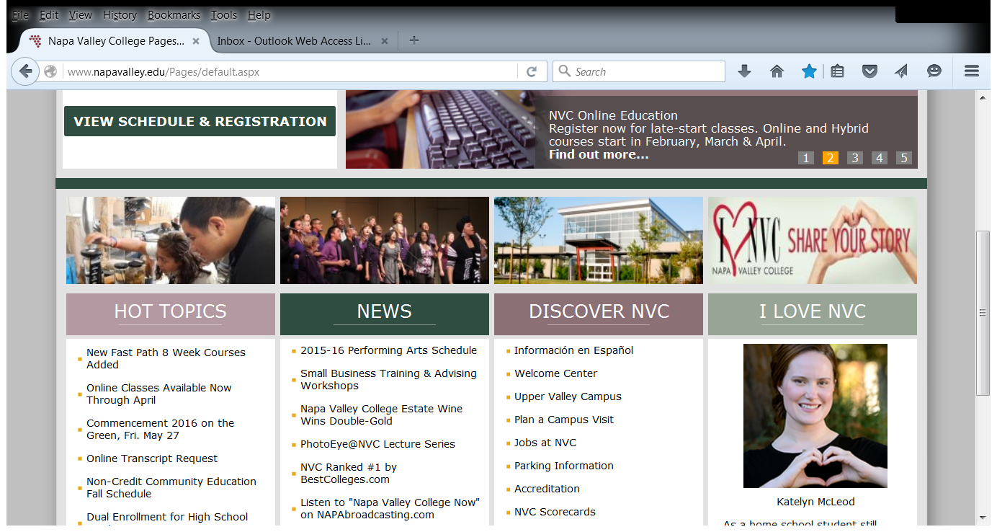

Slide 31
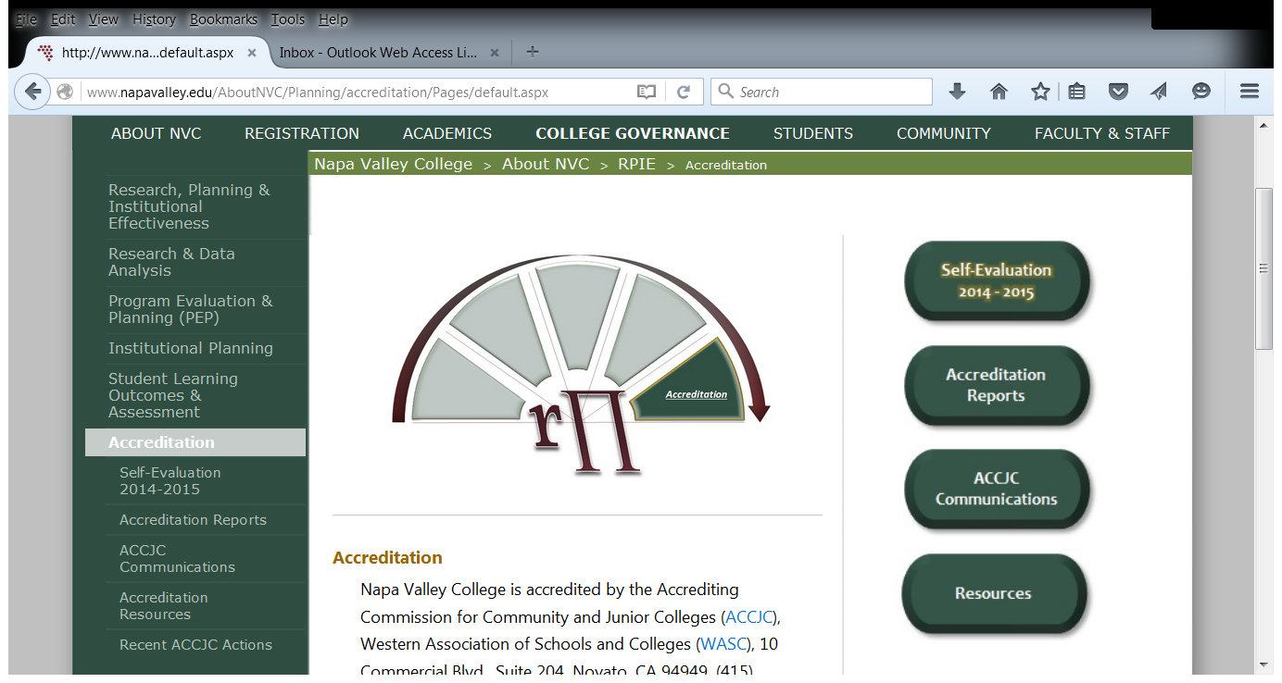

Slide 32
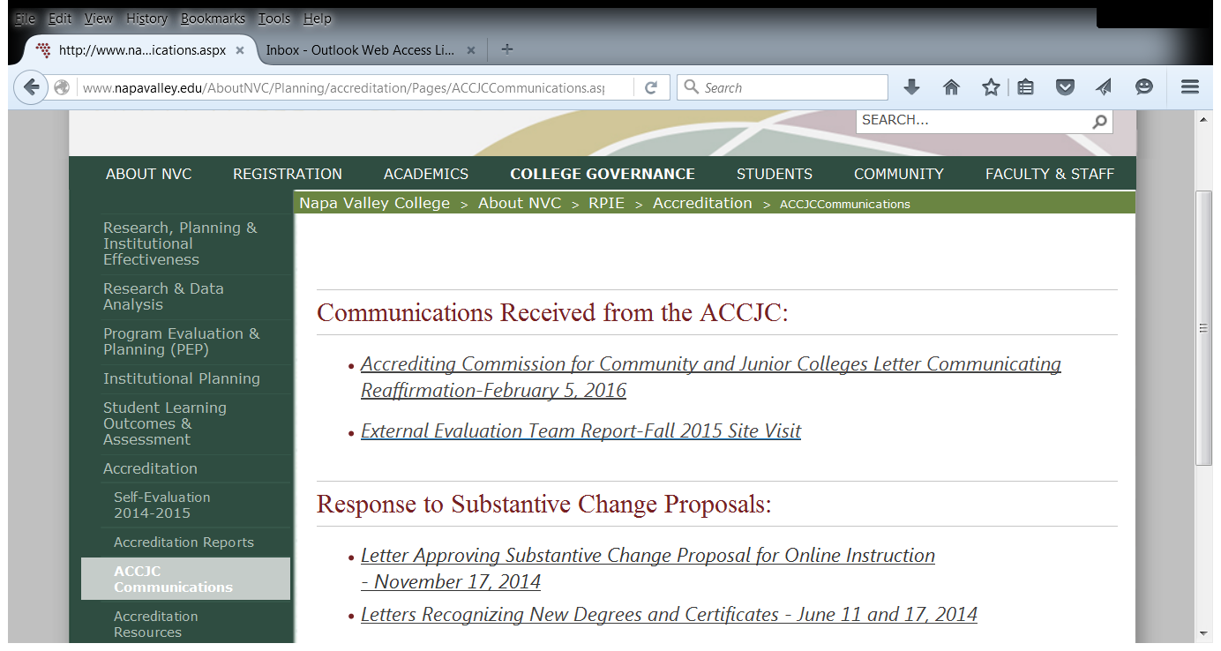

Slide 33
Preparing for a Team Visit Post-Sanction
Or How We Learned to Stop Worrying and Embrace Ambiguity

Slide 34
One Way to Prepare
Notes:
Not sure of the thought behind this slide.

Slide 35
The More Traditional Approach
Our visiting team will arrive in October 2017
In Fall 2015, the Accreditation Steering Committee reviewed the new standards and identified “problem areas”
We also received the ACCJC training and attempted to clarify some sub-standards
In the fall, we also appointed 4 Standard Chairs, but specifically asked them NOT to write parts of the report
Instead, their teams will gather evidence this spring and REACH CONSENSUS about what the evidence shows in relation to the sub-standards

Slide 36
One Person, One Voice
The ALO will be responsible for all drafting and revising
Writing is much easier than re-writing
The self-evaluation will be drafted by October 2016
Problematic areas will be addressed one by one over the next nine months
Report finalized in July 2017

Slide 37
Our Main Concerns
We were on Probation three years ago – are we somehow tainted or targeted?
Will the next evaluation focus on compliance or real evidence of concern for student success and outcomes?
Will our team be adequately trained and objective?

Slide 38
Sub-Concerns
As always, the standards are an odd mix of cut and dried (“Each employee has access to his/her personnel records”) and the impossibly broad (“The institution uses assessment data and organizes its institutional processes to support student learning and student achievement”)
Some require a sentence to answer, some could use a dissertation
ALOs and CIOs have been doing a certain amount of self-training for years to guide the self-evaluation

Slide 39
The Usual Suspects
The ambiguity of “institution-set standards”: Ceiling? Floor? Aspirational? Subject to rejection?
I.B.6: How disaggregated do we need to be?
III.A.6: “how” vs. “whether” employees use the results of the assessment of learning outcomes to improve teaching and learning

Slide 40
The Zen Approach
Don’t spend hours dissecting the standards – focus on what they mean in terms of student success and how you meet that goal
If you don’t quite fit what a standard seems to want, decide how your approach is valuable and prove it
Work on consensus and understanding college-wide – when the team comes, they should be able to ask anyone to speak to any standard
Be clear, be succinct, admit weaknesses, but hold on to the notion that your college does miraculous things for students even if it may not have disaggregated enough…….

Slide 41
In the End
Accreditation is essential and, ideally, is a fair and consistent process
Serving on a team should be a way to assist the institution you are evaluating as well as your own
We should resist the urge to magnify minor flaws or fret unnecessarily
Accreditation, even while it holds us to standards, should help us appreciate our strengths

Slide 42
“
Questions?

