Slide 1
Curriculum Committee Meetings: Keeping Meetings On Track and Committee Engaged
Michelle Sampat, Mt. San Antonio College
Randy Beach, ASCCC South Representative
ASCCC Curriculum Institute, July 6-9, 2016

Slide 2
Description and Objectives
Do your Curriculum Committee meetings wander into the weeds at the drop of a hat? Does the phrase "herding cats" come to mind? In this breakout, attendees will learn strategies and processes for running your curriculum committee meetings smoothly and productively. Participants will discuss challenges they face locally and discuss strategies for addressing them based on the recently approved ASCCC white paper on curriculum approval processes.
Objective: Provide strategies for managing curriculum committee meetings and working with administrative partners to ensure timely approval of curriculum locally and to empower committee members to act as curriculum “experts” for faculty.
Notes:
Not sure of the thought behind this slide.

Slide 3
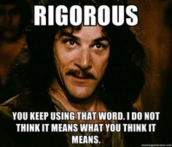
Why Even Have Curriculum Committees?
Because of Ed Code...
Faculty have purview over the creation, approval, revision of curriculum to maintain relevance and rigor - Ed Code §70902 (B)(7)

Slide 4
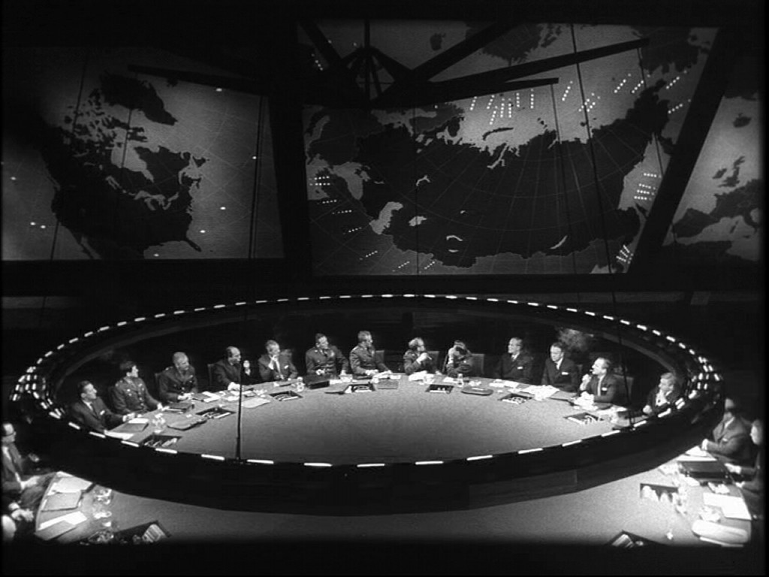
...And Title 5
“The college and/or district curriculum committee recommending the course shall be established by the mutual agreement of the college and/or district administration and the academic senate. The committee shall be either a committee of the academic senate or a committee that includes faculty and is otherwise comprised in a way that is mutually agreeable to the college and/or district administration and the academic senate. ( Title 5 Section 55002)

Slide 5
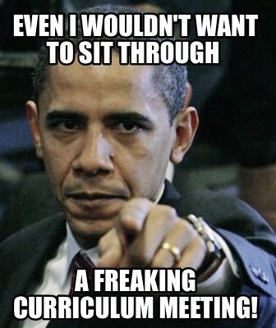
Why Do Things Go Wrong?
As difficult as it is to believe, there are many meetings that do not accomplish their intended goals.
Each one of these meetings began with good intentions, but something caused them to become ineffective.

Slide 6
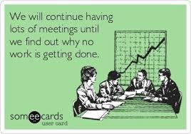
Ineffective Meetings
What are some things that make a meeting ineffective?
Notes:
Not sure of the thought behind this slide.

Slide 7
Effective Meetings
Effective meetings begin with planning OUTSIDE of the meeting room!
Notes:
Not sure of the thought behind this slide.

Slide 8
Building Relationships
Whether you were appointed or elected, you are now the Curriculum Chair. To effectively manage the work of your committee, you must have strong working relationships with your fellow faculty and with administration.
When everyone trusts that you are impartial and are striving to do the best for your college, it will be easier for you to achieve a consensus that everyone can agree with.

Slide 9
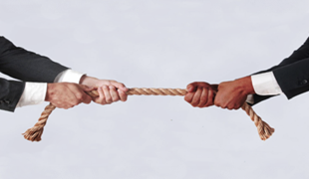
Building Relationships
These relationships can help you anticipate challenging conversations, address possible issues prior to a meetings, and to regain control of a meeting if things start to go badly.

Slide 10
Laying the Foundation
Faculty tend to only look at their CORs when they are in curriculum review, program review, or want to create a new class, certificate, or degree.
Educating the faculty on effective curriculum practices ahead of time is crucial.

Slide 11
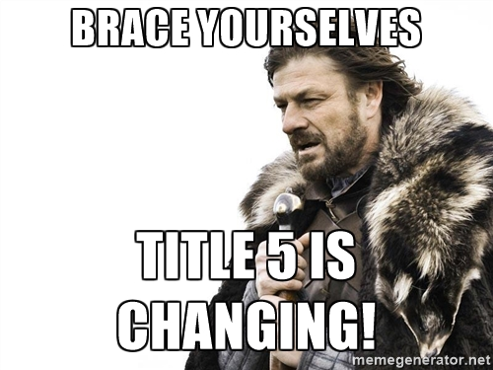
Being the Voice of Reason
Make yourself available to faculty to answer questions.
When regulatory changes happen (like repeatability), you need to sit down with affected faculty and explain what is going on and why.
Offer workshops to help faculty and managers stay current.

Slide 12
Controlling Expectations
Set norms and expectations early, but amend them when appropriate through time
Set goals for the committee and make them visible.
Train your curriculum committee so members understand roles and meeting expectations.

Slide 13
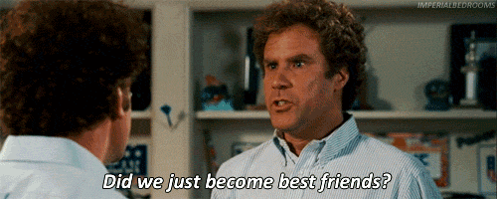
Getting To Know Your CIO
Schedule regular meetings with your CIO.
Discuss important issues outside of the Curriculum Committee meetings.
It is completely unproductive for the CIO and the Curriculum Chair to be disagreeing with each other during a committee meeting.

Slide 14
Getting To Know Your CIO
This does not mean that you will always agree with your CIO or that they just get their way. Curriculum is a “rely primarily” issue and belongs to the faculty. You need to develop a good working relationship with your CIO so that they will understand where you are coming from, when there is room for compromise, and when they will need to defer to the faculty.

Slide 15
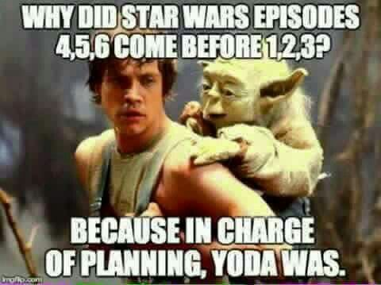
Keeping Senate in the Loop
Curriculum Committees operates under the umbrella of the Academic Senate.
Curriculum Chair should regularly attend Academic Senate meetings.
Academic Senate President needs to be briefed on curriculum issues.
What is your relationship between senate and curriculum committee?

Slide 16
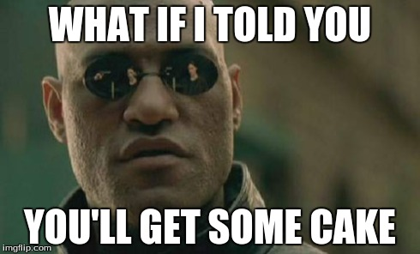
What’s Working?
What strategies have worked for building relationships with your curriculum committee, your CIO, your curriculum technical team, and your senate?

Slide 17
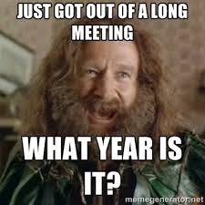
Time-Saving Tech Review
A thorough technical review of courses and programs will save time in your meetings.
Committee meetings should focus on content rather than grammar and spelling.
Establish a tech review process that ensures adequate review of the curriculum submissions.

Slide 18
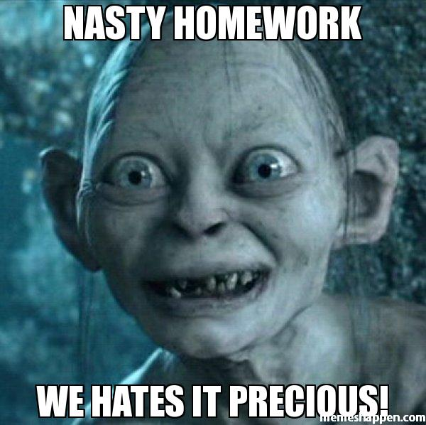
Time-Saving Tech Review
Consider creating a core team including the Articulation Officer, Curriculum Specialist, Librarian, and any other relevant members to review the courses and programs prior to the committee meeting.
Or give committee members homework.

Slide 19
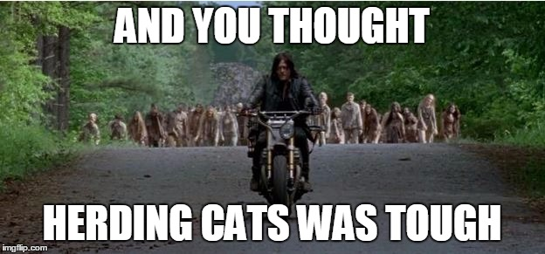
Facilitator of the Meeting
Keeps the group on task within the time frame
Provides unbiased opportunity for varying opinions; remains impartial
Knows Robert’s Rules
Is an Active Listener not an Active Talker
Represents the group accurately outside the meeting door

Slide 20
Mere Agenda...Nay, a Work of Art
Work with your CIO, AO, and office staff to create the agenda rather than doing it by yourself.
Provide background for topics for discussion (policy changes).
Establish time limits.
Use the consent calendar to approve courses with no/minor changes.
End an agenda with the date and time of the next meeting.

Slide 21
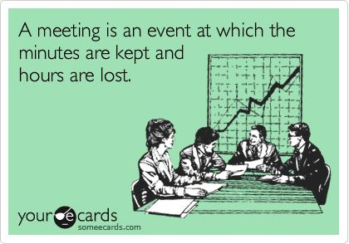
Minutes
Minutes are required on meetings and must have approval by the group
Can serve as official documents for CCCCO
Document discussion on difficult issues
Provide history for future actions/discussions

Slide 22
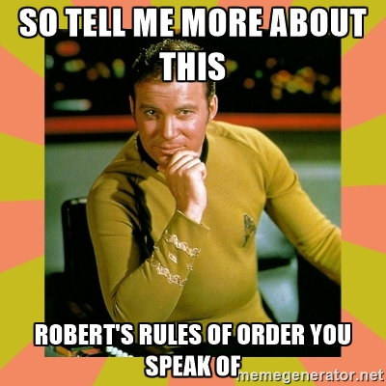
Robert’s Rules???
While you might not want to follow Robert’s Rules for your Curriculum Committee, establishing some procedures can make your meetings easier to manage.

Slide 23
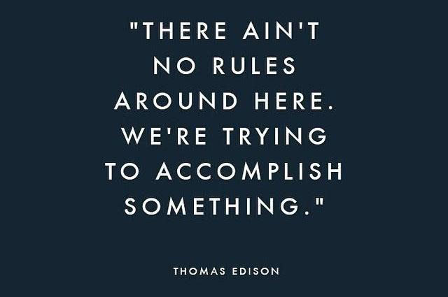
Robert’s Rules
Time limits for each speaker during a discussion
A speaker only gets to speak once until everyone interested in commenting has had a chance to speak
Presentations to the committee need to have a specified length of time. Without this, a “brief” presentation might take an hour of meeting time

Slide 24
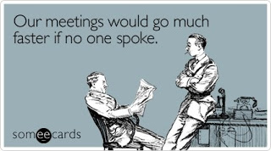
Robert’s Rules of Order Basics
Voting sequence:
Do I have a motion on the floor?
Do I have a second?
Discussion?
Are you ready for the question?
State the motion
All in Favor? Objections? (Do NOT take an Abstention vote = a choice not to vote and DOES NOT count at all)
Declare: The motion passes -or- The motion fails

Slide 25
The Ralph M. Brown Act Requirements (Government Code on Public Meetings 54951)
Agenda posted at least 72 hours (regular) and 24 hours special).
No Action on items not indicated as action on the agenda.
Allow public to address any item; can be at a designated time in the agenda or during meeting
Conduct only public votes; no secret ballots
Public records such as agendas and approved minutes must be displayed (electronically is fine)

Slide 26
What To Do When Things Go Wrong
Things can go terribly wrong for both new and experienced leaders.
Always try to remain calm. Everyone is looking for you to lead them and losing your temper will not help.
Heated arguments and circular discussions happen to all of us.

Slide 27
Suggestions
Properly preparing before the meeting can help you manage the tough situations
Meet with folks before the meetings. See where they are coming from so you know what to expect
Include some details on your agenda. Some background information will make it clear why you are having these discussions now. Time limits on the agenda can help keep meetings on track
Have established rules that allow you to regain control if things start to go south
Remain calm and do your best!

Slide 28
Running Effective Meetings
Open Dialogue and Sharing of ‘your’
Best Practices
Conclusion

Slide 29
Resources
The Course Outline of Record: A Curriculum Reference Guide (2008)
Curriculum Committee: Role, Structure, Duties and Standards of Good Practice (1996)
Curriculum Regional Meetings
Curriculum List Serve
Ensuring Effective Curriculum Approval Processes: A Guide for Local Senates

Slide 30
“
QUESTIONS?

