Slide 1
Cultural Competency Across the Curriculum
Gina Abbiate, Math Acceleration Specialist
Wendy Smith, Curriculum Development Specialist
Curriculum Institute
Anaheim 2016
Notes:
2:30-3:45

Slide 2
Mesa’s Course Redesign Institute
HSI/Title V Grant, Proyecto Éxito (second year)
Positive results when you give people not only funding, but *time* to develop projects and reforms
One goal: to provide professional development and create a space for it (.4 reassigned time)
The LOFT: Learning Opportunities for Transformation

Slide 3
California’s New Structural Paradigm
Redesigning developmental pathways (i.e., Acceleration)
Developing common assessment
Minimizing equity gaps
Acknowledging student capacity
Investigating Zero-Textbook-Cost Degrees

Slide 4
How do you encourage faculty to…
Introduce new classroom pedagogies
Support student engagement from a cultural perspective
Increase retention and success, particularly among traditionally underserved students
Redesign courses with high D,F,W rates?

Slide 5
How do you get them there?
Pay faculty for attendance and for follow-through $$$
Invite a range of facilitators
Encourage as much cross-pollination and collaboration as possible
Use mornings for workshops and collaborative activities and afternoons for syllabus redesign (as little lecture as possible)

Slide 6
Agenda
Day One: Equity and Student Success/Cross Cultural Understanding (CUE)
Day Two: Making the Invisible Visible/Reading Apprenticeship Across Disciplines (3CSN)
Day Three: Writing Across Disciplines (WP)
Day Four: Habits of Mind (3CSN)
Day Five: 21st Century Learning Modalities (Campus resources)

Slide 7
Which courses were represented?
Math
Spanish
English
Business/Accounting
Exercise Science
Fashion
Chemistry
Psychology
French
Geography
Spanish
Astromony
Computer/Information Science

Slide 8
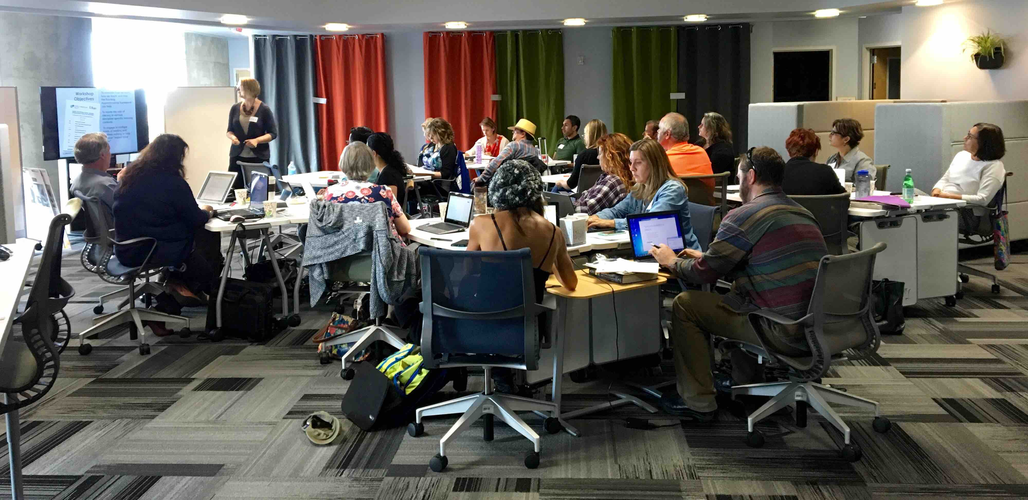
Follow Up (for the second ½ ESU)
A redesigned syllabus
Facilitated workshops (a menu of options)
Final project: a presentation (youtube, Prezi), portfolio (of handouts/infographics/game/puzzle, etc.)

Slide 9
Math Department Issues
Courses with high DFW
Intermediate Algebra
Trigonometry
College Algebra
Statistics
Pre-Calculus
Calculus 1
Increased Class Size
5 units in Basic Skills – 3 units in transfer

Slide 10
Syllabus Make-Over

Slide 11
“Nobody’s Reading Our Syllabus, So Why Are We Even Trying?”

Slide 12
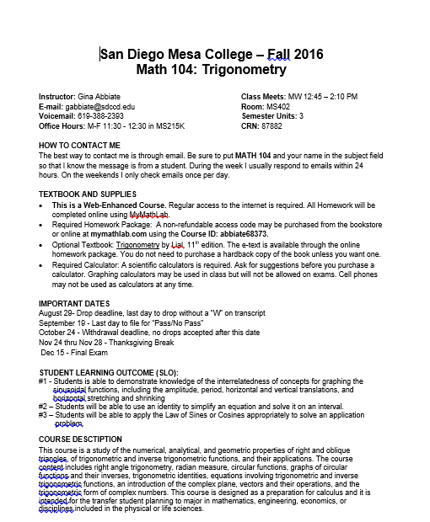
Syllabus Make-Over: First Impression

Slide 13
Syllabus Make-Over: Contact Info
Instructor: Gina Abbiate Class Meets: MW 12:45–2:10 PM
E-mail: gabbiate@sdccd.edu Room: MS402
Voicemail: 619-388-2393 Semester Units: 3
Office Hours: M-F 11:30 - 12:30 in MS215K CRN: 87882
HOW TO CONTACT ME
The best way to contact me is through email. Be sure to put MATH 104 and your name in the subject field so that I know the message is from a student. During the week I usually respond to emails within 24 hours. On the weekends I only check emails once per day.

Slide 14
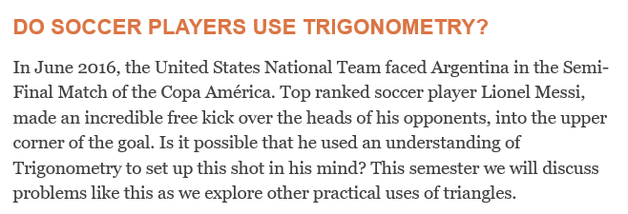
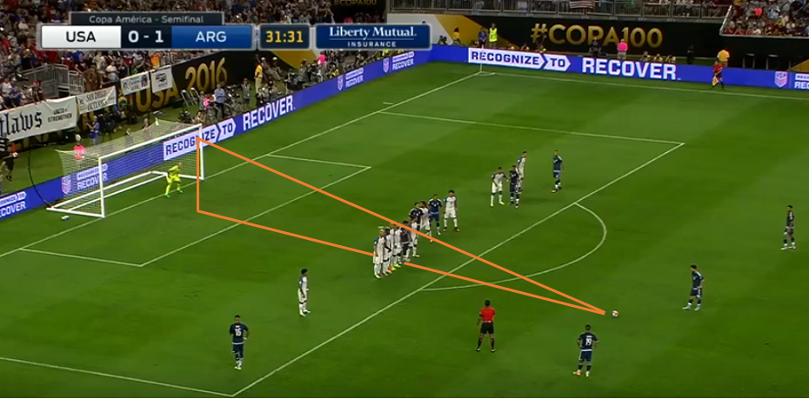
Syllabus Make-Over: Contact Info

Slide 15
Old Syllabus: GRADES
I do not give make-up exams, but I will drop the lowest exam score.
A missed exam will be scored as zero points.
The Final Exam cannot be dropped.
Homework will be assigned through the MyMathLab website. All homework is due at 10pm the night before the chapter exam. Late homework will only receive half credit.
Class participation will consist of:
Being on time to class
Staying for the duration of the class
Having cell phone turned off and put away during lecture
Completing the practice problems given at the end of class
The Final Exam will be comprehensive with questions from the entire semester.

Slide 16
New Syllabus: GRADES
assessment (grades)
My top priority is helping you get the best grade possible in this class. I will to give you many opportunities to show me your best work.
Group Projects (15%) will be assigned every other week and completed in class. Examples include making study aids, and working on sample exams. You will be given time in class to work with your groups. Groups will be rotated so that everyone gets to work together.
Practice Problems (15%) are available on MyMathLab. These problems are similar to what you will see on exams and are intended you help you study and prepare. We will spend time going over many examples in class.
Monthly Exams (50%) There will be four exams to assess your individual knowledge. You may miss one exam during the semester. A missed exam score will be replaced with your Final Exam grade.

Slide 17
Technology Technology Game: Object Oriented Programming
Introduction Video
Notes:
Internet connection / Do not show after 3:00

Slide 18
For the next CRI:
More STEM/Math-focused (RA/Writing Project)
Move beyond D,F,W classes (paid detention)
Shorter days? (A mini version?)
A modified version for adjuncts?
Opening it to courses that are “successful”
“Value open-mindedness. Charge $1 if someone says ‘that won’t work for me.’ Encourage explanation: ‘That would work for me if….’” (from an eval)
Curtains
Notes:
Day one boundaries? A 30 minute “norms” setting. “Let’s decide among us what we’re going to be comfortable with.” Working to be sure people don’t shut down.

Slide 19
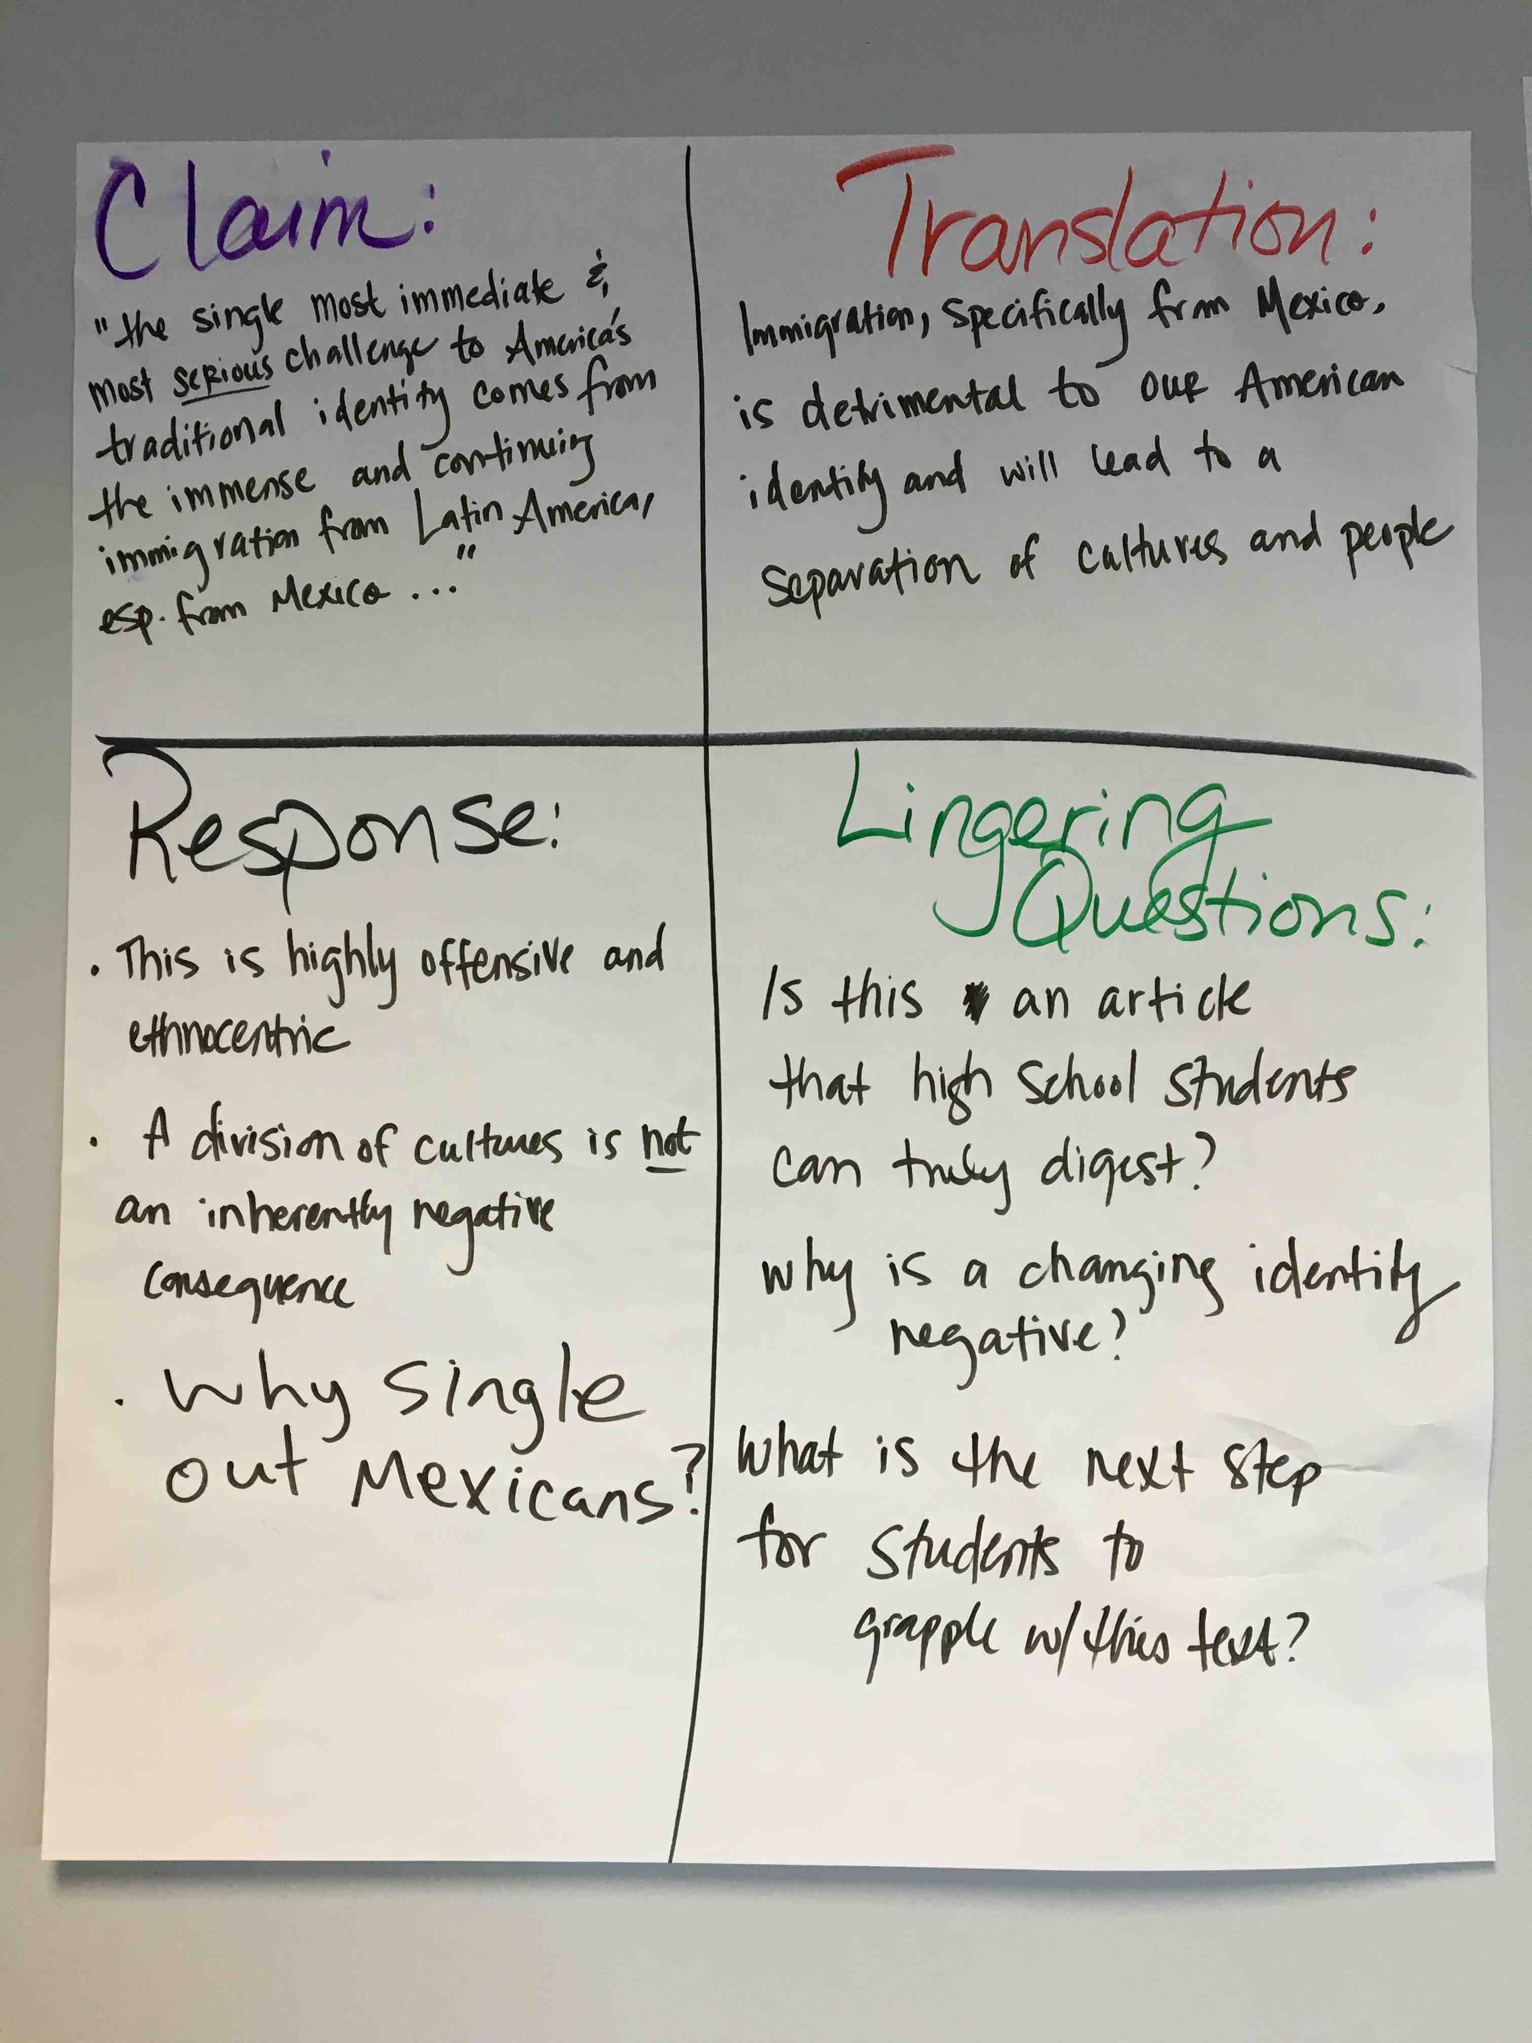
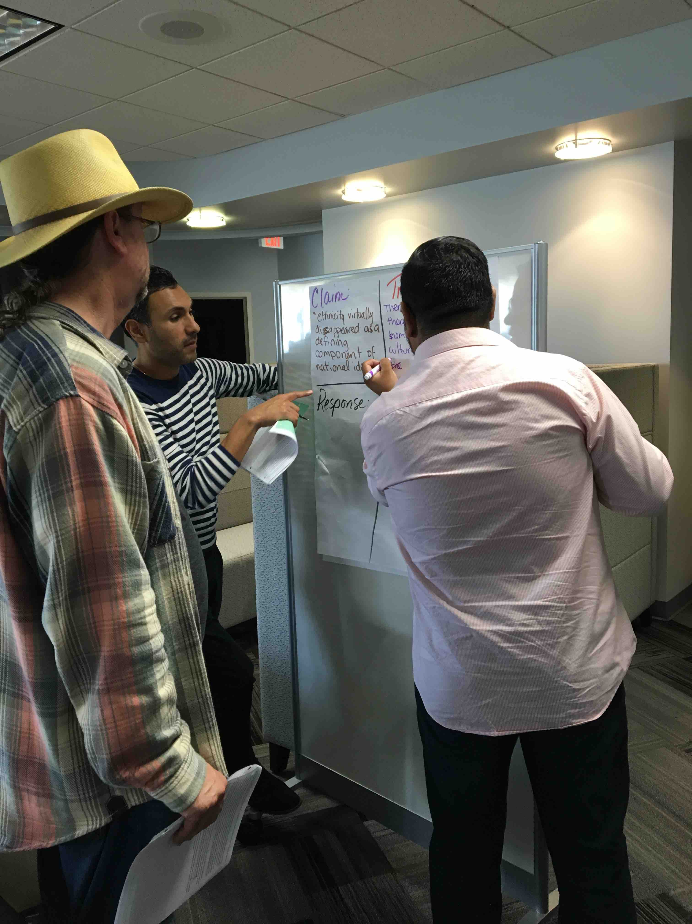
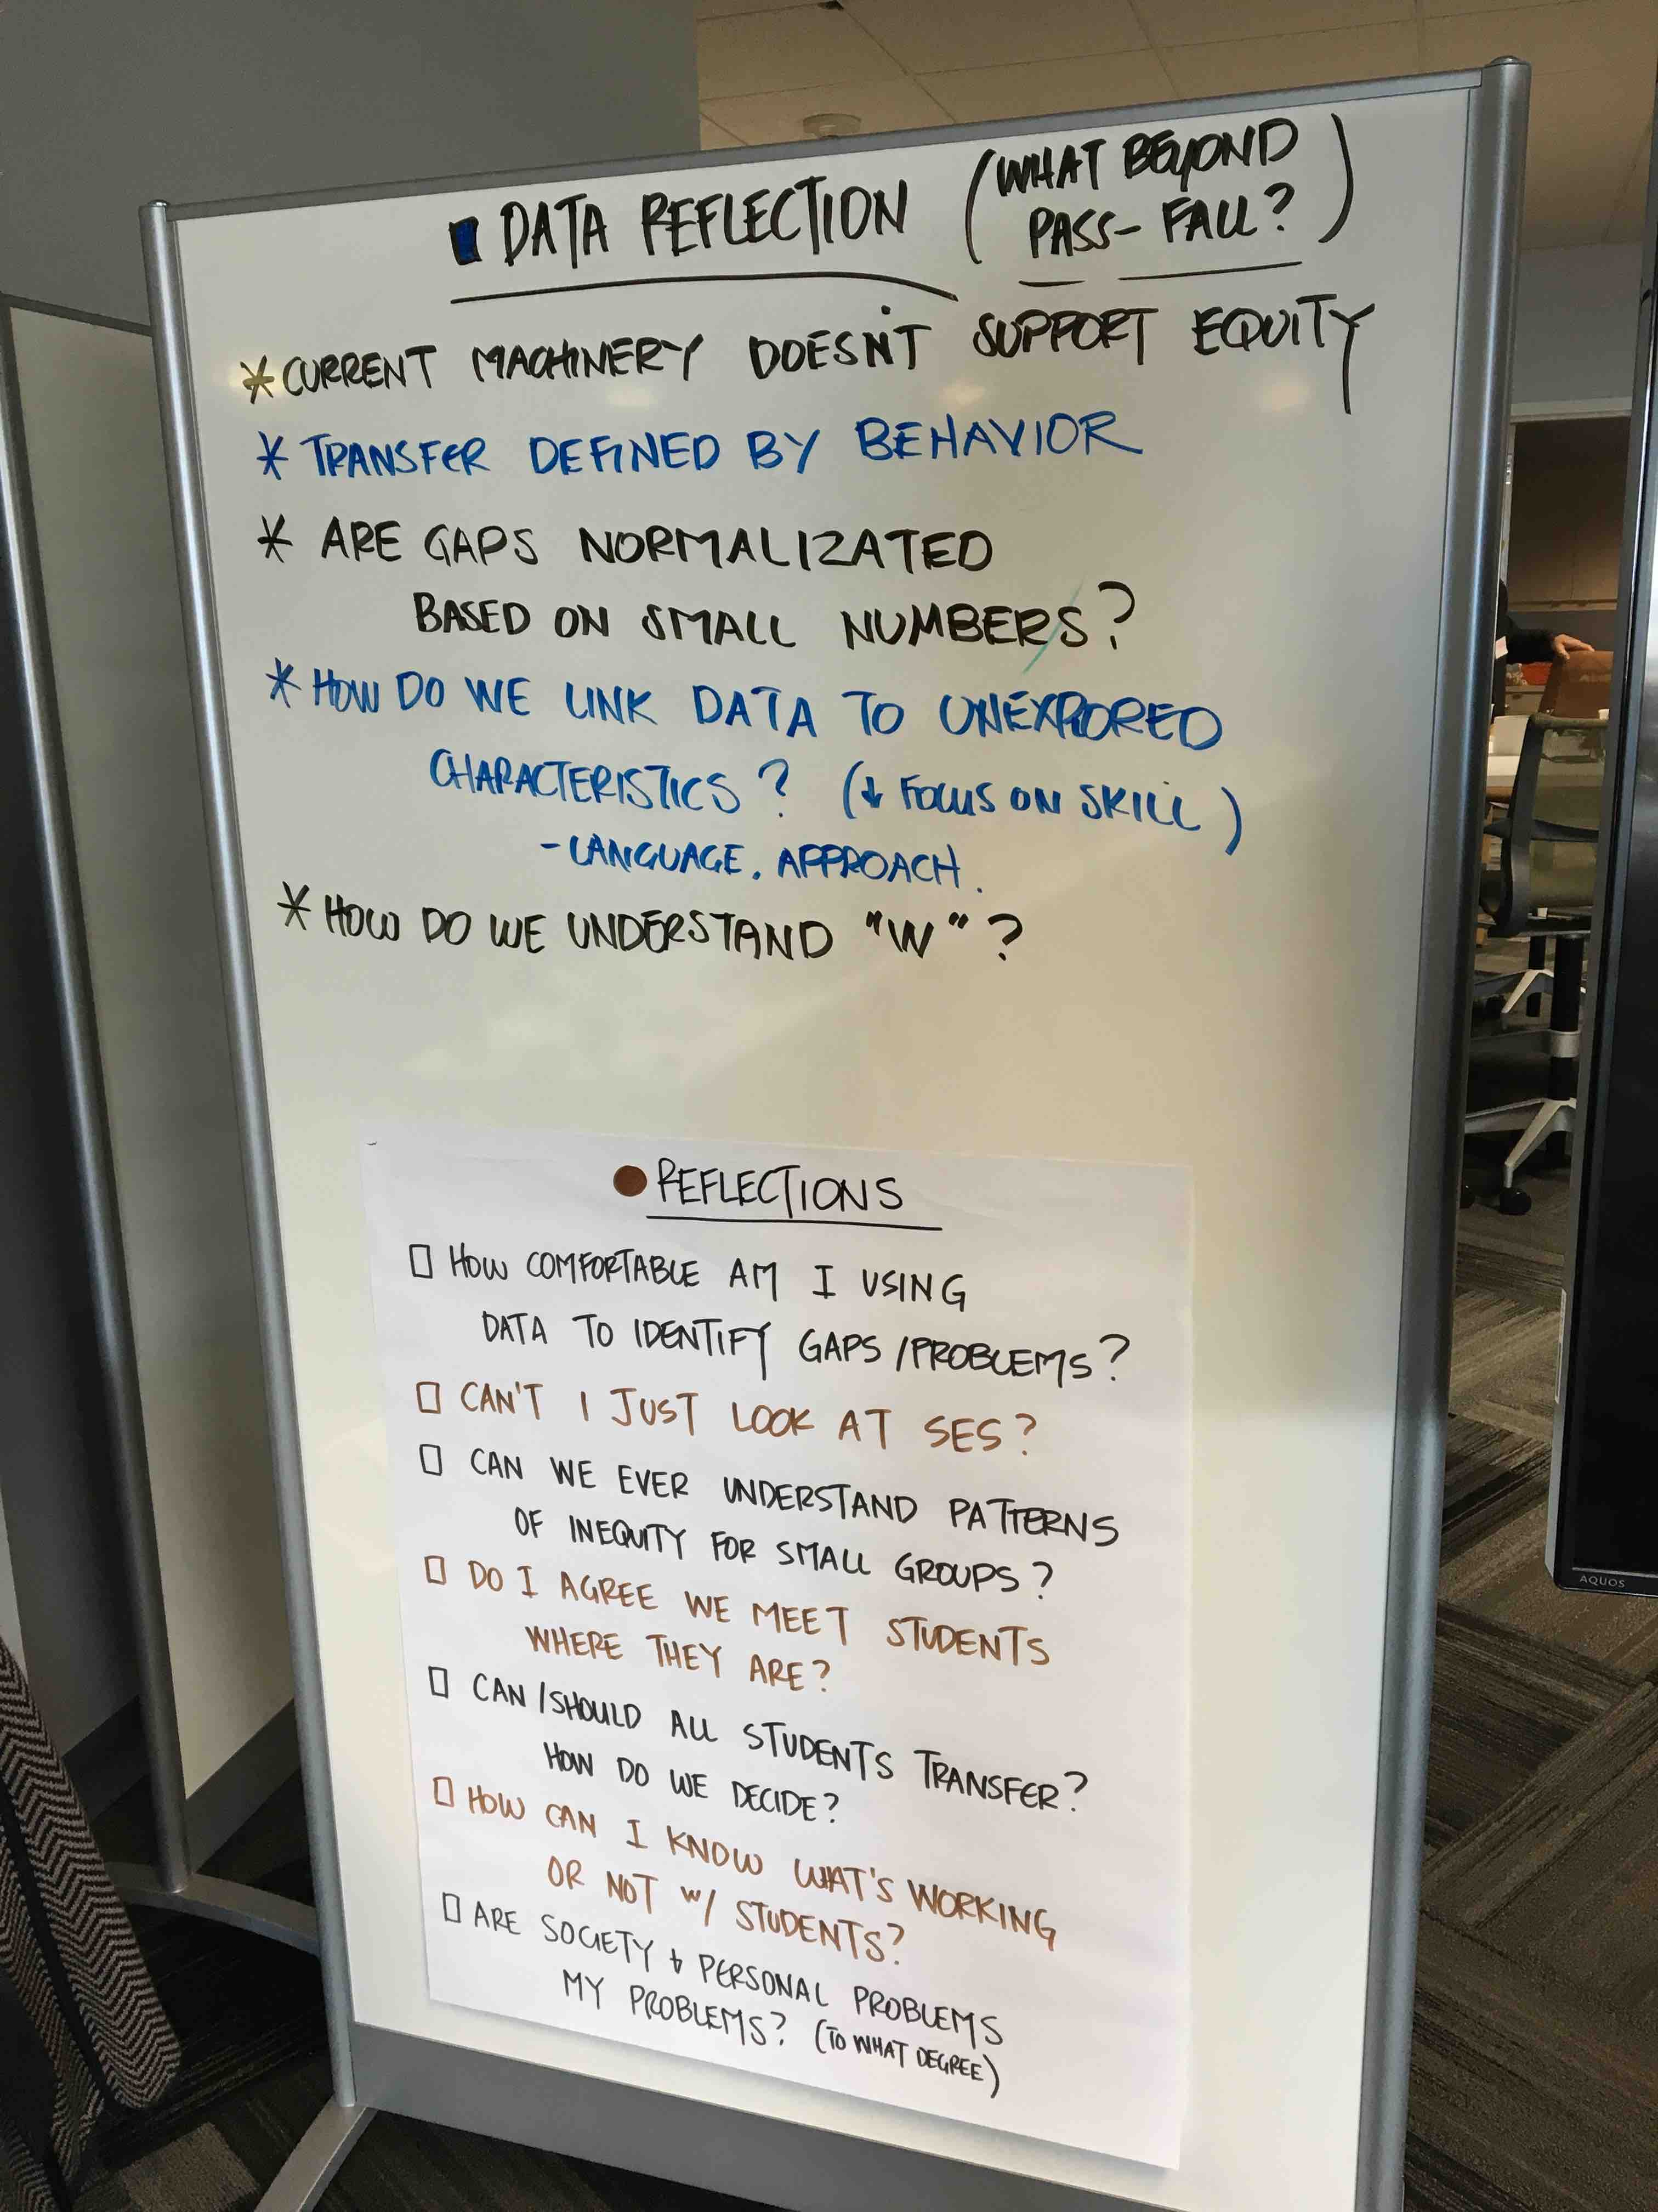
Put a glide in your slide, a dip in your hip, and come on to the Mothership….

Slide 20
How would you organize a one-day workshop for each outcome?
Analyze data to understand your college’s students.
Apply an equity lens when designing an activity, class session, or syllabus.
Generate ways to build on existing student capacity.
Develop and brainstorm course materials for cross-cultural, cross-socioeconomic class understanding.

Slide 21
HSI/Title V Grant: Proyecto Éxito
Critical Grant Imperatives
Redesigning Basic Skills and Gateway Courses
Examples include: acceleration and learning communities
Initiating New Academic Support & Student Support Systems
Examples include: peer mentoring and Structured Learning Assistance (a form of Supplemental Instruction)
Providing Essential Faculty and Staff Development
Examples include: professional development to introduce new classroom pedagogies and to support student engagement from a cultural perspective
Creating Supportive Spaces for Students, Staff and Faculty
Examples include: Development of Teaching & Learning Center for Staff and Faculty and the development of a Student Engagement Center with a cultural focus

Slide 22
A New Paradigm: “Reimagining the Privilege Line Exercise”*
OLD
If you are a white male take one step forward.
If you have skipped a meal because there was no food in the house take one step backward.
If you have visible or invisible disabilities take one step backward.
If you attended (grade) school with people you felt were like yourself take one step forward.
*By Jose Paez and Christina Torres. Education Week. 16 June 2016. Web.

Slide 23
Continued:
NEW
Step forward if you are earning an advanced degree, despite someone telling you couldn't do it.
Step forward if you work, are a parent, and/or take care of someone while going to school.
Step forward if your family immigrated to this country.
Step forward if the struggles of your ancestors/communit(ies) are a source of your resilience.

Slide 24
Related EdWeek Headlines:
“Teachers Are Not the Sun: Re-centering Our Classrooms”
“Is the Five-Paragraph Essay History?”
“Am I An Asshole?”

