Slide 1
The past, present, and future of curriculum
Dolores Davison, 2016-17 ASCCC Curriculum Chair
Craig Rutan, 2017-18 ASCCC Curriculum Chair

Slide 2
The Fairly Recent Past
Curriculum in the California Community Colleges is always changing.
From one year to the next, there will always be something new for our colleges to incorporate.
It wasn’t too long ago when:
We used paper and pen to create and submit curriculum.
We had the right to approve stand alone courses locally (the first time)
SB1440 and SB440 brought Associate Degrees for Transfer to our system and made C-ID so important.

Slide 3
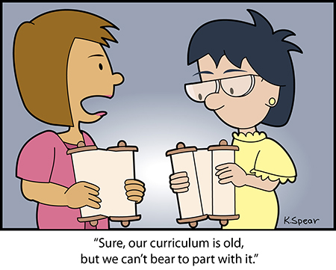

Slide 4
In the Last Few Years
Additional changes began about three years ago and have continued the constant evolution of curriculum in our system
Clarity on the relationship between hours and units
Creation of Community College Baccalaureate Degrees
Increased use of Open Educational Resources in our courses
Writing and publication of a new, streamlined Program and Course Approval Handbook (6th Edition)

Slide 5
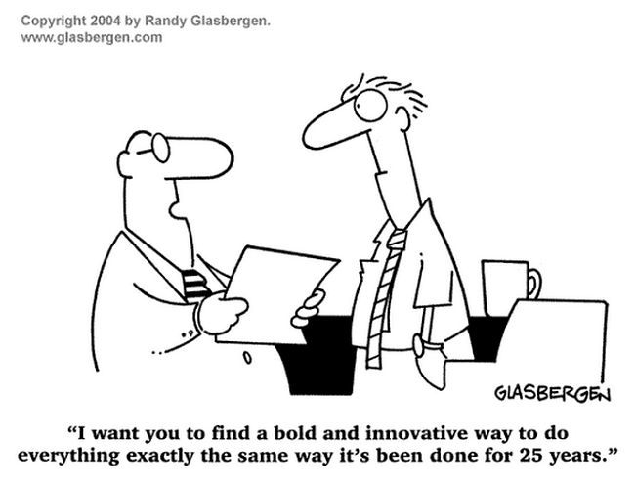

Slide 6
Curriculum Streamlining
The streamlining efforts of the last year have greatly reduced the time for the approval of credit courses, allowing the Chancellor’s Office to clear out the Queue on Q Street
Title 5 regulations have been modified to give local districts authority to approve their courses, and will be at the Board of Governors for a final read this coming Monday.
The new Chancellor’s Office Curriculum Inventory (now live for all colleges) has been developed to help facilitate these new processes

Slide 7
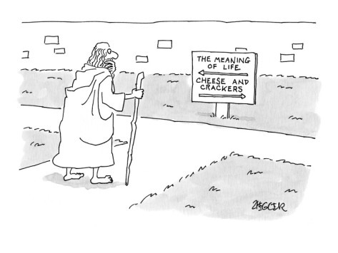

Slide 8
What is Yet to Come?
With so much change, it might seem like a good time to sit back and relax, but there is so much left to do.
Streamlining discussions for programs and noncredit
Implementation of the pilot program in Chemistry and Physics based on the UC Transfer Pathways
Possible expansion of the CCC Baccalaureate Degree Program
Future enhancements to COCI
Guided Pathways
And many other things we haven’t thought of yet ☺

Slide 9
Questions?
Thank you!
Dolores Davison (davisondolores@foothill.edu)
Craig Rutan (rutan_craig@scccollege.edu)

