Slide 1
Professional Development – Navigating the College Culture
John Stanskas, ASCCC Vice President
Lakita Long, Part-Time Faculty Leadership Committee
Don Hopkins, Part-Time Faculty Leadership Committee

Slide 2
Session Objectives
Introductions – What are you hoping to get out of this breakout?
Overview of most college structures
Departments, divisions, governance, professional development
Access to Professional Development
College Culture Experiences Dialog and Shared Wisdom

Slide 3
College Structures
Department Chairs → Division Deans
Academic Senates → College Council
Professional Development Committees

Slide 4
College Structures – Culture Differences
Department Chairs → Division Deans
Internal departmental and division cultures
Academic Senates → College Council
Faculty cultures and college-wide cultures
Professional Development Committees
Access to PD

Slide 5
Some Ways to Think About Culture
Do you like each other?
Do you value each other?
Do you have a community of practitioners or a group of similarly assigned individuals?
Notes:
What works better for student learning?

Slide 6
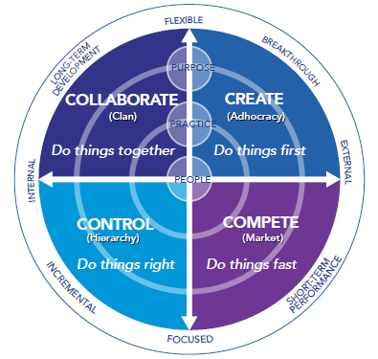
Notes:
One example to think about culture of a small group

Slide 7
Culture
What are your experiences in departmental cultures? Are they different from division cultures?
Have you interacted with the college culture? What are your experiences?

Slide 8
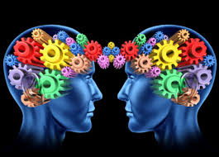
Thank You For Coming!

