Slide 1
Placing courses in local GE patterns: Models for Effective Practice
Dolores Davison, Foothill College
Dave DeGroot, Allan Hancock
Duane Short, San Diego Miramar College

Slide 2
What is a Degree?
An undergraduate degree is comprised of three parts:
Major course requirements
Major courses define the program of study.
General Education course requirements.
General Education provides broad exposure to multiple disciplines and forms the basis for developing important intellectual and civic capacities.
Elective courses (as needed)
Students choose electives that fit their individual interests.

Slide 3
General Education (GE)
Title 5 -55061
https://govt.westlaw.com/calregs/Search/Index
General Education is designed to introduce students to the variety of means through which people comprehend the modern world. It reflects the conviction of colleges that those who receive their degrees must possess in common certain basic principles, concepts and methodologies both unique to and shared by the various disciplines.

Slide 4
GE Patterns
California Community College – CCC GE
California State University – CSU GE
California State University – CSU GE for STEM
Used specifically for CSU transfer.
University of California – IGETC
University of California – IGETC for STEM
Used for CSU or UC transfer.
Individual UC Campuses, Private and Out-of-State Public Schools
Varies by institution.

Slide 5
CCC GE Required for AA & AS
Title 5 General Education Requirements
Minimum Units - 18 semester units or 27 quarter units.
Specific Subject Areas
Natural Sciences
Social and Behavioral Sciences
Humanities
Language and Rationality
English Composition
Communication and Analytical Thinking

Slide 6
CCC GE Options for AA & AS
Most CCC campus opt to include additional graduation requirements such as:
Computer Literacy
Multicultural Gender or Ethnic Studies
Health, Wellness or Physical Education
Results in a wide range of CCC GE patterns.

Slide 7
Associate Degrees for Transfer (ADT)
Colleges “can not” include additional graduation requirements for AA-T & AS-T:
“ . . . A community college district shall not impose any requirements in addition to the requirements of this section, including any local college or district requirements, for a student to be eligible for the associate degree for transfer .”
Senate Bill 440

Slide 8
CCC GE & Reciprocity
CCC GE Regional Reciprocity
Courses taken at a ‘sending’ college will be honored in the GE Area of that college by the ‘receiving’ college even if the local comparable course of the receiving college is in another GE Area.
C-ID Reciprocity
C-ID reciprocity policy applies to all applications of the local C-ID course, i.e. Major and GE requirements.

Slide 9
CSU GE
Title 5 GE Requirements and CSU Executive Order 1065
Minimum Units – 39 semester units/58 quarter units
Specific Subject Areas – 5 Areas:
Area A: English Language Communication and Critical Thinking
Area B: Scientific Inquiry and Quantitative Reasoning
Area C: Arts and Humanities
Area D: Social Sciences
Area E: Lifelong Learning and
Self-Development

Slide 10
IGETC
CSU and UC Academic Senate
Minimum Units - 37 semester units or 54 quarter units
Specific GE Subject Areas – 6 Areas:
Area 1 English Composition (If CSU – 1C Speech)
Area 2 Mathematical Concepts
Area 3 Arts and Humanities
Area 4 Social and Behavioral Sciences
Area 5 Physical and Biological Sciences
Area 6 Language Other Than English (UC only)

Slide 11
Role of Curriculum Committee
Academic Senate for CCC 1996 Best Practices Paper:
The main function of the curriculum committee is that of primary responsibility for the development, review, renewal, and recommendation of curriculum to be approved by the Board of Trustees.
Authority: Education Code 70901:
. . . the right of academic senates to assume primary responsibility for making recommendations in the areas of curriculum and academic standards.

Slide 12
Role of Curriculum Committee
Application: Title 5 53200 Definitions - “Ten plus One”
(1) Curriculum, including establishing prerequisites and placing courses within disciplines
(2) Degree and certificate requirements
(3) Grading policies
(4) Educational program development
(5) Standards or policies regarding student preparation and success
(6) District and college governance structures, as related to faculty roles
(7) Faculty roles and involvement in accreditation processes, including self study and annual reports
(8) Policies for faculty professional development activities
(9) Processes for program review
(10) Processes for institutional planning and budget development, and
(11) Other academic and professional matters as mutually agreed upon between the governing board and the academic senate.

Slide 13
Three Committee Decisions
Decision 1: What level is the course?
Pre-collegiate/basic skills: Not eligible for GE
Associate level: University transfer N/A
Baccalaureate level: Consider alignment to university GE
CSU GE
IGETC
Private/Independent

Slide 14
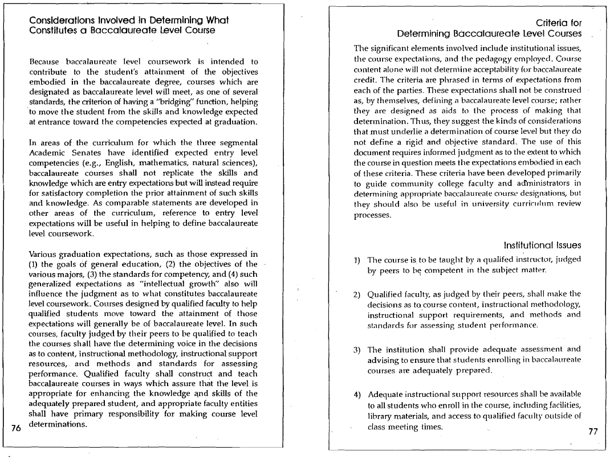

Slide 15
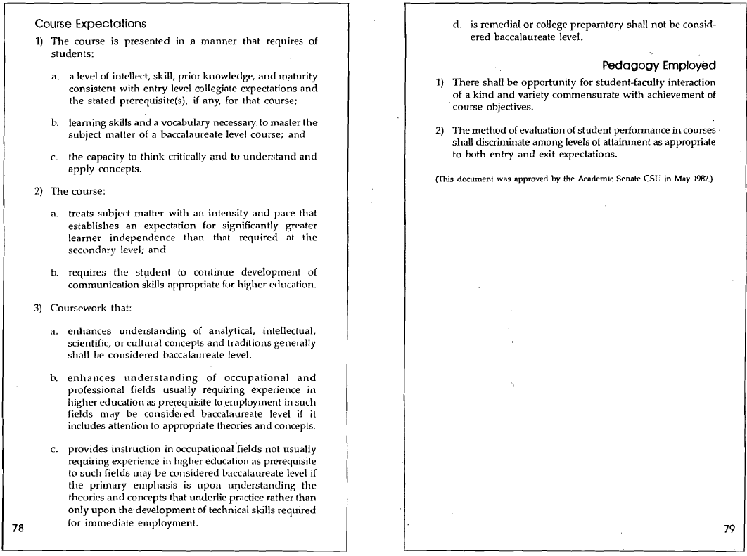

Slide 16
Three Committee Decisions
Decision 2: Is the course GE?
Does it align with the district’s GE philosophy?
Is the content appropriate for all students regardless of background or major?
Does it develop intellectual capacities that are applicable/transferable to other majors?
Does it provide a broad contextual understanding of the GE area (vs. a focus on technique or skills development)?

Slide 17
Three Committee Decisions
Decision 2: Is the course GE?
Is the focus and coverage appropriate?
Enough units to sufficiently cover the expected GE competencies/outcomes?
Too narrowly focused on one specific topic?
Too “diluted” with non-GE content or with too much content from multiple GE areas?

Slide 18
Three Committee Decisions
Decision 3: Which GE area(s) should the course be placed in?
Evaluate using criteria for the GE area(s)
Title 5
College’s GE SLOs or other criteria
Alignment to CSU GE (possibly)
Alignment to IGETC (possibly)
Alignment to other college or university GE (possibly)

Slide 19
Three Committee Decisions
Decision 3: Which GE area(s) should the course be placed in?
Other considerations
Course discipline assignment
Department offering the course
Placement in multiple GE areas

Slide 20
Three Committee Decisions
Activity
You are the Curriculum Committee at Avalon City College (Channel Islands CCD)
Your committee will evaluate three courses proposed for your local GE pattern
All courses are already determined to be baccalaureate level
You need to decide if they are GE, and, if so, which GE area(s) to place them in

Slide 21
Three Committee Decisions
Courses
AVIA 115 proposed for Natural Sciences
BUSE 120 proposed for Living Skills
SUST 101 proposed for Natural Sciences and Human Institutions-Social Sciences
Deliverables
List of issues you discussed
Is the course GE?
Which GE area(s) did you assign it to?

Slide 22
Three Committee Decisions
Debrief
List of issues you discussed
Is the course GE?
Which GE area(s) did you assign it to?

Slide 23
What’s next?
Future trends/areas uncertainty
Upper division GE in CCC bachelor’s degree
C-ID reciprocity
Student advisement

Slide 24
Questions and Contacts
Dolores Davison
Davisondolores@fhda.edu
Dave DeGroot
ddegroot@hancockcollege.edu
Duane Short
dshort@sdccd.edu

