Slide 1
The Power of the Pen: Local Resolutions and How to Use Them
Resolutions can be an effective way to encourage and facilitate civil discourse at your college; however, local senate leaders may often feel confused about the use of resolutions at the local level for doing business and taking action. In this breakout members of the ASCCC Resolutions Committee will delve into the question of when to write a resolution at your local senate, and what the process and outcomes may look like.
Objectives: Attendees will hear benefits and considerations to local resolution writing and approval to understand better how to use this parliamentary tool.
Eric Thompson, Santa Rosa Junior College
Donna Greene, College of the Desert
Carrie Roberson, Butte College
Rebecca Eikey, College of the Canyons
With Ginni May & Randy Beach

Slide 2
Why Resolutions?
Democracy: A Messy Enterprise
Unlike dictatorships, democratic decision-making is an often chaotic, bottom-up process involving lots of conversations, multiple levels of politicking, and rapid changes of opinion. Though seemingly chaotic—but not a free-for-all!--it tends to produce superior policy decisions because it treats participants equally, and judges ideas solely on their merit. The Academic Senate embraces the chaos and trusts the process.
Resolutions: The Primary Mechanism for Setting Policy
The AS relies on formal resolutions, a democratic process, to set direction for the organization as a whole.
RE:SOLUTIONS: Borne out of Issues
In many instances, before the AS can take action on an issue, concern, or problem, the adoption of a resolution by the body is necessary to provide direction and facilitate deeper understanding of the issue.

Slide 3
Resolution Making Santa Rosa Junior College Campuses and Centers Sanctuaries
December 7, 2016
Whereas, According to its Mission, “Santa Rosa Junior College passionately cultivates learning through creative, intellectual, physical, social, emotional, aesthetic and ethical development of our diverse community”: and, according to its value statement, values, “Diversity that supports . . . equal access for all students,” and “Multi-ethnic global cultural perspectives and cultural competencies”;1 and
Whereas, Santa Rosa Junior College is committed to distinguishing itself as serving a growing and increasingly integrated and contributing Latinx population, evidenced by its establishing the Dream Center and becoming a Hispanic Serving Institution; and
Whereas, Santa Rosa Junior College is committed to providing equal opportunities and equal human dignity for all people who have been historically, and are currently, marginalized by systemic inequality; and
Whereas, Many statements made by the President-Elect of the United States oppose Santa Rosa Junior College’s mission and values, including policies that threaten the students we serve with deportation,2 and positions and attitudes expressed by the President-Elect, his advisors and supporters, have directly resulted in an increase of harassment and hate-crime violence;3
1 The Santa Rosa Junior College Catalog, 2016/17, p. 4
2 http://www.nytimes.com/2016/11/15/us/politics/donald-trump-deport-immigrants.html?_r=0
3 https://www.splcenter.org/hatewatch/2016/11/11/over-200-incidents-hateful-harassment-and-intimidation-election-day

Slide 4
Resolved . . .
Resolved, That the Academic Senate urge the Sonoma County Community College District to declare and establish the Santa Rosa Junior College Campuses and Centers as Sanctuaries, where undocumented students are protected from immigration and customs enforcement; and
Resolved, That the Academic Senate urge the Sonoma County Community College District to refuse to release the names or addresses of undocumented students, or others targeted for discrimination to government agencies seeking their status; and
Resolved, That the Academic Senate urge the Sonoma County Community College District publically reaffirm SRJC’s commitment to equal access and equal rights for all our diverse communities; and
Resolved, That the Academic Senate urge the Sonoma County Community College District to publically reaffirm its commitment to creating a safe learning environment for all that is free of hate-speech and harassment.

Slide 5
Resolution from College of the Desert
Draft Resolution on Course Size Maximums:
Whereas, the ASCCC whitepaper, Setting Course Enrollment Maximums: Process, Roles, and Principles, (2012) states “processes for determining course enrollment maximums should include significant input from faculty in the discipline… and any recommendations made by discipline faculty must move forward through established college structures, allowing for appropriate input from administrators and bargaining units and approval by the curriculum committee and oversight by the academic senate.” And
Whereas, at College of the Desert the process for setting and determining course size maximum enrollments has not been clearly defined. And
Whereas, curriculum committees must ensure that discipline faculty have appropriately considered all relevant factors in establishing the class enrollment maximums.
Whereas, “decisions on the setting of class enrollments maximums should, whenever possible, be supported by current and reliable data, both locally produced and from external statewide and national organizations”. (ASCCC, 2012)

Slide 6
Continued
Therefore, the process for determining course size maximums shall be as follows:
Effective Fall of 2017 all faculty shall use a starting point of 50 as a course size maximum, for all new and modified courses. when establishing new courses or changing existing course size maximums, faculty shall use a discipline/course specific starting point (established in consultation with discipline faculty and deans).
Faculty members will review the following factors in determining a different course size:
-methods of course delivery
-methods of evaluation
-Local data on student success and student learning outcomes
-Recommendations from discipline specific organizations such as; National Council of Teachers of English, American Mathematics Association of Two Year Colleges.
-Special population classes such as basic skills or honors classes.
-Other pedagogical concerns such as Lab work.
To aid in this process a course size maximum calculator shall be available on the portal for faculty to use as an additional step to justify a smaller course size. as a tool.
Once faculty have determined a reasonable course size maximum in consultation with the area dean. This course size will be listed on the COR and will be reviewed through the curriculum committee process that is followed for all Course Outline of Record elements.
Faculty will include their rationale for the class size in the proposal to the curriculum committee so that the curriculum committee can review the data upon which the recommendations of the discipline faculty are based to ensure that the data are appropriate and have been given proper consideration.
Discipline faculty will be afforded the opportunity to explain or defend their conclusions, and the curriculum committee must make certain that the discussion by the discipline faculty has been comprehensive and conscientious.

Slide 7
Resolution from Butte College
Butte College Resolution 10.2 *Processes for institutional planning and budget development
10.2 Consulting Collegially with Local Senates on Participation in Grants and Initiatives
Whereas, Butte College Board Policy 2515 recognizes the Academic Senate’s important participatory role in areas of curriculum, academic standards, and professional matters, a role established in California Education Code (70901 (b) (1) (E)) as well as Title 5 (§53200 (b));
Whereas, The Academic Senate for California Community Colleges (ASCCC) affirmed in Fall 2012 “that grant development processes are processes for institutional planning and thus fall under the purview of academic senates in accordance with Title 5 §53200” ❶ ;
Whereas, The ASCCC then urged local senates to have discussions with their districts about such local processes and senate involvement, which the Butte College Academic Senate Executive Committee did on more than one occasion during the Fall of 2012; and
Whereas, The ASCCC has recently renewed its recommendation, stating “The educational direction for California community colleges in the last four years has been on an increasingly rapid trajectory” that has “resulted in the current dizzying array of initiatives all aimed at improving educational outcomes” and “faculty must now more than ever insist upon a seat at all tables where curriculum, program development, outcomes tracking, degrees and certificates, funding, and planning are being discussed” ❷ ;

Slide 8
RE: SOLVED…
Resolved, That the Butte College Academic Senate request that administrators collaborate with the Academic Senate to develop formal policies and procedures for collegial consultation before and during participation in any current or future grant-funded programs or initiatives which encompass academic and professional matters;
Resolved, That the Executive Committee of the Academic Senate report back to the Senate by Spring 2018 on the progress of such collaboration; and
Resolved, That the Butte College Academic Senate focus on the educational needs of students and the professional obligations of faculty when deciding whether or not to recommend to the governing board and/or designee(s) or support participation in any current or future grant-funded program and initiative.
❶ ASCCC, “Integration of Grants with College Planning and Budget Processes” (Resolution 17.03).
❷ ASCCC, “Participatory Governance in the Face of Initiative Fatigue,” Rostrum, February 2017.

Slide 9
Resolution from College of the Canyons: Civic Center Use
Whereas, According to the Mission Statement, “College of the Canyons offers an accessible, enriching education that provides students with essential academic skills and prepares students for transfer education, workforce-skills development, and the attainment of learning outcomes corresponding to their educational goals;” and Whereas, College of the Canyons believes in “fostering a broad range of community partnerships,” and, thus shared use of the District’s properties for the community and local businesses demonstrates this value; and
Whereas, Education Code 82537(d) states “the use of any community college facility and grounds for any meeting is subject to reasonable rules and regulations as the governing board of the district prescribes, and shall not interfere with the use and occupancy of the community college facilities and grounds, as is required for the purposes of the community colleges”; and
Whereas, College of the Canyons’ Board Policy 6700, Civic Center and Other Facilities Use, states that “public use of District property shall not interfere with scheduled instructional programs or other activities of the District on behalf of students;” and
Whereas, The civic center use including filming activities has negatively impacted instructional programs and other activities for students resulting in lost instruction time, such as: • blocked access to classrooms, student health center, parking, and other areas of campus, • barriers to access for disabled students and faculty, due to loss of designated disabled parking or barriers to elevators, • students being denied access to faculty office hours, delayed opening of tutoring centers, cancellation of student club fundraising events, • changing of classroom sets ups that delayed, damaged, and/or prohibited instructional use, • cancellation of classes, and more; and
Whereas, There is little to no advanced communication to students and faculty about filming or civic center use activities on campus.

Slide 10
Resolution from College of the Canyons: Civic Center Use
Resolved, The College of the Canyons Academic Senate urges that instruction and activities for students takes priority over filming activities and filming is not permitted at the expense of student, staff, and faculty access; and
Resolved, The College of the Canyons Academic Senate urges that direct communication to students, faculty, and staff, related to civic center use, such as filming, be done in a manner that consists of advanced notification of areas to be affected, and in the case of filming, includes advanced posting of film permits in public areas on campus; and
Resolved, The College of the Canyons Academic Senate urges that civic center use, such as filming, should not occur if it is at the expense of students’ access to their curricular or co-curricular activities; and
Resolved, The College of the Canyons Academic Senate request the establishment of a joint Academic Senate-Administration committee to review and report on the implementation of current policy and to propose revisions as appropriate.
Approved by Academic Senate, November 10, 2016

Slide 11
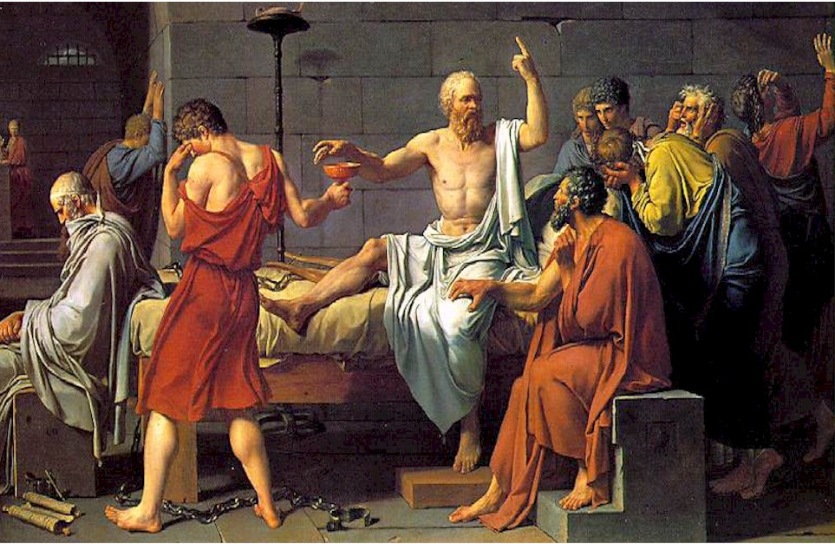
Discussion
How do you decide when to write a resolution to accomplish something in your district?
Do you follow the form of ASCCC or do you employ a local style?
What is the procedure for a local Academic Senate resolution? How is it generated, and to whom is it addressed?
Others . . .

