Slide 1
Models of Regional Collaboration

Slide 2
GRANTEES Roles
Community College Chancellor’s Office Staff
Sector Navigators
Deputy Sector Navigators
Regional Consortia Chair/Vice Chairs
Technical Assistance Providers

Slide 3
Coordination vs Collaboration
COORDINATE: Bring the different elements of a complex activity or organization into a relationship that will ensure efficiency or harmony
COLLABORATE: Work jointly on an activity, especially to produce or create something
Notes:
The idea of moving from coordination to collaboration was introduced earlier in the morning. The previous presenter may have shared these definitions, but they were not on the slide. So take a moment to discuss them OR briefly review them. Point out the primary difference: in collaboration things are built “jointly”…in coordination things may be built separately but then they are aligned to maximize efficiency or harmony. FOR OUR PURPOSES, BOTH OF THESE PROCESSES MAY BE USEFUL BUT THE CHALLENGE IS TO COLLABORATE. IN THE PAST, WE HAVE DONE MORE COORDINATION THAN COLLABORATION.

Slide 4
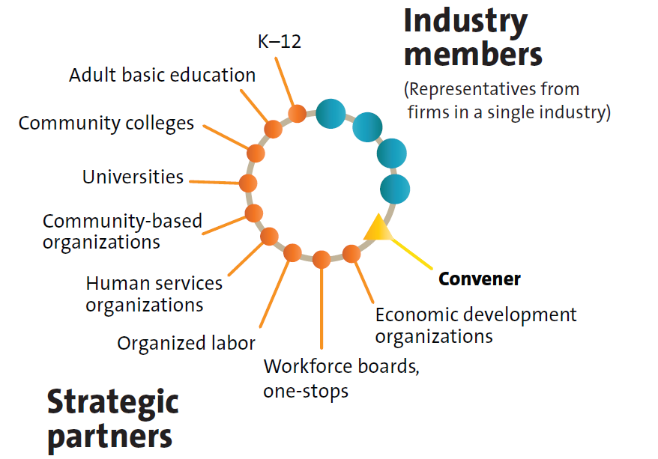
Many Collaborators
Notes:
Until now, we’ve been talking primarily about the rolls and relationships of the community college players. This model expands the view and shows a SECTOR PARTNERSHIP as outlined in State Sector Strategies Coming of Age, by the National Governors’ Association, http://www.nga.org/files/live/sites/NGA/files/pdf/2013/1301NGASSSReport.pdf, see page 3. You may want to note that the convener is not necessarily a community college person, though it certainly can be. IT IS THE ROLE OF CONVENER THAT THE DSNs HAVE BEEN CHALLENGED TO ACCEPT.

Slide 5
Regional Alignment Best Practices
Business Information Worker
Biotech Consortia
Heating Ventilation and Air Conditioning (HVAC) Collaborative

Slide 6
BIW Regional Program Application (LAOCRC)
THE STEPS TAKEN

Slide 7
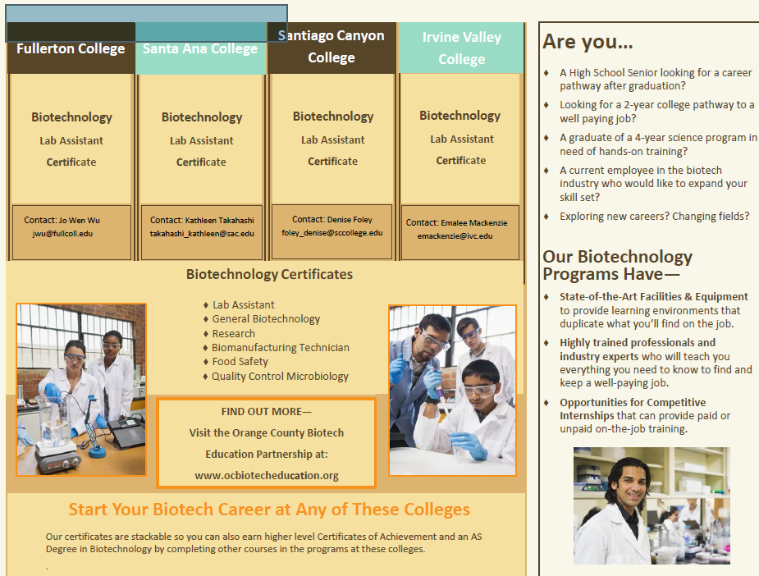

Slide 8
Energy, Construction, & Utilities Sector
Enroll Engage Employ

Slide 9
Energy, Construction & Utilities Sector

Slide 10
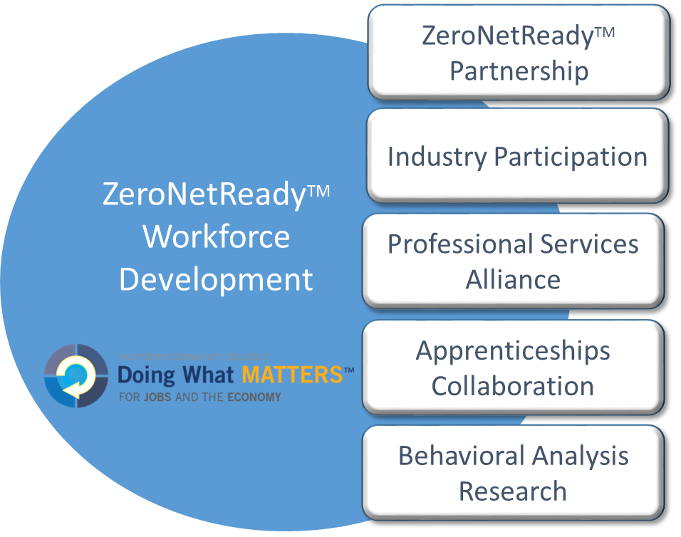
Alliances that Work

Slide 11
HVACR Worker Growth Outpaces Forecasts
Projection at
2012-15
Growth Rate
23%
Attrition
Underforecasted
2.2%
0.5%
2012 2015 2020

Slide 12
SoCal Regional HVACR Gaps
Labor Market Supply / Demand: Shortage of ~ 600 workers annually
Industry Certifications Earned: Limited
Completion Rate: ~ 30%
Occupations not addressed: 18 of 21
Incumbent Workers: 24,000 exhibiting significant skills gaps
Employer Advisories: Local, not aligned with regional economy

Slide 13
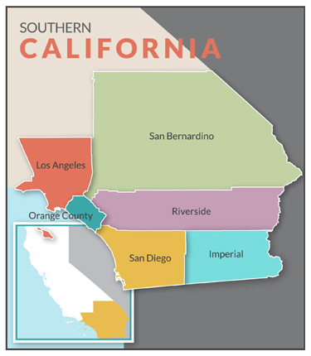
Pilot Project: Seven Colleges in Southern California
Citrus
San Bernardino Valley
LATTC
El Camino
Mt. SAC
College of the Desert
Cypress

Slide 14
Specialty Capstones
Multiple Colleges
Higher Levels
Of
Specialization
Collaborative
Model
Stackable
Certificates
Credit
Transfer
Entry-level
Job
Industry Valued
Credentials
Citrus
LATTC
College of the Desert
San Bernardino Valley
Internships
Cypress
El Camino
Mt. SAC
Common
Outcomes
Southern California
HVACR Collaborative
Foundational
Knowledge

Slide 15
Program Delivery Model
Rapid Prototyping and Statewide Scaling
Strategic College
Partnerships
Program Development
Professional Development
Strategic Industry
Partnerships
Expert Networks
Scaling Mechanisms
HVACR
Lighting
Auditing & Analysis
Building Science
Local / Regional
College Implementation
Sustainability
Local Advisory
Regional Advisory
State Advisory

Slide 16
Energy, Construction, & Utilities Sector
Enroll Engage Employ

Slide 17
For more information,
please visit the following websites:
http://www.calbiotechcareers.org/
http://www.ECUsectorDWM.com
http://ict-dm.net/
http://doingwhatmatters.cccco.edu/

