Slide 1
State
of the Senate
Plenary
Spring 2017

Slide 2
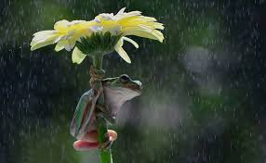
In preparation for the S.O.S.:
Question:
If a person cannot attend a breakout, what important information (issues, ideas, actions or events) do they need to know?
Working parameters
Significant information
Nothing too weedy
Keep it simple
Questions?
Email info@asccc.org

Slide 3
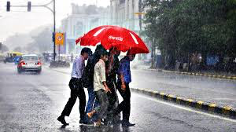
Accreditation
NACIQI – Recommended 18 month recognition
Workgroup I
Continues to work with ACCJC to improve process
Workgroup II
Continues conversation on a single regional accreditor
ASCCC Accreditation Institute – ACCJC participation in breakouts
ACCJC Conference – ASCCC participation with 3 presentations

Slide 4
Budget
Governor’s Budget Highlights
$150m “Guided Pathways” Program
$20m Innovation Awards
$5.4m for Apprenticeship, EOPS,DSPS, CalWORKS and Child Care Tax Bailout programs
$6m for an Integrated Library System
$10m for OEI to purchase Canvas
Waiting for the May Revise

Slide 5
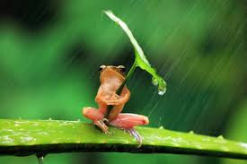
Curriculum
Chancellor’s Office and 5 C Curriculum Streamlining Efforts
Regional Workshops
PCAH 6th Edition
Send people to the
Curriculum Institute!!

Slide 6
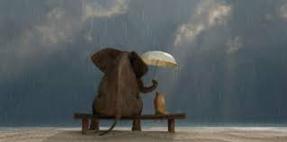
Faculty Hiring and Diversity
Focus on hiring teachers who can serve our diverse student population.
Re-imagine hiring processes from interview questions to criteria and interview structure to make them more focused on the ability to serve diverse students.
Professional development is needed for all to promote a college culture that nurtures diversity and stresses cultural competence.

Slide 7
Legislation
Legislation trends
Undocumented students
Access
Affordability
Accountability
On our radar
AB 705 (Irwin) Multiple Measures
AB 847 (Bocanegra) Academic Senates Membership and Demographics
AB 637 (Medina) Equity Plans
Legislative Newsletter
Legislative Updates
Legislative Liaisons

Slide 8
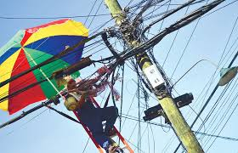
MQs and Equivalency
Minimum Qualifications for Credit Apprenticeships
Apprenticeship MQ Workgroup developed proposal
Hearings
North, May 4 at San Jose Marriott
South, TBD
Please review the proposal with your senates
Submit testimony in support
or opposition at the hearings
In person or by phone
Written testimony

Slide 9
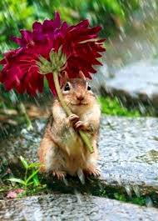
Inaugural Noncredit Summit!
Building Bridges: Developing and Sustaining a Culture of Noncredit
May 4-5, 2017, Sacramento
Event Partners
ASCCC
Association of Community and Continuing Education
3CSN
Career Ladders Project
CO Academic Affairs
Supported by IEPI

Slide 10
Strong Workforce Program

Slide 11
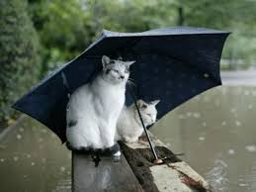
Strong Workforce Program
Local SWP Plans
ASCCC Survey indicated that local senates not meaningfully involved in SWP plans.
ASCCC is advocating for academic senate sign off for next round of planning.
CO CTE MQ Workgroup
Hiring CTE Faculty
Ensure that applications and equivalency processes are on your college website and easily accessible.

Slide 12
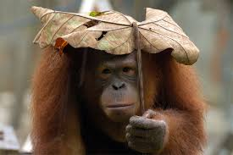
Strong Workforce Program
Legislation – Year 2
17% of SWP funding distributed using incentive funding based on WIOA (Workforce Innovation and Opportunity Act)
Metrics include: Progress, completion, and employment measures.
17% Committee
Implementation Fall 2017
SWP Incentive Funding
doingwhatmatters.cccco.edu

Slide 13
Transfer
Transfer Model Curriculum
Environmental Science
Hospitality Management
Law, Public Policy and Society
Social Work and Human Services
Chancellor’s Office Template still under development
UC Transfer Pathways
Possible pilot
AS UCTP Chemistry and Physics
Stay tuned!

Slide 14
Professional Development College
ASCCC Participatory Governance Module
Curriculum Development 5 Modules
Curriculum 101
Programs and Awards
The Course Outline of Record
Program and Degree Proposals
Focus on Career Technical Education (CTE)
Under Development
Inmate Education
New Faculty Orientation

Slide 15
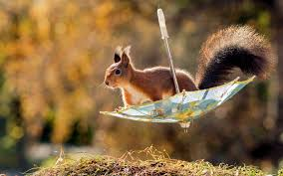
ASCCC Services
Accreditation Resources Teams
Local Senate Visits
Curriculum Technical Assistance
Governance Technical Assistance
Other technical assistance visits, as desired
Our Goal: Visit all 113 Colleges!

Slide 16
Upcoming Events
Noncredit Summit
May 4-5, 2017, Sacramento
CTE Institute
May 5-6, 2017, San Jose
Faculty Leadership
June 15-17, 2017, Sacramento
Curriculum Institute
July 12-15, 2017, Riverside

Slide 17
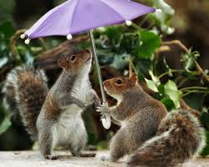
Could we be a match?
Us:
Intelligent, seasoned, spirited, traditional, and sometimes snarky.
You:
Smart, ambitious, good-looking, adventurous, and fun.
Us + You: Solid connection with purview issues.
Volunteer for Statewide Service!

Slide 18
ASCCC Facebook Page

Slide 19
Thank You!!

