Slide 1

Where is the Money?
Leveraging State and Local Funding Streams
to
Build CTE Programs
Notes:
Lynn will open and introduce all

Slide 2


Presenters
Duncan Graham: Vice President of Academic Affairs
San Jose City College
Julie Pehkonen: Regional Consortia Chair Inland Empire
Lynn Shaw: Visiting Faculty California Community College Chancellor’s office
doingwhatmatters.cccco.edu
Notes:
Lynn: ask audience level of expertise in understanding various funding streams, interactive workshop with questions and comments after each presenter makes brief remarks

Slide 3

Unifying framework
doingwhatmatters.cccco.edu
Notes:
Lynn

Slide 4
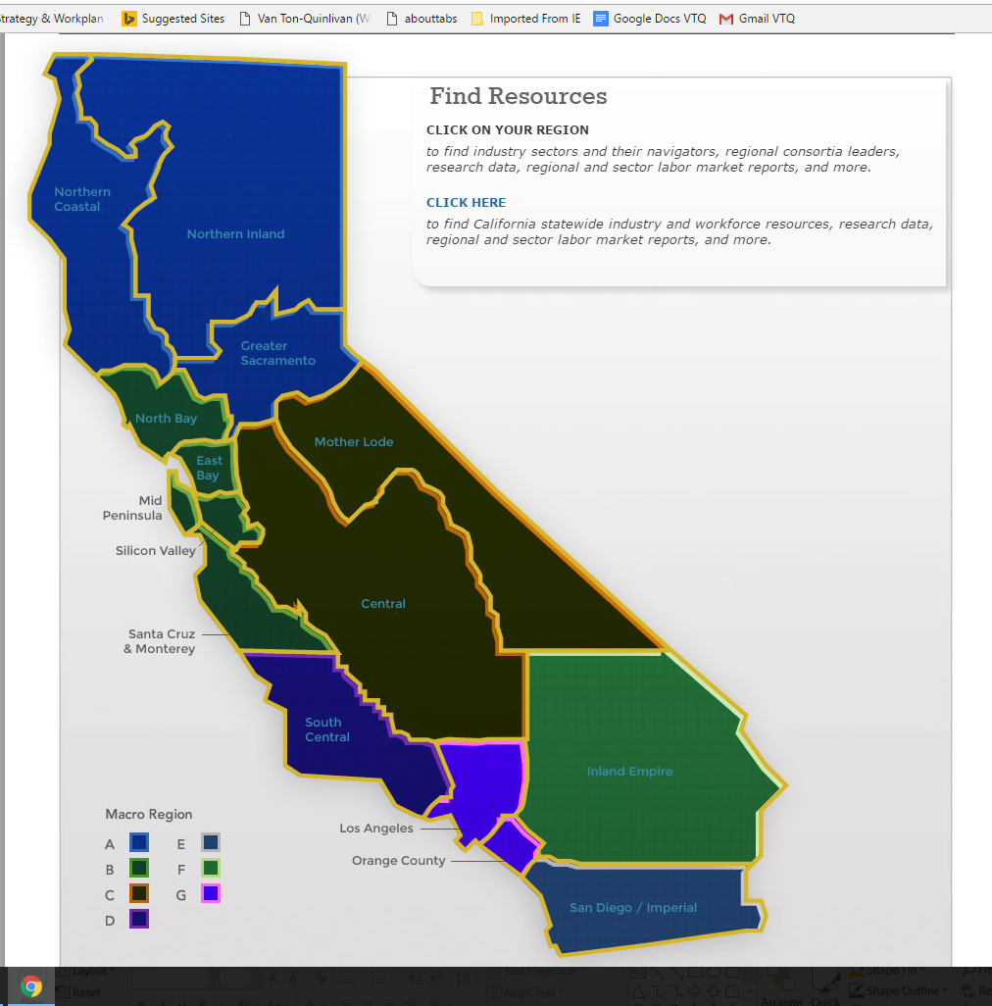
CALIFORNIA
113 community colleges
Regional economies
      - Differing labor market needs
          - Industry sector
          - Guided pathways
        Student workforce outcomes
doingwhatmatters.cccco.edu
Notes:
Lynn

Slide 5
CALIFORNIA
113 community colleges
Regional economies
      - Differing labor market needs
          - Industry sector
          - Guided pathways
        Student workforce outcomes
doingwhatmatters.cccco.edu
Notes:
Lynn

Slide 6

Ecosystem of intrapreneurs
Industry Sector
Technical Assistance
Region
doingwhatmatters.cccco.edu
Notes:
Lynn

Slide 7
WORKFORCE MISSION
From $100M to $900M…
From afterthought to state policy priority…
Unifying framework
Ecosystem of intrapreneurs
Tools to “free the data”
Innovations-at-scale
All in support of guided pathway development.
doingwhatmatters.cccco.edu
Notes:
Lynn

Slide 8

Types of Funding
Competitive Grants
Collaborative
Allocations
Categorical
Non restricted
Foundation
Internal Funding
External Funding
And More
doingwhatmatters.cccco.edu
Notes:
Julie: ways money comes into system, colleges, programs

Slide 9
Carl D. Perkins
Career Technical Education Improvement Act
Purpose
Formula funded
Required uses vs. permissive uses
The next iteration of the Act and alignment with SWP and other state initiatives
doingwhatmatters.cccco.edu
Notes:
Julie -

Slide 10
Carl D. Perkins
Career Technical Education Improvement Act
Federal act established to improve career-technical education programs, integrate academic and career-technical instruction, serve special populations, and meet gender equity needs.
doingwhatmatters.cccco.edu
Notes:
Julie

Slide 11

The Perkins Formula
doingwhatmatters.cccco.edu
Notes:
Julie -

Slide 12
The Formula
Districts receive Perkins funds based on the number of economically disadvantaged students enrolled in a SAMS A-D course.
SAMS CODES
A - Apprenticeship (offered to apprentices only)
B - Advanced Occupational (not limited to apprentices)
C - Clearly Occupational (but not advanced)
D - Possibly Occupational
E - Non-Occupational
doingwhatmatters.cccco.edu
Notes:
Julie -

Slide 13
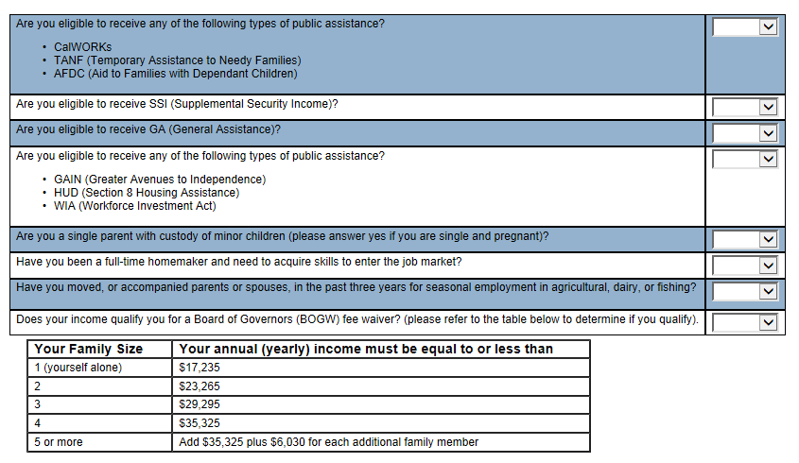
Perkins Survey Example
doingwhatmatters.cccco.edu
Notes:
Julie -

Slide 14
The Payoff
doingwhatmatters.cccco.edu
Notes:
Julie -

Slide 15
Strong Workforce Program Funding
$200 million in reoccurring annual funding
Focused on “More and Better CTE’
60% of funds go to districts, 40% of funds go to regions (after 5% goes to state leadership)
40% Regional allocation differs with each Region
Workforce Outcomes
doingwhatmatters.cccco.edu
Notes:
Duncan

Slide 16
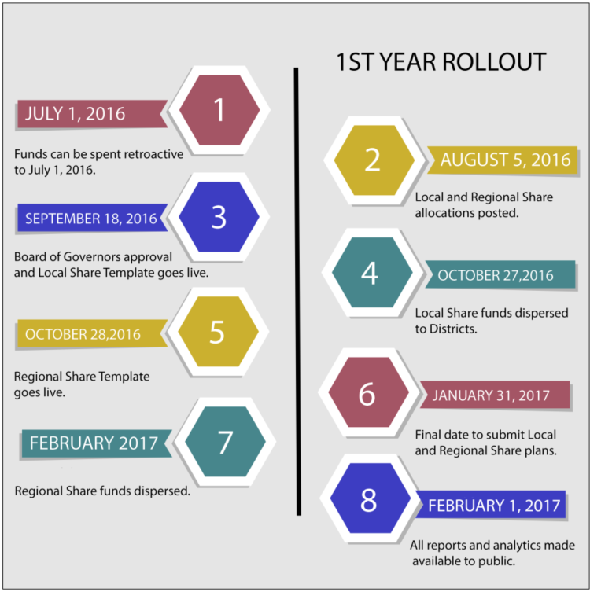
$200M
Strong Workforce Program
Workforce outcomes aligned with federal metrics
83% Allocation Guaranteed for 2017-18
17% requires increased CTE FTES % compared to overall college FTES
Two-year rolling budget
Ability to change budget
Ability to move expenses
doingwhatmatters.cccco.edu
Notes:
Duncan

Slide 17
How to advocate for funding for your program to your CIO?
doingwhatmatters.cccco.edu
Notes:
Duncan: give examples of cases at college of how funding was decided

Slide 18
CIO Perspective
Start with Your Dean
Allocation Disbursement at College
Braiding Strong Workforce Program with Perkins
Advisory Committees-authentic
Labor Market Demands/Competing Programs
Aligned with College Mission Statement
Measurable Outcomes-Better or More
Space Needs
doingwhatmatters.cccco.edu
Notes:
Ducan

Slide 19
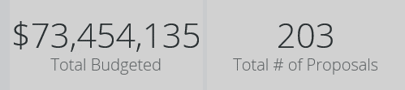
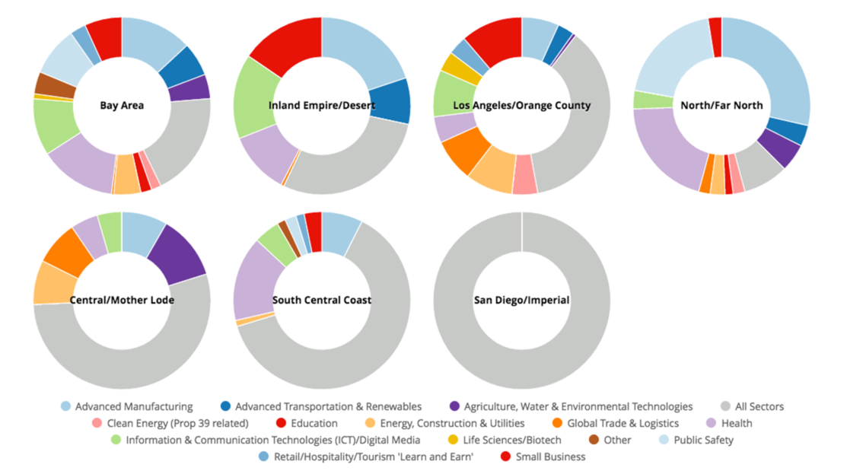
Strong Workforce Program:
Submitted Uses for 2016-2017 Regional Share
doingwhatmatters.cccco.edu
Notes:
Julie

Slide 20
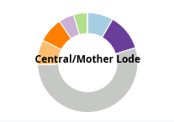
Visit doingwhatmatters.cccco.edu/StrongWorkforce/RegionalReports.aspx
Transparency on Proposed Uses of 2016-17 Regional Shares
Health
$437,000
ICT/Digital Media
$391,880
Global Trade & Logistics
$704,900
Advanced Manufacturing
$724,903
Ag, Water, & Environmental Technologies
$1,030,320
Energy, Construction, & Utilities
$704,900
Across Sectors $4,717,476
doingwhatmatters.cccco.edu
Notes:
Julie

Slide 21
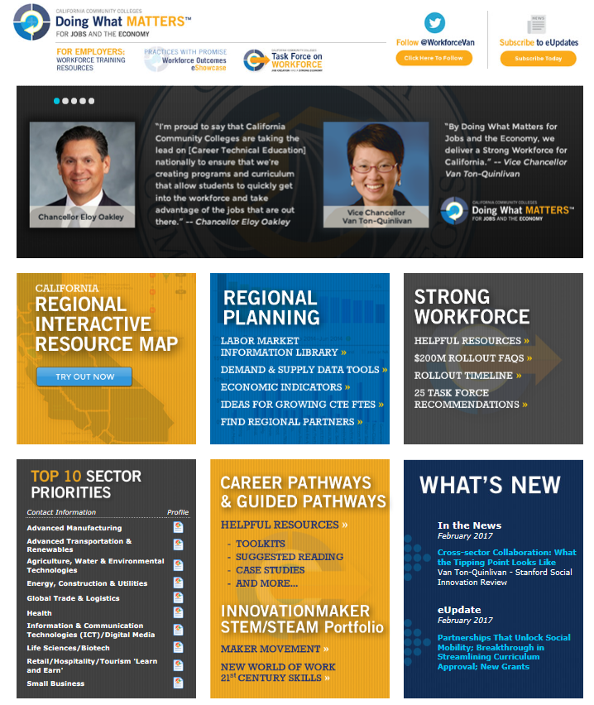
Visit
DoingWhatMATTERS.cccco.edu
doingwhatmatters.cccco.edu
Notes:
Lynn

Slide 22
Thank You!
Questions? Comments?
doingwhatmatters.cccco.edu
Notes:
Duncan

