Slide 1
Communication Studies
Presenters
Shagun Kaur - De Anza College
Jennifer Fowler - College of Alameda
Notes:
9:30 a.m.- 9:32 a.m.
Speaker: Shagun and Jennifer
-Brief introduction

Slide 2
What are Open Educational Resources (OER)?
“OER are teaching, learning, and research resources that reside in the public domain or are released under an intellectual property license that permits their free use and repurposing by others”
-- Hewlett Foundation
Notes:
9:32 a.m. - 9:40 a.m.
Speaker: Shagun

Slide 3
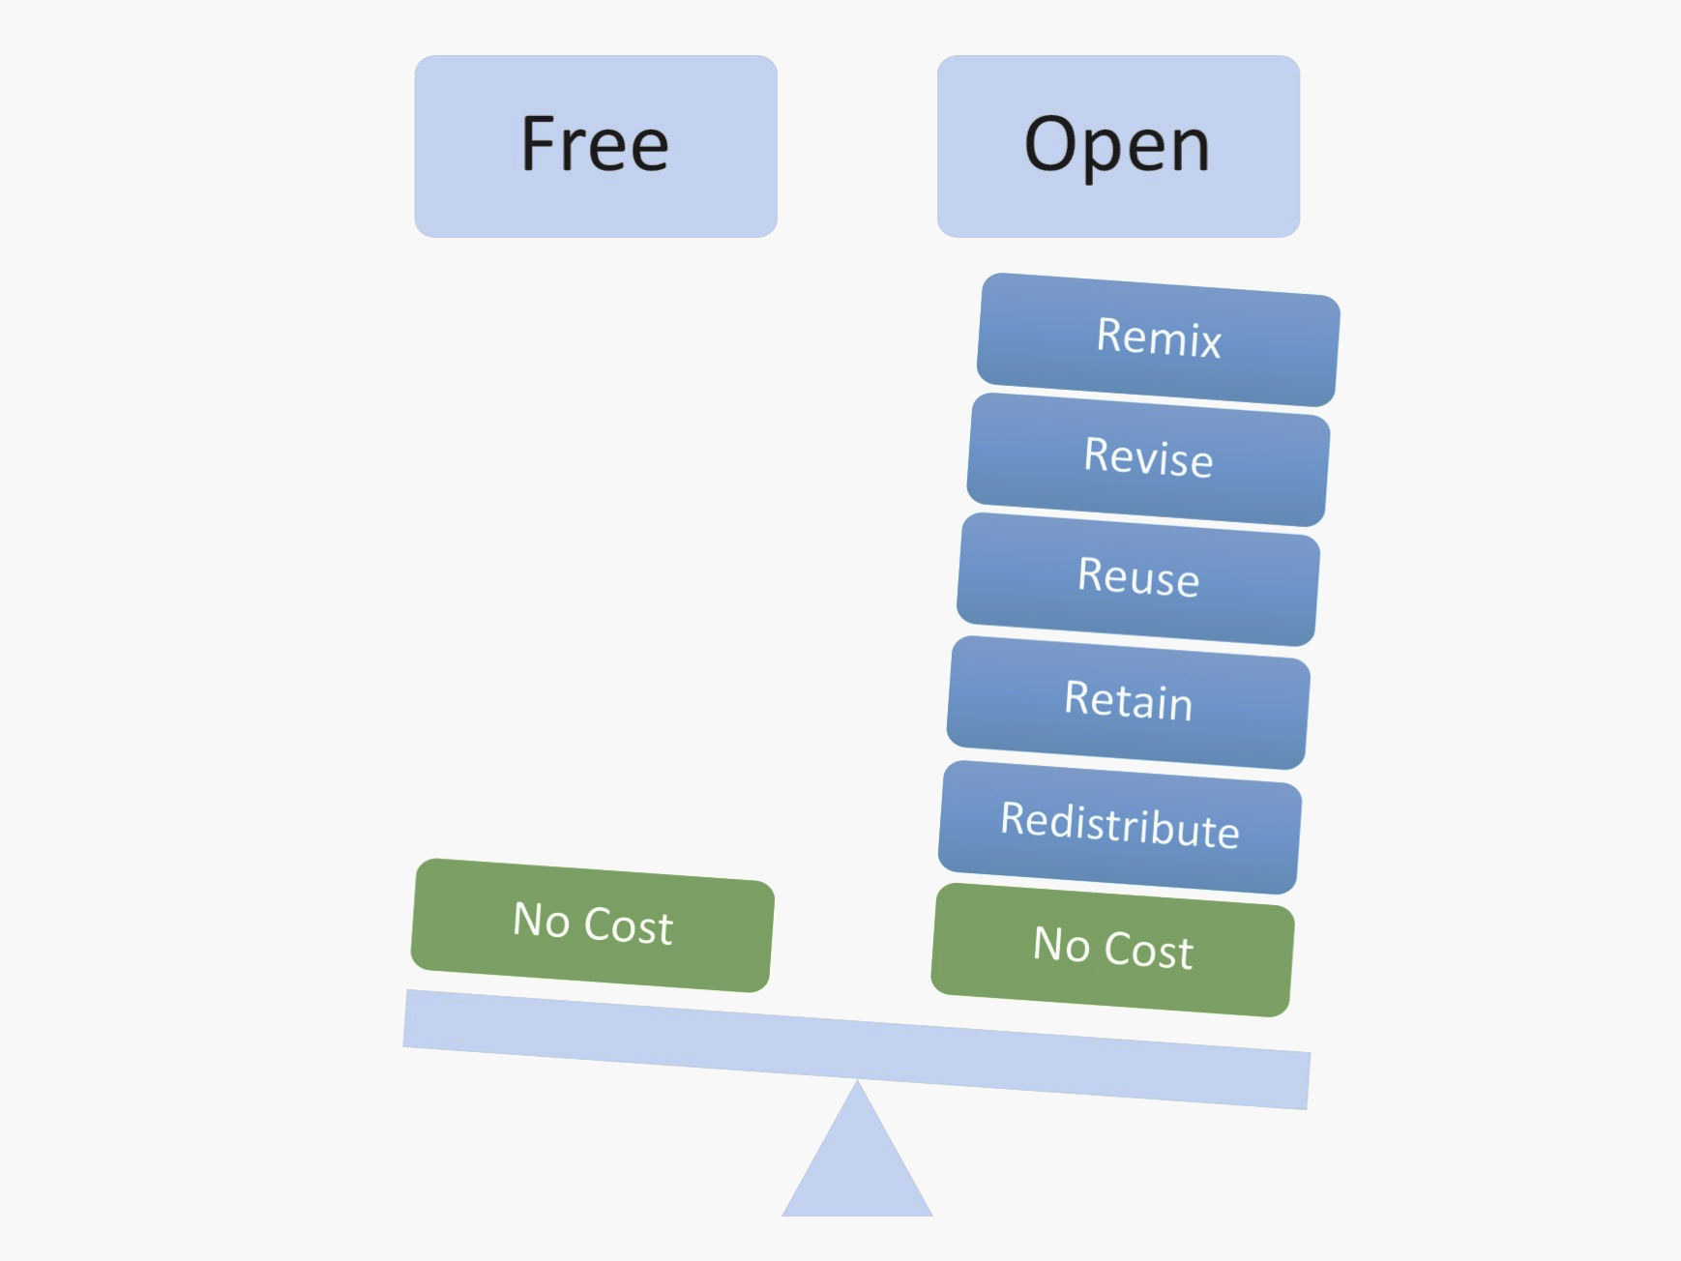
More Than Just Free
Fair Use
Magician by GraphicMama-team from Pixabay, CCO
Free v. Open by Designers for Learning: Gain Experience for Good, Jennifer Maddrell, Director (CC, BY, NC, SA)
Notes:
9:32 a.m. - 9:40 a.m.
Speaker: Shagun

Slide 4
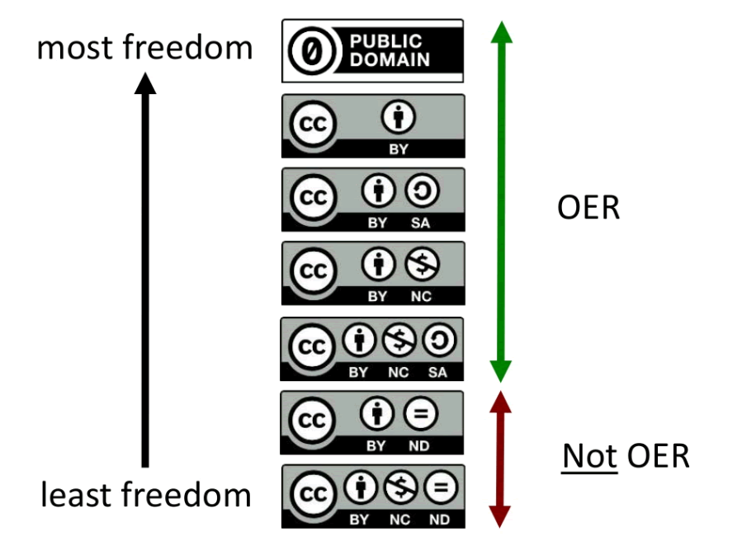
Creative Commons Licenses by D'Arcy Hutchings is licensed under a Creative Commons Attribution 4.0 International License.
All Ygraph.com content and data are available under the CCA 3.0 license.
Notes:
9:32 a.m. - 9:40 a.m.
Speaker: Shagun

Slide 5
Want to get started with OER?
Notes:
9:40 a.m. - 9:50 a.m.
Speaker: Jennifer

Slide 6
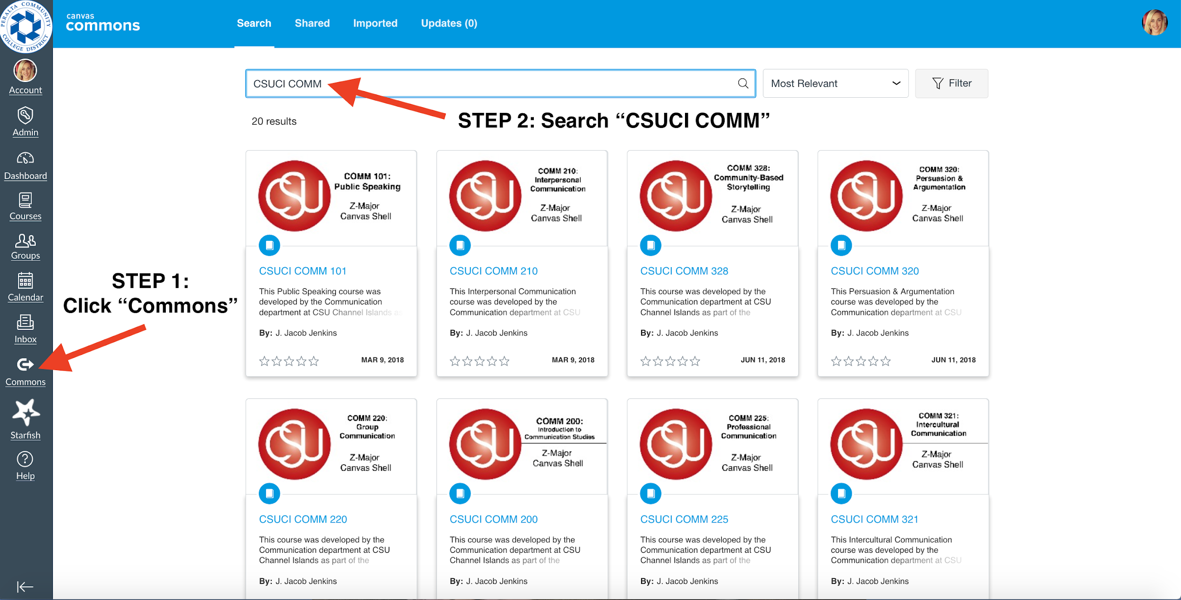
Search the Canvas Commons
Notes:
9:40 a.m. - 9:50 a.m.
Speaker: Jennifer

Slide 7
OER COMM General Resources
OER Commons
Merlot
WikiBooks
BCcampus OpenEd
Open Textbook Library
Saylor
Notes:
9:40 a.m. - 9:50 a.m.
Speaker: Jennifer

Slide 8
Public Speaking
http://publicspeakingproject.org/
Has complete chapters as PDF files
Short; easy to read; contemporary
Has supplemental resources, test banks
Growing movement - YouTube chapter summaries
Exploring Public Speaking: 3rd Edition
Stand Up, Speak Out: The Practice and Ethics of Public Speaking
Multiple formats
Reviews by discipline faculty
Boundless Communication
Principles of Public Speaking
Bite sized modules which can be adapted in part or whole
Notes:
9:50 - 9:55 a.m.
Speaker: Shagun

Slide 9
Survey of Human Communication
Principles of Human Communication
Has ancillaries - quiz, supplemental readings
Can host it on Saylor’s site
Communication in the Real World: An Introduction to Communication Studies
Multiple formats
Reviews by discipline faculty
A Primer on Communication Studies
Available in HTML and PDF format
Business Communication for Success
Clearly defined learning objectives; supplemental resources
Questions at the end can used for discussions
Notes:
9:55 - 10:00 a.m.
Speaker: Shagun

Slide 10
Organizational Communication
Original Book: An Introduction to Organizational Communication
Chapters borrowed/enhanced with:
An Introduction to Organizational Behavior
Chapters on organizational Structure, organizational culture, employee motivation and politics
Saylor Courses: Organizational Behavior and Corporate Communication
Chapters on organizations in business, crisis communication
YouTube Channel: Organization Communication Channel
Open Case Studies: Markkula Center for Applied Ethics
Notes:
10:00 a.m. - 10:05 a.m.
Speaker: Shagun

Slide 11
Persuasion or Argumentation
Influencing Through Argument
Written by University of Vermont debate coaches/professors
Exercises provided after each chapter
Text heavy - may want to balance with other visuals
A Concise Introduction to Logic
Available in HTML and PDF format
Best for pulling a few modules/chapters; heavy logic focus
Logical Reasoning
Chapter summaries, glossary, exercises after each chapter
Concept checks provided mid-chapter
Easy to navigate
Notes:
10:05 - 10:10 a.m.
Speaker: Jennifer

Slide 12
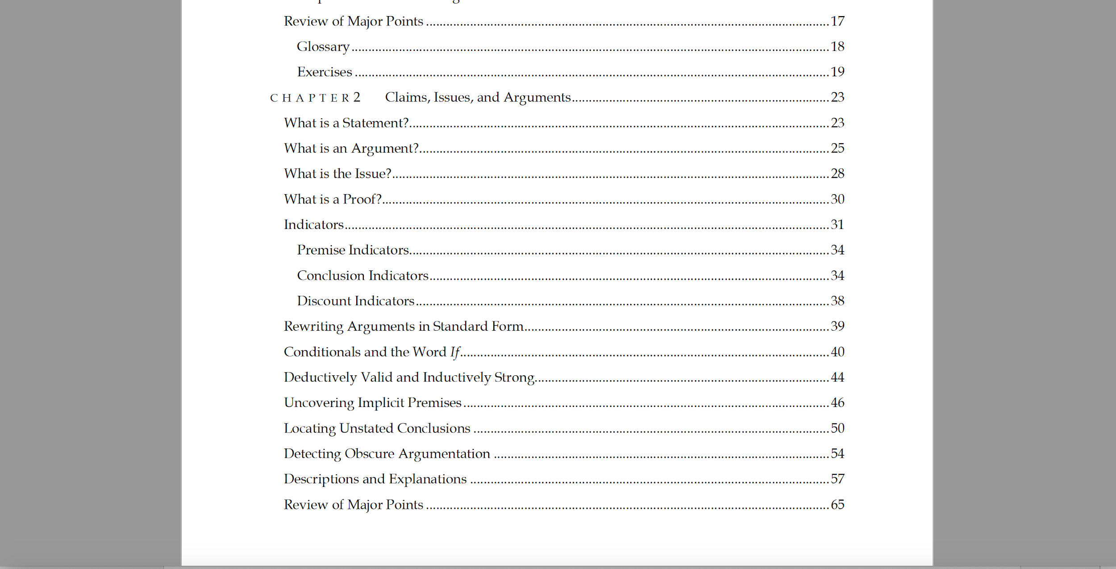
Think Outside the Box
Borrow from similar disciplines. Example: Philosophy Persuasion
Notes:
10:05 - 10:10 a.m.
Speaker: Jennifer
-Talk about my challenges with persuasion. Wasn’t finding a ready made persuasion text. Using a good chunk of a philosophy textbook and then combining with articles to fill in the gaps.
-Other interdisciplinary resources I’ve seen: Sociology, Psychology, Humanities.

Slide 13
Interpersonal Communication
Communication in the Real World: An Introduction to Communication Studies
Designed as a Survey of Human Communication book
Chapters 1-8 cover interpersonal topics
Principles of Human Communication
Unit 2 covers interpersonal concepts
Survey of Communication Study
Chapters 1, 2, 3, 9, 10, 12, and 13 cover interpersonal topics
Business Communication
Interpersonal chapters covering self-concept, interpersonal needs, conflict
An Introduction to Interpersonal Communication
Clear learning objectives, exercises, key chapter takeaways
Interpersonal Communication and Interpersonal Communication - Open Course Library
Notes:
10:10 - 10:15 a.m.
Speaker: Jennifer

Slide 14
Other COMM Courses
An Introduction to Group Communication
Divided into clear sub units
Has exercises that can be used for discussions
Small Group Communication
Units - which can be adopted whole or to enhance a section
Communication Theory - WikiBook
Intercultural Communication
Available as a course with readings and quizzes
Notes:
About 2 minutes
Speaker: Jennifer
-Use these as full resources for the respective course or to fill in gaps in interpersonal, intro to human communication, etc.

Slide 15
Questions?
Notes:
Final 13 minutes

Slide 16
Contact Information
Jennifer Fowler - fjennifer@peralta.edu
Shagun Kaur - kaurshagun@fhda.edu
Link to Survey : https://www.surveymonkey.com/r/968ZMXW

