Slide 1
Fearless Leadership: The Role of the Academic Senate President
Elizabeth Romero, Clovis Community College, Anna Bruzzese, ASCCC South Representative Stephanie Curry, ASCCC North Representative

Slide 2
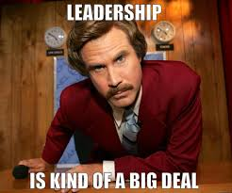
Breakout Summary
Join us for a collaborative discussion on Academic Senate Leadership. Bring your stories, anecdotes and questions about leadership and we will use our collective experience identify tips and strategies to become a fearless leader.

Slide 3
Duties of a Local Senate President
Being familiar with the statutory and regulatory context in which the senate operates
Advocating for Faculty Interests
Promoting and Effective Relationship with the Board of Trustees
Maintaining Contact with the Academic Senate for California Community Colleges
Maintaining Effective Relationships with Other Governance Groups
Per Local Senates Handbook

Slide 4
Tips for Fearless Leadership
Be prepared (do your research)
Know your 10 + 1, local shared governance agreement, senate constitution and bylaws
Understand the Brown
Act and Robert’s Rules

Slide 5
4) Make allies
5) Pick the hills you are willing to die on

Slide 6
6) Be transparent
7) Be pro-active

Slide 7
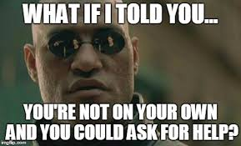
8) Ask for help
9) Use the expertise and resources of the ASCCC

Slide 8
10) You don’t need to reinvent the wheel
+1… Remember:
you are not alone

Slide 9
Share your Stories

Slide 10
Resources
ASCCC Webpage
Local Senates Handbook
info@asccc.org
ASCCC Listservs

Slide 11
Questions?
Elizabeth Romero
elizabeth.romero@cloviscollege.edu
Anna Bruzzese
bruzzeaa@piercecollege.edu
Stephanie Curry
stephanie.curry@reedleycollege.edu

