Slide 1


What’s New… and What Do You Need to Know?
Dolores Davison, ASCCC Vice President
Alice Perez, Vice Chancellor- Educational Services & Support
Carrie Roberson, ASCCC North Representative
2019 Curriculum Institute- Decoding Your Curriculum
Thursday, July 11
2:15 pm – 3:30 pm

Slide 2
Here we are…
Join us for a follow-up to the general session with the Chancellor’s Office that will focus on updates and information on changes in areas including Credit for Prior Learning, Competency Based Education, Credit by Exam, and changes to Title 5 Regulations.

Slide 3

TODAY
REALITIES!
  The Student Experience
  Legislation and Law
UPDATES:
  Credit for Prior Learning
  Competency Based Education
  Credit by Exam
  Changes to Title 5 Regulations
Q&A

Slide 4

And you…?
I went to a community college
I took time off between high school and college
I started college “undeclared”
I never changed my major
I began in below transfer level math or English
I received a certificate before a degree
I never saw a Counselor
I utilized more than one student service
I regularly attended classes
I took a class online
I utilized library services for support with my coursework
I was a parent during my college experience
I was a 1st generation college student
I worked at least part-time while going to college
College provided me with all of the resources I needed to succeed
I would not change ANYTHING about my college experience!

Slide 5

REMEMBER…
…this is all about the STUDENTS!

Slide 6

Here & Now!
Students are depending on California Community Colleges for education, career training, and social mobility.
The State of California is depending on California Community Colleges for economic improvement and
to close the skills gap.

Slide 7

Goal 1:
Guided Pathways
Vision for Success Goals
Increase by at least 20 percent the number of CCC students annually who acquire associates degrees, credentials, certificates, or specific skill sets that prepare them for an in-demand job.
Goal 2:
Increase by 35 percent the number of CCC students system-wide transferring annually to a CSU or UC, necessary to meet the state’s needs for workers with baccalaureate degrees.
Goal 3:
Decrease the average number of units accumulated by CCC students earning associates degrees from approximately 87 to 79 total units—the average among the top 5th of colleges showing the strongest performance on this measure.

Slide 8
Goal 4:
Guided Pathways
Increase the percentage of exiting CTE students who report being employed in their field of study, from the statewide average of 60% to 69%--the average among the top 5th of colleges showing the strongest performance on this measure.
Goal 5:
Reduce equity gaps by 40% across all of the previous measures through faster improvements among traditionally underrepresented students, closing the gap within 10 years.
Goal 6:
Reduce regional achievement gaps across the previous measures through faster improvements among colleges located in regions with the lowest educational attainment of adults, with the goal of closing the gap within 10 years.

Slide 9

Vision for Success Commitments
Commitment 1: Focus relentlessly on students’ end goals.
Commitment 2: Always design and decide with the student in mind.
Commitment 3: Pair high expectations with high support.
Commitment 4: Foster the use of data, inquiry, and evidence.
Commitment 5: Take ownership of goals and performance.
Commitment 6: Enable action and thoughtful innovation.
Commitment 7: Lead the work of partnering across systems.

Slide 10
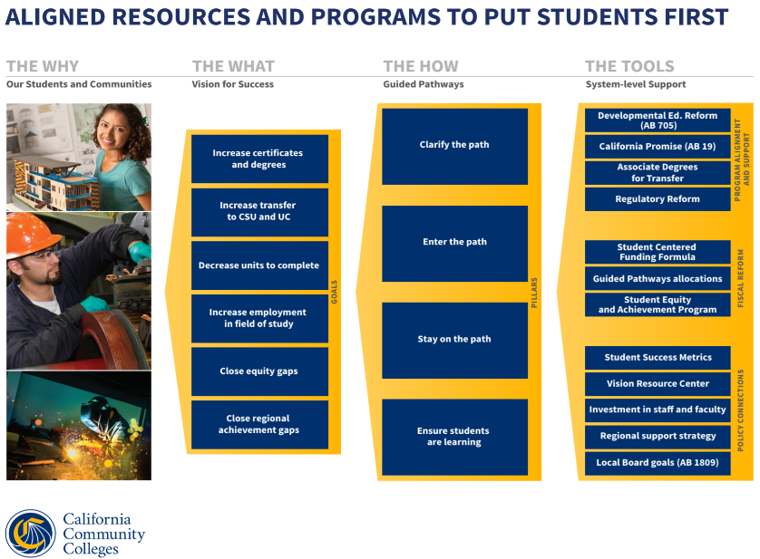

Slide 11
UPDATES:
  Credit for Prior Learning
  Competency Based Education
  Credit by Exam
  Changes to Title 5 Regulations

Slide 12

ACTIVITY
How can local Academic Senates stay informed?
How can information be shared with the local college faculty?
How can a college support informed decision-making related to systemwide changes and updates?

Slide 13

QUESTIONS…& THANK YOU!
Dolores Davison
davisondolores@fhda.edu
Alice Perez
aperez@cccco.edu
Carrie Roberson
robersonca@butte.edu

