Slide 1
NUTURING AN ANTI-RACIST CAMPUS CULTURE DURING CONSTANT CHANGE
California Community Colleges Chancellor’s Office

Slide 2
Equity
Framework
Personal Equity
Institutional Equity
Professional Equity
Personally, individuals practice self-awareness and equity-mindedness; making a commitment to equitable educational practices; learning to recognize and combat personal biases.
Administrators, faculty & staff utilize equity-based practices to effectively support and actualize success for disproportionately impacted and marginalized populations.
College policies, practices, processes, curricula and structures actualize success for disproportionately impacted and marginalized populations.

Slide 3
DEI Integration Plan
Leadership and Engagement
Policy Development
Stakeholder Collaboration and Coordination
Professional Development/Resource Deployment Plan
Building Local and Legislative Support
Cultivating Cultural Change
Promoting Model Practices and Colleges
Evaluation and Continuous Improvement
Providing Statewide Communication and Guidance

Slide 4
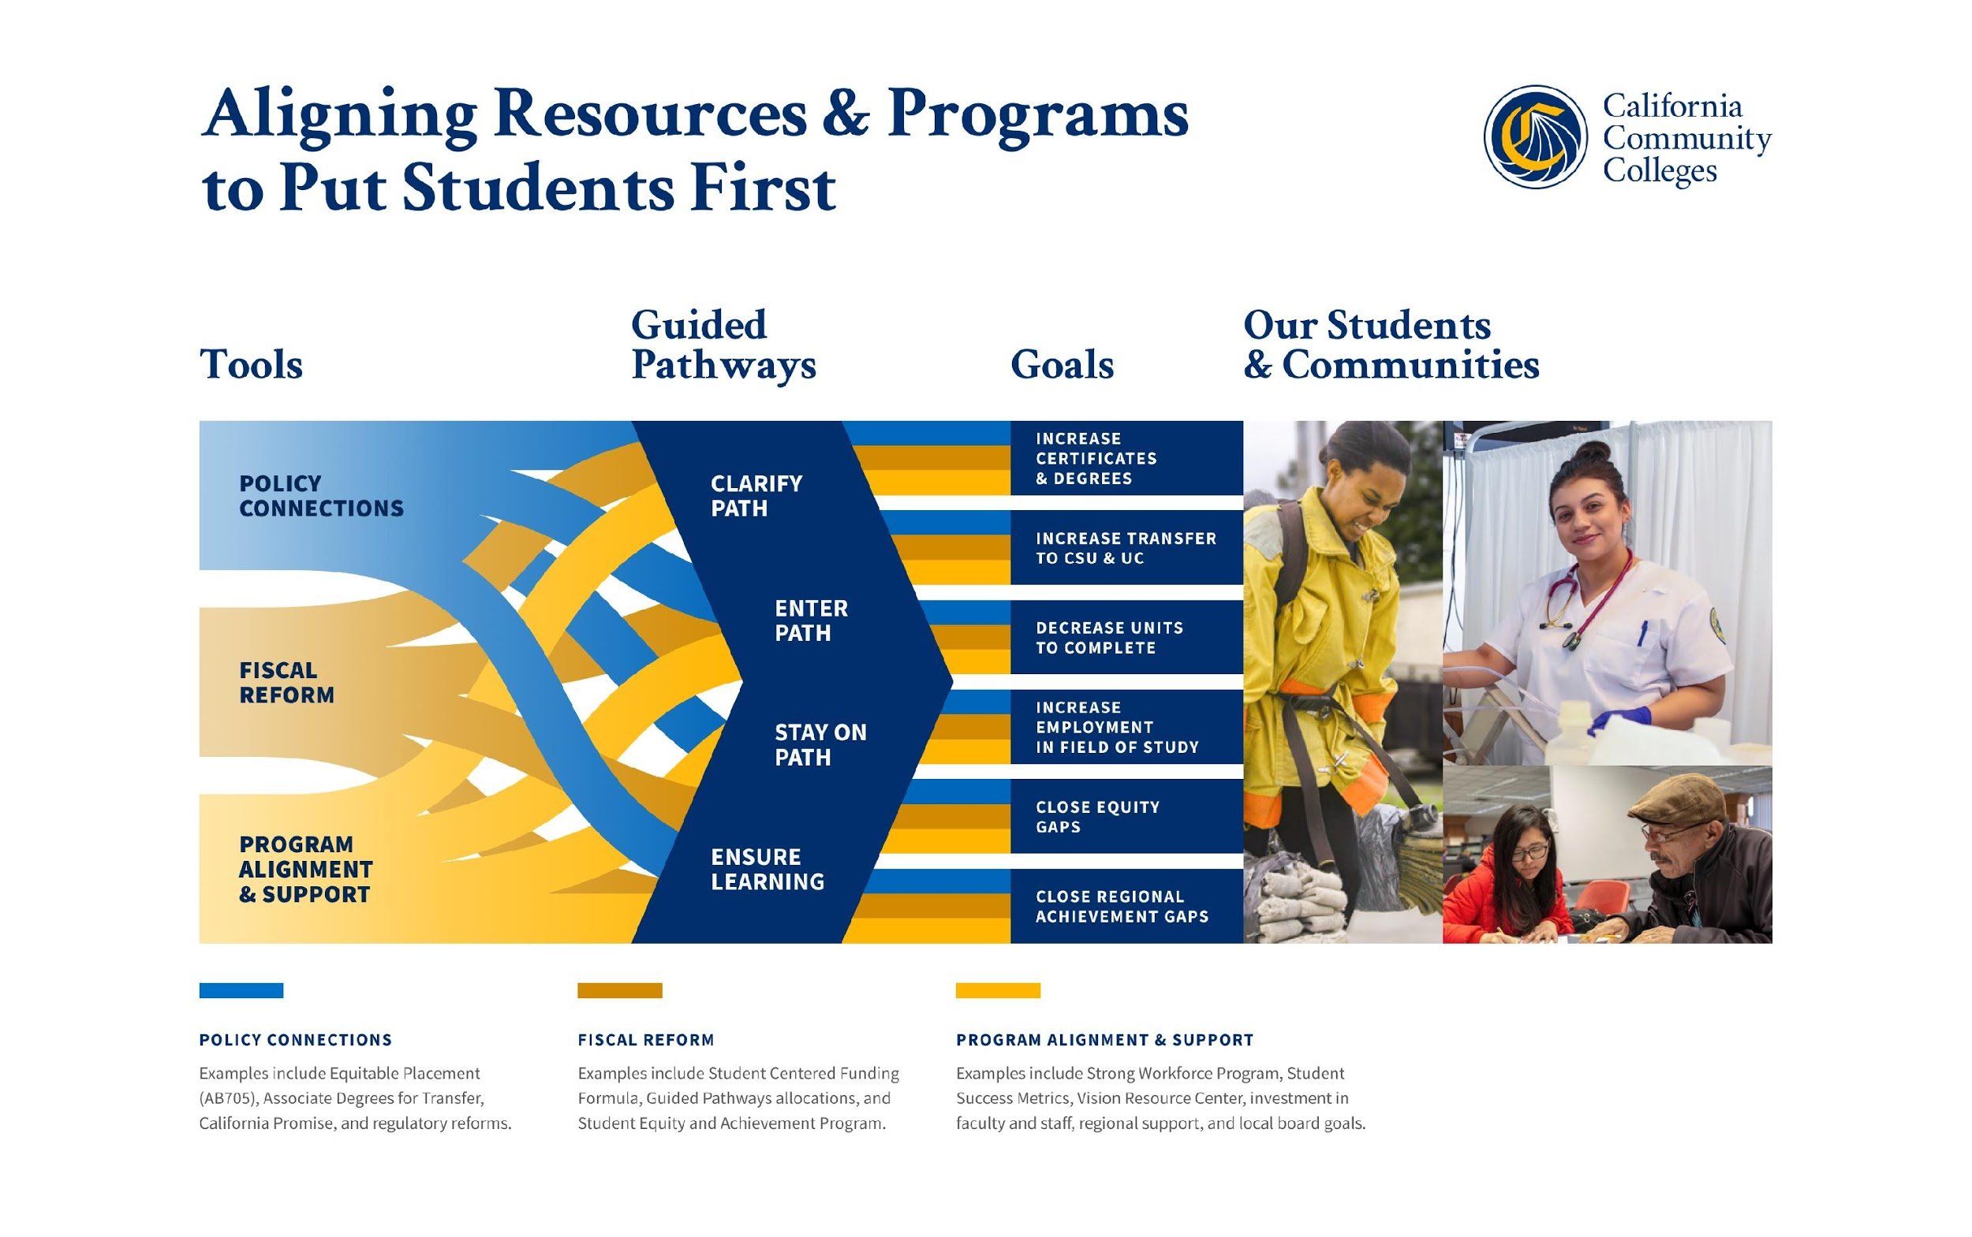

Slide 5

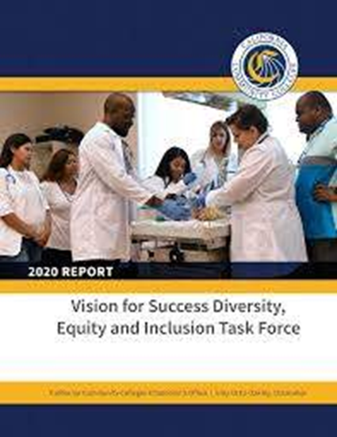
Transforming a Culture
Compliance
Institutionalizing and Integrating DEI
Minimum Qualifications/
Competencies
Hiring Advertisement & Recruitment
Professional Development & Required Training
Centralized tools (i.e. modules and fellowship)
Evaluations and Tenure Review
Transforming campus culture

Slide 6
Inclusive & Anti-Racist Institutions
Universal
Design
Basic Needs
(addressing social determinants to student success)
Resource
Allocation (i.e.
SCFF, etc.)
Classroom and
Campus Climate
Equitable
Hiring Practices
Anti-racist
Pedagogy,
Andragogy,
and Curriculum
Streamlined Reporting
6

Slide 7
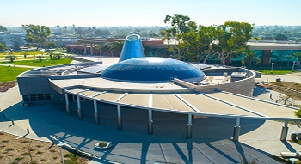
Anti-Racist Institutions
Have Culturally Relevant Curriculum
Integrate and analyze equity gaps
Adopt and embrace policies and practices that are anti-racist.
Validate Students via hiring employees that reflect them.
Professional Development and Supports
Notes:
How do we operationalize equity and design with equity in mind?
This framework calls upon each of us to think deeply about the ways in which, although there are power asymmetries within institutional hierarchies, each of us experiences and exercises some measure power and privilege in our respective positions. We will be expected to interrogate the status quo, examine old assumptions about what is or has worked in the past, test new approaches to solving persistent gaps in opportunities and achievement and be unafraid of iteration.
That means imagining systems anew through a change paradigm that is inherently disruptive but most certainly, necessary. Each of us, individually and in our respective teams, will be responsible for empowering and enabling strategic and systematic thinking, innovation and actions internally and partnering with stakeholders in the Field, who are seeking guidance and support, to effectuate system wide change and align student outcomes with our values.

Slide 8



Mindset Shift: Disrupting the Status Quo
State
Associations
Districts
Colleges
Accreditation
State
Associations
Districts
Colleges
Accreditation

Slide 9
Evolution: From Initiatives to Outcomes
Do institutional set standards meet the identified mission and standards for student performance?
Does the data collected and reviewed demonstrate progress towards institutional set standards?
How are institutional learning environments designed for equitable student outcomes?
How has the data collected and reviewed demonstrate assessment and effective planning for student success achievement and learning?

Slide 10
Collective Transformation
Member Institutions
Accrediting Institutions
Mission and Vision
Institutional Set-Standards
Codification into policies, measurement tools and professional development
Intentional integration! (We should see your ACTIONS through your: policy, program and fiscal procedures.)
Mission and Vision
Codification into measurement tools and policies
Training for Peer Review Teams and Chairs
Support and Educational Programming (Who are we elevating/rewarding?)

Slide 11
Not a moment in time. A movement!
Level 1: Compliance
Level 2: Programmatic Evolution
Level 3: Integrated Local Transformation
Level 4: Cross-System and Institutional Leadership Transformations
Compliance
And we are all called to become equity-centered leaders.

Slide 12
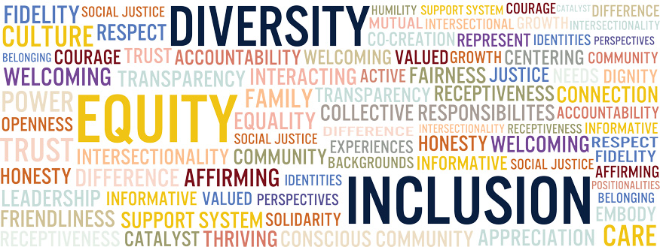
Thank you so much!!

