Slide 1
Noncredit 101: A Crash Course in Noncredit Curriculum Development

Slide 2
Chat it up!
Using the chat…
Please share: you name, position, and college in addition to your familiarity with noncredit curriculum

Slide 3
Presenter
Garrett Rieck
Faculty Director of Adult and Continuing Education
School of Personal and Professional Learning, College of the Canyons
Board Member
Association of Community and Continuing Education (ACCE)

Slide 4
Program Description
The past few years have seen a noticeable increase in noncredit education in the California community college system. While noncredit programs have been advocated as a promising way to address educational equity, there are varied topics of noncredit education to explore. Join us in dialogue and discussion on the categories of noncredit, mirrored classes, noncredit course completion factors, and local/state compliance.

Slide 5
Learning Outcomes
During this presentation you will learn…
The basics of noncredit curriculum, including an introduction to terms like Career Development and College Preparation (CDCP) noncredit and the ten instructional categories
Considerations for incorporating noncredit courses and programs into curriculum offerings
The possibilities for integrating noncredit into instructional programs
Practical tips for developing noncredit curriculum
and much more!

Slide 6
What is Noncredit? A brief history and guiding philosophy
First adult school in California in 1865
Important contributor to “open access” for students with diverse backgrounds
Tuition free
Can be a first point of entry
Transition point to credit instruction and the workforce
Courses focus on skill attainment, not grades or units
Flexible course scheduling

Slide 7
What is Noncredit? Guiding Philosophy
Flexible
Equity Centered
Competency Focused
Flexible course scheduling
Open Entry/Open Exit
Open Access
First point of entry for underserved students
Low and no-cost courses
Prepares students for credit instruction and workforce opportunities
Focus is on skill attainment, not grades or units

Slide 8
Noncredit Instructional Categories Eligible for Apportionment
[EC § 84757; Title 5 § 58160] | [CDCP: EC § 84760.5; Title 5 § 55151]
ESL
Immigrant Education
Workforce Preparation
Short-term Vocational
Elementary and Secondary Basic Skills
Noncredit Course Categories
Note: A noncredit instructional category that is outlined/circled in red denotes an instructional category in which eligible noncredit courses may be sequenced to lead to a Career Development and College Preparation (CDCP) (“enhanced funding”) certificate program, pursuant to
Ed Code § 84760.5.
STREAMLINED APPROVAL!
Noncredit courses are approved by districts and “chaptered” by CCCCO via the CO Curriculum Inventory (COCI)
Older Adults
Health and Safety
Refer to PCAH for specific curriculum submission requirements applicable to each category
Home Economics
Substantial Disabilities
Parenting
Notes:
Noncredit course categories that are eligible for State apportionment, per EDC section 84757 (9 categories defined in EDC; 10th category (workforce preparation) defined in Title 5 section 55151)
Underlined categories are CDCP enhanced funding (EDC 84760.5(b); Title 5 section 55151 – CDCP)

Slide 9
Noncredit Programs
Certificate of Competency
Noncredit Pre-apprenticeship
NONCREDIT PROGRAMS
Certificate of Completion
Note:
Programs circled in red are CDCP (Career Development and College Preparation).
CO “approval” is currently required for CDCP programs in the instructional domain of short-term vocational with high employment potential. The short-term vocational CDCP program is in the certificate of completion group
[References: EC 84760.5; Title 5, 55151]
STREAMLINED APPROVAL!
Noncredit programs are approved by districts and “chaptered” by CCCCO via the CO Curriculum Inventory (COCI). Streamlined approval does not include CDCP programs in the instructional domain of “short-term vocational with high employment potential”; CCCCO review and approval is required
Adult High School Diploma
(AHSD)
The underlined programs are eligible for CDCP enhanced funding, EDC 84760.5 (b)
Notes:
- Noncredit Programs, Title 5 section 55155
- Underlined programs are CDCP (EDC 84760.5; Title 5 section 55151)
- AHSD, see Title 5 section 55154

Slide 10
Career Development and College Preparation (CDCP) Programs
Edu Code 84760.5 (b) -
Limits CDCP eligibility to courses in the following instructional domains:
Workforce Preparation
* Short-term Vocational
With High Employment Potential
Elementary and Secondary Basic Skills
English as a second language (ESL) and
vocational English as a second language
*CCCCO approval is required
Certificate of Completion
Title 5,
§ 55151(h)
Career Development
Certificate of Competency
Title 5,
§ 55151(i)
College Preparation
Notes:
Education Code section 84760.5 provides the fundamental framework for defining CDCP noncredit courses and classes that are eligible for enhanced funding.
Only courses subject to subdivision (b) of 84760.5 are eligible for enhanced funding, which limits eligibility to the following:
- Classes and courses in elementary and secondary basic skills;
- Classes and courses for students eligible for educational services in workforce preparation classes in the basic skills of speaking, listening, reading, writing, mathematics, decision-making and problem-solving skills that are necessary to participate in job-specific technical training;
- Short-term vocational programs with high employment potential, as determined by the California Community Colleges chancellor in consultation with the Employment Development Department utilizing job demand data provided by that department; and
- Classes and courses in English as a second language and vocational English as a second language.

Slide 11
Labor Market Information for Short-Term Vocational Programs
For short-term vocational program proposals colleges must provide evidence of high employment potential in one of two ways:
They can identify the area of instruction on the list of occupational titles with high employment potential (http://www.labormarketinfo.ca.gov) or attach another data source containing current labor market or job availability data with an explanation of how the data is verified.
If LMI is limited or not available, other data sources may include:
Recent employer surveys
Industry studies
Regional economic studies
Letters from employers attesting to the service area need
Minutes of industry advisory committee meetings (beyond required advisory committee meeting minutes)
Job advertisements for positions in the individual college’s service area
Newspaper or magazine articles on industry or employment trends
Applicable studies or data from licensing agencies or professional associations

Slide 12
Noncredit Course Outline of Record (COR)
All courses are required to have an official course outline of record
Current CORs must be maintained in the official college files (paper or electronic database) and made available to each instructor.
COR must meet standards in title 5, § 55002 (c) and contain components described in subsection (2):
“[(2)] Course Outline of Record. The course is described in a course outline of record that shall be maintained in the official college files and made available to each instructor. The course outline of record shall specify the number of contact hours normally required for a student to complete the course, the catalog description, the objectives, contents in terms of a specific body of knowledge, instructional methodology, examples of assignments and/or activities, and methods of evaluation.”
The COR of noncredit distance education courses must specify the expected hours of outside-of-class student work if trying to collect apportionment for those hours.

Slide 13
Side-by-Side Comparison of COR Requirements
CREDIT
NONCREDIT
Total contact hours for course
Catalog description
Objectives
Content (typically in outline form)
Assignments and activities
Methods of instruction
Methods of evaluation/grading policy
Unit value
Total contact hours for course
Conditions of enrollment: requisites, advisories, other conditions
Catalog description
Objectives
Content (typically in outline form)
Reading and Writing Assignments
Other outside-of-class assignments
Methods of instruction
Methods of evaluation/grading policy

Slide 14
Noncredit Curriculum Considerations
While there are no registration fees for noncredit courses, other fees may be charged
Materials fees may be charged:
Must meet the same standards of documentation as materials fees for credit courses
Many colleges try to limit or eliminate materials fees using grant and categorical funding
Noncredit courses may require textbooks, but many colleges consider no- and low-cost alternatives:
Classroom sets
OER
Lending library
Grant funding

Slide 15
MQ’s Noncredit
Title 5 § 53412 lists the minimum qualifications (MQs) to teach noncredit. Although some MQs are the same as for credit instruction (i.e., §53410), some areas have different MQs including: Basic skills mathematics and English, English as a Second Language, health and safety, citizenship, home economics and older adults
The Minimum Qualifications Handbook (also called the Disciplines List) details the requirements.

Slide 16
Teaching Considerations
Unique challenges
Open-entry/open exit environment
Varying gaps in the academic knowledge
Pedagogy becomes increasingly important
Scaffold lessons
Faculty who understand noncredit students

Slide 17
Collaboration between Credit and Noncredit
Noncredit Support Courses. These courses are designed together with credit faculty to support students who are currently enrolled or are preparing to enroll in credit courses.
Some options include
Corequisite support courses
Modularized support courses
Intensive review courses
Mirrored courses (more on this on the next slide)
Partnerships between credit and noncredit faculty can be an effective way to help students meet their educational goals
Courses that build bridges between credit and noncredit can be a way to introduce noncredit offerings to faculty that typically teach credit courses

Slide 18
Mirrored Credit and Noncredit Courses
Credit and noncredit course with identical course outline of record.
Usually seen in ESL and short-term vocational classes.
Creates pathways for the adult noncredit learners.
Courses are scheduled at the same time with one instructor teaching all students.
Sections are typically crossed listed with a specified amount of seats in the credit and noncredit sections.
Noncredit students attend all class sessions and complete the same work as the credit students.
Noncredit students cannot earn units for successfully completing the course, but they can earn a certificate

Slide 19
Mirrored Courses (Cont.)
Helpful for students that are transitioning from noncredit to credit.
Low-stakes option for students who want to:
attempt a course
need extra time mastering the content
don’t qualify for financial aid
Provides a unique opportunity for students to explore the rigor and expectation of credit courses without the pressure of
tuition fees
failing grade
repeatability restrictions
Credit for Prior Learning (CPL) can be used to earn units at a later time.

Slide 20
From Noncredit to Credit: Providing a Guided Pathway for Students
For noncredit students seeking to transition into credit programs transition specialists can provide an important safety net.
Some crucial areas of support include:
Career and academic counseling
Financial aid services
Academic support including tutoring
Supportive Services such as CalWORKs, CAEP, EOPS and DSPS

Slide 21
Practical Tips for Developing Noncredit Curriculum

Slide 22
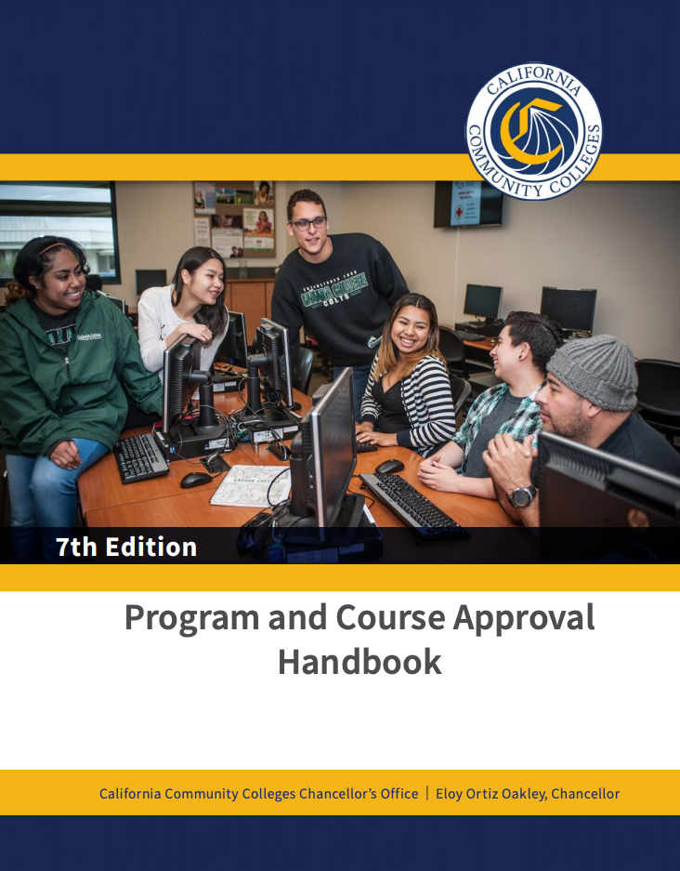
Tip #1: Read the PCAH! Specifically, pages 97-137

Slide 23
Tip #2: Do your Homework
There are specific TOP codes that must be used for each category of noncredit.
Being familiar with TOP Codes will help you determine which category of noncredit is most appropriate for the curriculum you’re developing.
What noncredit curriculum currently exists at other colleges?
Use COCI 2.0 and your Curriculum Specialist to answer that question
Research Labor Market Demand
onetonline.org
EDD’s LMI System: http://www.labormarketinfo.edd.ca.gov
Centers of Excellence for Labor Market Research: http://coeccc.net/Supply-and-Demand.aspx

Slide 24
Tip #2: Do your Homework (cont’d)
Attend advisory board meetings
What short-term vocational programs can increase the employability of students?
What skill gaps can be covered in noncredit?
Ask for help!
CCC Chancellor’s Office
Other noncredit faculty
Association of Continuing and Community Education (ACCE)
Noncredit is new to many, but there are also many experienced NC practitioners (Mt. SAC, NOCE, SDCE, etc.)

Slide 25
Tip #3: Attend Conferences and Workshops
ASCCC 2021 Curriculum Institute - Virtual Event link
Association for Continuing and Community Education (ACCE)
Several workshops and conferences offered throughout the year
Visit acceonline.org for details on upcoming events
First Friday Webinars link
Webinars are conducted in collaboration with noncredit practitioners from ACCE, ASCCC, Career Ladders Project, and the CCC Success Network (3CSN)

Slide 26
Tip #4: Breakdown Silos!
Start developing a culture of cross campus collaboration
Credit faculty may know very little about noncredit
Pass on your knowledge!
Benefits of collaboration between credit and noncredit:
Fill skills gaps
Close the equity gap
Increase access to learning opportunities
Develop support courses
Address advisory committee needs
Create a comfortable environment for first time or returning college students
And much more!
You know nothing, credit faculty.

Slide 27
Noncredit Resources
Academic Senate CCC http://asccc.org
CCC Chancellor’s Office http://cccco.edu
Vision Resource Center https://visionresourcecenter.cccco.edu/
California Adult Education Program https://caladulted.org/
Association of Community and Continuing Education (ACCE) http://www.acceonline.org/
California Council of Adult Educators (CCAE) https://www.ccaestate.org/
LaunchBoard https://www.calpassplus.org/LaunchBoard/Home.aspx

Slide 29
Thank you for attending
Wendy Brill-Wynkoop, Noncredit & Basic Skills Committee
Wendy.Brill@canyons.edu
Garrett Rieck, College of the Canyons
Garrett.Rieck@canyons.edu

