Slide 1
The Chancellor’s Office Curriculum Inventory – Using it, and for How Long?
Marty Alvarado, Executive Vice Chancellor of Educational Services, CCCCO
Virginia Guleff, Vice President of Instruction, Butte College
Ginni May, ASCCC Treasurer, 2018-19 Curriculum Chair
Curriculum Institute, Hyatt Regency San Francisco Airport
July 11, 2019, 2:15-3:30

Slide 2
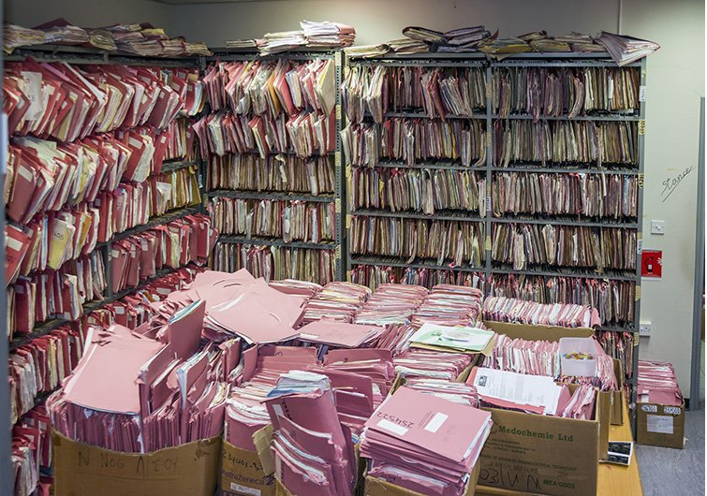
Presentation Description
With 114 colleges in the California Community College system, finding an efficient and effective curriculum inventory or repository system has turned out to be easier said than done. Join us as we discuss the history and future of the Chancellor’s Office curriculum inventory system(s).

Slide 3
Overview
Need and Purpose of a Chancellor’s Office curriculum inventory system
History of curriculum inventory systems at the Chancellor’s Office
State of COCI
Future of the Chancellor’s Office curriculum inventory system
Discussion

Slide 4
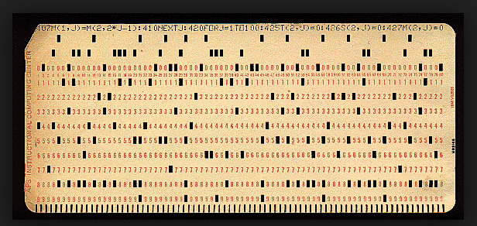
Need and Purpose

Slide 5
Curriculum Inventory System
Current Role
Provides a mechanism for colleges to submit their approved curriculum for the Chancellor’s Office to review and chapter
Houses colleges’ locally approved and CO chaptered curriculum
Provides control numbers for courses and programs quickly

Slide 6
History

Slide 7
History of Chancellors Office Curriculum Inventory (COCI)
2011 – The Chancellors Office contracted with Governet to provide a curriculum inventory product. Prior to 2011 all curriculum management was done on paper. The Governet product functionality proved to be limited and created processing issues for the Chancellors Office & the Colleges.
2016 –The decision was made to sever ties with Governet and turn the continued development of COCI over to the CCC Tech Center.
2016-2017 – The CCC Tech Center in conjunction worked to transition the Governet system into a CC Developed system.
July 2017 – COCI went live with the Chancellors Office and the Colleges we serve.

Slide 9
Additional History
Curriculum approval was slow – paper processes to Governet
Fall 2016 – North/Far North Regional Consortium had grant to set up a streamlined curriculum approval process in response to the Strong Workforce Recommendations
ASCCC asserted that curriculum processes fall under academic and professional matters and joined project with CCCCO
5C began discussions on streamlining curriculum approval processes
Title 5 Regulations needed to be changed to allow for streamlining curriculum approval processes – 2016-17 academic year
COCI went live July 2017

Slide 11
State of COCI

Slide 12
COCI
State of COCI (current system)
Went live July 2017
Curriculum inventory system that was built to:
Facilitate streamlining of curriculum approval processes
Generate control numbers in a timely fashion
Replace Governet
Some are satisfied and some are not
Updates and improvements continue

Slide 13
Ongoing issues in the transition of COCI
Parity with the Governet system was never achieved.
Delays in enhancements of required functionality due to “hot fixes” requiring immediate attention.
No “save” option for nearly 18 months
Options for generating control numbers
Data is not clean – Inaccurate record of curriculum within the system.
Data lost in transition from Governet to the Tech Center
Cleanup continues to require manual intervention from the CCCCO and College
Basic and Enhanced functionality is required to support the Colleges as well as needs of the CCCCO.
Integration of systems
Document Management
Program workflows – certificates
Enhanced Course & Program validation
Information & Reports
User Experience
ADT and Transfer Course functionality

Slide 14
18-19 COCI Roadmap
2018 – A “COCI Roadmap” was requested from the Tech Center
For the first time a list of all outstanding issues and the agreed upon timeframe for which these fixes & enhancements will be completed was provided.
Prior to this request, a complete list or “Roadmap” didn’t exist. Issues, fixes & enhancement requests were sent to the Tech Center one by one creating additional issues
“Hot fixes” (i.e. Ad hoc issues based upon system failures) are necessarily prioritized, causing the outstanding issues to continue to be delayed.
Deadlines were hard to meet and releases were generally not completed on time.

Slide 15
18-19 COCI Roadmap
The “roadmap” supported progress in some areas, however critical requirements were determined to be “out of scope“:
Dynamic reporting interface or on-demand self-generated reporting tool
Integration with applications other than MIS, requiring all other potential integrations to be managed as separate projects.
Custom data extracts or overrides for colleges.
Application support for users not associated with a CCC, a college district or the CCCCO.
Real-time integration with the local college stand-alone curriculum management system
Ingesting catalog data from the colleges (descriptions, pre-prerequisites, co-requisites) not currently included in the COCI work plan.
The 18-19 work plan, going forward, is also highly dependent upon the CCCCO Academic Affairs team & College Curriculum specialists for testing, training development & execution.

Slide 16
The Future…

Slide 17
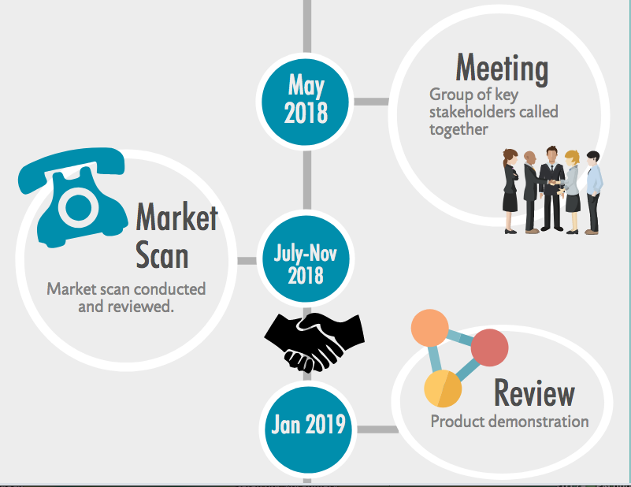

Slide 18
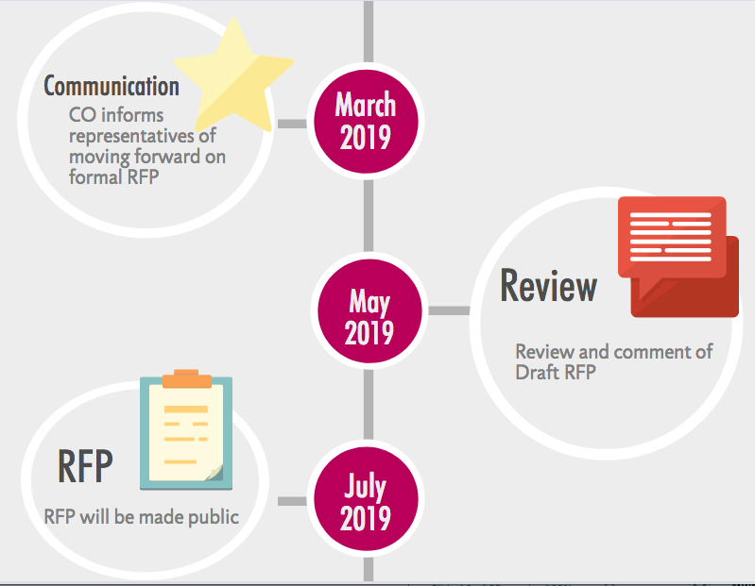

Slide 19
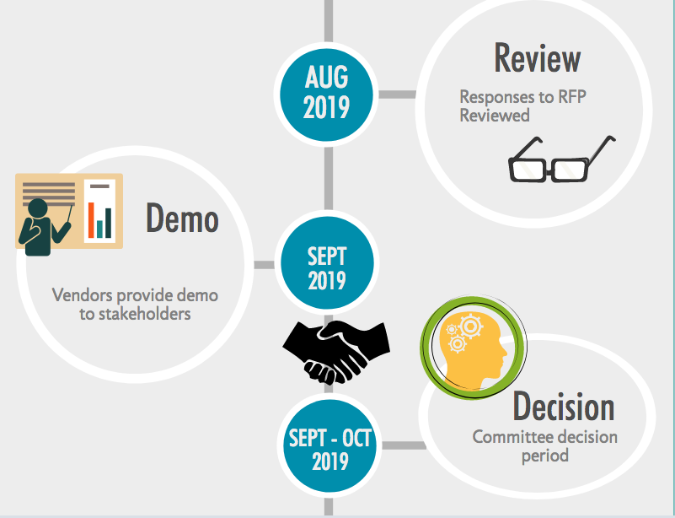

Slide 20
Discussion

Slide 21
Let’s Hear From You
What are your concerns with implementing a new Chancellor’s Office curriculum inventory system?
What are your needs for a Chancellor’s Office curriculum inventory system?
What would you like to see in a new Chancellor’s Office curriculum inventory system?

Slide 22
Thank You!

