Slide 1
Welcome! We’ll be with you shortly.
The chat will be used for questions and input.
All attendees will be muted upon entry.
You can find this presentation on the ASCCC website below.
ASCCC Guided Pathways RESOURCES https://www.asccc.org/guided-pathways
Notes:
Jessica Ayo

Slide 2
Using the SOAA as a Tool for Guided Pathways Reflection, Planning and Collaboration
Presenters:
Jessica Ayo Alabi, ASCCC Guided Pathways Faculty Lead, Orange Coast College Guided Pathways Onboarding Faculty Coordinator
Eric Thompson, ASCCC Guided Pathways Taskforce Member, Academic Senate President, Humanities Faculty, Santa Rosa Junior College
Notes:
Jessica Ayo

Slide 3
Bridging the Gap Between Credit and Noncredit using Guided Pathways – Debunking Myths and Creating Instruction
March 18, 2019 | 12 Noon – 1:00 PM – Register Now
Many colleges operate under major misconceptions about the type of education provided by noncredit. Guided Pathways implementation has caused many colleges to look at student needs in a different way. Join us for a basic understanding of noncredit purpose and outcomes, debunking some myths and steps to create and implement noncredit. We will discuss strategies for developing bridges and seamless transition from non-credit to credit programs and the onboarding experiences for non-credit students. We will also consider the question of how colleges can create parallel Guided Pathways processes for non-credit and exploring non-credit opportunities to help students transition to college.
Notes:
Jessica Ayo

Slide 4
Using the SOAA as a Tool for Guided Pathways Reflection, Planning and Collaboration
March 4, 2020 | 12 Noon – 1:00 PM
The Scale of Adoption Assessment (SOAA) was a tool created by the California Community College Research Center (CCRC) and modified by our California Community Colleges Chancellor’s Office (CCCCO) for colleges to submit regarding Guided Pathways money and strategies. In this webinar we will discuss some of the challenges and positive aspects of the tool that colleges have reported. Join us for tips and suggestions on how to improve your use of the document along with a few examples from a few colleges regarding the strategies to get input and use the tool with planning. This tool included your annual goals, getting ahead of your implementation by using the information you submitted as a self-evaluation tool. We will also use this as an opportunity to discuss how to better clarify and understand the roles of the different Guided Pathways groups such as your GP campus committees/teams, GP Liaisons, ASCCC GPTF, Academic Senates, shared governance groups, and GP Regional Coordinators and collaborate on design, implementation, and evaluation.
Notes:
Jessica Ayo

Slide 5
Who completed the Scale of Adoption Assessment at your college? Was it parceled out into different sections, completed in a group session, completed by one person, but edited by others or some other process?
Please answer in the Chat!

Slide 6
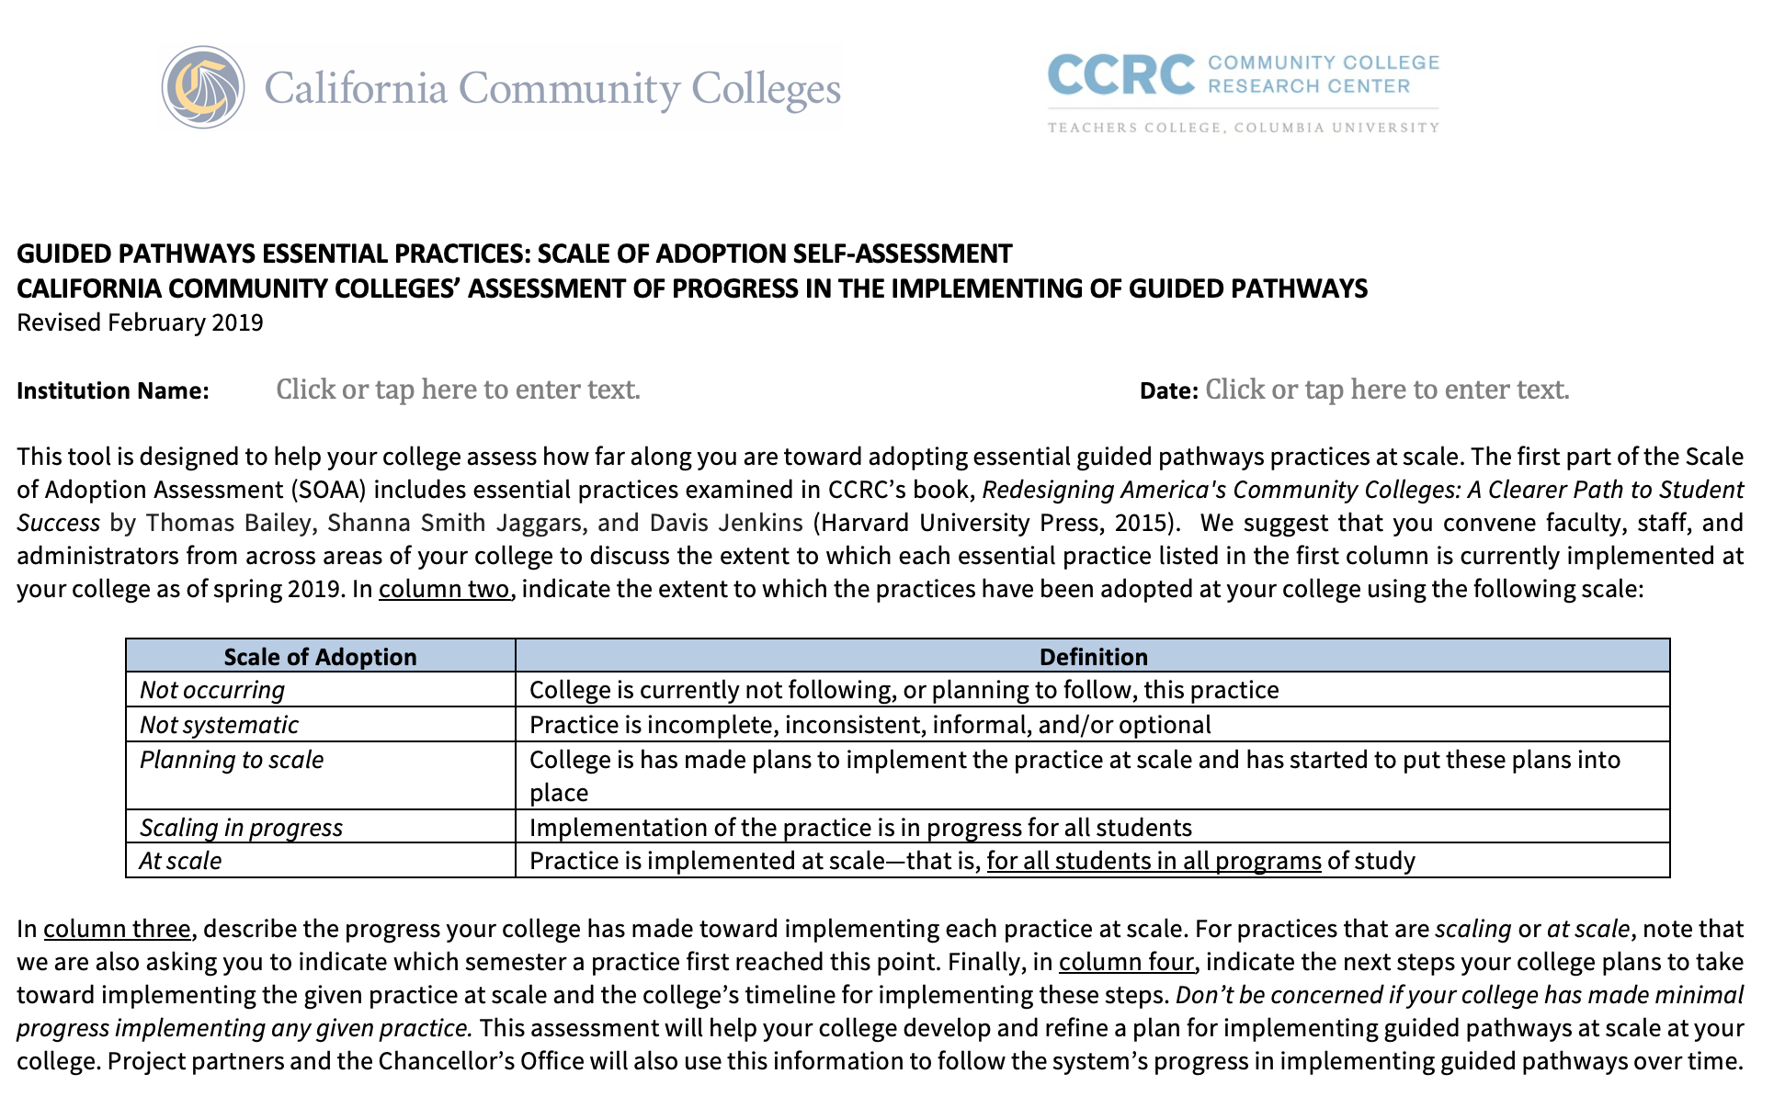
Scale of Adoption (SOAA) History
Original California template was created and distributed by CCCCO
A general analysis
CCRC assessment introduced
Current SOAA is the CCRC Scale of Adoption with additional questions and equity considerations from the CCCCO Regional Coordinators
Notes:
Jessica Ayo-
Initially an original template was created and distributed by CCCCO and a general analysis was done
Then CCRC (Community College Research Center) assessment was introduced
The thoughts were to get CA data and compare with National data and other GP colleges outside of CA
RP and others created an initial tool. All colleges were required to complete and submit it in order to get GP funding
Then the CCRC model was distributed and later the model due in March 2020 was constructed with additional factors needed to report to the legislature and an umbrella of equity

Slide 7
“CCRC developed the Guided Pathways Scale of Adoption in 2015 as a framework for helping colleges plan the implementation of guided pathways practices in four key domains
1) mapping pathways to student end goals;
2) helping students choose and enter a path;
3) helping students stay on their path…and finish strong;
4) ensuring that students are learning.
https://jfforg-prod-prime.s3.amazonaws.com/media/documents/CCRC_SOAA_Services_Descriptions_March_2018.pdf
Notes:
Eric
What is the intent of Scale of Adoption Assessment?
CCRC’s own description:
CCRC has developed summary reports for assessments for American College Counseling Association colleges’ pathways, which have been used to write progress reports to college leaders, policy makers, and funders and to plan capacity building events.”

Slide 8
Local Colleges’ Experiences with SOAA
Uh-oh’s and Ah-ha’s
Notes:
Eric

Slide 9
What challenges did your college encounter in completing the SOAA?
Please answer in the Chat!
Notes:
Jessica ayo

Slide 10
Challenges
Hard to find in NOVA
Click on Programs > then GUIDED PATHWAYS > then PROJECTS > your College
May feel like a “Straight-Jacket” working in tension with local understanding / control / interpretation/definition
You don’t have to do it all, and you can explain how local implementation expresses local culture
May not be terrifically conducive to collaboration
Notes:
Eric
If you can get a diverse group of people in one room working on it together, it can be a great focuser, but its home in NOVA doesn’t make that particularly easy

Slide 11
Example from Santa Rosa
Objectionable prompts with substantial resistance
For example:
Practice A: Pillar 3 (Staying on the Path)“Advisors monitor which program every student is in and how far along the student is toward completing the program requirements.”
It isn’t hard to see why faculty respond “surveillance culture” and “Big Brother”
Practice B: “Instruction across programs . . . engage students in active and applied learning, encouraging them to think critically, solve meaningful problems, and work and communicate effectively with others.
How does this relate to faculty autonomy & academic freedom?
Notes:
Eric
What do you do when a substantial amount of faculty, including GP leaders, finds the SOAA prompt objectionable?
(Note: This practice was added to SOAA in February 2019).”
This then becomes a tool for planning; mostly planning the Academic Senate Agenda for philosophical conversations about policing students and faculty this way.

Slide 12
The rating choices are not clear when the college is working on only some projects within a pillar or have limited ability to scale
Scale of Adoption | Definition
Not occurring | College is currently not following, or planning to follow, this practice
Not systematic | Practice is incomplete, inconsistent, informal, and/or optional
Planning to scale | College has made plans to implement the practice at scale and has started to put these plans into place
Scaling in progress | Implementation of the practice is in progress for all students
At scale | Practice is implemented at scale—that is, for all students in all programs of study
Notes:
Jessica Ayo
Discuss and describe the choices for responses what their scope may mean
Make a single appropriate choice of the 5 and make notes in the section on the right
Decide what At Scale means for you – an example, perhaps you have mypath or degree audit and it is at SCALE available for all pathways including CTE, certificate, noncredit but to improve you need all students to know where to go and how to use it.
Scaling in progress – the policy, plan and the processes are in are in place, but you are rolling it out as resources, rescheduling, restructuring or communication allows
Planning to scale – The policy and plans are in place, the timeline and people responsible are identified
Not systematic – perhaps practiced in an area, identified as the way forward but not
Not occurring is either not following or planning to follow

Slide 13
Governance Processes for Guided Pathways
A guided pathways structure that parallels governance. There may be points of intersection, but not necessarily integration. How sustainable is this?
College personnel report they are working on Guided Pathways, but critical decisions are made “over there”.
Moving towards integrating guided pathways and adaptation governance to support and advance guided pathways implementation while taking care of “regular business”.
Notes:
Jessica Ayo

Slide 14
Potential Issues as we continue…
Some colleges are stuck or parked because they have not designated timelines or final authorities.
One college worked diligently to identify meta-majors and program maps only to find that when the final structure was announced, changes had been negotiated, departments moved, etc. by others… beyond the final document.
Some GP teams are operating parallel or independent of normal governance processes; the Guided Pathways Liaisons are a critical piece to this
Communication and transparency issues - One college created a website that dated and recorded Guided Pathways work allowing people to see numerous iterations, dated, with explanations of the committees adopting the changes
Notes:
Jessica Ayo-
Use the task of the SOAA completion to document and timeline work going forward. Define terms that may have different meetings
Colleges are encouraged to implement Guided Pathways in ways that compliment their student populations and campus culture, and at the same, there are concerns about continuity around 10+1 issues, inclusion, student engagement, equity-minded….and we’re hearing that this continuity is lacking in many ways around the state.

Slide 15
Has your college benefitted from completing the SOAA? If so, please explain how.
Please answer in the Chat!
Notes:
Eric-

Slide 16
Positive Aspects of SOAA
It puts the whole GP process and framework together in one place
It helps facilitate participation of all essential constituents*
It affords reflection on institutional identity formation and self-assessment
Who are the stakeholders that should be at the table?
Notes:
Eric
*Should Include: GP liaisons, leads, team members (faculty, classified, students, administrators), presidents and vice presidents, and (above all) Academic Senates

Slide 17
How Careful Should I Be on My Answers?
In the national project several things were apparent:
Some colleges:
New to GP work--overestimated their adoption and work because they did not know the extent of the change
Those that were further along in their GP work, underestimated their work because it seemed like such a huge change
The SOAA should be used to get a good baseline
defined by your work
to scale and evaluate progress going forward
A tool to document what you have done
An opportunity to communicate to your campus
Notes:
Jessica
This is a self-evaluation tool. There are no standards for colleges as all 114 are extremely different and work at paces consistent with their resources, aligned with their mission and addressing diverse populations.
Because this is a self-evaluation tool – the meaning is dependent upon those who answer. Our experience in the national project was that many colleges began assessing themselves high until they realized all the work that needed to be done, in later evaluations they lowered their self evaluation – it looked like they were going backwards. Many factors and your knowledge may cause you to underestimate yourselves on certain areas, such as work on placement and equity.
Create a good baseline that subsequent colleagues can follow
One way to do this is by effectively using you governance process

Slide 18
SOAA as a Tool to Integrate Guided Pathways into the Governance Structures
Notes:
The more groups included the more critical mass of informed and participating constituents you have. You may think that you do not want certain comments made, but it is better to have them through the process than as a barrier at the end - even if after adoption. This work involves many perspectives and people of varying expertise - respect them allow.

Slide 19
Customization of the SOAA as a Tool
Create an opportunity for review
Open discussions for input
Document you progress
Plan on-going work, proposals, and recommendations
Disseminate knowledge of the constellation of initiatives collectively called Guided Pathways
Use it as a communication tool
Evaluate the effectiveness of your governance processes
Shift from an institutional to a student perspective
Notes:
Jessica Ayo
How to use SOAA as a strategic planning tool vs. compliance
Communication
Transparency
Across the institution - don’t give the task to the small group that does it - like the basic skills work or the onboarding.
Give people a chance to share their data
Base it on evidence - we think we are at scale - why, how etc
Explain the issue with language
Particularly some language inconsistent with California
Special supports are provided to help academically underprepared students to succeed in the “gateway” courses for the college’s major program areas. We do not use the term Gateway
Intensive support is provided to help very poorly prepared students to succeed in college-level courses as soon as possible. We do not highlight VERY POORLY PREPARED students but rather speak to providing the kind of support students need when they need it.
Describe the importance of governance
To make the SOAA plan integrated with all other plans

Slide 20
SOAA and Accreditation
What is the purpose of accreditation? Meet the standards, right? What do the standards consist of?
Standard I: Mission, Academic Quality and Institutional Effectiveness, and Integrity
Standard II: Student Learning Programs and Support Services
Standard III: Resources
Standard IV: Leadership and Governance
When we look at the questions on the SOAA, could we be duplicating our work?
Should we be using this document to think more broadly about how to Guided Pathways is impacting our Standards?
Should there be more collaboration between groups, who don’t normally meet together?
Notes:
Jessica Ayo

Slide 21
Did your college involve students in the SOAA process? If so, how?
Please answer in the Chat!
Notes:
Jessica

Slide 22
Guided Pathways and Equity… …Light at the End of the Tunnel!
One of the main ways the Chancellor’s Office has modified the SOAA is by adding “Equity Considerations” to each section.
The purpose of these is to frame GP as fundamentally about equity, and provide an equity beacon to which all answers should refer.
Was this accomplished?
Notes:
Eric

Slide 23
Pillar 1 Equity Considerations
Equity and Clarifying the Path
Website and program pages should be easy to navigate and understand
Accessible for historically underrepresented and/or underserved in higher education
(e.g., racial/ethnic minority students, lower-income students, first-generation students, students with disabilities, indigenous students, formerly incarcerated students, veterans, undocumented students, etc.).
Explain financial costs, potential debt, and economic benefits of program completion
Clarify differences in earnings potential between related certificates and degrees and across levels of educational attainment.
Notes:
Eric-
Website and program pages should be easy to navigate and understand for students and families without prior experience with higher education.
Access to and use of this information should be equitable for students who have been historically underrepresented and/or underserved in higher education (e.g., racial/ethnic minority students, lower-income students, first-generation students, students with disabilities, indigenous students, formerly incarcerated students, veterans, undocumented students, etc.).
Financial costs, potential debt, and economic benefits of program completion (including paths to program-relevant regional employment, projected earnings, and transfer outcomes) should be made clear for prospective students. Program websites should clarify differences in earnings potential between related certificates and degrees and across levels of educational attainment.

Slide 24
Pillar 2 Equity Considerations
Equity and Getting Students on the Path
Assess whether historically underrepresented and high needs students are disproportionately enrolled in programs that lead to lower remuneration careers.
For critical program courses, disaggregate enrollment, pass rate, and subsequent success data by student characteristics.
Proactively partner with feeder high schools that serve predominantly underrepresented and high needs students.
Make dual enrollment opportunities available to high school students who are deemed “not yet college ready”.
Build bridges to high-opportunity college programs for students in adult basic skills programs.
Notes:
Jessica Ayo-
Assess whether historically underrepresented and high needs students are disproportionately enrolled in programs that lead to lower remuneration careers. Consider how to help underrepresented students raise their educational and career expectations while at the same time meeting their more immediate economic needs.
For critical program courses, disaggregate enrollment, pass rate, and subsequent success data by student characteristics. Employ strategies to improve overall student success in these courses.
Proactively partner with feeder high schools that serve predominantly underrepresented and high needs students to help students explore academic and career interests and develop viable plans for college. Dual enrollment opportunities should be made available to high school students who are deemed “not yet college ready”. Build bridges to high-opportunity college programs for students in adult basic skills programs.

Slide 25
Pillar 3 Equity Considerations
Equity and Helping Students Stay on the Path
Incorporate engaging, proactive, and culturally relevant advising
Ensure that underrepresented students are not disproportionately directed away from competitive, limited access programs.
Integrate academic and student support services into pathways
Ensure that low-income students' financial stability are being met so they can make progress toward program completion.
Notes:
Eric
Support advisors to incorporate engaging, proactive, and culturally relevant advising practices to better support underrepresented students’ success in their programs.
Ensure that underrepresented students are not disproportionately directed away from competitive, limited access programs.
Integrate academic and student support services into pathways so that the support is unavoidable and therefore less stigmatized.
Ensure that low-income students' financial stability needs (e.g., nutrition, transportation, childcare, public benefits, emergency assistance) are being met so they can make progress toward program completion.

Slide 26
Pillar 4 Equity Considerations
Equity and Ensured Learning
Ensure that underrepresented students participate in program-relevant active and experiential learning opportunities.
Align course assignments with program learning outcomes
Support faculty to implement pedagogical changes that better support learning outcomes success for underrepresented students
Identify opportunities for faculty or advisors to critically examine their role in advancing equity-minded teaching and advising practices
Disaggregate program learning outcomes data, program retention and completion data, and other assessment measures by race, income, age, and gender to examine equity gaps.
Notes:
Jessica Ayo-
Ensure that underrepresented students participate in program-relevant active and experiential learning opportunities.
As faculty make curricular changes to better align course assignments with program learning outcomes, support faculty to implement pedagogical changes that better support learning outcomes success for underrepresented students (e.g., culturally responsive teaching).
Identify opportunities for faculty or advisors to critically examine their role in advancing equity-minded teaching and advising practices at the college (e.g., critically examining the role of unconscious bias in the classroom or advising that could affect student aspirations for a particular field and/or program selection).
Disaggregate program learning outcomes data, program retention and completion data, and other assessment measures by race, income, age, and gender to examine equity gaps. Ensure this data is disseminated and discussed among college staff, with students, and with the outside community.

Slide 27
What was the process of getting your senate’s approval like? Easy, difficult, collaborative?
Please answer in the Chat!
Notes:
Eric

Slide 28
Student Centered, Faculty Driven
Role of the academic Senate
The whole Senate, as the elected representatives of the whole faculty, should participate in the conversation
What does the AS president’s signature mean?
It should mean the majority of senators understand and approve what is being signed
Two lights, our beacon
Notes:
Eric-

Slide 29
Remember to use the Resources!
Notes:
Eric

Slide 30
Questions
Notes:
Eric

Slide 31
Bridging the Gap Between Credit and Noncredit using Guided Pathways – Debunking Myths and Creating Instruction
March 18, 2019 | 12 Noon – 1:00 PM – Register Now
Many colleges operate under major misconceptions about the type of education provided by noncredit. Guided Pathways implementation has caused many colleges to look at student needs in a different way. Join us for a basic understanding of noncredit purpose and outcomes, debunking some myths and steps to create and implement noncredit. We will discuss strategies for developing bridges and seamless transition from non-credit to credit programs and the onboarding experiences for non-credit students. We will also consider the question of how colleges can create parallel Guided Pathways processes for non-credit and exploring non-credit opportunities to help students transition to college.
Notes:
Jessica Ayo

Slide 32
Additional Resources
ASCCC GP Canvas - https://tinyurl.com/CCC-GP2018
ASCCC Guided Pathways RESOURCES https://www.asccc.org/guided-pathways
Searchable Calendar of Events https://asccc.org/calendar/list/events
GP Newsletter https://asccc.org/signup-newsletters
Quick Access link: https://tinyurl.com/CCC-GP2018
For Technical Visit email: info@asccc.org
Notes:
Jessica Ayo

