Slide 1
Program Mapping and “Meta-Majors”: Exploring the Issues
Julie Bruno, Guided Pathways Lead Coordination, ASCCC Past President, Sierra College
Janet Fulks, Guided Pathways Lead for Capacity Building, Bakersfield College
Virginia May, ASCCC Treasurer, 2018-19 Curriculum Chair,
Sacramento City College
Friday September 14 1:00-2:15 PM

Slide 2
What are the intended outcomes?
Outcome #1 Using the worksheet, identify key needs for your college and plan discussions
Outcome #2 Analyze how to facilitate discussions about the role and benefits of metamajors
Providing the ability to message and support students at critical points
Linking degree results with both employment and transfer
Analyzing data relevant to students by programs
Clarity
Notes:
Janet - Looking at the Metamajors worksheet -

Slide 3
Overview
Why?
What are Meta Majors?
Strategies for Developing Meta Majors
Examples
Digging in…
Discussion…
Notes:
Ginni -Looking at the big picture Meta Major development is the first big transformative step for a college so defining it, discussing process (particularly leveraging existing governance structures for decision-making) is key. We will look at a variety of examples so that you can reference them later. The examples show differences, similarities and reflect a variety of guiding principles for developing your colleges groupings.

Slide 4
Why Consider Metamajors?
Begins with the “end in mind”
Clarity (GE, Basic Skills, CTE)
Collaboration
Integration
Manageability
Messaging
OR
Notes:
I have created the worksheet to follow these questions. SO I was thinking we could either reference or coordinate the slide sections with the worksheet.
Julie - Other considerations: skill and knowledge development across the curriculum, developing the whole student, creating connection and community among students and faculty, others?

Slide 5
Beginning with the End in Mind
Notes:
Janet – Quick examples on the following slides

Slide 6
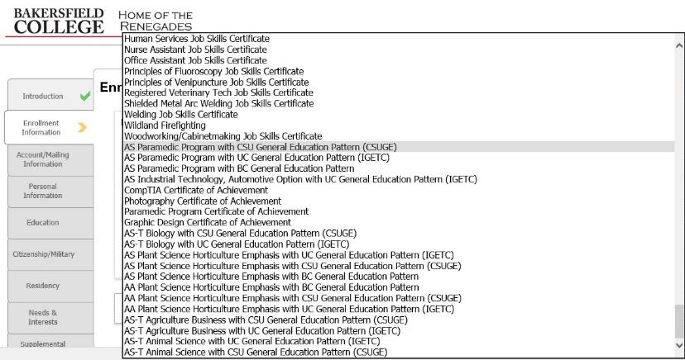
Clarifying Pathways Bakersfield: 9 Screens of Majors not alpha order
Notes:
The end in mind begins with choosing a major, which may not be easy or clear.
Students must get through 9 screens to determine a major and then the major determines the math pathway
Some data we could not live with and what faculty thought they knew

Slide 7
141 options in no order ADTs at bottom

Slide 8
Meta Majors with Program Mapping
Notes:
Beginning with the end in mind – minimizing unintentional swirling and off-ramping
Better Guidance at All Levels
Helps to Find Majors
Exploration
Demonstrates the Starting and Ending Points
Informs Choices
Reduce Excess Units
Related Careers and Salaries
Register for the Correct Math and General Education
Math Pathways – Depends on Major

Slide 9
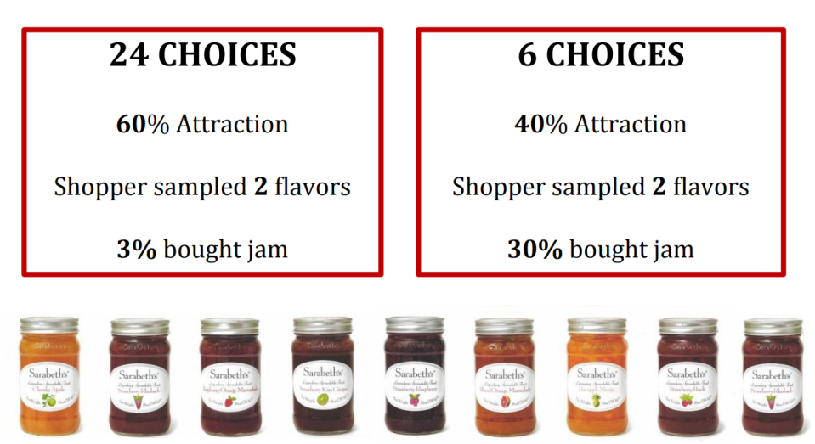
Notes:
Janet - Behavioral Psychology Research shows more choices, less takers

Slide 10
What are Meta Majors?
Definitions…
Meta Majors are collections of academic majors that have related courses.
Meta Majors cluster groups of degrees and certificates that are considered similar from a student’s perspective.
Meta Majors give incoming students an opportunity for early exploration within a cluster of academic and career choices while still making progress to graduation.
More…
Notes:
Ginni – Meta Majors are described in various ways but the over-riding outcome is to provide a simpler student-facing picture of college and to create a inward facing structure that is manageable. Not intended to limit choice – the intent is to streamline choice
Julie – Meta majors also creates connection and integration among majors, lending itself to skills and knowledge across the curriculum

Slide 11
What are Meta Majors?
Other Titles for the Meta Major concept…
Focus Area
Cluster
Major Pathways
Clustering Majors
Career and Academic Pathways
Interest Areas
Career Clusters
Program Clusters
Others???
Notes:
Ginni - Many colleges have elected to call these groupings different names depending upon their Mission, Vision and local culture. There is no RIGHT name. It’s a local decision – recommend including all constituencies in this process
Julie – Some have brought students in to determine names that resonate with them, not us

Slide 12
City Colleges of Chicago
Notes:
Ginni - Moving to clarity – go through these examples quickly – note the differences in naming conventions
City Colleges of Chicago have 10 FOCUS areas

Slide 13
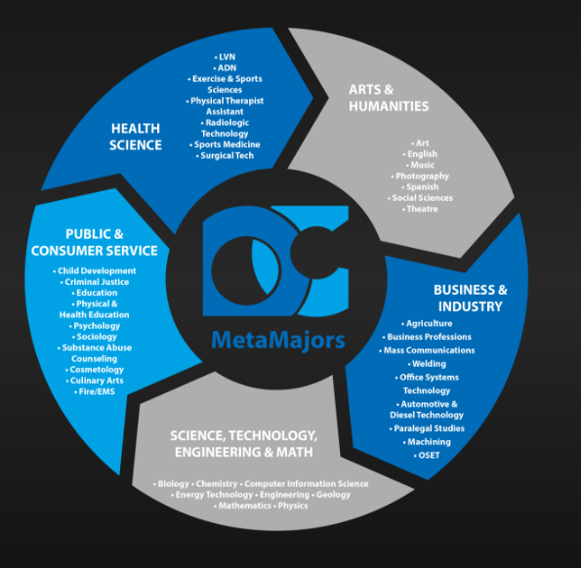
Notes:
Ginni - Odessa College in Odessa Texas has 5 metamajors – “Odessa College Offers more than 45 Associate Degree programs and more than 70 professional certificates. Whether you're looking to start a new career right away, or transfer to a four-year institution” They have good definitions for each meta major at https://www.odessa.edu/programs/Metamajors/index.html
Arts & Humanities Students select courses of study including political science, world languages, cultural studies, literature, history, & fine arts. They will give a fresh voice to culture, ethics and policy, and will shape our society both today and in the future.
Business & Industry Students pursue courses of study from a variety of fields that include: information technology, graphic design, welding, marketing, logistics, automotive technology, communications, finance, architecture, agricultural science, and other industrial fields of study.
Health Science Students are preparing for careers in fields such as Nursing, Physical Therapy, Radiology, Medical Office Procedures and a variety of fields related to medicine. Programs are designed to prepare students for transfer and the workforce.
Public & Consumer Service Students select courses of study in the public and consumer service industry, including child development, cosmetology, criminal justice, culinary arts, emergency medical services, fire administration, psychology and sociology, and the education field.
Science, Technology, Engineering & Math Science, Technology, Engineering and Math students apply their knowledge and skills to in diverse programs including the petroleum industry, space industry & civil work projects. They will be the innovators of the future.
Odessa College 201 W. University, Odessa, TX 79764

Slide 14
Notes:
Wharton Junior College (in Texas) has 9 Major Pathways they divide academic and vocational pathways
Academic Pathways This includes the Associate of Arts (AA) and Associates of Arts in Teaching (AAT) and is designed for students planning to pursue a 4-year baccalaureate degree from a university. Applicants for the AA and AAT degree must
be TSI-satisfied in Reading, Writing and Math. AA and AAT degrees contain a set of common courses referred to as the General Education Core Curriculum.
Vocational Pathways The Associate of Applied Science (AAS) degree is an occupationally-oriented degree designed to prepare students for entry into a particular occupation upon completion. Applicants for the AAS degree must be TSI-satisfied in Reading, Writing and Math. AAS Degrees are comprised primarily of vocational/technical courses along with some general education courses.
Certificate Programs are designed to prepare students with specific occupational skills that enable them to enter the workforce in a short period of time. Some certificate programs waive TSI requirements.
Some vocational programs are offered in a Block Schedule Format.
For a description of student learning outcomes, topical outlines, and assessment practices for a course, see the Administrative Master Syllabus (AMS) Not sure about your major pathway? Try Career Coach!

Slide 15
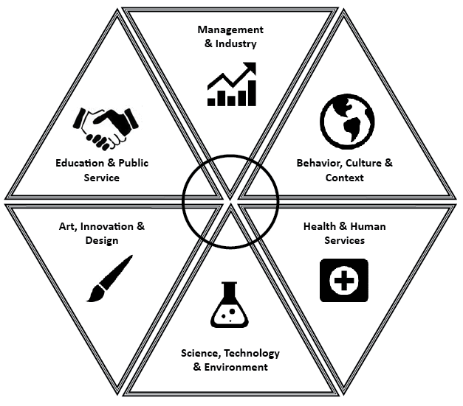
If you are wondering how you will narrow 200 majors into one, narrowing your options down into one or two meta-majors is a good place to start.
In Exploration, we concentrate on six broad areas where majors share similarities.
It is also important to note that no one college or school contains all the majors at Ohio State that are in a particular field of study.
Notes:
Ohio State University uses metamajors for exploration and colleges for majors see the definitions below
Arts, Innovation, and Design
Do you enjoy design and having creative control of your work? Are you interested in increasing awareness of the arts? Majors in the arts explore performance and/or production of various art forms as well as theory, history and the impact of art on society. This field of study is a great fit for students who like to create art and also for those who enjoy and value art.
Sample Curriculum: Arts, Innovation & Design
Health and Human Services Are you interested in science and helping people become healthier and well in all areas of their lives? Are you fascinated by the healthcare industry on all levels? Ohio State offers undergraduate licensure and certification majors in the healthcare field. University Exploration advisors also help students select undergraduate majors that do not lead to licensure, but instead these majors have the potential to lead to a post-baccalaureate health degree. Sample Curriculum: Health & Human Services
Behavior, Culture, and Context Do you love learning about people, society, culture and how they intertwine? Are you interested in communication & relationships? This area includes majors in the Humanities and Social Sciences that are great opportunities for students who love learning about people, cultures and relationships. Sample Curriculum: Behavior, Culture & Context
Management and Industry Are you interested in managing and leading people, looking at data and numbers, analyzing or persuading consumers? This area refers to business related majors, which are available in many different colleges at Ohio State. We have over 20 ways to pursue a business related major and your choice will depend on what your specific interests and skills are.
Sample Curriculum: Management & Industry
Education and Public Service Do you enjoy teaching, training and educating others? Are you interested in working directly with people from a leadership position? Ohio State offers education licensure programs at both the undergraduate and graduate level in a variety of subject areas as well as majors which open up career opportunities in a variety of work settings. ​Sample Curriculum: Education & Public Service
Science, Technology, and Environment Do you enjoy investigating how and why things work? Are you interested in how science is applied to everything in our lives? Majors within the Science, Technology and Environment field of study can be applied or theoretical. Majors in these areas often have a strong math and natural science core, which will require students to take several math and natural science courses as prerequisites to major coursework.
Sample Curriculum: STEM with math placement N​ Sample Curriculum: STEM with math placement M or higher

Slide 16
Cabrillo College’s Career and Academic Pathways (CAP)
Notes:
Cabrillo College has taken a first stab at Meta Majors calling them Career and Academic Pathways (CAP) note that some degrees are in multiple CAPs.

Slide 17
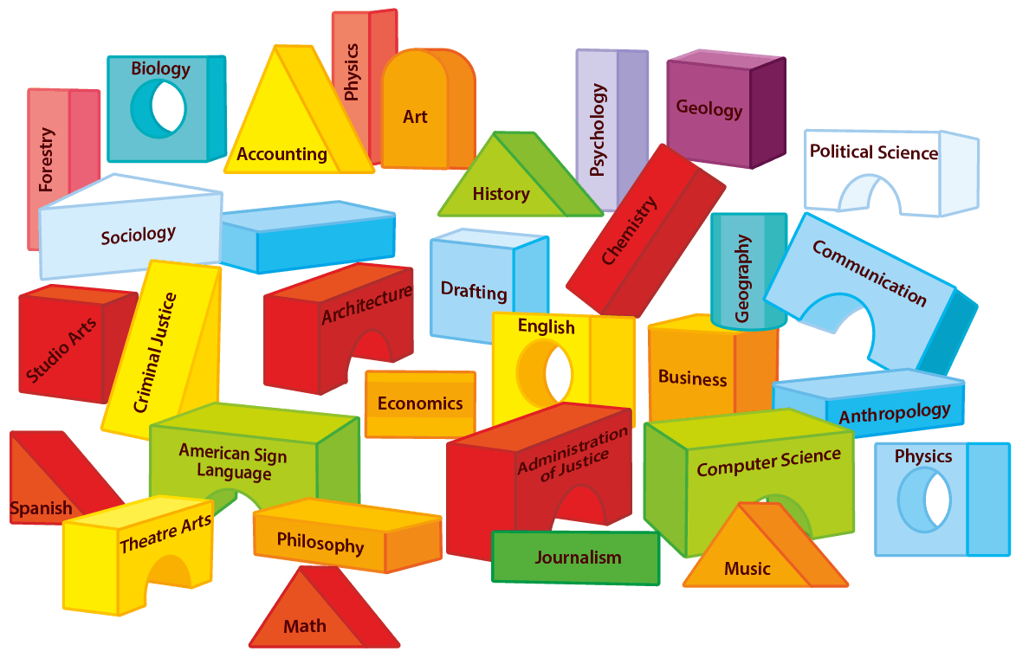
General Education…
Notes:
Julie - What does your GE look like? This??????

Slide 18
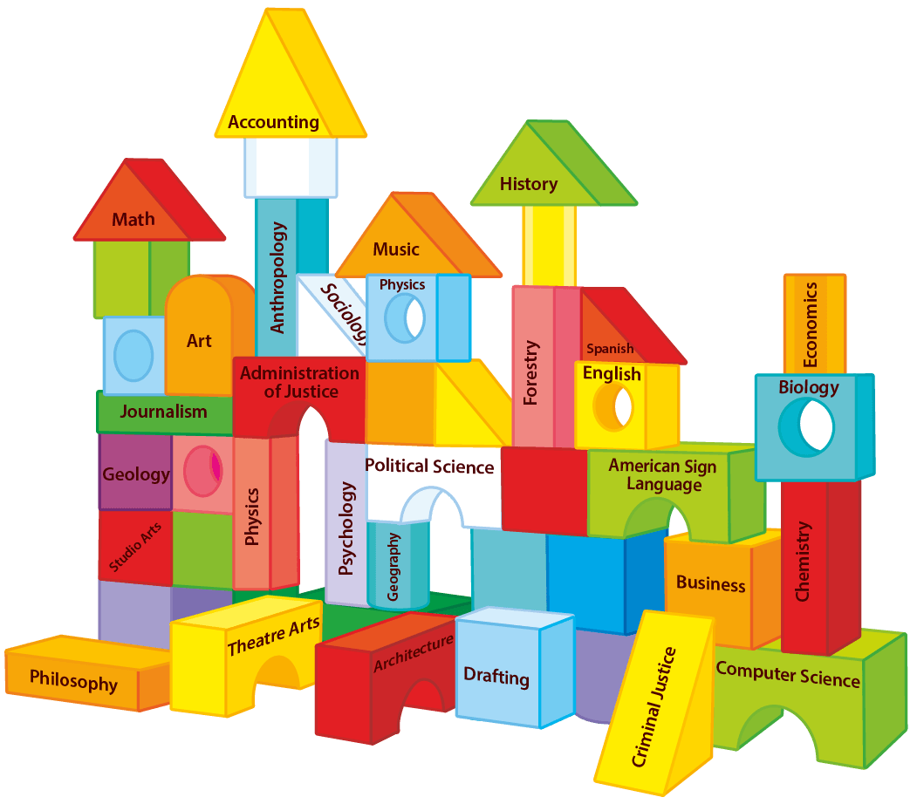
Notes:
Julie - Or this? Which is better? Organization can ease choice.

Slide 19
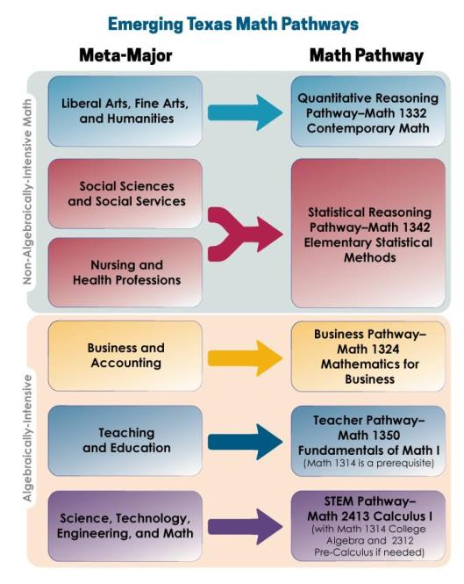
Notes:
Ginni/ Janet See Meta-majors and clarity on work sheet which leads into Meta-majors and collaboration
A little deeper dive into quantitative reasoning/mathematics requirements help some grouping activities. Here the Dana Center in Texas exams some of the potential matches between meta Major and required math. Link in last slide

Slide 20
Multiple Paths FORWARD: Diversifying Mathematics as a Strategy for College Success
Notes:
Ginni Janet - Recent articles say that California is ahead of the country in this thinking – link on last slide

Slide 21
The Intersection between Program Mapping, Metamajors and Quantitative Reasoning
CSU Area B4 Quantitative Reasoning and IGETC Area 2 Mathematical Concepts and Quantitative Reasoning
Statewide data - 1629 transfer quantitative reasoning courses
Different Course types – 483 unique variations
Individual Colleges average 14 different transfer level courses that fill these requirements
Many of these courses are not counted in the KPI’s (key performance indicators) or CCCCO Scorecard
Programming Methods & Computer Discrete Math (Computer Science); Behavioral Statistics; Biostatistics; Business Calculus, Business Math, Liberal Studies Math
Notes:
Janet/Ginni Different TOP Codes for QR courses that fulfill Math and QR requirements – know them!!!!! Tell your researcher, curriculum chair, CIO, ….

Slide 22
Considerations for Guidelines to Construct Metamajors or Program Maps
Check conversations about meta-majors at participant colleges
Share any problems or solutions
Potential solution: consider guidelines before creation
See handout
Discuss usefulness of guidelines
Did any of them consider these?
Would they suggest others
Notes:
At this point we could stop and check in with the audience allow time for group discussion of the factors so far on the worksheet and have some groups share out.
Julie –

Slide 23
Analysis to Support Creating Meta Majors and Program Mapping
What is the full scope of programmatic offerings at the college?
Do the college’s programs align to the local labor market and/or university transfer partner?
Which general education courses align best to each Meta Major?
What are the common courses across all programs?
What is the required core within this Meta Major that allows students to branch off into various majors without losing any credits?
Which courses will introduce students to relevant faculty and career information early in their academic careers?
Which courses might not be included, and who needs to be involved in that decision?
Notes:
Questions From Jobs for the Future

Slide 24
Developing Meta Majors
Effective practices ("reverse engineering" from program outcomes)
Curricular considerations (overlap)
Facilitating the conversation between faculty from different disciplines and services
Student voice!
What about program mapping—which should be done first?
Notes:
Janet/Julie - As you begin to explore Meta Majors you should look at what other colleges have done. The process is iterative and it is not a lone ranger task. Here is the evolving work from Florida showing the changes in thinking to expand to labor market and K-12.

Slide 25
Program Mapping
DO we need them?
What are they?
Guidelines for program mapping…
Notes:
The best way to begin is to actually…BEGIN!

Slide 26
Graduating in Math at Bakersfield College
Sample Pathways at BC

Slide 27
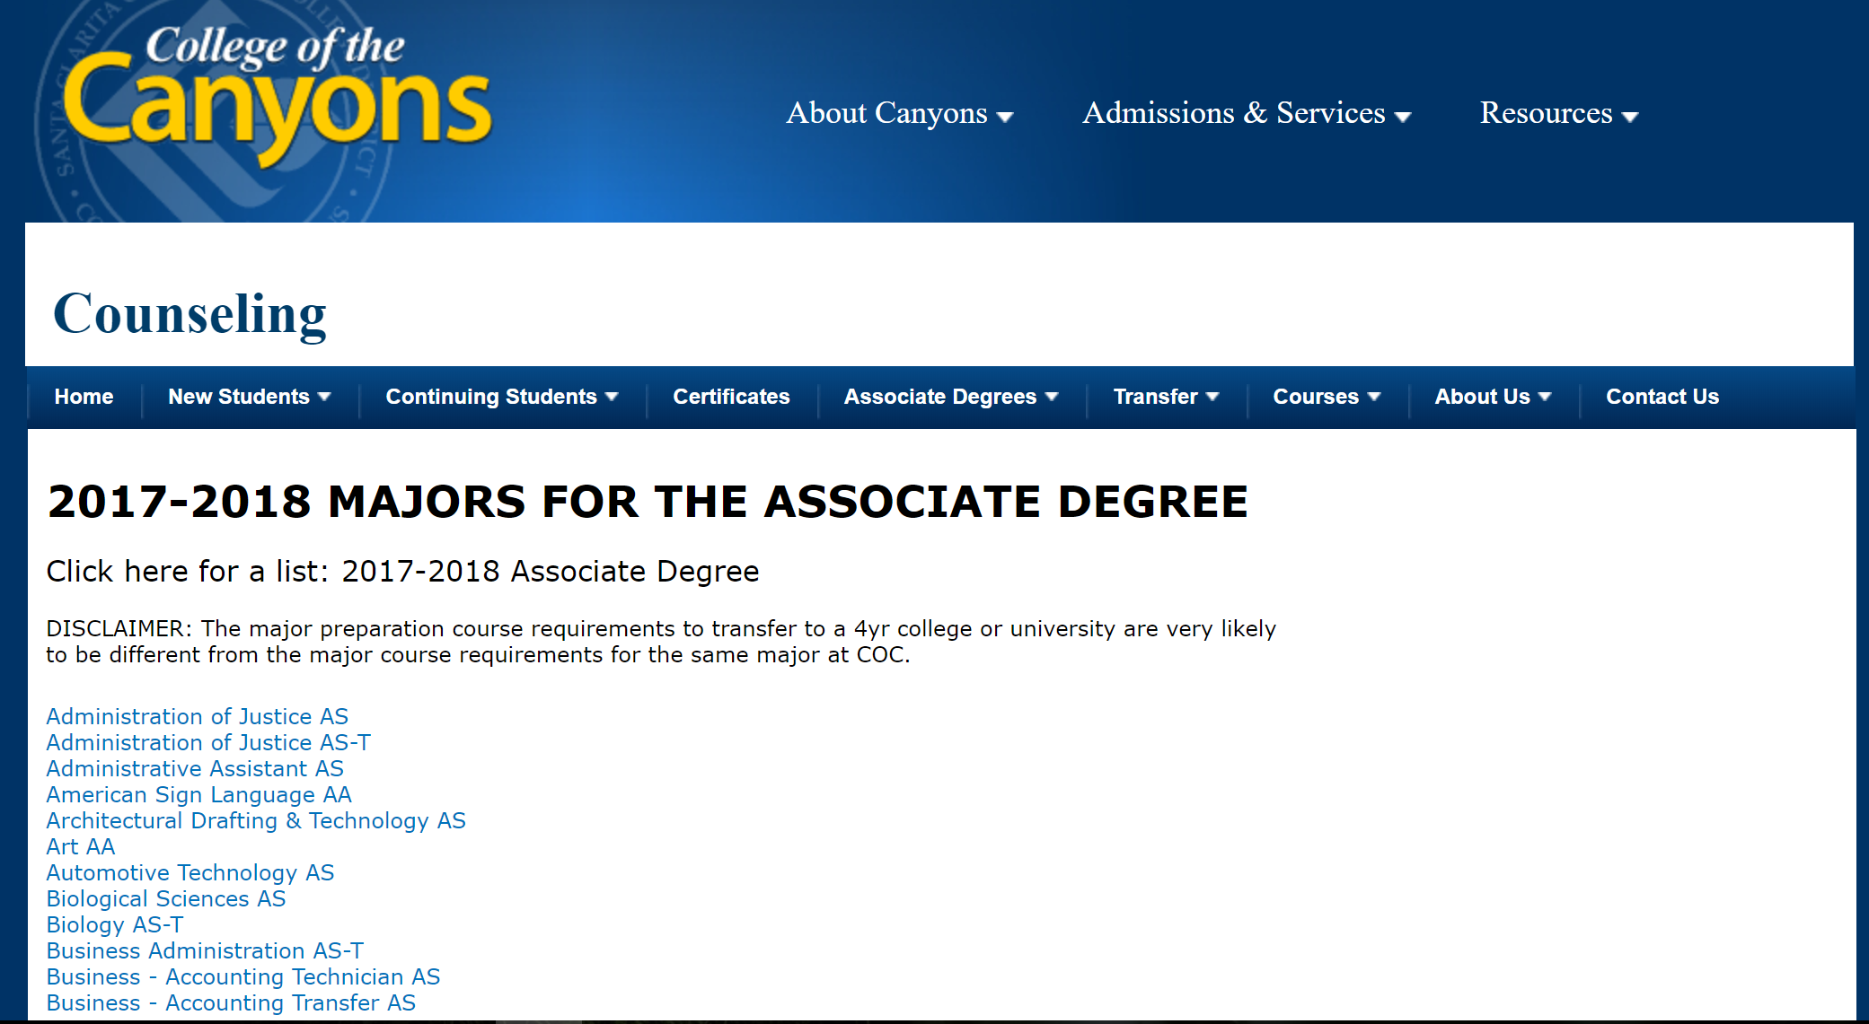
Observation: List of Majors with a Disclaimer

Slide 28
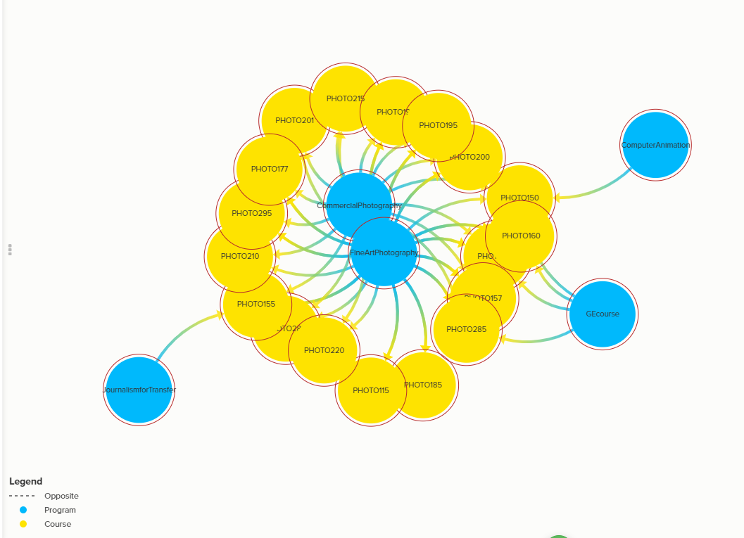
Programs that Require Photography Courses for Degree, Certificate, and/or Transfer
Kumu Map of Programs & Courses Visualization
Notes:
Janet - College of the Canyons and Skyline College used a free software program to map and visualize course overlap - Kumu is a powerful data visualization platform that helps you organize complex information into interactive relationship maps.
https://www.kumu.io/

Slide 29
Student Course Taking Behavior
Programs with the Greatest Percentage of its Students Successfully Completing Photography Courses who are not Fine Art Photography program completers
Notes:
Janet - College of the Canyons further examined course taking behavior of students by their major. They were especially looking at areas of commonality where students within a particular major took specific general education courses within areas. This helps us to better understand the student view. Look at the number and majors associated with photography outside of fine arts. It makes sense that this is a useful “Arts” course for Fireman or ASL based upon needs within their major.

Slide 30
Iterative – Back to Meta Majors

Slide 31
Notes:
Initial iteration of Florida System
Lake Sumter State College, Leesburg Florida – first iteration of state imposed metamajors on all colleges – first iteration of Meta Majors in Florida system

Slide 32
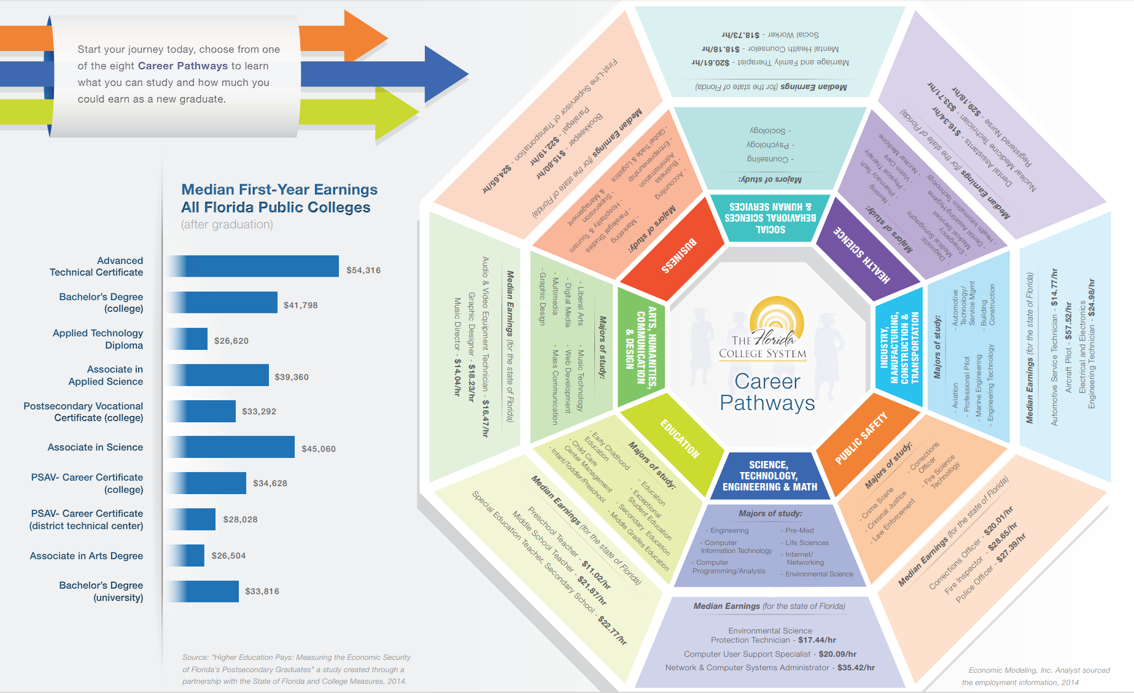
Florida College System
Notes:
Later iteration of Florida statewide pathways, mapped with the interactive deeper information for students.

Slide 33
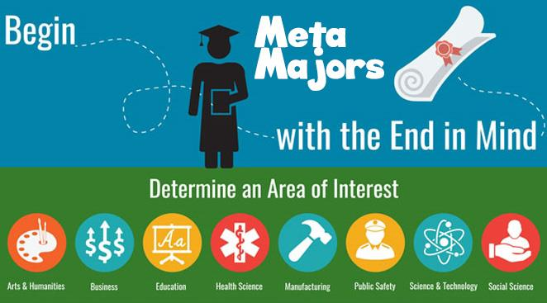
The Florida System aligns with K-12 pathways with the college and university 8 pathways as exemplified by this district, St Lucie Public Schools in Port St, Lucie, FL
Notes:
The Florida System aligns with K-12 as exemplified by this district, St Lucie Public Schools in Port St, Lucie, FL
http://www.stlucie.k12.fl.us/departments/career-and-technical-education/meta-majors/

Slide 34
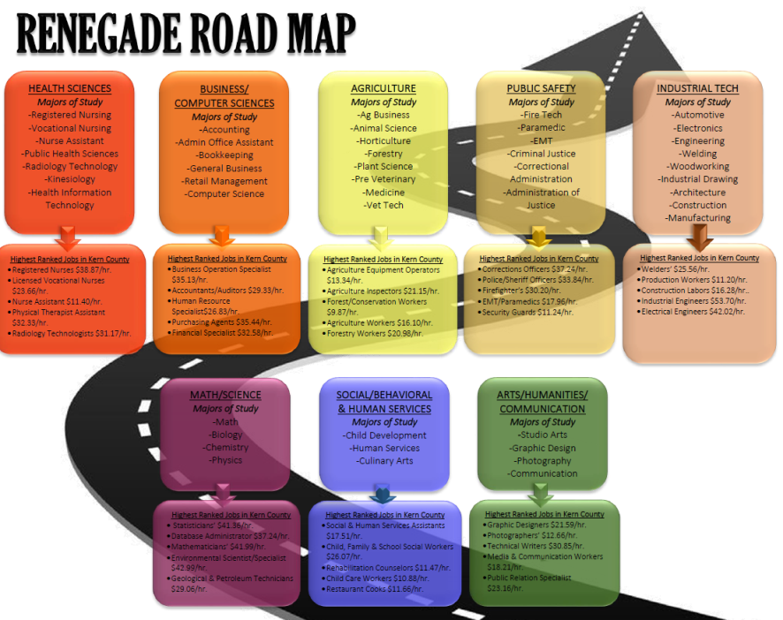
Notes:
Bakersfield College Focused on Outcomes and Jobs

Slide 35
Notes:
Refinement of the Renegade Road Map

Slide 36
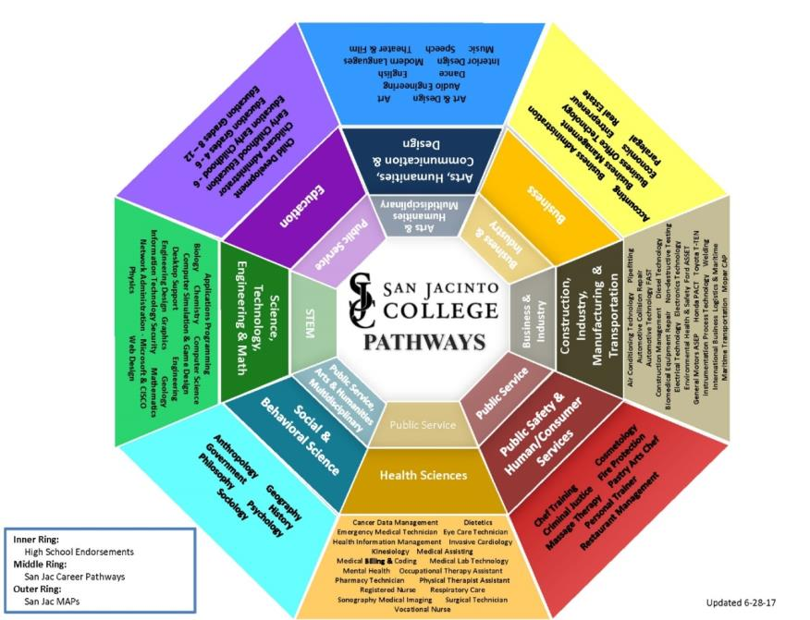
Notes:
Next iteration for San Jacinto College, TX (not Mt San Jacinto in CA)This includes the high school pathways in the inner most faded circle as aligned to the college pathways in the second brighter circle.

Slide 37
Additional Curricular Considerations
How does the college communicate Meta Majors to prospective students?
How does the college help students make informed choices about Meta Majors?
How does Meta Majors placement align with English, math and ESL placement?
Do orientations, first-year experience courses, and student success courses align to the Meta Major?
Will mapped pathways be presented to students as their default registration?
How will you incorporate the Golden 4 and other transfer requirements?
Will these organizational strategies have any unintended consequences on equity?
Notes:
This is the rest of the worksheet managing and communicating metamajors
Deeper exploration should include questions about implementation strategies and effects across the institution and with community partners.

Slide 38
Part Two

Slide 39
Program Mapping and “Meta-Majors”: Exploring the Issues
Julie Bruno, Guided Pathways Lead Coordination, ASCCC Past President, Sierra College
Janet Fulks, Guided Pathways Lead for Capacity Building, Bakersfield College
Virginia May, ASCCC Treasurer, 2018-19 Curriculum Chair,
Sacramento City College
Friday September 14 2:30-3:45 PM
Notes:
Thais

Slide 40
What are the intended outcomes?
Outcome #1 Using the worksheet, identify key needs for your college and plan discussions
Outcome #2 Analyze how metamajors can facilitate positive effects for your college and students by
Providing the ability to message and support students at critical points
Linking degree results with both employment and transfer
Analyzing data relevant to students by programs
Clarity
Notes:
Looking at the Metamajors worksheet -

Slide 41
Notes:
Janet -The outward facing meta-majors, we call learning and career pathways, are now part of the CCC apply process and allow students to dig deeper into pathways, requirements and jobs.

Slide 42
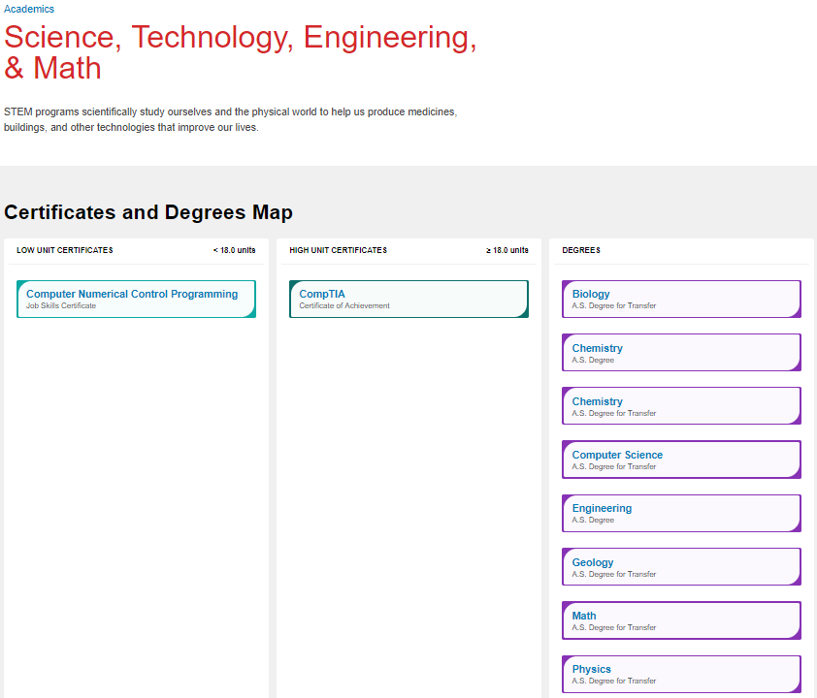
Notes:
Janet - This is the result of clicking on the STEM pathway.

Slide 43
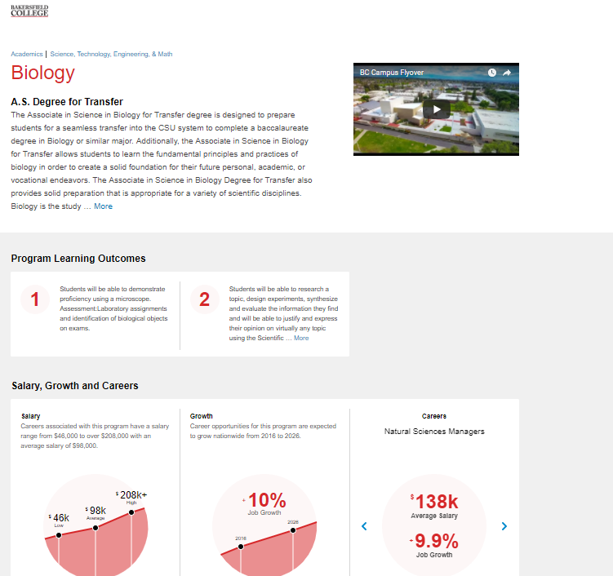
Notes:
Janet - This is the result of clicking on the Biology program.

Slide 44
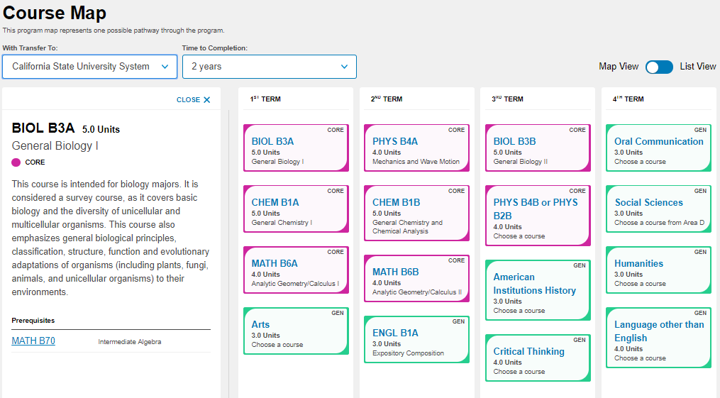
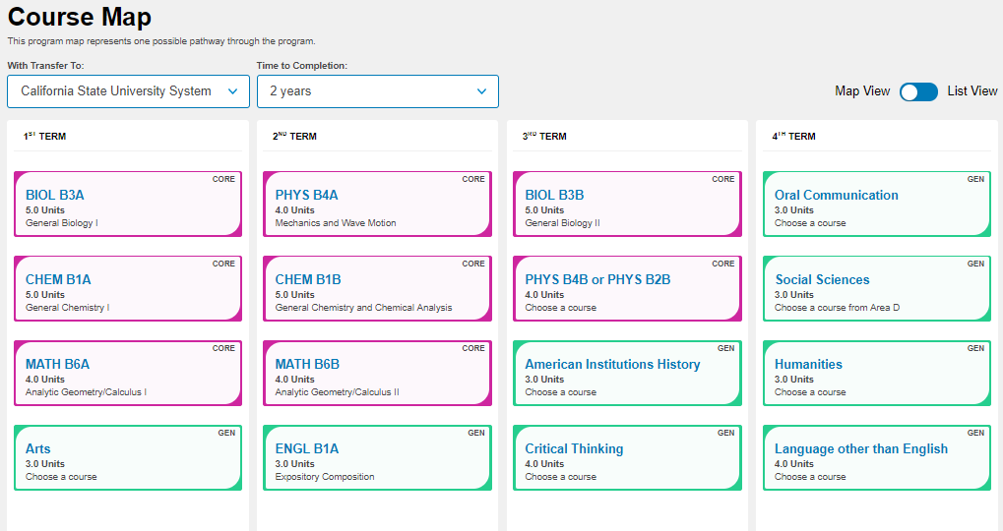
Notes:
This is the result of scrolling to the program requirements

Slide 45
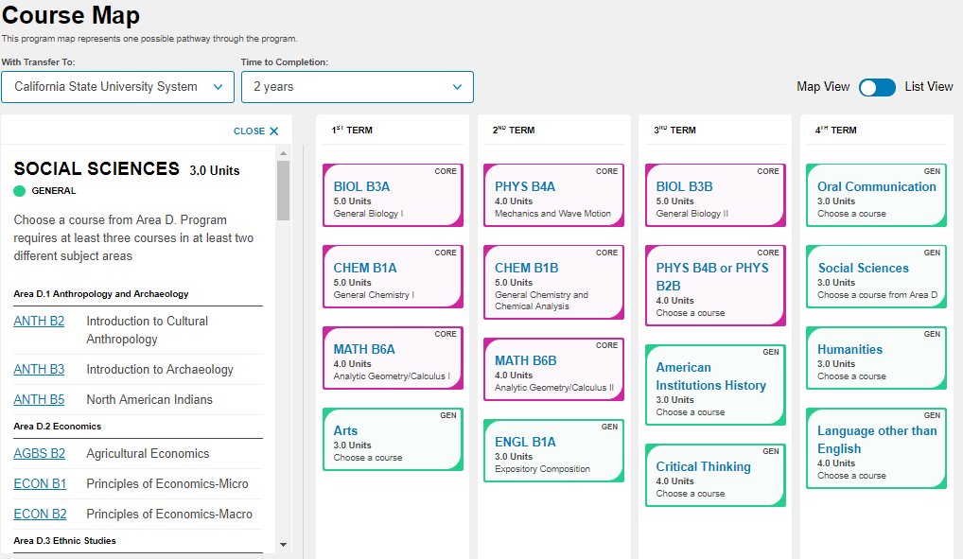
Notes:
This is the result of clicking on the Gen Ed requirement of Social Science and allows students to see the various choices they have. In most cases we opted for student choice. Details of the various levels of choice at another time.

Slide 46
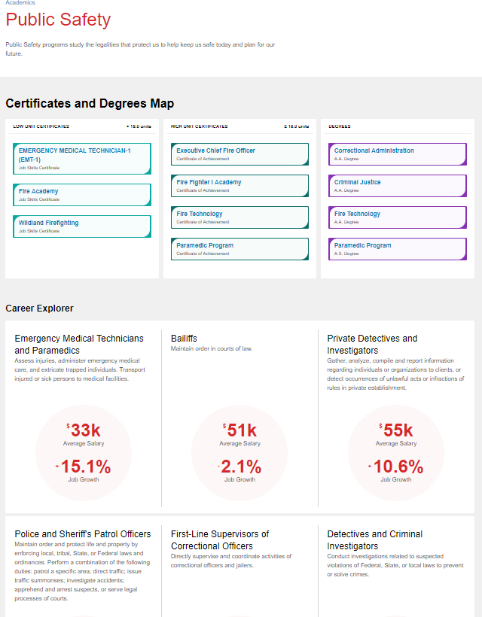
Notes:
This is the result of clicking on the Public Safety metamajor

Slide 47
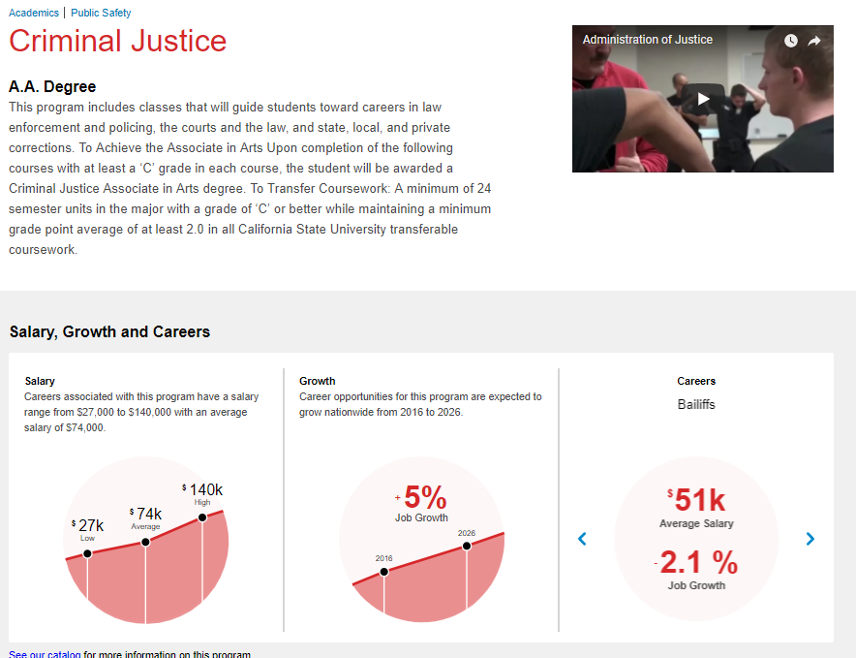
Notes:
Janet - This is the result of clicking on the Criminal Justice Program

Slide 48
What are Some Outcomes?
Program clarity
Sequencing clarity
Specific data for nudges
Targeted messaging
Clear contacts for student questions
A village to lead the student to the outcome
Notes:
Janet -

Slide 49
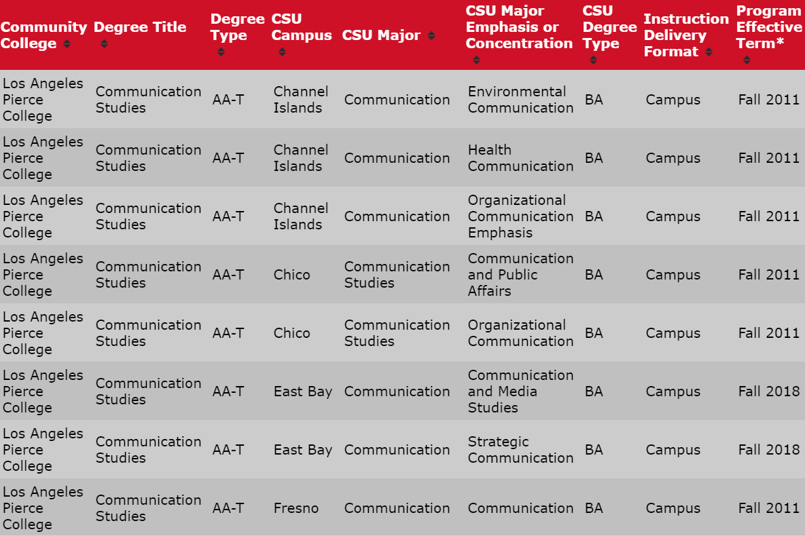
Learning about majors and transfer
Notes:
Julie

Slide 50
Notes:
Program mapping and meta major analysis help colleges consider GE relevancy. This ADT at BC transfers into 6 different areas of Sociology BAs where the GE courses can help meet upper division requirements in some cases or better prepare students to make a decision about area of emphasis when transferring.

Slide 51
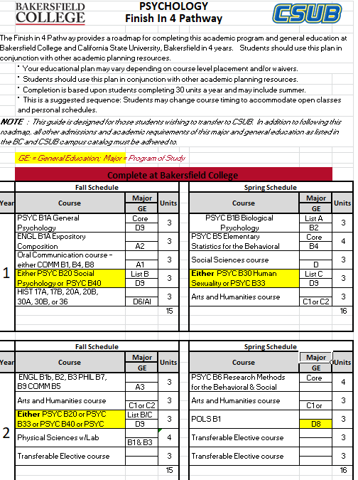
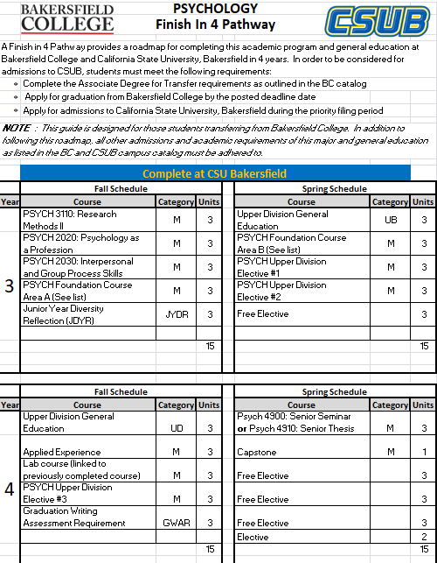
Notes:
This is an example of a program map that goes beyond the first two years to align with the BA years and guarantee graduation

Slide 52
Tracking Data by Meta Majors is manageable and makes a difference!
Notes:
Organization by metamajors has helped provide detail information to message students and to follow programs. Look at the large drop in Personal and Career exploration as the college has more carefully advised students.

Slide 53
Facilitating the Conversation
How much of a degree is within a particular department?
How do you incorporate representation from other disciplines?
Where do under-prepared or undecided students go and who plans for them?
How do you consider transfer requirements?
Where do conversations with high school faculty fit in?
Where do conversations with the students fit in?
Notes:
Julie

Slide 54
Let’s give it a try!
See scenarios…
ASCCC also has an exercise for colleges to try and use that looks at programs and potential metamajors NOT at their college
Notes:
Ginnie

Slide 55
Follow-up Discussion and Q&A
What aspect of Meta Major development do you think will work best at your college?
What aspect will be the most challenging?
For those that have already begun Meta Major development, what worked well, and what didn’t?

Slide 56
Additional Resources
Meta-Majors: An Essential First Step on the Path to College Completion (JFF)
http://www.jff.org/publications/meta-majors-essential-first-step-path-college-completion
How meta-majors guide students toward on-time graduation (EAB)
https://www.eab.com/daily-briefing/2016/07/26/how-meta-majors-guide-students-toward-on-time-graduation
Key Meta-Major Questions to Consider
https://jfforg-prod-prime.s3.amazonaws.com/media/documents/Meta-Majors-Key-Questions-071816.pdf
Multiple Paths FORWARD: Diversifying Mathematics as a Strategy for College Success
https://www.wested.org/wp-content/uploads/2018/05/Multiple-Paths-Forward-Booth.pdf
Quantitative Reasoning the Next “Across the Curriculum” Movement by (AACU) Susan Elrod, 2014
https://www.aacu.org/peerreview/2014/summer/elrod
The Dana Center Mathematics Pathways: The Right Math for the Right Student at the Right Time
https://dcmathpathways.org/dcmp/dcmp-model

