Slide 1
Placement in the world of ab 705
Craig Hayward, Bakersfield College
Craig Rutan, ASCCC Secretary
2018 ASCCC Curriculum Institute

Slide 2
Placement prior to ab 705

Slide 3
Placement Tests
Most colleges relied primarily on tests like ACCUPLACER or COMPASS to place students.
Discipline faculty set cut scores required for placement into each level.
Some colleges incorporated additional measures like high school GPA, courses, completed, etc. to add or subtract additional points (known as a compensatory placement model).
This was a typical way to satisfy the requirement to use “multiple measures”.
Multiple measures were not well understood and were generally poorly validated.
All placement tests reviewed and approved by the Chancellor’s Office.

Slide 4
MMAP
The Multiple Measures Assessment Project (MMAP) created models (decision trees) for mathematics and English placement.
Models built using high school performance data, including HS GPA, HS course grades, and HS courses taken.
RP Group researchers identified students that were highly likely to succeed (70%+ likelihood), thereby reducing the “underplacement” that had been observed when test scores primarily drove student placement.
Colleges that implemented MMAP placement rules saw an increase in the number of students being placed into transfer level courses.
Most colleges maintained or increased their success rates.
Notes:
The average change in success rates across all pilot colleges for English was +2% and for math it was 0%.

Slide 5
Basic requirements for math and English Under ab 705

Slide 6
AB 705
AB 705 (signed October 13, 2017) requires colleges to use one or more of the following when placing students into courses in math and English:
High School Coursework
High School GPA
High School Grades
If colleges are not able to obtain official transcript data, they can use self reported data or guided placement.

Slide 7
Let’s get interactive
Pull out your cell phone and start a new text to ‘22333’ – that’s the “phone number” of the poll.
Enter CraigHayward694 as the text of the message and send it.
You should now be joined to the poll and able to respond.
Alternatively, if you are on a device with a browser, you can go to http://pollev.com/craighayward694 and participate from there.

Slide 8
Notes:
Poll Title: What one word best captures how you feel about AB 705? https://www.polleverywhere.com/free_text_polls/PUmIUCwboHpfuuI

Slide 9
Notes:
Poll Title: What one word best captures how you feel about AB 705? https://www.polleverywhere.com/free_text_polls/PUmIUCwboHpfuuI

Slide 10
AB 705 – Highly Unlikely and Maximize Likelihood
"a community college district or college cannot require a student to enroll in remedial English or mathematics coursework that lengthens their time to complete a degree unless placement research that includes consideration of high school grade point average and coursework shows that those students are highly unlikely to succeed in transfer-level coursework in English and mathematics”
“placement models selected by a community college demonstrate that they guide English and mathematics placements to achieve the goal of maximizing the probability that a student will enter and complete transfer-level coursework in English and mathematics within a one-year timeframe”
Notes:
The second bullet point is probably the more important and actionable aspect of the law.

Slide 11
Notes:
Poll Title: If something is "highly likely", what is the percentage chance that it will happen? https://www.polleverywhere.com/multiple_choice_polls/N6ZmFDFkiADnr6q

Slide 12
Notes:
Poll Title: If something is "probable", what is the percentage chance that it will happen? https://www.polleverywhere.com/multiple_choice_polls/9gJuDOOTJAotP1D

Slide 13
Notes:
Poll Title: If something is "improbable", what is the percentage chance that it will happen? https://www.polleverywhere.com/multiple_choice_polls/6yVS84eknyCcJEI

Slide 14
Notes:
Poll Title: If something is "probably not" going to occur, what is the percentage chance that it will happen? https://www.polleverywhere.com/multiple_choice_polls/PlDJcoYXw4sYRtS

Slide 15
Notes:
Poll Title: If something is "highly unlikely", what is the percentage chance that it will happen? https://www.polleverywhere.com/multiple_choice_polls/ot7PGCC6ChYenzr

Slide 16
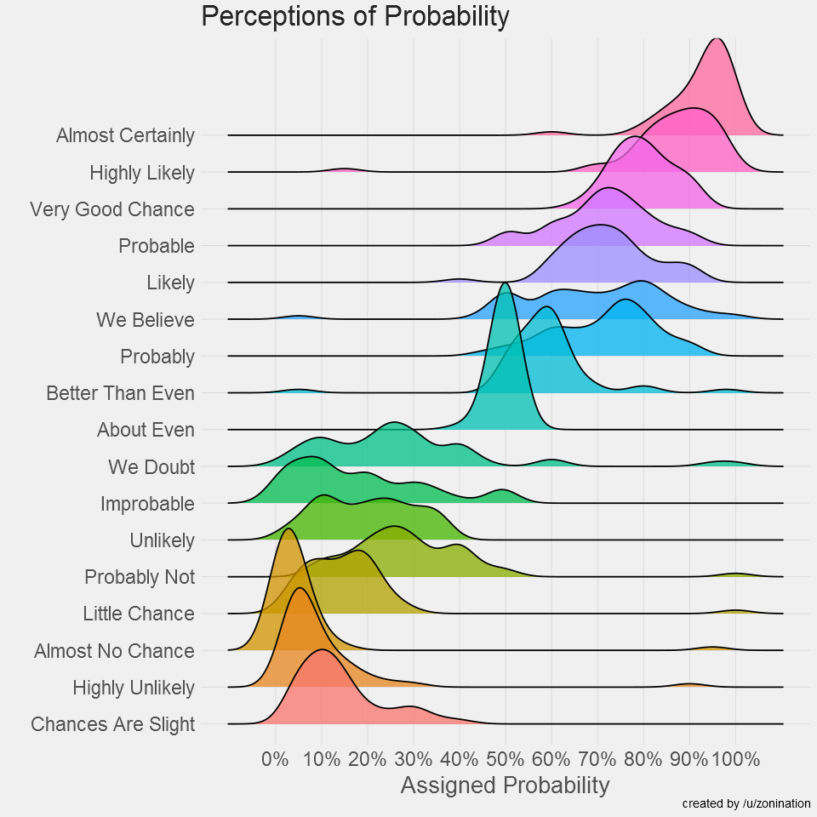
https://github.com/zonination/perceptions/blob/master/README.md
Notes:
John – Reddit (n=47) replication of Sherman Kent (1968) study using NATO military officers accustomed to reading intelligence reports with probabilistic language.

Slide 17
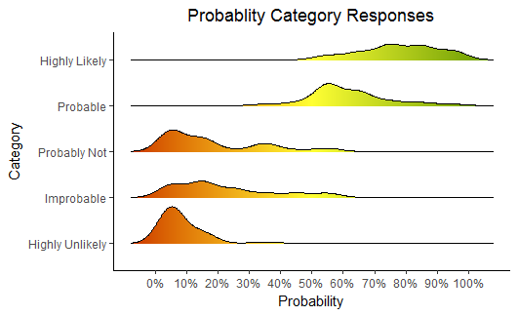
RP Post-conference workshop attendees of California Community College stakeholders
Notes:
Results from 40 AB 705 workshop attendees in March, 2018.

Slide 18
Developing Placement Models
The Chancellor’s Office has interpreted AB 705 to mean that colleges may only place students into basic skills courses if they are highly unlikely to succeed at the transfer level AND taking the basic skills course will improve the likelihood that a student will complete transfer level coursework in one year.
This does not mean that colleges must get rid of their basic skills courses, but students can only be placed into them if the college can show that students will increase their likelihood of completing a transfer level course within one year.
Students can still choose to take a basic skills course if that is what they want.

Slide 19
Default Rules for English
High School Performance Metric for English | Recommended AB 705 Placement for English
HSGPA ≥ 2.6 Adjusted one-semester success rates of 79% Throughput from one-level below is 40% | Transfer-Level English Composition No additional academic or concurrent support required
HSGPA 1.9 - 2.6 Adjusted one-semester success rates of 58% Throughput from one-level below is 22% | Transfer-Level English Composition Additional academic and concurrent support recommended
HSGPA < 1.9 Adjusted one-semester success rates of 42% Throughput from one-level below is 12% | Transfer-Level English Composition Additional academic and concurrent support strongly recommended
Notes:
I’ve changed the throughput rate to the revised adjusted predicted throughput rates, since that is the latest data.

Slide 20
Default Rules for SLAM
High School Performance Metric for Statistics/Liberal Arts Mathematics | Recommended AB 705 Placement for Statistics/Liberal Arts Mathematics
HSGPA ≥ 3.0 Adjusted one-semester success rates of 74% Throughput from one-level below is 31% | Transfer-Level Statistics/Liberal Arts Mathematics No additional academic or concurrent support required
HSGPA from 2.3 to 2.9 Adjusted one-semester success rates of 48% Throughput from one-level below is 17% | Transfer-Level Statistics/Liberal Arts Mathematics Additional academic and concurrent support recommended
HSGPA < 2.3 Adjusted one-semester success rates of 29% Throughput from one-level below is 8% | Transfer-Level Statistics/Liberal Arts Mathematics Additional academic and concurrent support strongly recommended
Notes:
The throughput rate in the table is the adjusted projected/expected rate that accounts for differences in ACCUPLACER and GPA scores among students historically placed at different levels. Note that SLAM includes GE math, math for teachers, quantitative reasoning and similar courses.

Slide 21
Default Rules for BSTEM
High School Performance Metric BSTEM Mathematics | Recommended AB 705 Placement for BSTEM Mathematics
HSGPA ≥ 3.4 or HSGPA ≥ 2.6 AND HS Calculus Adjusted one-semester success rates of 75% Throughput from one-level below is 54% | Transfer-Level BSTEM Mathematics No additional academic or concurrent support required
HSGPA ≥2.6 and < 3.4 or HS Precalculus Adjusted one-semester success rates of 54% Throughput from one-level below is 34% | Transfer-Level BSTEM Mathematics Additional academic and concurrent support recommended
HSGPA ≤ 2.6 and no Precalculus Adjusted one-semester success rates of 28% Throughput from one-level below is 13% | Transfer-Level BSTEM Mathematics Additional academic and concurrent support strongly recommended
Notes:
Adjusted/projected throughput rates included.

Slide 22
Placement Model vs. Default Rules
The default rules specify that students with 11th grade high school transcript data should be placed into transfer level courses (with the exception of BSTEM if the student has never taken Intermediate Algebra/Algebra 2).
Colleges can only place students into basic skills courses if they have data (or are collecting data in the two year window allowed for new prerequisites) that shows the student’s likelihood of completing a transfer level course in one year is greater than the throughput thresholds.
A placement model will specify the specific class (with or without support) a student will be placed into. The model will include information like the student’s chosen program of study and can include the use of HS data beyond GPA

Slide 23
Placing Students
AB 705 requires that colleges maximize the likelihood of completing transfer level in one year; it does not specify in which courses students should be placed.
For example, a student comes to a college with a HS GPA of 2.4 and they completed Algebra I and Geometry in high school. The student wants to major in Chemical Engineering.
The student does not automatically qualify for placement into transfer level math on the BSTEM pathway by the default rules, but the college could have developed a corequisite for College Algebra that would allow the student to start at transfer level.
The placement model could offer the student the option of Intermediate Algebra or College Algebra with a corequisite.
If the student had chosen Sociology as a major, they would have been placed directly into statistics, which they are still eligible to take.

Slide 24
Multiple Versions of a Transfer Course
Many colleges are exploring the idea of having multiple versions of the same transfer level course, one with additional embedded support and one without.
Placing students into either of these course would satisfy the requirements of AB 705 and the default placement rules.
Colleges will need to determine how to place students into each course using high school performance data.
The placement could be based on GPA, course grades in HS, highest level completed in high school, or some combination.
Sample corequisite BSTEM courses can be found here: bit.ly/Math-Coreqs

Slide 25
Requiring Credit Corequisites
Many colleges are considering corequisite lab or lecture courses to provide additional support for students.
Can these courses be required? The simple answer is yes, but colleges requiring these courses must follow the requirements in §55003 of Title 5.
(d)(3) the corequisite course will assure, consistent with section 55002, that a student acquires the necessary skills, concepts, and/or information, such that a student who has not enrolled in the corequisite is highly unlikely to receive a satisfactory grade in the course or program for which the corequisite is being established;
(m) Whenever a corequisite course is established, sufficient sections shall be offered to reasonably accommodate all students who are required to take the corequisite. A corequisite shall be waived as to any student for whom space in the corequisite course is not available.

Slide 26
Data Collection Requirements
Colleges wishing to develop new curriculum that includes basic skills courses must collect data that demonstrates that the throughput rates are higher than the defaults (up to two years).
Colleges must collect data on their placement models (even if they are just the default rules) to demonstrate that there is no disproportionate impact.
Additional data may be required by the Chancellor’s Office, but those decisions have not been made yet.

Slide 27
Measures Other Than HS Performance Data
If HS performance data are not available (either official or self reported), colleges are allowed to use guided self placement under AB 705.
In the past, colleges were able to develop other multiple measures that could be used to place students, but that is no longer the case.
Once AB 705 has been fully implemented (Fall 2019 for English and math, Fall 2020 for ESL), colleges will only be able to use assessment measures that have been approved by the Board of Governors.

Slide 28
Guided or Directed Self Placement
An allowed placement option for students who have incomplete or no transcript data
Students are asked a series of questions and/or presented with sample materials and courses are recommended based on answers
The questions may be about the students perceptions of their abilities for a particular subject and their previous work as a student
Students may choose to enroll in classes other than those recommended
Colleges implementing guided self placement have not seen a significant change in success rates

Slide 29
eSL

Slide 30
ESL
Colleges are expected to maximize the likelihood that credit ESL students complete transfer level coursework in English (could be an ESL course equivalent to freshmen composition) in three years.
Placement models based on high school performance data have had mixed results.
A workgroup is meeting to develop tools for placement into credit ESL courses and develop strategies colleges could explore to decrease the time it takes for students to complete ESL sequences.
Full implementation for ESL is required by Fall 2020.
The Chancellor’s Office plans to release initial guidance for ESL by Fall 2018

Slide 31
Items Being Discussed for ESL Students
About 25% of ESL student have complete high school transcripts and will likely have access to transfer level English. Colleges can develop distinct placement tools using HS performance data for these students, but are not required to do so.
ESL faculty have requested that assessment tests continue to be available (especially writing samples) to place ESL students. It is unclear whether placement tests for ESL will continue to be reviewed and approved for use.
Some colleges have been exploring the use of guided self placement for ESL students.
In spring 2018 several colleges piloted an ESL student background survey developed by Irvine Valley College that will be analyzed by fall 2018 and used to inform the guidance.

Slide 32
Placement into other courses

Slide 33
Reading
For colleges that have separate reading and writing courses, there have been many questions about placement for reading under AB 705.
Colleges cannot place students into a basic skills reading course unless it increases the likelihood that they will complete transfer level English within one year.
Colleges may choose to create corequisite reading courses that could be included in their placement models. For example, a college could require some students to enroll in a reading corequisite to take college composition, as long as it increases the student’s likelihood of success and the student is highly unlikely to succeed to in the transfer-level course without it.

Slide 34
Chemistry
Most colleges have a prerequisite on General Chemistry of Prep Chem or a high enough score on a placement test.
Currently there are approved chemistry placement tests on the list of approved tests from the Chancellor’s Office, but those approvals are only for up to six years.
The Chancellor’s Office has not indicated whether they will continue to review and approve these tests, which could require colleges to stop using them.
Colleges have the ability to waive the prerequisite based on performance in high school chemistry and colleges may need to explore this option if placement tests are no longer available.
Colleges could also use credit by exam to give credit for the Prep Chem course, allowing students to enroll in General Chemistry.

Slide 35
Questions?

