Slide 1
Best Practices in Coordinating, Developing, and Using the ISER

Slide 2
Best Practices in Coordinating, Developing, and Using the ISER
Participants
Laura Adams, ASCCC Accreditation Committee Member
Amber Gillis, ASCCC South Representative
Jeff Lamb, Vice President of Academic Affairs, Santa Ana College
Van Rider, ASCCC Accreditation Committee Member
Notes:
Van

Slide 3
Best Practices in Coordinating, Developing, and Using the ISER
This breakout session will discuss best leadership and planning practices, approaches, and utilization of the ISER in accreditation work on your campus. Additionally, this session will explore how the college can use their ISER to support sustainable work as we strive to meet our mission and support continuous quality improvement both during and after the writing of the ISER.
Notes:
Van

Slide 4
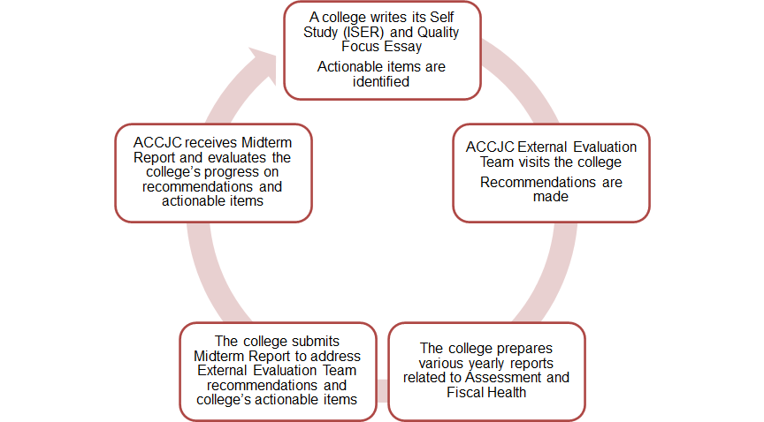
Accreditation Cycle
Notes:
Van

Slide 5
Share with us where you are in your accreditation process?
We are just beginning our self study process. (Yikes)
We are in the middle of our self study process. (Double Yikes)
We just finished our self study process. (Phew)
We are in between self studies (nearing Midterm Report/Mini Yikes).
Notes:
Van Lead - Poll/Chat

Slide 6
Coordinating the ISER
If possible, before you begin:
Start Early
Get Trained
ASCCC friendly VP visit,
ASCCC Institute,
Familiarize yourself with the Standards, ERs, and Policies,
Read Midterm Report and last ISER
Review Past Reports from your college
Serve on a Visiting Team or IEPI PRT
Notes:
Jeff

Slide 7
Coordinating the ISER
If possible, before you begin:
Establish an Organizational Structure
Executive Team
Core Team
Standard Teams
Establish a Timeline
Writing, Reporting, Approvals, Board of Trustees (first read and second read)
Invite EVERYONE to participate:
All constituent groups should be represented
Develop a Standard Matrix with names, role, and assigned Standard
Establish and Define Roles
Notes:
Jeff

Slide 8
Questions to Consider at Your College
What defined accreditation roles does your college have around ISER writing?
How is your accreditation organizational structure designed and maintained?
Considering your current accreditation organizational structure (or lack thereof), what does this say about your local governance model or campus culture?
How do you ensure students are involved in your accreditation process?
Notes:
Jeff

Slide 9
Santiago Canyon College Defined Roles
Liaison – Oversees all the work for the major standard areas (Standard I, II, III, or IV)
Each standard area will have the following tri-chair leads (classified, faculty, administrator) with the following designated roles:
Planner – facilitator, sets agendas for meetings, communicates updates, and is the point of contact for liaison overseeing all of Standard I, II, III, or IV.
Investigator - quality control over evidence ensuring evidence is formatted correctly, evidence is recent and relevant, and that text within evidentiary documentation is highlighted appropriately.
Documenter – compiles information, organizes draft responses to standards, and serves as the writer and editor for their area of focus
In addition, for each portion of a standard there will be a designated:
Standard Supporter – serves as the lead for each portion of a standard area (I.A, I.B, I.C, etc.)
Notes:
Jeff - Helps participants to see what the various roles and responsibilities are so that work is disseminated fairly and work moves quicker.

Slide 10
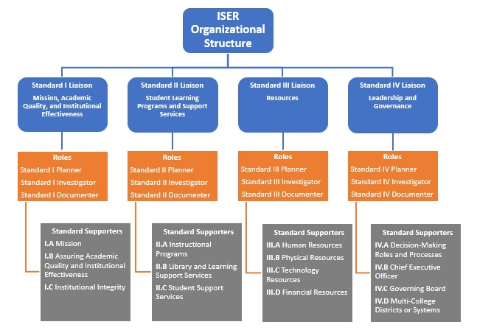
Santiago Canyon College Model for Accreditation Roles
Notes:
Jeff - Helps participants to see what the various roles and responsibilities are so that work is disseminated fairly and work moves quicker.

Slide 11
Coordinating the ISER
Participatory Governance: Include all Constituent Groups
Chair, Co-Chair, Tri-Chair
Faculty Accreditation Coordinator and Connection to Senate
Where to work?
Microsoft Teams
Google Docs
Sharepoint
Upload all relevant resources to one location
Core Editing Team (of one?)
Verify Budget– Coordination, Overtime, etc
Multi-College District Coordination
Notes:
Jeff

Slide 12
Developing the ISER
Use ACCJC Resources and Guides
ACCJC Style Guide
Evidence Template (Stolen from SCC)
Process, Policy, Practice
Evidence to be cited
Individuals to be interviewed
Evidence Protocols
How to name, where to save, etc
Establish regular meetings
Calendarize Reporting Out
Notes:
Amber

Slide 13
Developing the ISER
Hold ISER Writing Retreats
SAC Workshop document
Writing Tips
Evidence in Accreditation (PPT)
Coordinate with ITS
Post on Webpage
Linking evidence
Linking Evidence
Plan ahead
Evidence drives the writing and should be collected prior to writing narratives
Notes:
Amber

Slide 14
Accreditation Cycle/Evidence Collection Cycle
Notes:
Evidence gathering is a continual process and shouldn’t just be an afterthought for years 5-7.

Slide 15
Using the ISER in Your Everyday Practices
Use ISER to continually evaluate college processes and procedures
Develop/ Rely on Accreditation Standing Committee that Works in Years 1-7
Identify which committees link to which standards
Human Resources Committee and Standard IIIA
Maintain agendas with minutes to later use as evidence
Notes:
Laura - Operationalizing the spirit of accreditation in your everyday work.

Slide 16
Using the ISER in Your Everyday Practices
Standardize Practices/Procedures to make your life easier
Board Policies linked to accreditation standards
Committee annual goal setting/evaluation
Linking committees to standards
Potential Ideas to Collect Evidence/Wish List:
Means to tag documents as evidence
On committee agendas
On committee minutes
SharePoint/Microsoft Teams Folders
Notes:
Laura - Operationalizing the spirit of accreditation in your everyday work.

Slide 17
Long Term Accreditation Work
What kinds of practices does your college have around organizing and collecting evidence throughout the entire 7-year accreditation cycle?
If your college does not have one, what conversations can you have with constituent groups to make this happen?
Notes:
Laura - Jamboard

Slide 18
Best Practices Wish List
What does your college need to make the continuous, ongoing preparation and actual writing of your report easier?
Tangibles – ALO, Accreditation Faculty Lead, Budget for OT/RT, SharePoint and other technology, changes in leadership positions/roles
Cultural Shift – Organizational Structures, Attitudes towards Accreditation (it’s not somebody else’s job; it’s everyone’s job)
Notes:
Amber/Laura

Slide 19
Questions?
Thank you!
Laura Adams
Associate Professor of Psychology
Norco College
laura.adams@norcocollege.edu
Van Rider
Assistant Professor of Library Studies
Antelope Valley College
vrider@avc.edu
Jeff Lamb
VP Academic Affairs
Santa Ana College
lamb_jeffrey@sac.edu
Amber Gillis
Associate Professor of English
Compton College
ASCCC South Representative
agillis@compton.edu

