Slide 1
Developing a Leadership Style That Suits You
Michelle Bean, Area C Representative
Dolores Davison, Vice President
Nate Donahue, Representative At-Large
Faculty Leadership Institute, Sheraton Sacramento
June 14th, 2019
2:15-3:45 pm

Slide 2
WELCOME TO OUR BREAKOUT!
GETTING TO KNOW YOU, GETTING TO KNOW ALL ABOUT YOU:
NAME
COLLEGE
LEADERSHIP ROLE

Slide 3
STEP ONE: ACCEPTANCE
You are the same person, but you have a new role
Own your role
Understand Your Duties
Know the context of how you became a leader
You are now a public figure on
your campus, and folks are watching and listening

Slide 4
STEP TWO: INSPIRATION AND EMULATION
Which leaders inspire you?
What are the qualities of leadership that you value in others?
How can you emulate the qualities of the
leaders you admire in your leadership style?

Slide 5
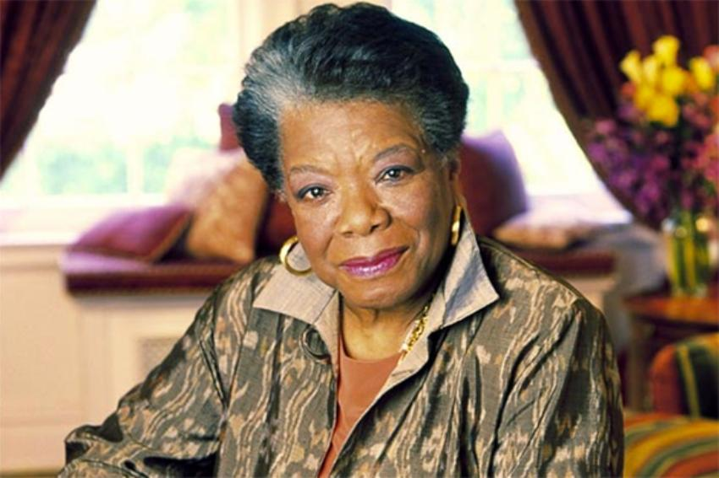
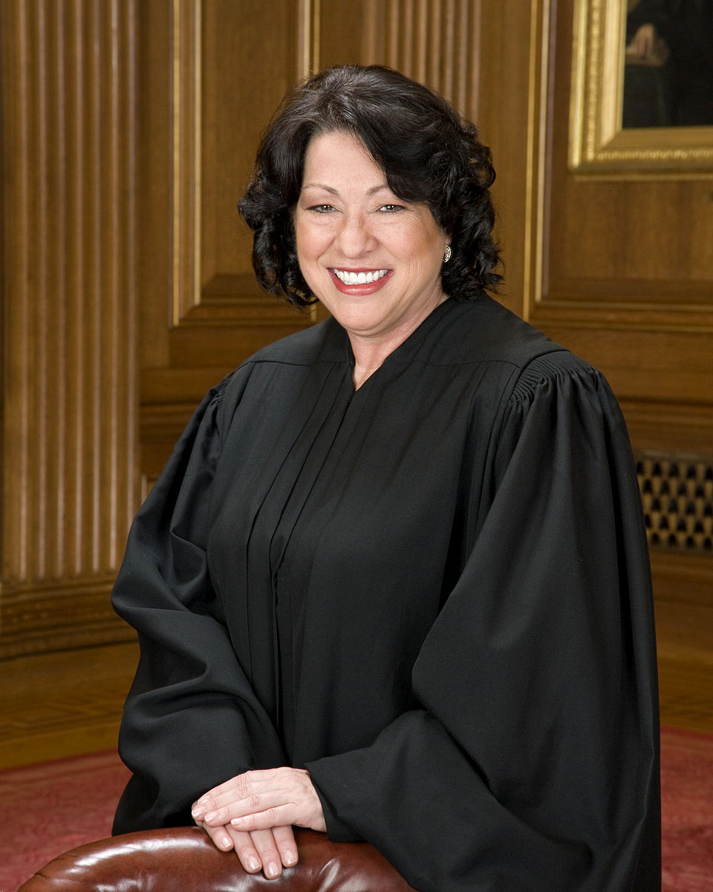
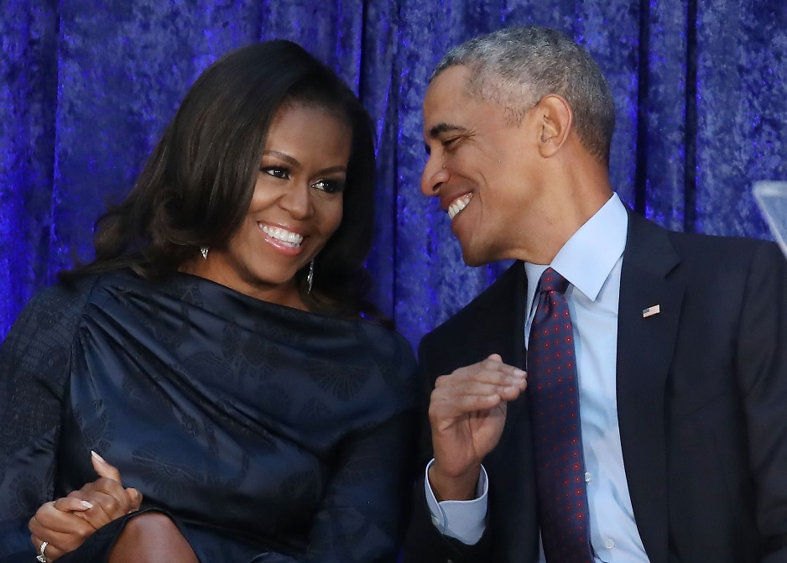
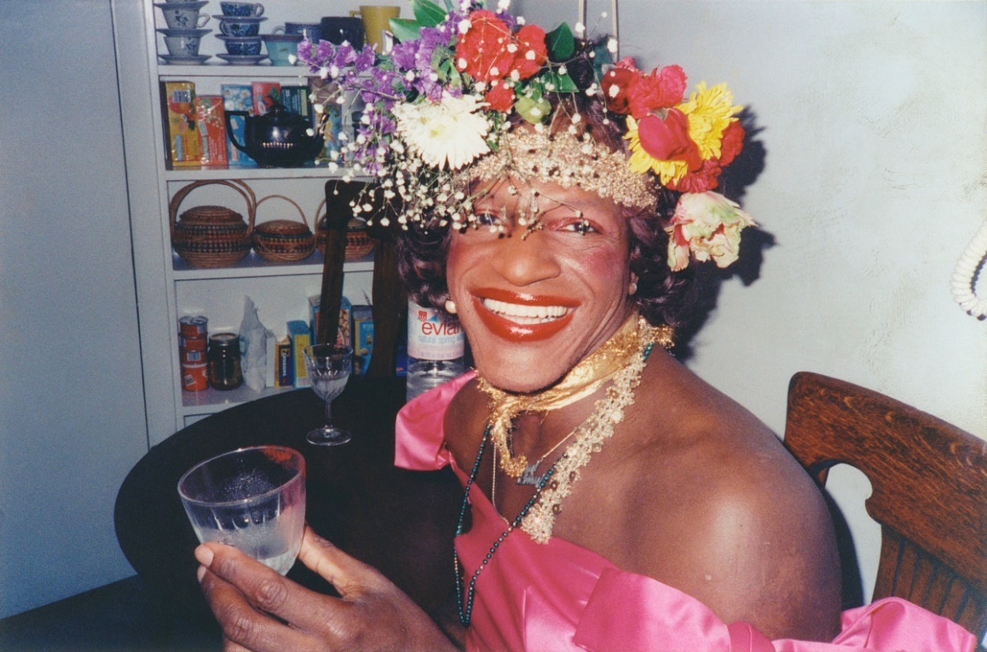
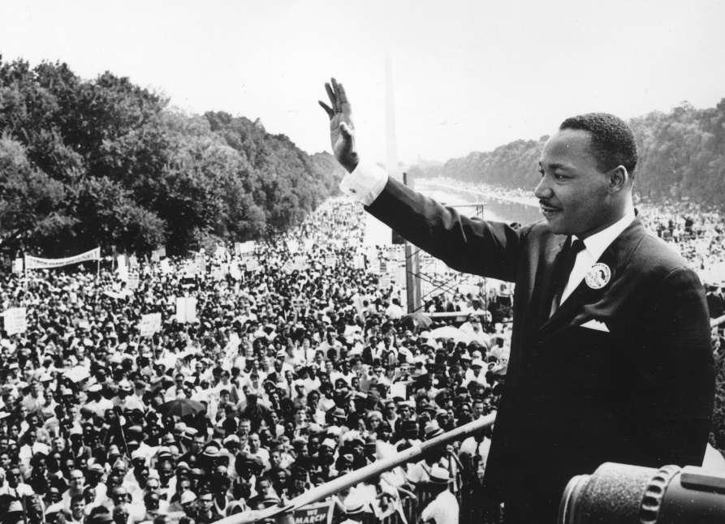
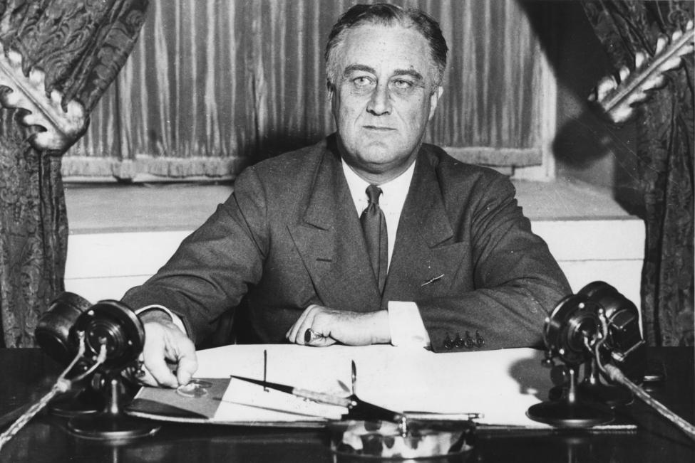

Slide 6
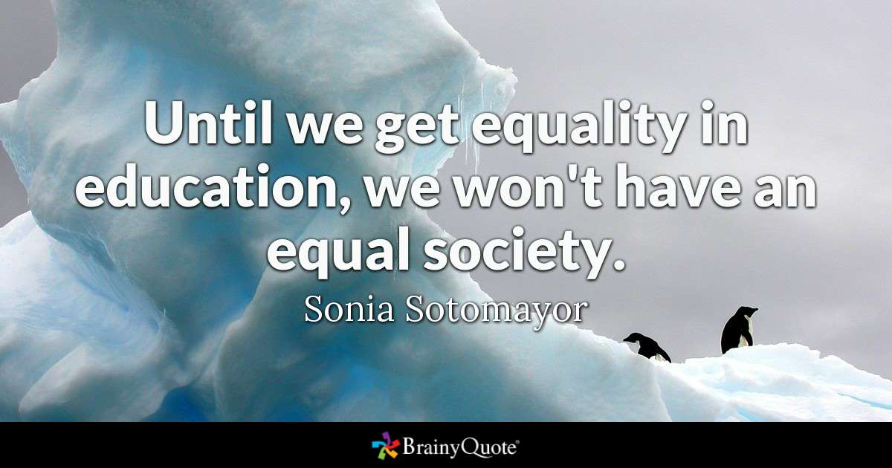

Slide 8
PLAYING YOUR ROLE MEANS BEING PREPARED FOR YOUR VOICE TO CHANGE
The Paradox of Having an Amplified Voice:
You represent your constituents, and to promote student
success and equity according to the purview of the Academic Senate’s “10+1”
Your opinions are your own, and your influence and platform are real,
But your voice now represent the people you serve and the organization you lead.

Slide 9
STEP THREE: DEVELOP YOUR VALUE SYSTEM
What core qualities will you center as your foundation for leadership?
How can faculty develop strategies to achieve equitable student outcomes?
What of governance and committee structure can be improved and be
be maximally collaboartive?
What aspects of the college can be made more effective from the standpoint
of the “10 +1”?

Slide 10
STEP FOUR: BUILDING YOUR TEAM
The Local Senate President is responsible for making all
faculty appointments to college committees
Assemble diverse and inclusive coalitions that balance
experience, expertise, and new leadership
Assert faculty purview and build alliances
Ensure robust faculty participation in development
of Curriculum, District Planning and Governance,
Budget Development, Hiring Processes, and Student
LIfe

Slide 11
The importance of COMMUNICATION:
Respond to all emails, even if just briefly
Create spaces where people can be their authentic selves
Educate and bridge conversation between constituent groups
Build consensus and lead folks to the solution which that best
fosters student success and equitable outcomes
Develop future leaders for providing mentorship and
opportunities for professional development

Slide 12
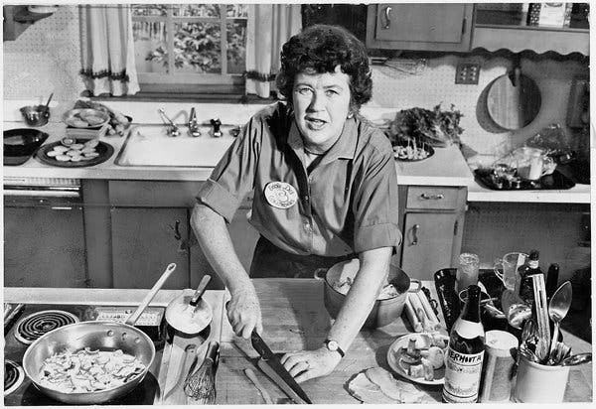
RECIPES FOR SUCCESS
Hold regular meetings with clear and effective agendas
Set yearly goals for the committee and commit them to writing
Amplify faculty, student and classified voices, work in good faith
with partners and allies in adminstration
Present strategies for achieving goals of student success to all
constitent groups and planning committees
Attend Board Meetings, develop relationships across the college

Slide 13
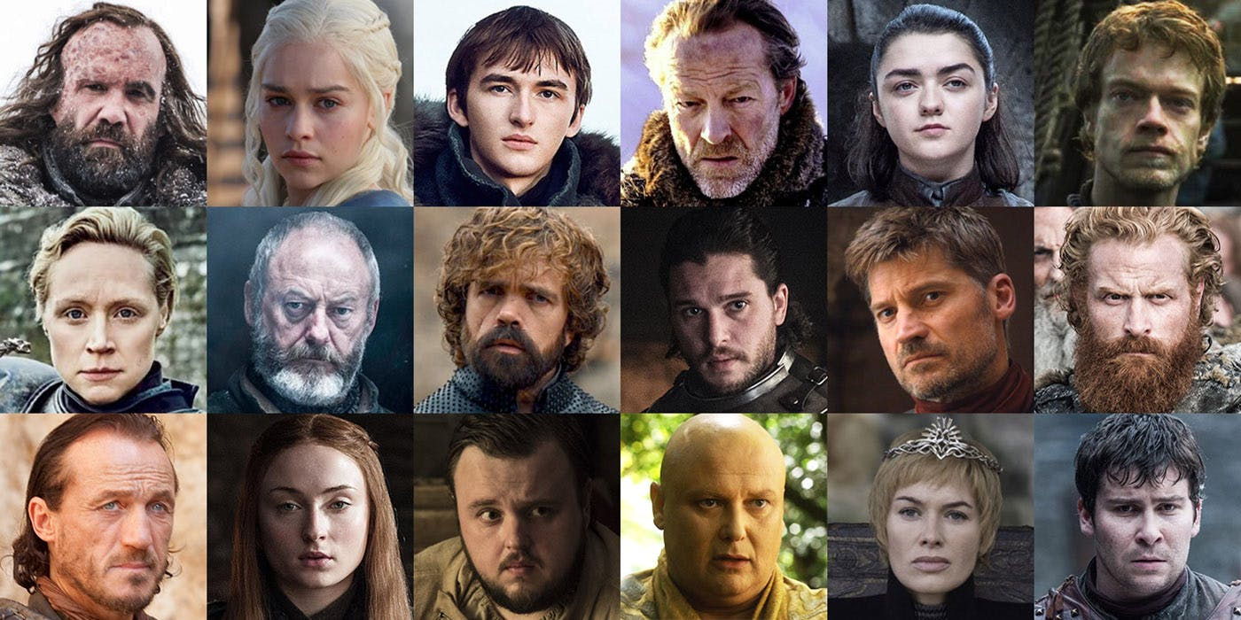
AVOID DRAMA!
We are not playing the Game of Thrones

Slide 14
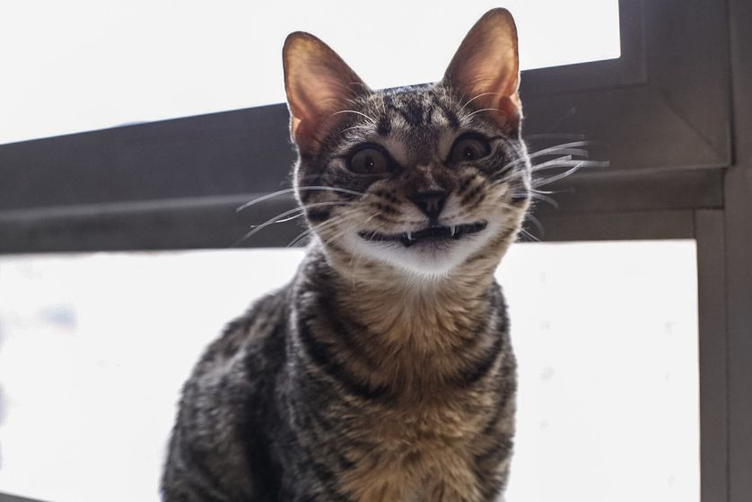
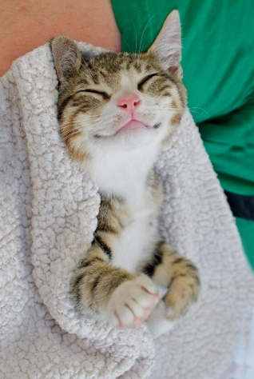
STEP FIVE: ACHIEVING SUCCESS
The Senate becomes a respected space of expertise, collaboration and influence
The campus understands the 10+1 and the Senate is actively engaged with decision making regarding all pertaining issues, via joint committees and other groups.
The practice of equity is the foundation of senate culture and a top priority for your college
The senate is engaged with and has positive relationships with all constituent groups at the college, including but not limited to faculty, students, classified professionals, bargaining units, and the board of trustees.
The organization is emotionally healthy, fiscally sound, full of participating member who are actually having fun and building community, and you are developing tomorrow’s leaders.
You are emotionally, physically, mentally and spiritually fulfilled. You have grown as a leader, professional, and human. You are not burnt out, but ready for your next challenge.

Slide 15
CONVERSATION CIRCLE:
What are you most excited about in your leadership role?
What do you think will be some of your biggest challenges on your campus?
What strengths that you already have will you draw on in order to accomplish your goals?
What aspects of your leadership can you work on to improve the quality of your experience?
T

