Slide 1
ONE PLACE, ONE SOLUTION
Notes:
Title Slide
--
Kuali Curriculum & Catalog
One Place, One Solution.
One Place, for All Users.
Designed with you in Mind.
On behalf of the Kuali team present and the Kuali company at-large thank you for hosting Kuali to continue the conversation.
We value the opportunity to present and appreciate your time to consider our proposal to collaborate on your curriculum and catalog management needs.
Introductions of Kuali Team Presenting:
Joanie Shafer, VP of Sales
Dani O’Rourke, Regional Director
Peter Stassen, Sales Development Representative

Slide 2
KUALI
AGENDA
PART I
INTRODUCTIONS
BRIEF OVERVIEW (SLIDES)
PART II
LIVE DEMO OF KUALI, ONE SOLUTION
QUESTIONS & ANSWERS THROUGHOUT
PART III
CLOSING (SLIDES)
NEXT STEPS
Notes:
Agenda Slide
--
Note: Each session includes a tailored agenda based on prospective client, presentation purpose, project needs, goals, and next steps. A sample agenda is provided in this slide and listed below.
Sample Agenda
1 Hour Presentation
Part I
Warm Welcome
Brief Overview (Slides)
Part II
Live Demo of Kuali, One Solution
Questions & Answers Throughout
Part III
Closing
Next Steps

Slide 3
KUALI
INTRODUCTIONS & OVERVIEW
PART I
INTRODUCTIONS
BRIEF OVERVIEW (SLIDES)
Notes:
Presentation Divider Slide
--
Introductions & Overview
Part I
Introductions
Brief Overview (Slides)
In Part I, we will...
Confirm Project Need(s)
Identify Existing Pain Points
Consider Desired Outcome
& Learn more about Kuali

Slide 4
KUALI
WELCOME
Notes:
Warm Welcome Slide (PART 1 OF 3 SLIDE CLICKS) --
Welcome.
Kuali is excited to support you as you evolve your Curriculum Management practices and achieve your objectives related to the implementation of a new Curriculum Management System.
We are committed to working hard to meet your project needs and desired outcomes.
(CLICK TO NEXT SLIDE)

Slide 5
KUALI
WELCOME
WE’RE GLAD THAT YOU’RE HERE
Notes:
Warm Welcome Slide Continued…(PART 2 OF 3 SLIDE CLICKS) --
(Previous Slide: Welcome) We’re glad that you’re here…(CLICK TO NEXT SLIDE)

Slide 6
KUALI
WELCOME
WE’RE GLAD THAT YOU’RE HERE TO...
01
STREAMLINE PROCESSES
02
INTEGRATE SYSTEMS & DATA
03
DYNAMICALLY BUILD CATALOG
04
PROVIDE BROAD ACCESS
05
CONTRIBUTE TO WIDER MODERNIZATION
Notes:
Warm Welcome Slide Continued…(PART 3 OF 3 SLIDE CLICKS) --
(Previous Slide 1 of 3: Welcome) (Previous Slide 2 of 3: We’re Glad that you're here to…)
Streamline & Improve Curriculum Management Processes
Integrate Key Program & Course Data in a Central Location
Provide Broad Access to a Dynamically Built Catalog
Contribute to Wider Modernization of Institutional System
--
Project Need/Intent Slide, Tailored to Demo/Prospective Client --
Helpful Notes
Streamline and improve curriculum management processes: Kuali solutions are modular and cloud-based allowing for an accessible and centralized data source for changes and approvals, which creates a smooth curriculum process. The solution provides insights for improvement, visibility between departments, and ultimately better catalog.
Integrate key program and course data in a central location: The Kuali solution provides full access to all your data and our robust and open RESTful APIs allow Kuali Curriculum and Catalog to integrate with virtually any system in your ecosystem now or in the future. Use Kuali to help maintain accurate course and program data to a central location for data integrity that is part of the production of high-quality curriculum.
Provide broad and intuitive access to a dynamically built catalog: Dynamically build your catalog through seamless integration with Kuali Curriculum (CM) developed to produce high quality curriculum that your institution is known for. You’ll have full control for on-demand publication to instantly provide students access to quickly find courses, programs, specializations, and other learning experiences in a searchable online academic catalog that is accessible, easy to navigate, and maintains data integrity.
Contribute to wider modernization of institutional systems: Kuali’s solution provides a modern user experience expected by faculty, staff, and students today. The solution supports your desire to focus on improved processes and the ability to make strategic decisions driven from data insights that contribute to the overall improvement of student experience and ultimately the success of the student and university.

Slide 7
KUALI
Procure a transparent, integrated system;
Manage the full suite of curriculum development processes;
Incorporate approvals in flexible next generation smart forms with dynamic workflows;
Apply institution-specific guidelines, and dependencies.
IN PARTNERSHIP WITH KUALI, YOU CAN...
Notes:
IN PARTNERSHIP WITH KUALI, YOU CAN…
(FYI Gartner - We adjust this slide to fit the prospective clients project needs)
Procure a transparent, integrated system;
Manage the full suite of curriculum development processes for undergraduate and graduate curricula;
Incorporate approvals in flexible next generation smart forms with dynamic workflows;
Apply institution-specific guidelines, and dependencies

Slide 8
KUALI
BORN OUT OF COLLABORATIVE EFFORTS IN
HIGHER EDUCATION.
TODAY
2014
2004
Notes:
Background of Kuali Slide (PART 1 OF 3 SLIDE CLICKS) --
2004
To provide background, Kuali was Born out of Collaborative Efforts in Higher Education
Our Kuali curriculum management solution (CM) evolved from the collaborative efforts of higher education including the University of Washington, University of Toronto, and other institutions with similar needs.
NOTES
Kuali disrupted the curriculum and catalog software market by bringing something new and fresh to the world of ed-Tech.
Because of this vision, we started by creating modular solutions for sustainability and flexibility to use as needed.
The intuitive design of Kuali solutions streamlines data to access everything from one place - and it’s designed with you in mind - by higher education - for higher education.
-----
Other Notes:
Flexible and configurable
Tailored to your institution's needs
When universities and colleges choose to partner with Kuali, - they quickly find it’s not just a solution, but a collaborative partnership.

Slide 9
KUALI
SUSTAINABLE MODULAR SOLUTIONS
BUILT FOR THE CLOUD
TODAY
2014
CURRICULUM & CATALOG
BUILD
RESEARCH
FINANCIALS
BUSINESS CONTINUITY PLANNING
SINGLE-SIGN-ON, USERS, GROUPS, PERMISSIONS, DYNAMIC WORKFLOW
Notes:
Background of Kuali Slide (PART 2 OF 3 SLIDE CLICKS) --
(2004
To provide background, Kuali was Born out of Collaborative Efforts in Higher Education
Our Kuali curriculum management solution (CM) evolved from the collaborative efforts of higher education including the University of Washington, University of Toronto, and other institutions with similar needs)
2014
Kuali has designed sustainable modular solutions built for the cloud including:
Curriculum & Catalog
Build
Research
Financials
Business Continuity Planning
All of the modules are accessed intuitively and includes SSO, the ability to add users, roles, and groups. You can assign permissions, and apply dynamic workflows.
(NEXT SLIDE)

Slide 10
KUALI
MEET PROJECT NEEDS IN PARTNERSHIP
AND REACH
DESIRED OUTCOMES
WILL YOU JOIN US?
TODAY
2014
2004
Notes:
Background of Kuali Slide (PART 3 OF 3 SLIDE CLICKS) --
(Previous Slides…
2004
To provide background, Kuali was Born out of Collaborative Efforts in Higher Education
Our Kuali curriculum management solution (CM) evolved from the collaborative efforts of higher education including the University of Washington, University of Toronto, and other institutions with similar needs.
2014
Kuali designed sustainable modular solutions that are built for the cloud:
Curriculum & Catalog Management
Build
Research
Financials
Business Continuity Planning
Next Slide)
--
TODAY
Our focus in the presentation today is on the first module listed, “Curriculum & Catalog Management”.
We welcome the opportunity to engage in a collaborative partnership.
begin by seeking a clear understanding of your required project needs so that we can apply the appropriate experience through our partnership approach to:
Meet your project needs and
reach your desirable outcomes.
With a primary focus to create modern technology for the greater good, we began our journey to (NEXT SLIDE):
(Today) we welcome the opportunity to partner with us. We begin by seeking a clear understanding of your required project needs so that we can apply the appropriate experience through our partnership approach to:
Meet your project needs and
reach your desirable outcomes.
With a primary focus to create modern technology for the greater good, we began our journey to (NEXT SLIDE):

Slide 11
KUALI
...is more than a modern and intuitive solution.
...is an extension of community, welcoming a people-centric, collaborative partnership approach to meet project objectives and reach desired outcomes.
...is environmentally and socially conscious and recognizes that we can make a greater impact - together - in the world of which we live.
With you’ll have time to do more of what matters...
Produce high-quality curriculum that your institution is known for;
& continue as a leader in higher education.
Notes:
KUALI
...is more than a modern and intuitive solution.
...is an extension of community and welcoming of a people-centric and collaborative partnership approach to reach project objectives and desired outcomes.
...is environmentally and socially conscious and knows we can make a greater impact - together - in the world of which we live.
With Kuali, you’ll have time to do more of what matters:
Produce high quality curriculum
& continue as a leader in higher education.

Slide 12
KUALI
ONE
PLACE
VISION
Notes:
Presentation Transition Slide
Now that we know a little bit about Kuali’s background - all of it can be tied back to our “ONE PLACE VISION” at Kuali.

Slide 13
Notes:
SUMMARY OF PREVIOUS SLIDE: ONE PLACE VISION

Slide 14
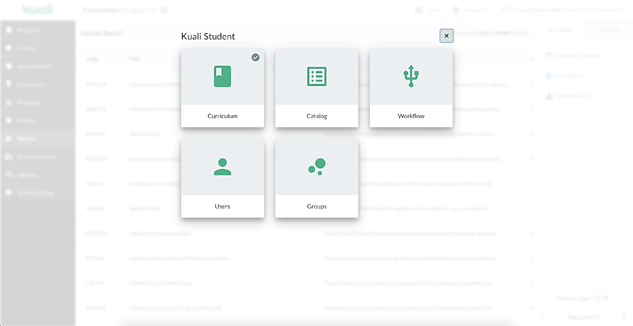
KUALI
One Place, One Solution
Curriculum
CURRICULUM
ONE PLACE
Catalog
CATALOG
Notes:
One Place, One Solution
For the project we recommend use of Kual Curriculum & Catalog management – one place for curriculum and catalog for a seamless and intuitive experience.
Kuali’s Curriculum and Catalog Management helps administrators with every aspect of the process from proposing a course to publishing the academic catalog for students to accessibly review, search, and discover.
Whether you offer traditional courses and programs or are forging new pathways to learning and the workplace, we’re here to help you manage it all in one place
One of the things you’ll notice with other vendor options is how disjointed the user experience can feel when they move from one URL to the next – they are often designed in silos using new developers who haven’t spent any time in their other solutions – making a much more cumbersome user experience or journey – especially when using assistive technology – going from one platform to the next. It can also become costly for adopters while the company tries to tie the different technology together more – the responsibility often falls on the client to pay more money or spend more time and resources, to have the efficiencies expected from the beginning.
--
Kuali's flexible software-as-a-service (SaaS) is hosted in the cloud and provides easy access to a streamlined, accessible, and environmentally sustainable platform One place in the cloud, for access across many devices around the world.

Slide 15
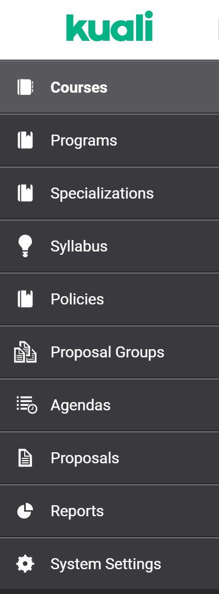
KUALI
One Place, One Solution for All Content Types
Notes:
One Place, One Solution for All (Curriculum) Content Types
Courses
Programs
Specifications
Syllabus
Policies
Proposal Groups
Agendas
Reports
Academic Plan

Slide 16
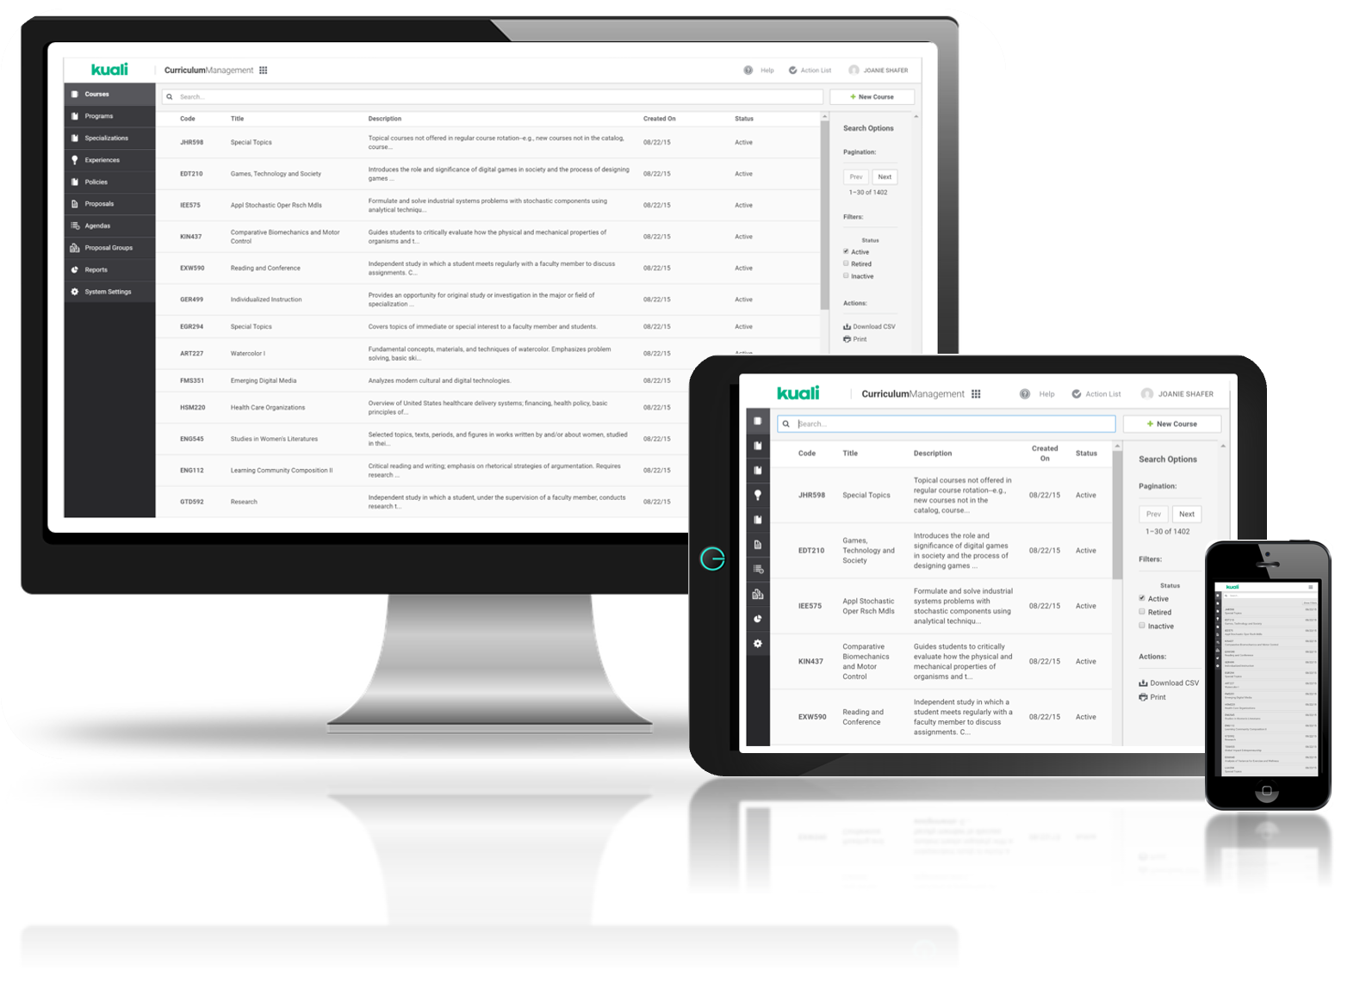
KUALI
One Place, Evolve Curriculum
Before
After
Next Generation Smart Forms
Notes:
One Place to Evolve Curriculum in CM with Next Generation Smart Forms
Before & After Visual
Before: It feels as bad as it looks. Keeping track of the number of proposals or managing data from disparate systems that don’t integrate easily with one another.
After: Kuali is one streamlined solution for curriculum and catalog to digitize records, automate workflows, and streamline processes to increase efficiencies and maintain the academic (student) record.
In one place – you’ll be able to evolve curriculum over time using a future-proof platform designed for the production, review, and management of high quality curriculum that the University is known for.
Kuali Curriculum (CM)
Digitize records
Flexible Next generation smart forms
Apply your specific business logic
Graphically build workflows that can automatically assign the right process

Slide 17
KUALI
One Place, Dynamically Build Catalog
Before
After
Notes:
One Place, Dynamically Build Catalog
In one place you can dynamically build catalog from curriculum and include other content that might not go through the curriculum review process though is still needed to be content in the catalog copy/publication.
--
Through our unique curriculum first approach you can begin by implementing Curriculum first to dynamically build Catalog.

Slide 18
KUALI
One Place, On-Demand Publishing
Provide Broad Access
Responsive Design
Desktop
Laptop
Tablet
Mobile
Notes:
One Place, On-Demand Publishing
In one place you can dynamically publish on-demand without putting in a support request or ticket which is unique to Kuali.
Publish in fully responsive design and mobile-ready platform for one single instance of the catalog which is often preferred (as opposed to having a separate mobile site considering the type of document/publication). The template shifts as though it was built for the device you’re on (tablet, mobile, laptop, desktop).

Slide 19
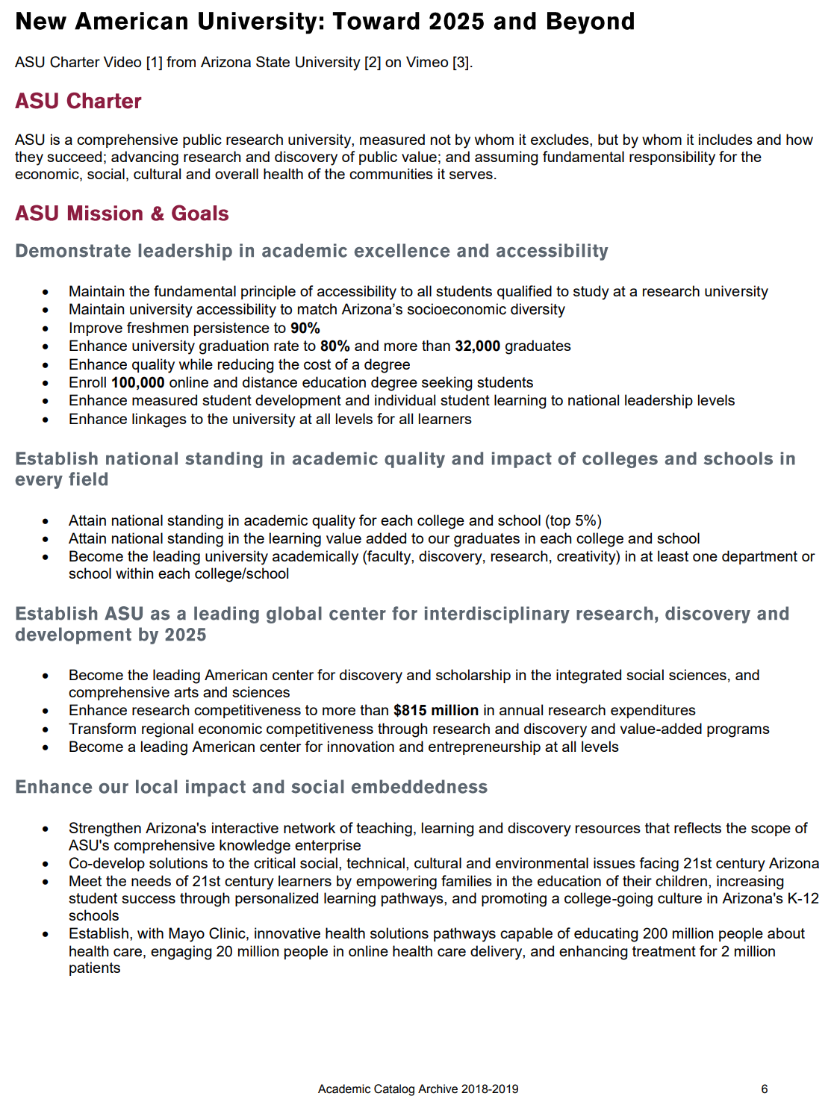
KUALI
One Place, On-Demand Publishing
Notes:
One Place, On-Demand Publishing
(Previous Slide: In one place you can dynamically publish on-demand without putting in a support request or ticket.
Publish in fully responsive and mobile ready platform. One instance of the catalog which is preferred (as opposed to having a separate mobile site) - the template shifts as though it was built for the device you’re on (tablet, mobile, laptop, desktop).
Use APIs to share content with other websites on campus or integrated systems.
Given the different mediums available with publication, people will easily connect and begin sharing with others.
--
Integration
Kuali Curriculum (CM) & Catalog (CAT) Management Solution
Kuali Student Analytics
Kuali Student Data Export
Kuali Student APIs
Kuali SIS Connector for Curriculum

Slide 20
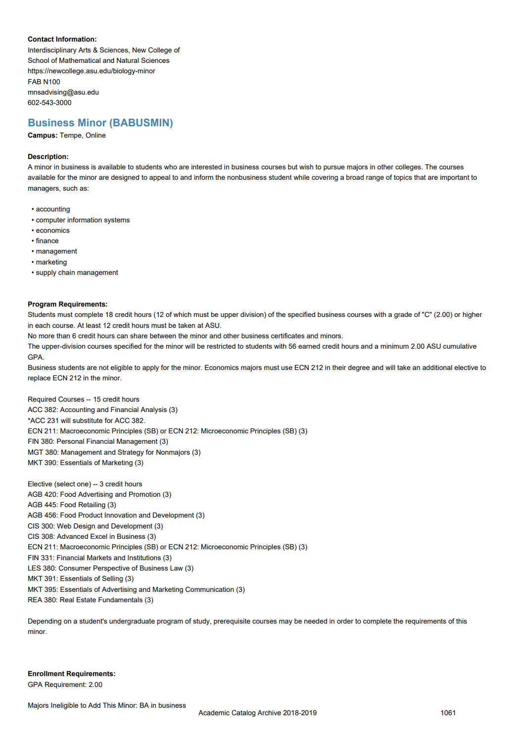
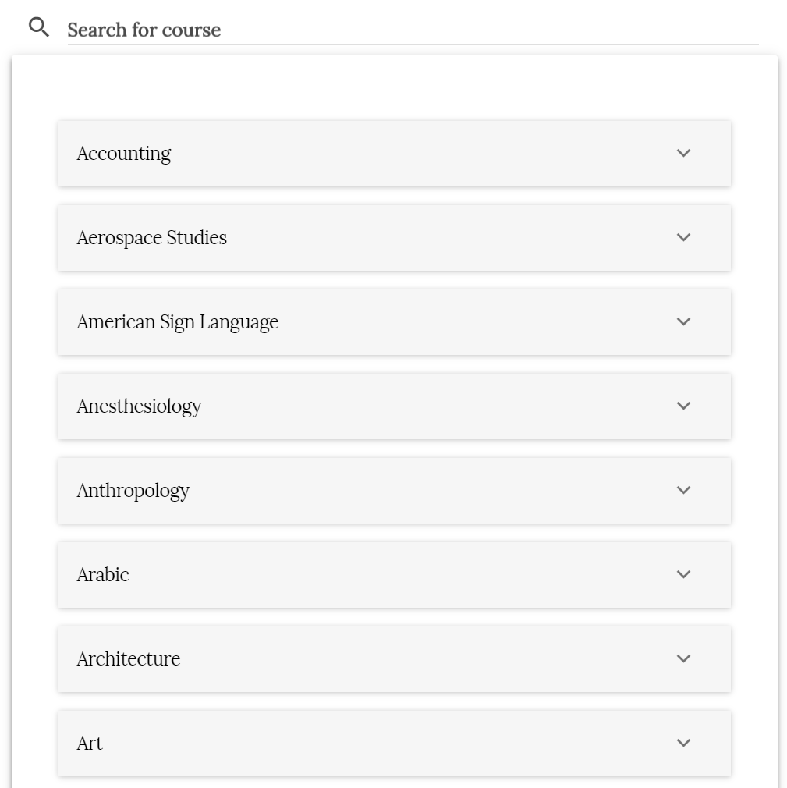
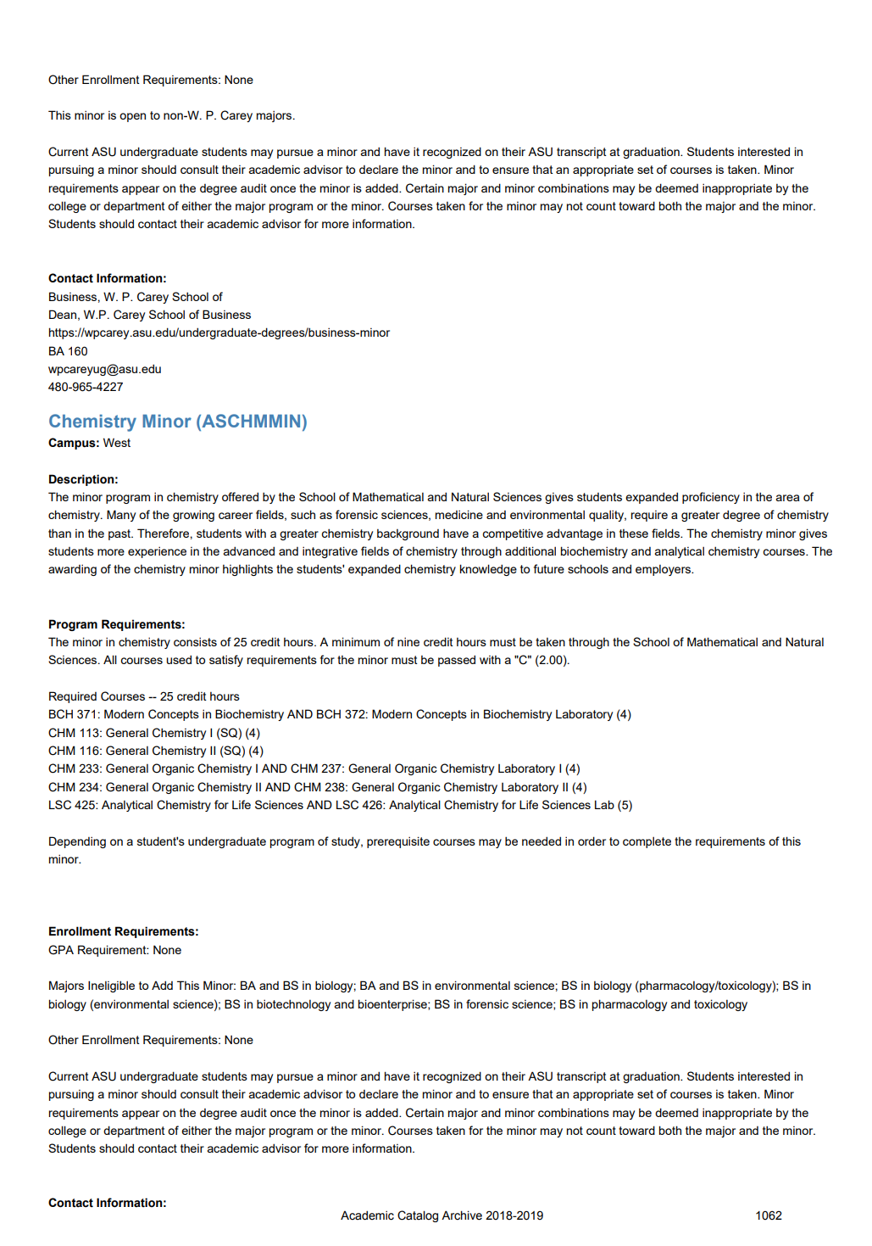
KUALI
One Place, Search & Discover
Before
After
Notes:
One Place for Search & Discovery
One Place for a smarter search with accurate data to help students/prospective students find exactly what it is they are looking for with fewer clicks.
Before: When considering the catalog copy, search is often cumbersome to find what you’re looking for. PDF catalogs are often set up with a specific organizational hierarchy.
After: Search with Kuali is intuitive and what users expect. Moving to online dynamically created catalogs exemplifies search & helps users find what they’re looking for as quickly as possible. This includes the ability to search archived copies.
Navigation is set up in a way that makes sense for your audience or students/stakeholders. Users can take fewer clicks to find what they’re looking for. Plugging in your API can help explore analytics - like the number of times a certain program is visited in the catalog; that navigation path; or even terms that are being searched for. With insight, you can learn more about how the student or prospective student navigates your catalog in order to take the fewest clicks possible to what the current or prospective student is looking for - having a program/degree/course oriented catalog for example, or providing links to sync the student journey with anticipated experience.
Have confidence that what you’ve taken the time to review and produce is then available to easily search to learn more about. There are opportunities to focus on how students navigate content in order to let students take fewer clicks to find the information they are looking for.

Slide 21
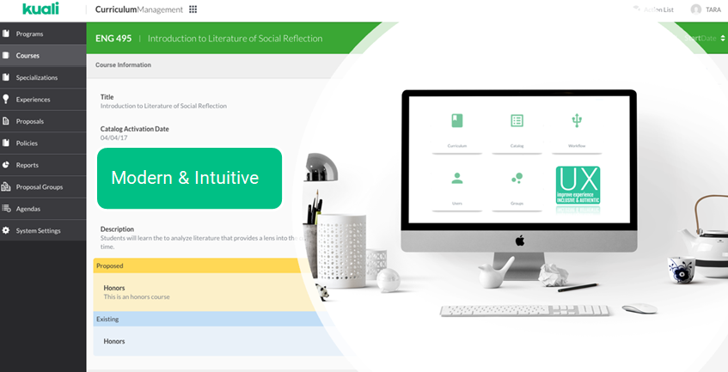
KUALI
One Place, One Solution
Inclusive &
Accessible
VPATS 2019
WCAG 2 AA Goals
Accessible Customer Service (AODA) Training
Notes:
One Place, One Solution (for many)
Inclusive & Accessible (VPATS 2019; WCAG 2 AA Goals; Accessible Customer Service)
Recently completed VPATS with an independent 3rd party reviewer who identifies as visually impaired. While some vendors may be focused on “checking the box” on accessibility, we focus on designing what is useable and intuitive and continue to reduce barriers with continued training for a truly accessible and useable site.
Modern & Intuitive
Fresh and innovative solution in ed-Tech
Tailored with institution-specific branding and guidelines for a seamless experience
Increases user adoption

Slide 22
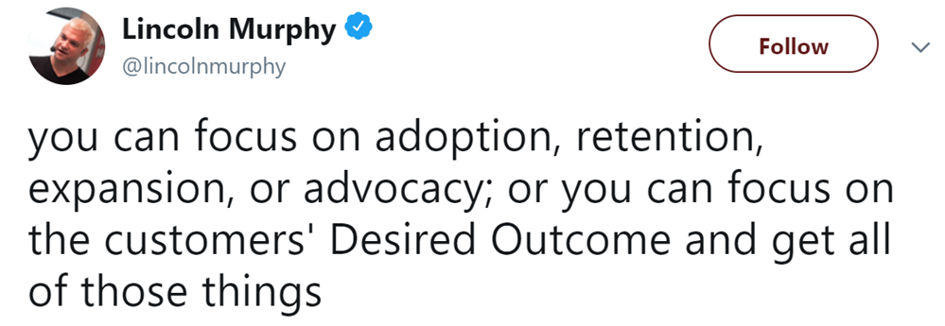
KUALI
One Place, Desired Outcome
Desired Outcome is a Transformative Concept
Notes:
Customer Success, Desired Outcome
Desired Outcome is a Transformative Concept
“You can focus on adoption, retention, expansion, or advocacy; or you can focus on the customers’ Desired Outcome and get all of those things.”
-Lincoln Murphy’s model of Customer Success

Slide 23
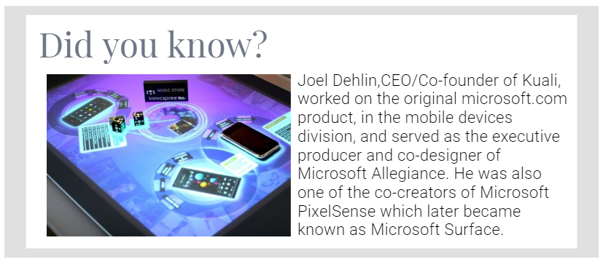
KUALI
One Place, Innovative Leadership
Notes:
Fun Fact / Did you know?

Slide 24
KUALI
One Place, One World
Kuali is Environmentally & Socially Conscious
Notes:
One World, Environmental & Social Consciousness
Sustainable architecture - modular solutions
You reduce paper, we will plant a tree (or give back in a way that makes sense considering geographical locations).
Equality in the workplace - We pledge for parity. & Support women in tech.

Slide 25
KUALI
DEMO OF KUALI
PART II
LIVE DEMO OF KUALI, ONE SOLUTION
QUESTION & ANSWER THROUGHOUT
Notes:
Presentation Divider
--
Demo of Kuali
Part II
Live Demo of Kuali, One Solution
Questions & Answers Throughout
Once the live demo is complete, transition from the solution back to the slides for Part III of the agenda (closing, next steps).

Slide 26
KUALI
SUMMARY
SUSTAINABLE MODULAR TECHNOLOGY
FLEXIBLE & CONFIGURABLE SOLUTION
MODERN & INTUITIVE USER EXPERIENCE (UX)
NEXT GENERATION SMART FORMS
INSTITUTION-SPECIFIC RULES & GUIDELINES
PROGRESSIVE DISCLOSURE
DYNAMICALLY ADJUSTS FOR EASE OF USE
DYNAMICALLY BUILD CATALOG
ON-DEMAND RESPONSIVE DESIGN PUBLICATION
PRINT-READY PDF (ACCREDITATION, VETERANS AFFAIRS, PREFERENCE)
INTEGRATION (OPEN APIS, SIS CONNECTOR)
Notes:
Presentation Divider
--
Demo of Kuali
Part II
Live Demo of Kuali, One Solution
Questions & Answers Throughout
Once the live demo is complete, transition from the solution back to the slides for Part III of the agenda (closing, next steps).

Slide 27
KUALI
CLOSING & NEXT STEPS
PART III
CLOSING (SLIDES)
NEXT STEPS
Notes:
Presentation Divider Slide
--
Closing & Next Steps
Part III
Closing (slides)
Next Steps

Slide 28
Did You Know?
KUALI
In Malaysia, a wok-like pan is called a kuali (small wok) or kawah (big wok)
Conveniently, you can find recipes to try with your wok online at kuali.com
You can find us at kuali.co

Slide 29
KUALI
Why
Retire Outdated, inefficient, and manual processes
Improve overall user experience
Reduce ecological footprint
Restore community, transparency, and accountability
Elevate efficiencies for faculty, staff, and students
Provide broad access to streamlined, accessible, and sustainable platform
Notes:
SUMMARY (TAILORED TO INSTITUTION)
Retire outdated, inefficient, and heavily manual processes.
Improve overall user experience (UX) for all, inclusivity
Reduce our ecological footprint: with sustainable modular solutions to reduce technological waste and reduce the amount of paper being used with curriculum and catalog projects
Restore community, transparency, and accountability
Elevate efficiencies for faculty, staff, and students
Provide Broad Access to streamlined, accessible, and sustainable platform

Slide 30
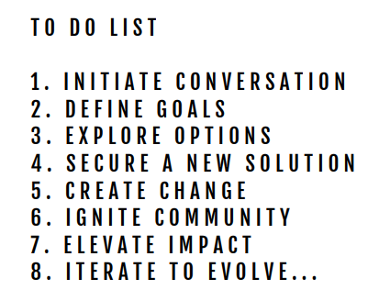
KUALI
Why
One Place for Your Next Steps
...where we recognize the interconnections of education, technology, career, and impact of the world in which we live.
Notes:
Why Kuali?
One Place for your New Steps
...where we recognize the interconnections of education, technology, career, and impact of the world in which we live.
Consider distilling the process you’re in to a “to do list”. For example...
You’ve already Initiated Conversation
Taken the time to Define Goals for the Project
And You’re Currently Exploring Options
So that you can Secure a New Solution.
By selecting Kuali as a collaborative partner, we can Create Change,
Ignite Community,
Elevate Impact,
And Iterate to Evolve...in the world of which we live so that you can (next slide).....

Slide 31
KUALI
Do More of What Matters
Notes:
...find time to do more of what matters - like continuing with the production of high quality curriculum that your institution is known for and focus on connecting with higher level strategic initiatives at the institution.

Slide 32
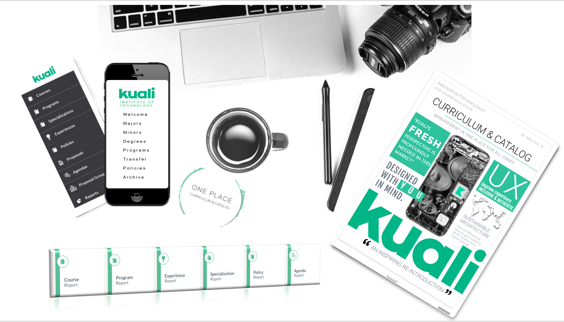
KUALI
Thank you.
We hope to continue the conversation with you and create lasting change - together.
Notes:
Thank you.
We hope to continue the conversation with you and create lasting change - together, beginning in one place, one solution.
Please Note: The primary focus with Gartner for our advisory meeting is on the Introductory slides listed above and doesn’t include demo slides, use cases, implementation slides, or other general slides that we might pull from the appendix to use to help tailor a presentation to the needs of the prospective client presentation.
Because of this, we left the section divider/placeholder of “Appendix Slides” here as an FYI, but didn’t include the sample appendix slides for this experience.

Slide 33
KUALI
APPENDIX
Notes:
Presentation Divider
--
Demo of Kuali
Part II
Live Demo of Kuali, One Solution
Questions & Answers Throughout
Once the live demo is complete, transition from the solution back to the slides for Part III of the agenda (closing, next steps).

Slide 34
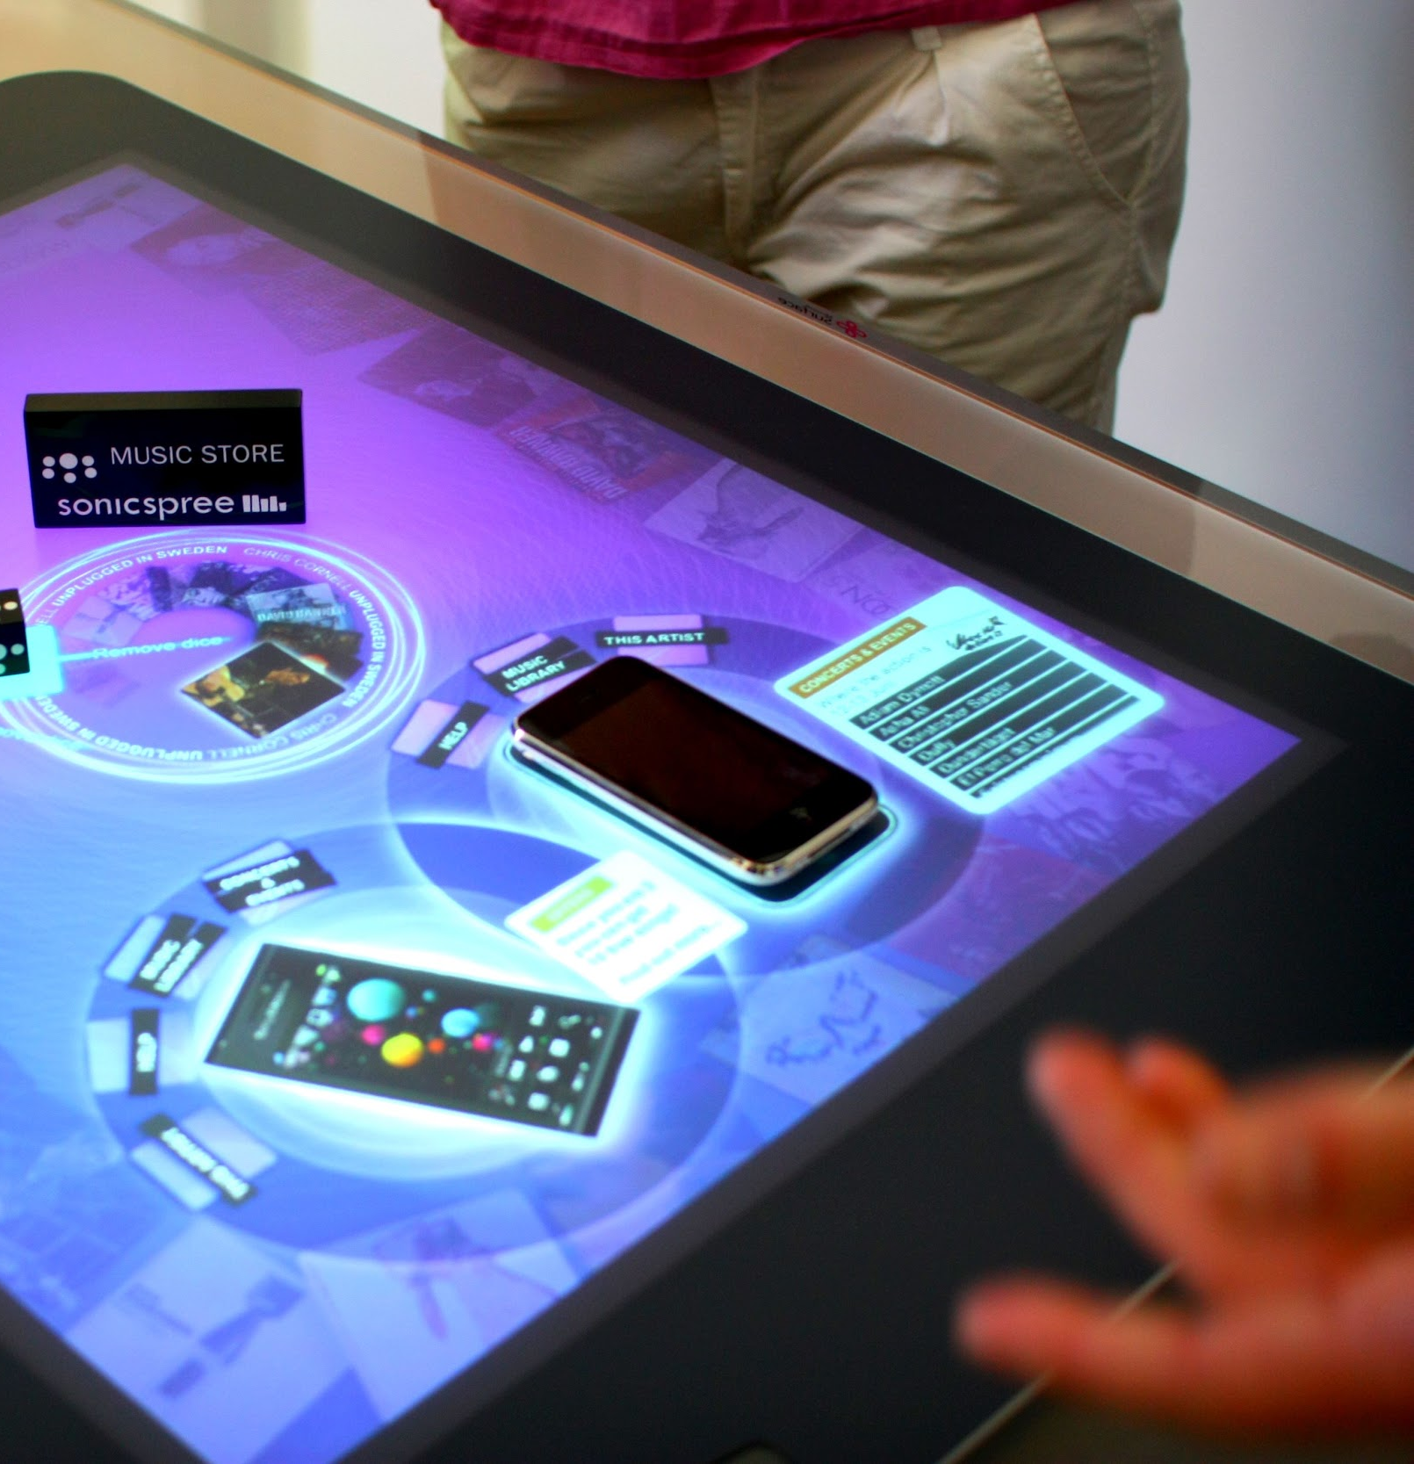
Fun Fact
KUALI
Joel Dehlin, CEO/Co-founder of Kuali, worked on the original microsoft.com product, in the mobile devices division, and served as the executive producer and co-designer of Microsoft Allegiance. He was also one of the co-creators of Microsoft PixelSense which later became known as Microsoft Surface.

Slide 35
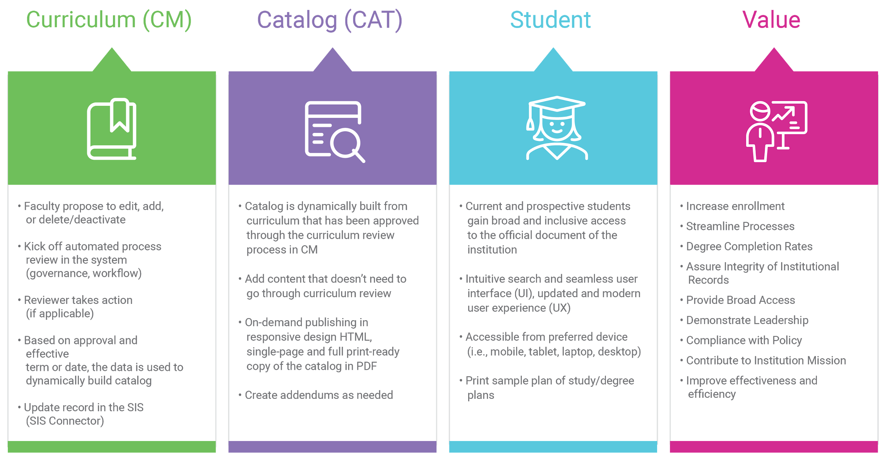
KUALI
APPENDIX
Notes:
Presentation Divider
--
Demo of Kuali
Part II
Live Demo of Kuali, One Solution
Questions & Answers Throughout
Once the live demo is complete, transition from the solution back to the slides for Part III of the agenda (closing, next steps).

