Slide 1
Online Education Initiative:
Information and Opportunities
Kate Jordahl
Director of Strategic Planning & Operations
August 4, 2017

Slide 2
Online Education Initiative Mission: Increase student
COMPLETION of transfer degrees by working together to increase access to quality online courses and support
services for students.

Slide 3
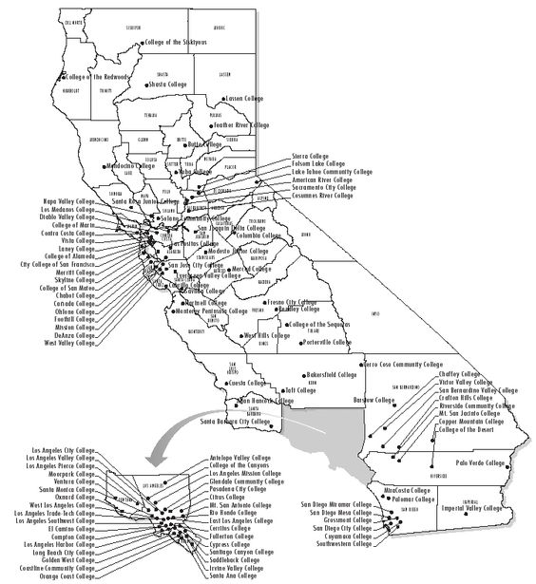
California Community Colleges
One in every five community college students in the nation attends a California Community College
One in three takes at least one online course
2015-16: 57,883 online sections with 796,600 unduplicated students
Notes:
With more than 2.1 million students on 113 campuses, the California Community Colleges is the largest system of higher education in the United States.
One in every five community college students in the nation attends a California community college.
Most of the 113 colleges are on the semester system, but Foothill, De Anza and Lake Tahoe community colleges are on the quarter system.
Three out of every 10 Californians ages 18-24 are currently enrolled in a community college.
Over 67 percent of California community college students are people of diverse ethnic backgrounds and roughly 53 percent are female.

Slide 4
Student Access & Completion
Increase online course quality
Support course design standards
Professional development for faculty
Provide online resources and tools (part of a larger learning ecosystem)
Accessibility support

Slide 5
Goal? Increased:
Access. Quality. Completion

Slide 6
Online Course Exchange
Enhanced access for students to get a course needed for completionfrom another college in the consortium that they cannot get at their home college, without a lot of hassle. Students...
Can combine units for financial aid award.
Do not need to repeat placement & orientation
Receive a combined schedule
FIND THE CLASSES THEY NEED!
Teamwork Puzzle Concept - credit link: thegoldguys.blogspot.com/ or www.lumaxart.com/

Slide 7
Online Course Exchange
Enhanced access for students to get a course needed for completionfrom another college in the consortium that they cannot get at their home college, without a lot of hassle. Students...
Can combine units for financial aid award.
Do not need to repeat placement & orientation
Receive a combined schedule
FIND THE CLASSES THEY NEED!

Slide 8
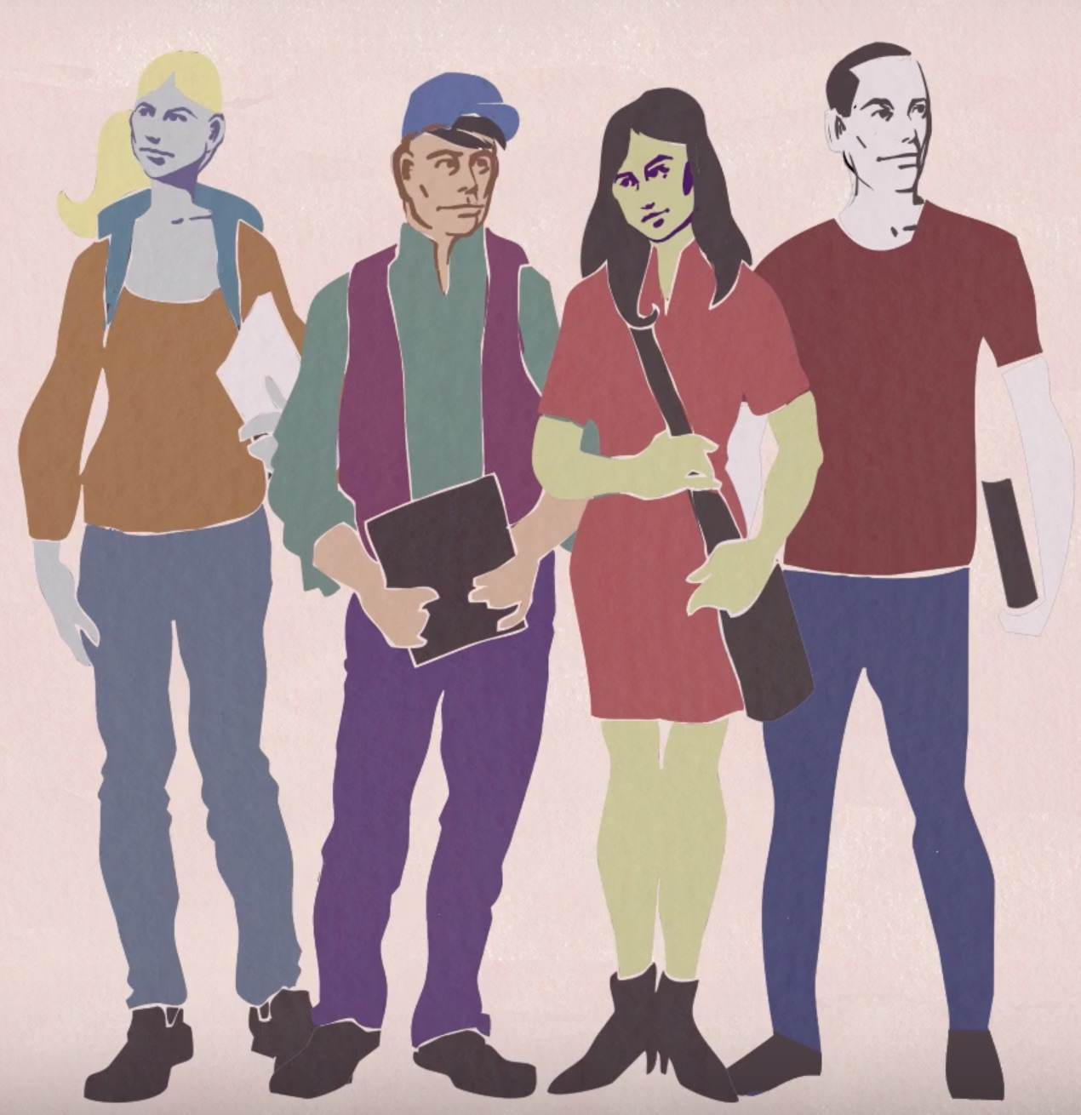
Advantages of Course Exchange
COLLEGES - Flexibility and tool for Enrollment Management
STUDENTS - Find and complete the classes they need to complete their degree and reach their transfer goals
FACULTY - Supports quality online classes through resources, accessibility support and professional development
Screen shots from Course Exchanges: The intended consequences (CC) e-Literate TV

Slide 9
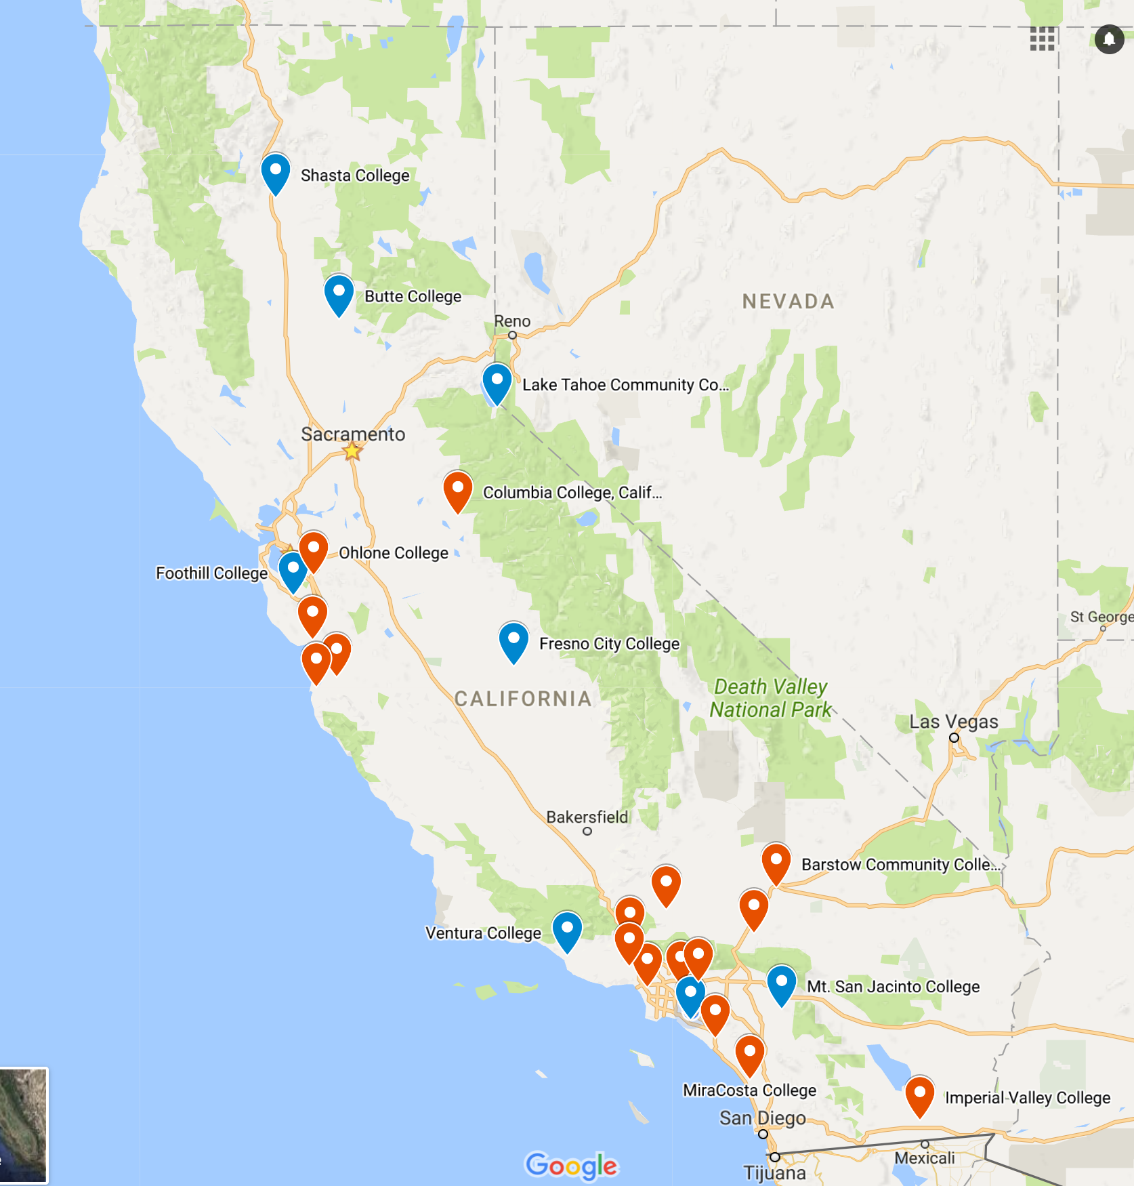
Course Exchange in production:
Butte
Coastline
Foothill
Fresno
Lake Tahoe
Ventura

Slide 10
OEI Course Exchange: Student Guide

Slide 11
Course Exchange: Current Status
Launched v1.0 in January 2017
Currently 6 pilot colleges live for Fall 2017 registration
Working with additional colleges on implementation
Version 2.0 deployment at end of September
Key milestones:
Students pilot priority registration workflows for Fall 2017 term
Version 2.0 automates financial aid activities, introduces feature flags, reporting enhancements

Slide 12
24 OEI Consortium Colleges
Antelope Valley
Barstow
Butte
Cabrillo
Coastline
College of the Canyons
Columbia
Foothill
Fresno City
Hartnell
Imperial Valley
Lake Tahoe
Mira Costa
Monterey Peninsula
Mt. San Antonio
Mt. San Jacinto
Ohlone
Pierce
Rio Hondo
Saddleback
Shasta
Ventura
Victor Valley
West Los Angeles

Slide 13
How do you participate?
Submit your class for review
Apply to be a POCR (Peer Online Course Reviewer)
Take advantage of training opportunities
@ONE
Can•Innovate

Slide 14
Review Process
Start Here: Step-by-Step Guide to Course Review

Slide 15
Faculty Voices: Lindsey J Bertomen
Instructor, Administration of Justice Hartnell College
OEI has completely changed the way I look at online education. The entire initiative is focused on student success and they do this by creating an environment of available resources.
OEI provided professional development training, great networking with experienced educators and well vetted apps for use in the online classroom. Since the inception of OEI, I have had the benefit of shared experience and expert advice that has really given me insight on how I can improve my online content delivery.

Slide 16
Faculty Voices: Wendy Bass
Distance Education Coordinator and Instructor, Early Childhood Education Los Angeles Pierce College
One of the best features of the OEI ecosystem is the ability to find support in so many place. Prior to this I was isolated as a DE Coordinator using RL Moodle, there was only one other coordinator I could call when I had issues and I did not want to bother her all the time. Now with so many DE Coordinators supporting Canvas, I have a complete network to go to for support. Additionally, OEI recommendations and the online course rubric have helped me to emphasize some best online practices for my faculty.

Slide 17
Faculty Voices: Xochitl Tirado
Distance Education Coordinator and Instructor, English Imperial Valley College
Putting my course through the OEI review process has allowed me to build a stronger course and to reflect on the needs of my students.

Slide 18
Thanks!
Kate Jordahl Director of Strategic Planning & Operations
kjordahl@ccconlineed.org
CCC Online Education Initiative (OEI)
Office: 650-949-6187
Visit us online at http://cccOnlineEd.org
The OEI is funded by a grant from the California Community Colleges Chancellor’s Office

Slide 19
ADDITIONAL SLIDES

Slide 20
What are the possible outcomes of Course Exchange
For Students
For Faculty
For Colleges

Slide 21
Without Course Exchange
A Student signs up for two classes at your college
That student can’t find another class for full-time status
Student Drops out

Slide 22
Without Course Exchange
Loss of two class enrollments for college
Possible loss of completion for college if student was ready to graduate
Loss of progress for student

Slide 23
With Course Exchange
A Student signs up for two classes at your college
That student uses Course Exchange to find the additional needed class for full time status
Student stays in school and completes their degree or transfer goal

Slide 24
With Course Exchange
Home college preserves the two enrollments and get the completion
Teaching college gets one class enrollment
SUCCESS for student

Slide 25
Another Course Exchange Story
Your College has an advanced class that does not have sufficient enrollment to be offered each year.
Class is Cancelled
Students don't get the class they need
College loses the enrollments for those students

Slide 26
Results?
Loss of enrollments
Delay of students progress toward degree or transfer goals
Faculty might lose a class assignment for that term

Slide 27
With Course Exchange
College enrolls additional students from other colleges to fill the class
College keeps the enrollments that would have been lost from a cancelled class
Local Students stay in school and completes their degree or transfer goal
Course Exchange students get a class they need
Faculty keep their class assignment

Slide 28
Advantages of Course Exchange
Another tool for Enrollment Management as campus and student needs change
Allows student to find the classes they need to complete their degree, reach their transfer goals
Supports quality online classes through resource, accessibility support and professional development

Slide 29
Student Guide to the Online Course Exchange
This video shows how the course exchange enrollment looks to the student. Other videos about course exchange and online learning are in this playlist.

