Slide 1
Accreditation 101: A Crash Course Orientation for Those New to Accreditation Work

Slide 2
Presenters
Laura Adams, ASCCC Accreditation Committee Member
Stephanie Curry, ASCCC Area A Representative
Amber Gillis, ASCCC South Representative

Slide 3
Breakout Description
The process of accreditation can seem overwhelming. This session is for individuals who are new to accreditation work or those who would welcome an overview refresher. Some of the questions that will be answered are: Who is ACCJC? What is the accreditation process? What are the standards and why do we have them? Who are on the accreditation teams? What are the benefits of being an accredited institution? Also, please feel free to bring your own questions for a peer discussion.

Slide 4
Why are Colleges Accredited?
Encourage institutions to continuously improve:
Academic quality,
Institutional effectiveness,
Student success
Provides assurance to the public that the college meets:
Set Standards and Eligibility Requirements (ERs)
ACCJC Commission Policies
Education received (degree) is legitimate
Needed to receive federal financial aid - Title IV

Slide 5
Who Is ACCJC?
Who is ACCJC?
Accrediting Commission for Community and Junior Colleges
Part of WASC (Western Association of Schools and Colleges)
Accredits community colleges and other associate degree granting institutions in the Western region.
ACCJC recognized by the US Dept. of Education

Slide 6
Regional Accreditation—It’s not just about CCCs

Slide 7
Peer Review
What is accreditation?
Voluntary, non-governmental, self-regulation, peer review participation
Systems of self-evaluation on standards of good practice:
Mission, goals, objectives
Appropriateness, sufficiency, utilization of resources
Usefulness, integrity, effectiveness
Achievement of intended student learning outcomes
Assurances of institutional integrity/effectiveness & educational quality

Slide 8
What is the Accreditation Process ?

Slide 9
New Formative and Summative Approach
A “Formative/Summative” model for comprehensive reviews
The college’s self-study is submitted to the review team a semester prior to the site visit for the Team ISER Review (TIR)
During the TIR, peer review team conducts a formative evaluation:
Verifies compliance with many operational aspects, taking them “off the table” as not requiring onsite verification
Specifies areas where additional information is needed, or where the institution needs to further develop its processes, in anticipation of the site visit a semester later
Identifies focused “Core Inquiries” that will be pursued during the on-site visit
A smaller team (and/or a shorter visit schedule) conducts the Focused Sit

Slide 10
What are the Standards?
Current Standards (2014)
Standard I- Mission, Academic Quality, Intuitional Effectiveness and Integrity
Standard II- Student Learning Programs and Support Services
Standard III- Resources
Standard IV- Leadership and Governance
New Standards Currently in development. Expected to be used for colleges 2025 and beyond.

Slide 11
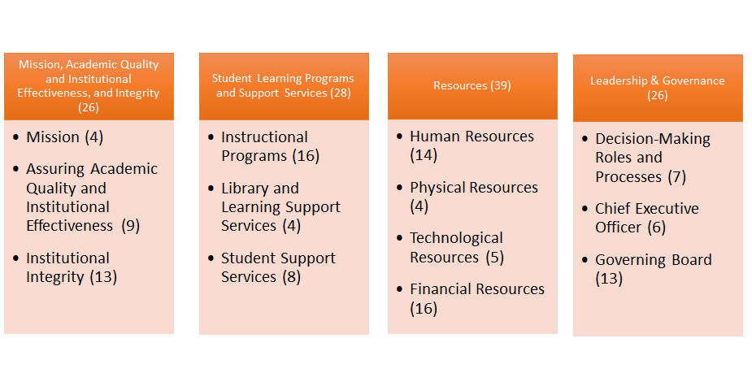
Accreditation Standards at a Glance

Slide 12
Key Concepts Woven Throughout Standards
Focus on achieving institutional mission
Integrity and honesty in institutional policies and actions
Focus on student outcomes
Student achievement: Completion of meaningful educational goals
Student learning: Attainment of demonstrable knowledge and skills
Metrics and evidence used to assess institutional quality
Ongoing internal quality assurance practices
Continuous improvement for high performance

Slide 13
What can be used for Evidence?
Policies on curriculum review & implementation
Evaluation of student learning outcomes
Review elements, cycles/timelines, connection and correlation between program review with institutional planning
Usage of program review data at all levels and across multiple cycles
Actions taken (improvements) on the basis of available data, program review, etc. - What have we done? Examples?
Student achievement data
Planning data (external and internal scans, community)
Surveys

Slide 14
Quality Focus Essay (QFE)
Used for the College to identify policies, procedures, or practices that need to be changed in order to improve student learning and/or student achievement.

Slide 15
What are Eligibility Requirements (ER)?
The Commission’s Eligibility Requirements represent the minimum qualifications for institutions seeking an accredited status with ACCJC
Member institutions are expected to maintain compliance with the Eligibility Requirements at all times. Ongoing compliance with Eligibility Requirements will be monitored during an institution’s comprehensive review process
Sample ER’s
Offers Degrees, Has a CEO, College Mission, Governing Board, Student Learning Outcomes, Academic Freedom, Financial Resources

Slide 16
ACCJC Policies
Sample Policies for Guidance and Clarification
Baccalaureate Degrees
Competency Based Education
Distance Education and Correspondence Education
Role of Accrediation Liaison Officers (ALO’s)
Social Justice
Substantive Change

Slide 17
ISER- Institutional Self Evaluation Report
College appraises itself: Eligibility Requirements,
Accreditation Standards, Commission Policies
Honest self-assessment of strengths & weaknesses
Assessment of meeting ACCJC standards
On-going self-evaluation of activities for continuous improvement
Reflective and forward thinking review & analysis of college processes, procedures, & practices
Future planning with Quality Focus Essay (QFE)

Slide 18
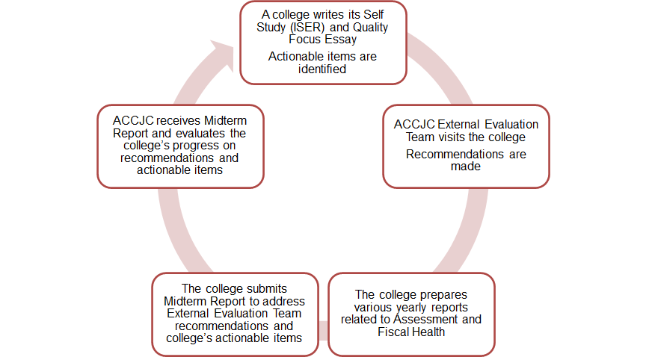
Accreditation Cycle

Slide 19
Who is on Accreditation Teams?
Our Peers
Typically 8-12 members:
Faculty and Administrators (discipline, counselor, librarian, researcher, CIO, CEO, CBO, DE Coordinator, SLO Coordinator…);
Commission Liaison
* You can volunteer to be on a team!

Slide 20
What is the Faculty Role in Accreditation?
Faculty Roles in Accreditation is one of the ASCCC 10+ 1
#7 Faculty roles and involvement in accreditation processes
ASCCC created a handbook, “Effective Practices in Accreditation: A Guide for Faculty,” in fall 2015.
“The Accreditation Standards begin with the message, ‘The primary purpose of the ACCJC-accredited institution is to foster student learning and student achievement.’ That is, obviously, impossible without faculty involvement” (3).
Most colleges have an Accreditation Faculty Chair/Coordinator.

Slide 21
Additional Questions?

