Slide 1
Honoring Faculty Leadership Dolores Davison, ASCCC President Karla Kirk, ASCCC North Representative

Slide 2
Event Mask Guidelines
The Westin Long Beach continues to follow all city and state guidelines regarding safety and mask requirements. At this time, the hotel is enforcing the mask mandate, and all guests and employees are required to wear a mask when in public spaces throughout the hotel (except when actively eating or drinking in the hotel restaurant or event space). There are signs posted throughout the property to remind people of the mask requirement and masks are available at the Westin Long Beach front counter or the ASCCC Registration Desk.

Slide 3
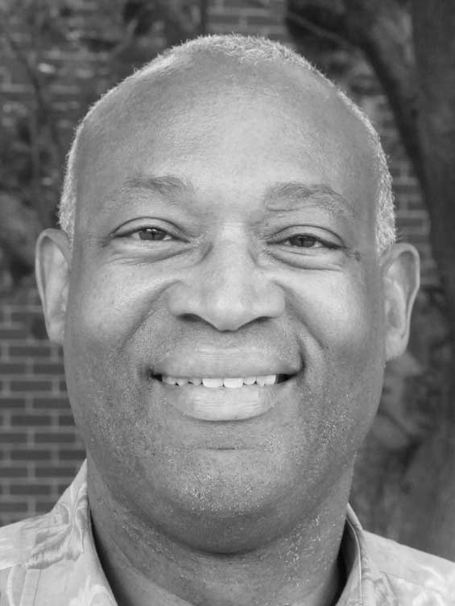
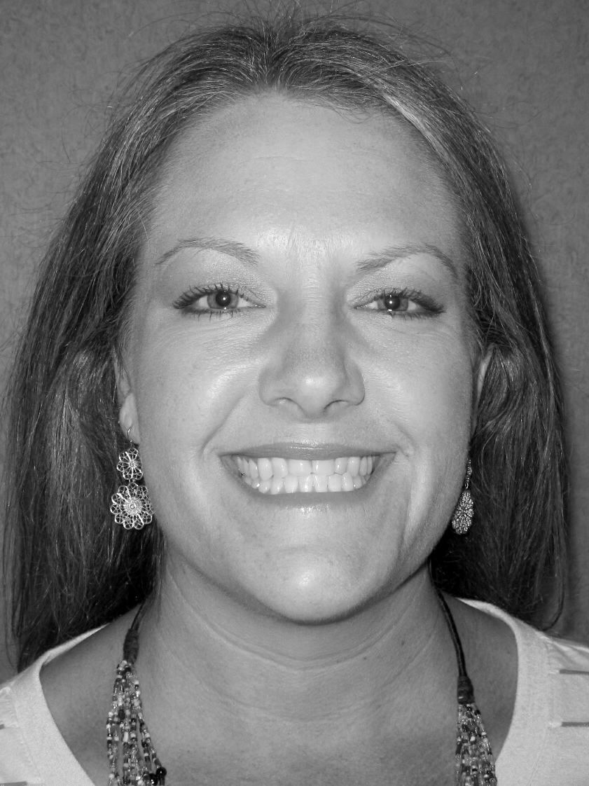
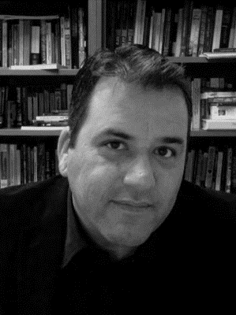
ASCCC Executive Committee 2021-22
Regional
Representatives
Christopher Howerton
North Representative
Karla Kirk North Representative
Lance Heard
At-Large Representative
Carrie Roberson
At-Large Representative
Amber Gillis
South Representative
Manuel Velez
South Representative

Slide 4
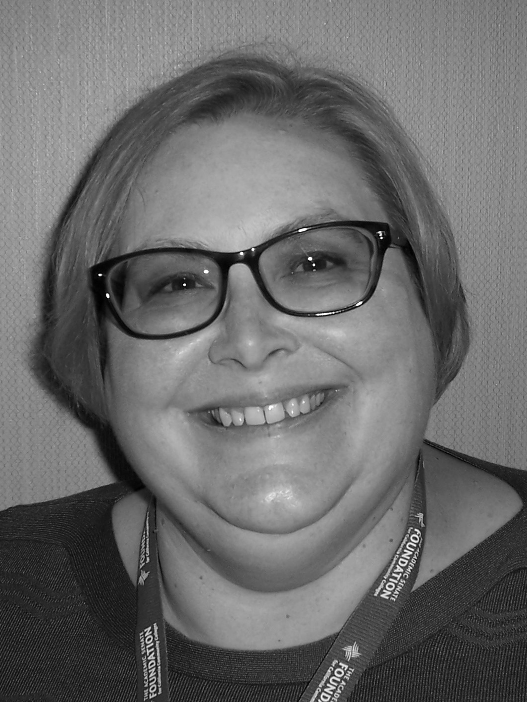
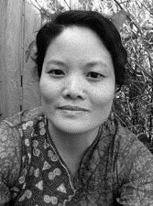
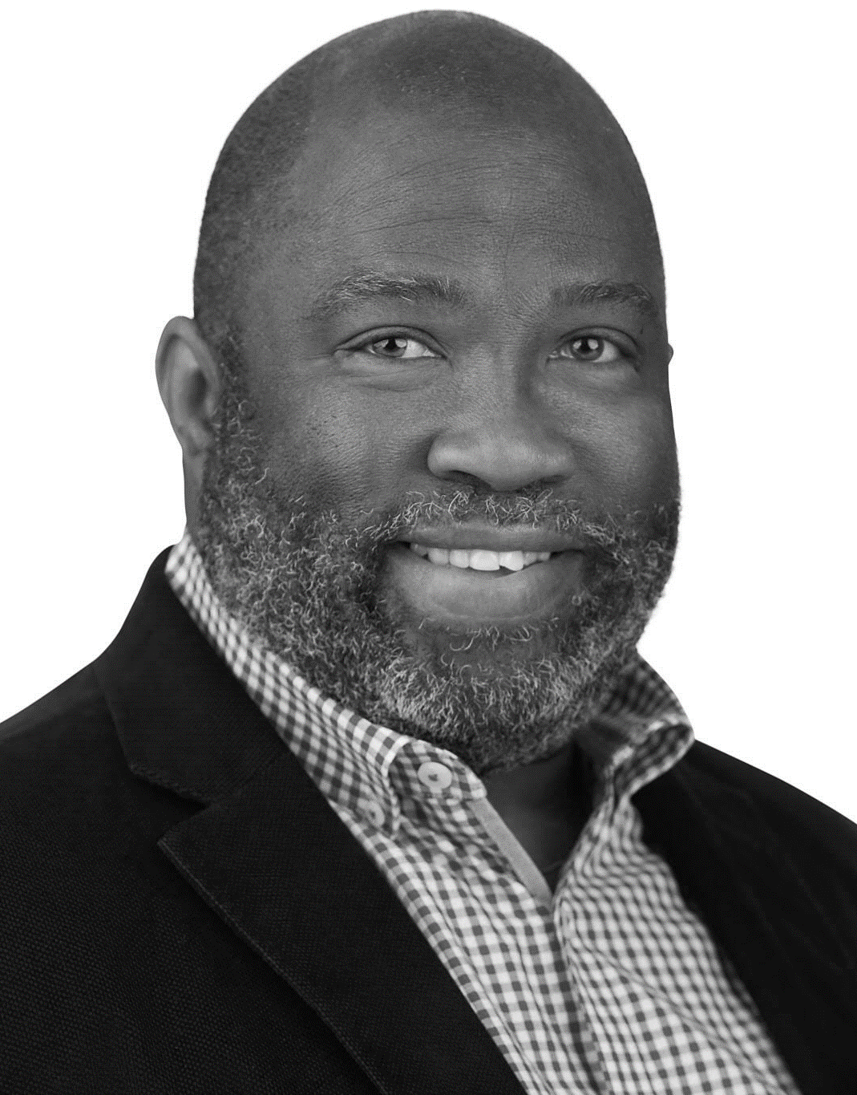
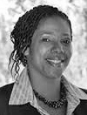
ASCCC Executive Committee 2021-22
Area
Representatives
Stephanie Curry
Area A Representative
Karen Chow
Area B Representative
Robert L. Stewart Jr. Area C Representative
LaTonya Parker
Area D Representative

Slide 5
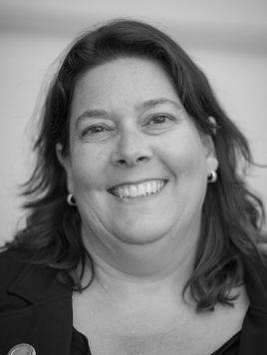
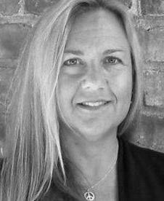
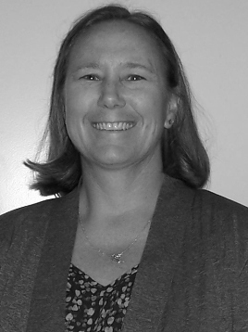
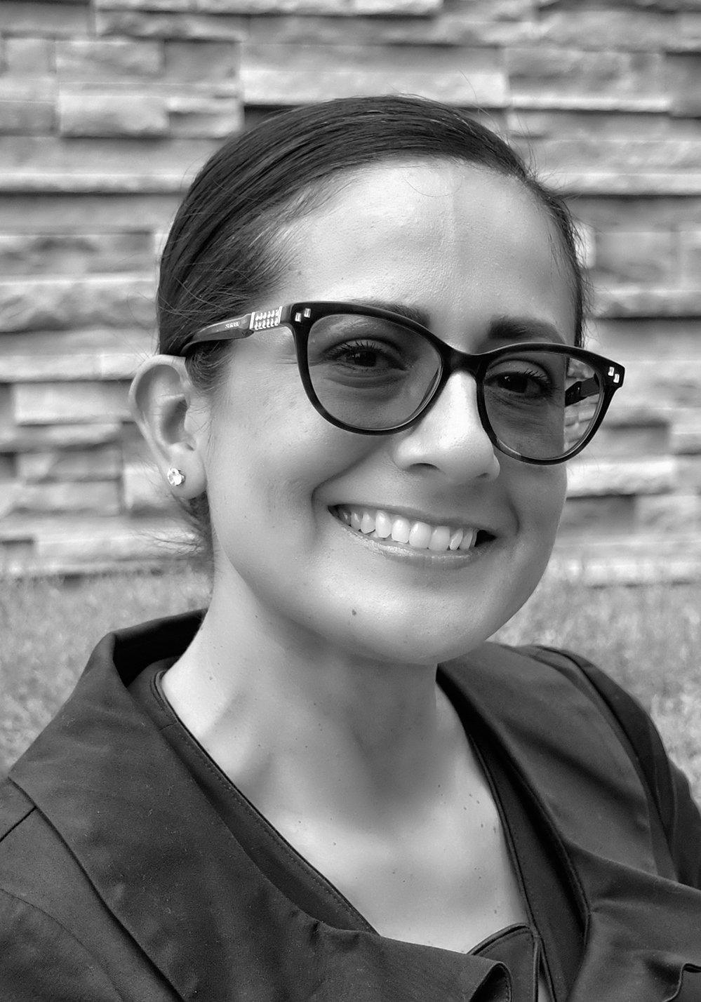
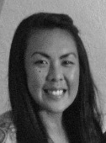
The 2021-22 Executive Committee
Officers
Dolores Davison
President
Virginia May
Vice President
Cheryl Aschenbach
Secretary
Michelle Bean
Treasurer
Krystinne Mica
Executive Director

Slide 6
Board of Governors Representatives Jolena Grande Roy Shahbazian Cypress College Santa Ana College

Slide 7
Faculty Empowerment & Leadership Academy – Karla Kirk, ASCCC Area A Representative

Slide 8
2020-2021 Award Winners -- Exemplary Program Award
2021 Award Winners
Sierra College Undocumented Student Support Santa Barbara Community College WELL Center Ventura College Faculty Academy
Honorable Mentions
College of the Canyons Noncredit Program Oxnard College Public Safety Program

Slide 9
2021-2021 Award Winners -- Hayward Award
Area A: Brandy Thomas, Butte College Area B: Peter “Tony” Zitko, Solano College Area C: A. James McKeever, Los Angeles Pierce College

Slide 10
2020-2021 Award Winner – Stanback- Stroud Award
2021 – Hossna Sadat Ahadi, Palomar College
2020-- San Joaquin Delta College’s Social Justice and Equity Committee

Slide 11
Honorary Resolutions

