Slide 1
Supporting the Work of the Academic Senate for California Community Colleges
Ginni May, AS Foundation President
2015 Fall Plenary Session
Irvine, Marriott
Notes:
Or do you want to have a picture of the real trophy?

Slide 2
Our Mission
The mission of the Academic Senate Foundation for California Community Colleges is to enhance the excellence of the California community colleges by sustained support for professional development of the faculty in the furtherance of effective teaching and learning practices.

Slide 3
Board of Directors
President:
Ginni May
mayv@scc.losrios.edu
ASCCC North Representative
Secretary:
Adrienne Foster
fosteraa@wlac.edu
ASCCC South Representative
Treasurer:
Craig Rutan
rutan_craig@sccollege.edu
ASCCC Area D Representative
Director:
Richard Mahon
richard.mahon@rcc.edu
Riverside City College
Director:
Lorraine Slattery-Farrell
lfarrell@msjc.edu
Mt. San Jacinto College
Executive Director:
Julie Adams
julie@asccc.org
ASCCC Executive Director

Slide 4
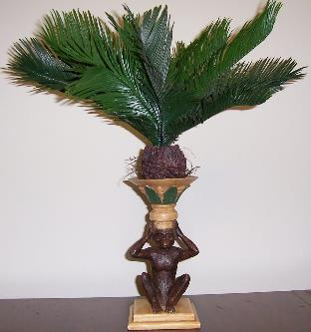
Sneak Preview
Area Competition
Monkey Trophy
Which area will it be this year?
A, B, C, or D?

Slide 5
What we do
Professional Development College (PDC)
Scholarships
Research
Receptions
Area Competition
Logo Items
Spring Fling

Slide 6
Professional Development College (PDC)
What is it?
A resource to assist faculty in developing the knowledge and skills necessary to become strong academic leaders for their colleges and districts as well as for the California Community College system
What does it do?
Provides opportunities for faculty to
expand and improve their skills
gain valuable insight into their chosen position on their own campuses
receive certification and/or continuing education units as well as
develop a cohort of fellow learners and leaders
Notes:
Reformatted for larger font

Slide 7
Professional Development College (PDC)
Leadership Academy
Participants in each cohort will:
Attend plenary sessions, leadership institute, and other ASCCC events,
Work with their mentors on particular local senate concerns, and
Gain insight into effective senate leadership.
Cohorts will:
Graduate at Faculty Leadership Institute in June, and
Serve as a resource for the incoming cohort.
Class of 2015 – 10 participants
Class of 2016 – 12 participants
Notes:
Added an “and”

Slide 8
Professional Development College (PDC)
Leadership Academy – Class of 2016
Kindra Beale, San Joaquin Delta
Anna Bruzzese, Sociology, Los Angeles Pierce College
Jason Edington, Math, Mendocino College
Steven Fredricks, Math, Skyline College
Michelle Lewellen, Psychology, Cerritos College
Mary Mettler, DSPS, Santiago Canyon College
Conan McKay, Child Development, Mendocino College
Eric Narveson, History, Evergreen Valley College
Rochelle Olive, Accounting/Tax, Alameda College
Julie Oliver, Biology Cosumnes River College
Michelle Sampat, Reading, Mt. San Antonio College
Thais Winsome, Biological Sciences, Mission College

Slide 9
Professional Development College (PDC)
Curriculum Basics 101
What is it?
Five online modules that provide a basic introduction to the curriculum processes in California community colleges:
course outlines,
course approval,
program creation,
regional consortia, and
Chancellor’s Office approval.
When will this component of the PDC be available?
We anticipate that Curriculum Basics 101 will be available this month.

Slide 10
Scholarships
Part-time Scholarship winner
2015 Fall Plenary Session:
Michelle Livote, ESL,
Orange Coast College
Scholarships are available for part time faculty members to Senate Institutes and Plenary Sessions.
Each local senate may nominate one part time faculty who has shown an interest in college governance and participated locally in professional activities.

Slide 11
Research
Impact of Full-time Faculty on Student Success:
In partnership with the Faculty Association for California Community Colleges (FACCC).
Ian Walton, past ASCCC President and Greg Gilbert, past ASCCC Executive Committee Member are spearheading the project.
Effective Practices for Hiring Diverse Faculty:
Initiated by ASCCC’s Equity and Diversity Action Committee (EDAC).
Process:
Literature review
Write grant for further research
Interested… email to info@asccc.org.
Notes:
Increased font size

Slide 12
AS Foundation Reception
The AS Foundation sponsors a reception at each of the ASCCC plenary sessions, institutes, and academies.
If you have donated to the AS Foundation or are wearing a foundation badge or T-shirt, you are invited to join the Foundation Directors for hors d’oevres, drinks, and conversation Friday evening, November 6, 5:00 p.m.-6:00 p.m.

Slide 13
Area Competition for the Monkey Trophy!
Raffle drawing for each of the following 5 prizes:
Registration to any three ASCCC events through July 2016
Registration to the 2016 Curriculum Institute
Registration to the 2016 Accreditation Institute
Registration to the 2016 Academic Academy
Registration to the 2016 Faculty Leadership Institute
Raffle Tickets at Foundation Table:
1 raffle ticket for $5
5 raffle tickets for $20
“10+1” raffle tickets for $40
What a deal!

Slide 14
ASCCC and AS Foundation Logo Items
Support the AS Foundation and enjoy your logo items with a recommended minimum donation:
T-Shirts - $20 donation
Lanyards - $5 donation
Pins - $10 donation
and more…

Slide 15
Spring Fling 2016
AS Foundation event to take place at the 2016 Spring Plenary Session in Sacramento, CA…
Details coming soon!
Notes:
Reformatted

Slide 16
Spring Fling 2015

Slide 17
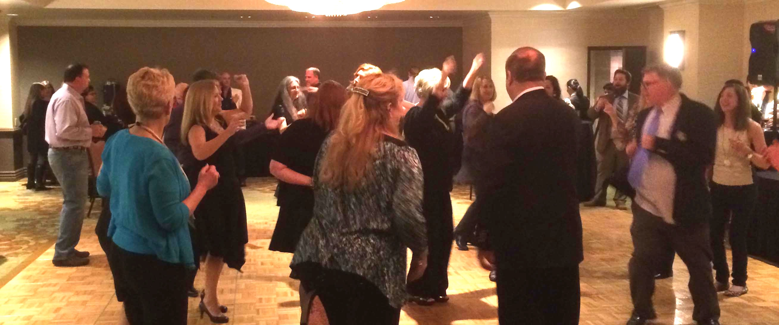
Spring Fling 2014
Notes:
Reversed order of slides 16 and 17…seemed to make more sense to cover 2014 before 2015

Slide 18
Fundraising Goal for 2015-16
$20,000 $20,000
$10,000
Help us reach our goal…
Notes:
Increased font size

Slide 19
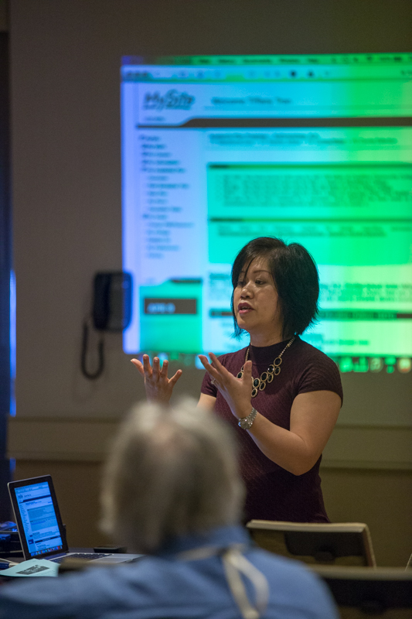
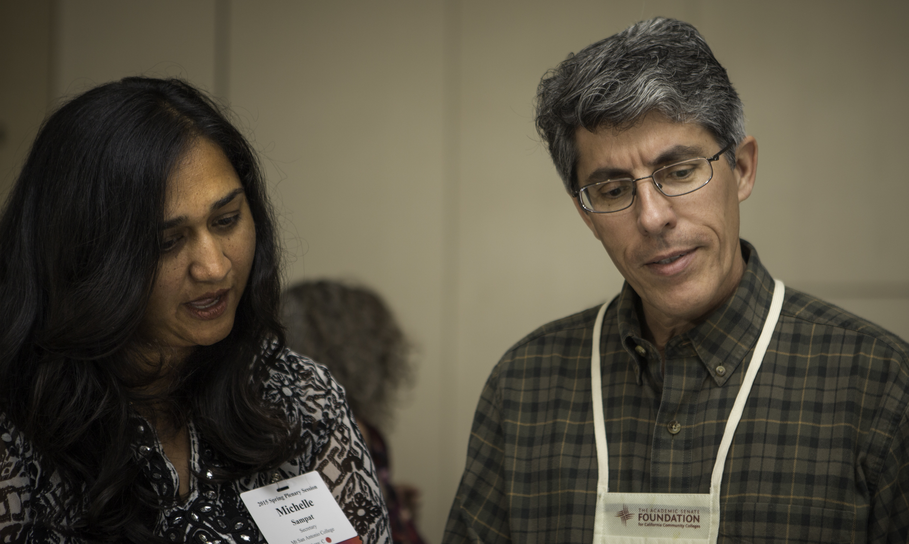
Support the AS Foundation
Your generosity empowers faculty voice, facilitates ongoing professional development, and supports the broad engagement of the Academic Senate on issues facing our colleges and students.

Slide 20
Support the AS Foundation
LIFETIME GIVING TO THE FOUNDATION – $10,000
ANNUAL GIVING or MONTHLY ONGOING GIVING to support the work of the Academic Senate for 2015-16 at www.asfccc.com.
Platinum – $1,000 donation
Gold – $500 donation
Silver – $250 donation
“10+1” Monthly Ongoing Giving
Area Competition (Monkey Trophy! – Get your raffle tickets…)
Spring Fling (Stay Tuned…!)
Logo items (at the Foundation Table!)
Join FACCC (see Shaaron Vogel)
Contact any one of the Board of Directors
Notes:
Reformatted – picture cut off words

Slide 21
Thank you!
Now, how many raffle tickets do you want?
“10+1”

