Slide 1
ACCJC Town Hall Listening Session on the Draft 2024 Accreditation Standards

Slide 2
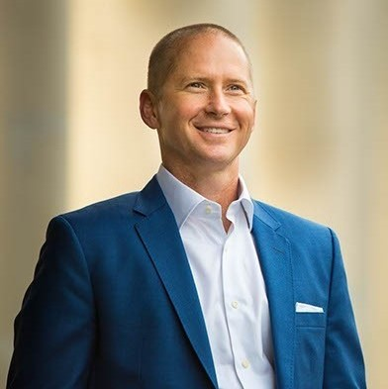
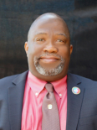
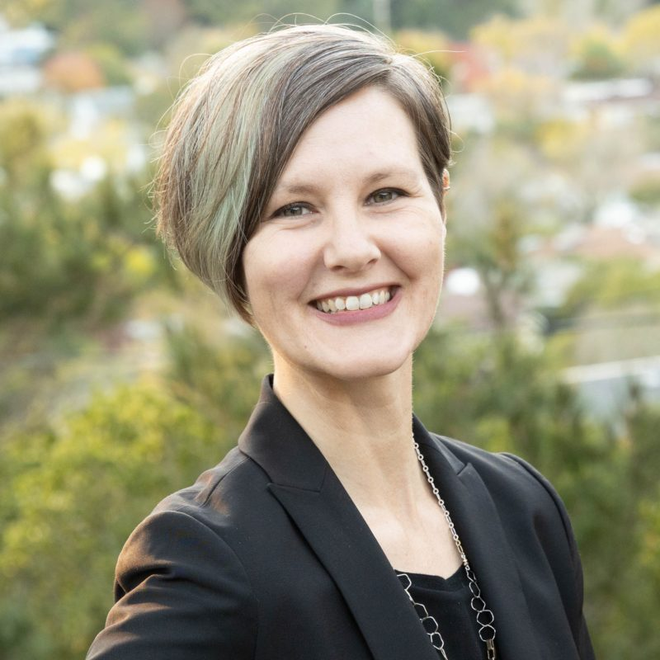
Session Facilitators
Mac Powell, ACCJC President
Robert L Stewart Jr, ASCCC South Representative
Catherine Webb, ACCJC Vice President

Slide 3
Town Hall Listening Session on the Draft 2024 Accreditation Standards
Academic Senate for California Community Colleges
2022 Fall Plenary Session

Slide 4
ACKNOWLEDGING THE CONTEXT
Pandemic
Campus Tensions
Turnover
Yearning for Equity and Inclusion
Fatigue and Burnout
Persistent Opportunity Gaps
Declining Public and Performance-Based Funding
Rapid Change
Questioning the Value of Higher Education
Notes:
Where Does Transformation Begin
Whether at the institutional level or at the level of the Commission, it begins with a “Why” that unifies messaging and processes. It is a word or an idea that is repeated, reinforced, and imbued in every conversation, decision, and process.
There is no doubt that the why that unifies us is…

Slide 5
Student Learning & Success
Institutional
Improvement
Quality
Assurance
Equity
Notes:
Where Does Transformation Begin
Whether at the institutional level or at the level of the Commission, it begins with a “Why” that unifies messaging and processes. It is a word or an idea that is repeated, reinforced, and imbued in every conversation, decision, and process.
There is no doubt that the why that unifies us is…

Slide 6
How Do We Serve A New World?
Integrity
Quality Assurance
Peer Review
Institutional Improvement
Student Learning & Achievement
Collegiality
Conversation & Listening
Empathy
Encouragement
Support
Facilitating Solutions
Commitment Equitable Outcomes
Notes:
First row: What is important that has already been built into the process.
Click: Due to the work of the ACCJC
Second click: Second row: what is needed for this new phase/paradigm/vision

Slide 7
What is the Skillset of A New Version of Accreditors?
Convener
Partner
Facilitator
Expert in Transformation
Advocate

Slide 9
Acknowledge Our Limitations
Recognize Our Possibilities of What Can Be
Accreditation can’t be a tool of fear in this new context
Accreditation must constantly articulate value
Accreditation is PEER driven and volunteers are the life source of the experience
Accreditation standards and processes should be a key way an institution demonstrates its quality and value
Advocate for students, faculty, staff, and stakeholders inside and outside the college
Amplifier of student voice and institutional quality
Conduit to conversations on campus and in legislatures around our aspirations for equity and student success
Convener and connecter that understands the external environment and can connect stakeholders to solutions

Slide 10
Background: Why Review and Revise The Standards?
To align with our own accountability requirements based in:
Federal regulations (CFR 602.21)
Commission Policy on Review of Accreditation Standards
As well as to:
Model continuous learning and improvement
Respond to member feedback about usability and effectiveness
Reflect an evolving higher education landscape

Slide 11
Foundational elements for the Standards
Effective Standards must be grounded in:
Federal requirements for accreditation agencies
Accepted norms and practices within US Higher Education
Commission’s Eligibility Requirements and Policies
Commission’s Values

Slide 12
Principles guiding the revision process
The new Standards should:
Balance accountability and improvement
Emphasize equity and inclusion
Use clear language and minimize redundancy
Reflect and be appropriate for the diversity of ACCJC’s membership
Focus on outcomes and improvement rather than processes
Support a systems approach to institutional evaluation
Remain grounded in broader norms for higher education

Slide 13
Organizational structure for the drafting process
COMMISSION
Standards Review Leadership Team
Content Area
Co-Leads
Content Area Co-Leads
Content Area Co-Leads
Content Area Co-Leads
Content Area Co-Leads
Peer Writing Team
Peer Reading Team
Peer Writing Team
Peer Reading Team
Peer Writing Team
Peer Reading Team
Peer Writing Team
Peer Reading Team
Peer Writing Team
Peer Reading Team
Notes:
85 individuals from 59 colleges involved in preparing the draft – serving on one of the writing/reading teams or on the leadership team
Teams intentionally structured to include perspectives representing the professional, geographic, and institutional diversity of ACCJC’s membership
Five Peer Writing Teams, working in parallel
Each team’s process emerged organically, and were roughly parallel
All teams used the same Guiding Principles and Grounding Questions

Slide 14
Outcomes of the Drafting Process
Increased emphasis on equity and inclusion
Direct alignment with Commission’s Policy on Social Justice
“Policy statement” approach: Standards focus on “what” rather than “how”
Focus on outcomes rather than processes
Streamlined and simplified structure
Use of evidence “checklists”
Clear language

Slide 15
Timeline
2020-2021
2021-2022
2022-2023
Process design and preparation
Participant recruitment and team-building
Process kick-off: May 2021
Writing Teams create first draft (fall ‘21)
Reading Teams critique and refine (spring ‘22)
Leadership Team makes final revisions (summer ‘22)
Draft shared with the field for feedback (Sept ‘22)
Additional revision based on comments from field
First Reading: Jan 2023
Second draft shared with field for feedback (early ‘23)
Second Reading & Adoption: June 2023

Slide 16
https://accjc.org/standards-review/

Slide 17
Themes from comments received to date
Commenters have appreciated:
Attempt to streamline structure & make the process more efficient
Emphasis on equity, diversity, and inclusion throughout
Emphasis on unique institution mission and culture
Emphasis on students and the student experience
Emphasis on regular assessment and meaningful outcomes

Slide 18
Themes from comments received to date
Suggestions for Further Improvement:
Include more explicit language about libraries and learning support resources (including tutoring and counseling)
Clarify/strengthen expectations for institutional decision-making bodies other than the Governing Board, particularly with regard to engagement in decision-making and communication of decisions
Clarify/strengthen expectations for outcomes assessment in student support and administrative areas
Strengthen alignment with Policy on Social Justice in Standards 3 and 4
Consider including concepts related to effective resource stewardship in Standard 4
Consider revising Standard 4.3 with a more pronounced growth mindset framing
Consider reversing the order of Standards 3 and 4

Slide 19
Frequently Asked Questions
The draft Standards seem much less precise than the current Standards. How will colleges be held accountable if the specificity is removed?
How will the draft Standards apply to multi-college districts/systems?
When will the new Standards be implemented?
My college is getting ready to start its ISER now - can we pilot?
My college has just started our ISER – can we pilot?
What is happening with the Quality Focus Essay?

