Slide 1

Actions and Strategies for Navigating Through
ASCCC Plenary & Resources
LaTonya Parker, ASCCC South Representative
Krystinne Mica, ASCCC Chief Operating Officer
Fall Plenary 2018
Irvine, CA

Slide 2

Overview of this Session
Make connections with other first time attendees and delegates
Role of the ASCCC and Plenary Session
Resolutions, Voting and Discussion: Who participates in each?
Resources: Local Senates Handbook, website
Define Common Acronyms
ASCCC Awards
Find someone to sit with at lunch ☺

Slide 3

Making Connections
Introduce yourself to at least two people around you and answer the following question: If you had one superpower, what would it be and why?

Slide 4
Mission of ASCCC
Fosters the effective participation by community college faculty in all statewide and local academic and professional matters;
Develops, promotes, and acts upon policies responding to statewide concerns;
Serve as the official voice of the faculty of California Community Colleges in academic and professional matters.
The Academic Senate strengthens and supports the local senates of all California community colleges.

Slide 5
Purpose of Plenary
To be apprised about hot topics,
To receive new training to bolster the effectiveness of their senate,
To select representatives and officers,
To determine Senate positions and provide the Executive Committee direction through the resolution and voting processes.
Notes:
The Academic Senate strengthens and supports the local senates of all California community colleges.

Slide 6

I’m a new delegate…what do I do at Plenary?
Attend the Area meetings at plenary
Read session resolutions packets…they are revised daily.
Debate and vote on resolutions - represent your local senate’s positions
Part of a team? Spread yourselves around to different breakouts
Network!
  Get to know your Area Representative and the entire Executive Committee…they’re here to help!
And remember – have fun!
Notes:
Slides 6-10 are regarding new delegates. John S. need to let us know if these need any changes, since this is his 20-30 minute section of the breakout.

Slide 7

Saturday is Voting Day - Resolutions
Resolutions are debated and voted…anyone can debate
Arguments are made at the pro and con mics.
  Debate continues until no one is at a mic, or until time for debate expires
  (15 minutes)
Parliamentary mic is for making motions, parliamentary inquiries to the chair, etc.
Voting is typically done by voice and only delegates can vote!
  If voice vote inconclusive, division of the house is done
  If division of the house inconclusive…serpentine vote!
Notes:
Slides 6-10 are regarding new delegates. John S. need to let us know if these need any changes, since this is his 20-30 minute section of the breakout.

Slide 8

Resources for Local Senates and Delegates
Resources for Delegates
Local Senates Handbook
ASCCC Website
  Local Senate Visits
  Events
Relations with Local Senates
Committee
      18-19 Committee
      LaTonya Parker - latonya.parker@mvc.edu
      Carrie Roberson - robersonca@butte.edu
      Peggy Campo - Peggy.Campo@norcocollege.edu
      Robert Stewart - stewarrl@lasc.edu
      Gayle Pitman - pitmang@scc.losrios.edu
Notes:
Slides 6-10 are regarding new delegates. John S. need to let us know if these need any changes, since this is his 20-30 minute section of the breakout.

Slide 9
Important Senate Resources for Delegates
About the Academic Senate - http://www.asccc.org/about
“Roles and Responsibilities for Delegates”: http://www.asccc.org/sites/default/files/Senate%20Delegates%20Roles%20%26%20Responsibilities_0.pdf
Resolutions Handbook: http://www.asccc.org/papers/resolution-handbook
Senate resolutions web page (searchable): http://asccc.org/resources/resolutions
Session Resources (Includes discipline lists & Foundation election information…click the “Resources’ tab): http://asccc.org/events/2017-11-02-150000-2017-11-04-230000/2017-fall-plenary-session
ASCCC Bylaws: http://asccc.org/about/bylaws
Notes:
Slides 6-10 are regarding new delegates. John S. need to let us know if these need any changes, since this is his 20-30 minute section of the breakout.

Slide 10
Local Senates Handbook
www.asccc.org/sites/default/files/local_senates_handbook2015-web.pdf
Part I – A Brief History
Part II – Roles and Responsibilities of the Senate
Part III – Duties as a Local Senate President
Part IV – Ensuring the Effectiveness of the Local Senate
Part V – Linking Local Senates
Online version includes helpful hyperlinks!

Slide 11

The ASCCC Web Site http://www.asccc.org/
Notes:
Take a few minutes to review the web site. Past resolutions, past papers, Rostrum Articles, links to Title 5, Curriculum, SLO’s, future events, Disciplines List and Minimum Qualifications, request site visit, other???

Slide 12
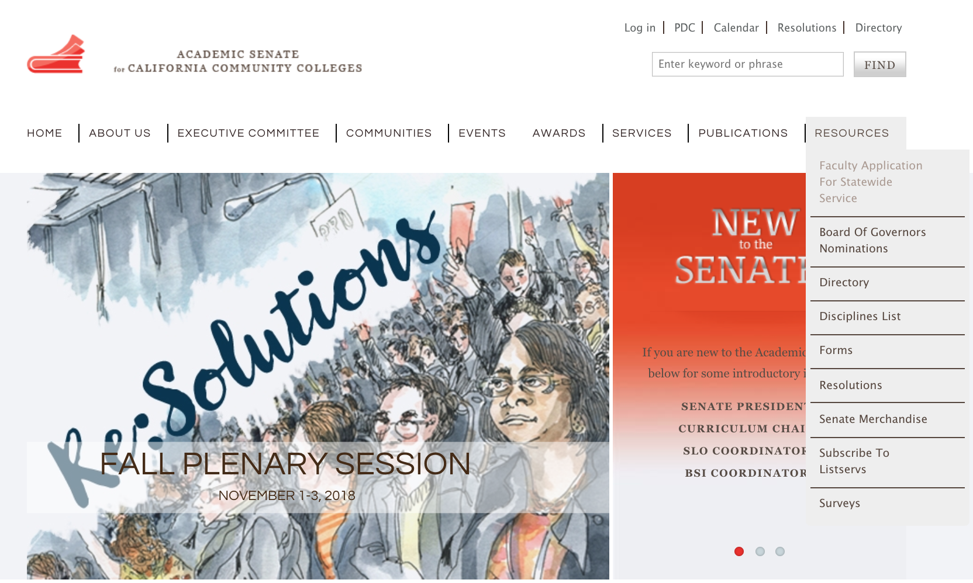
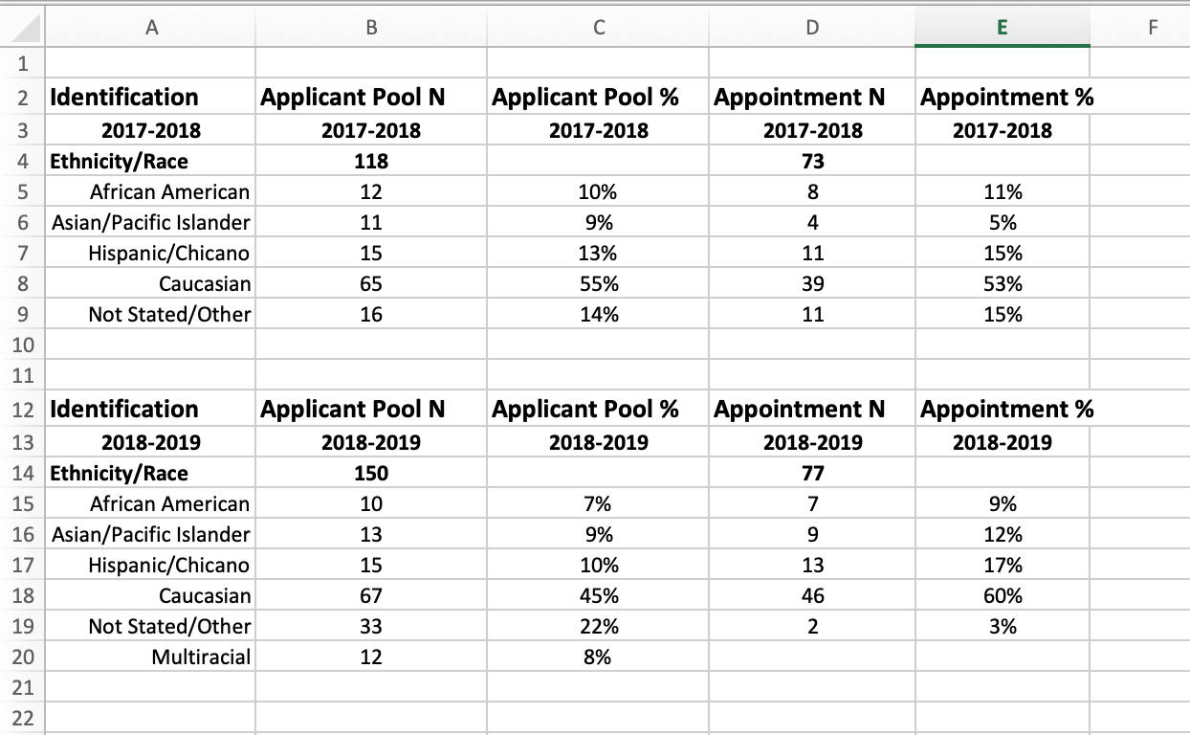
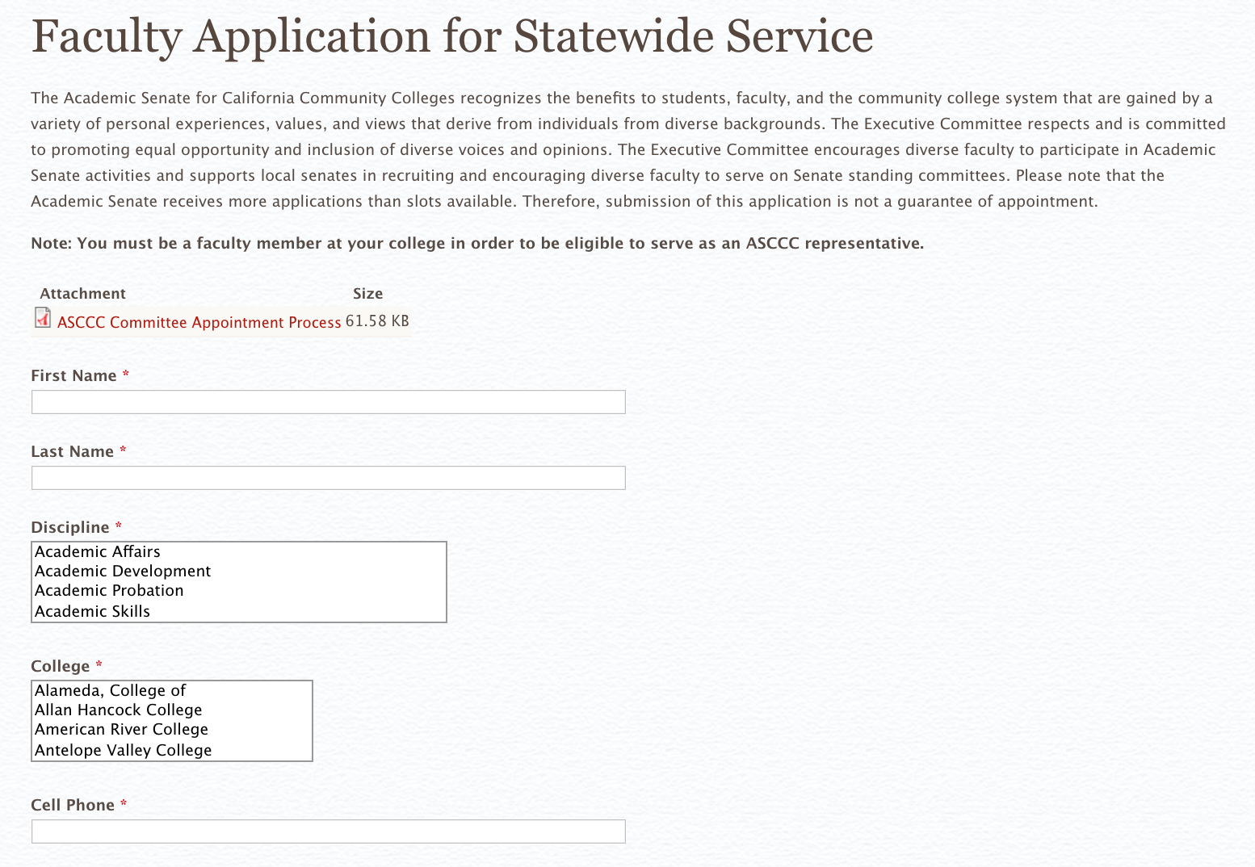
Application to Serve https://asccc.org/content/faculty-application-statewide-service
Notes:
Take a few minutes to review the web site. Past resolutions, past papers, Rostrum Articles, links to Title 5, Curriculum, SLO’s, future events, Disciplines List and Minimum Qualifications, request site visit, other???

Slide 13
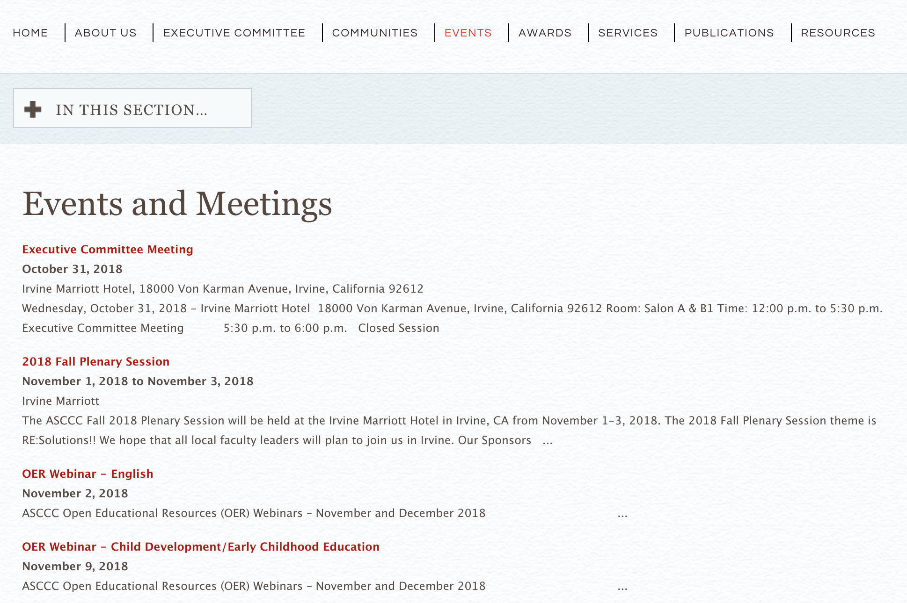
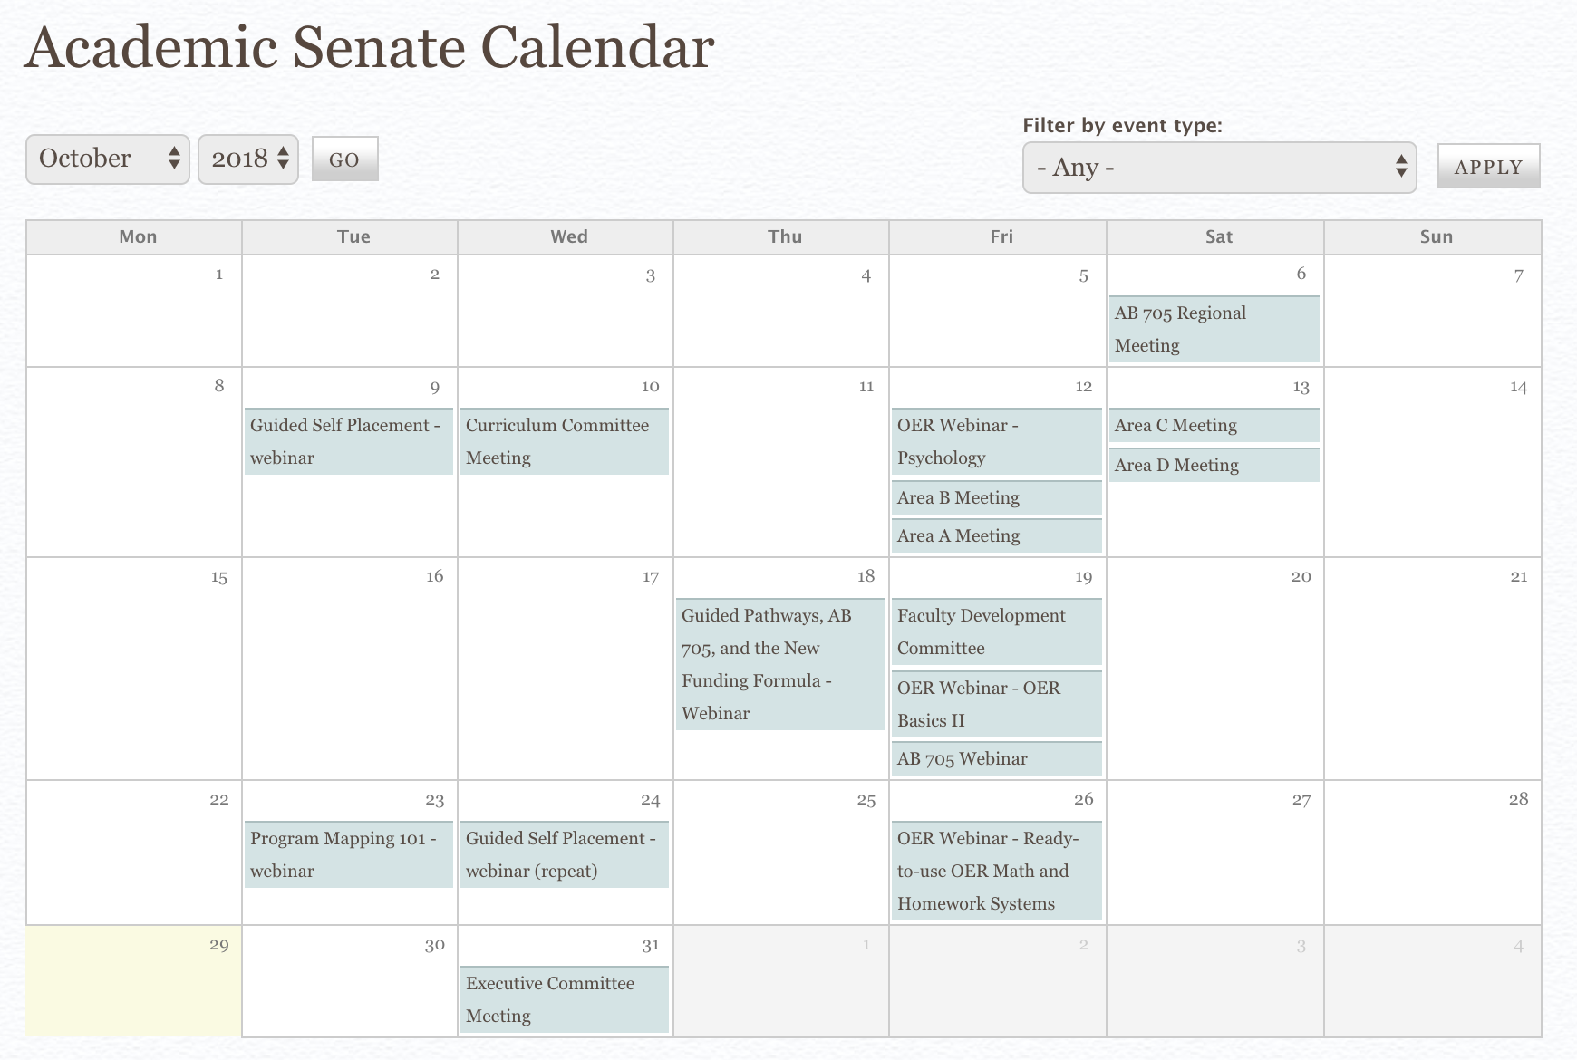
Institutes and Meetings
Plenary Sessions
Curriculum Institute
Career and Noncredit Institute
Leadership Institute
Part-Time Institute
Academic Academy
Regional Meetings
Area Meetings
and others
See website for more details

Slide 14
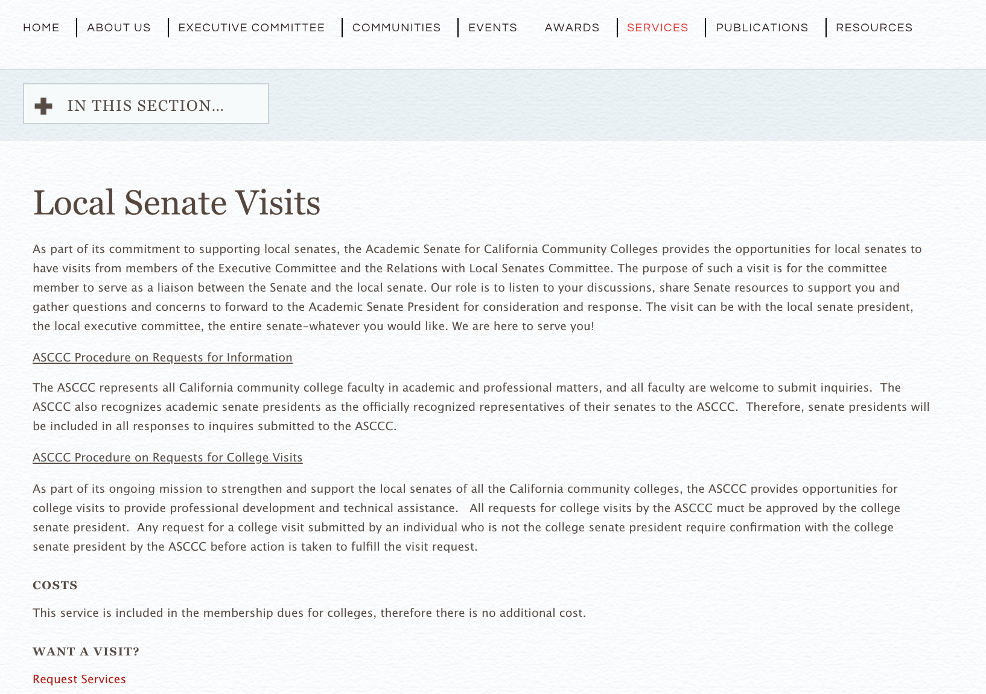
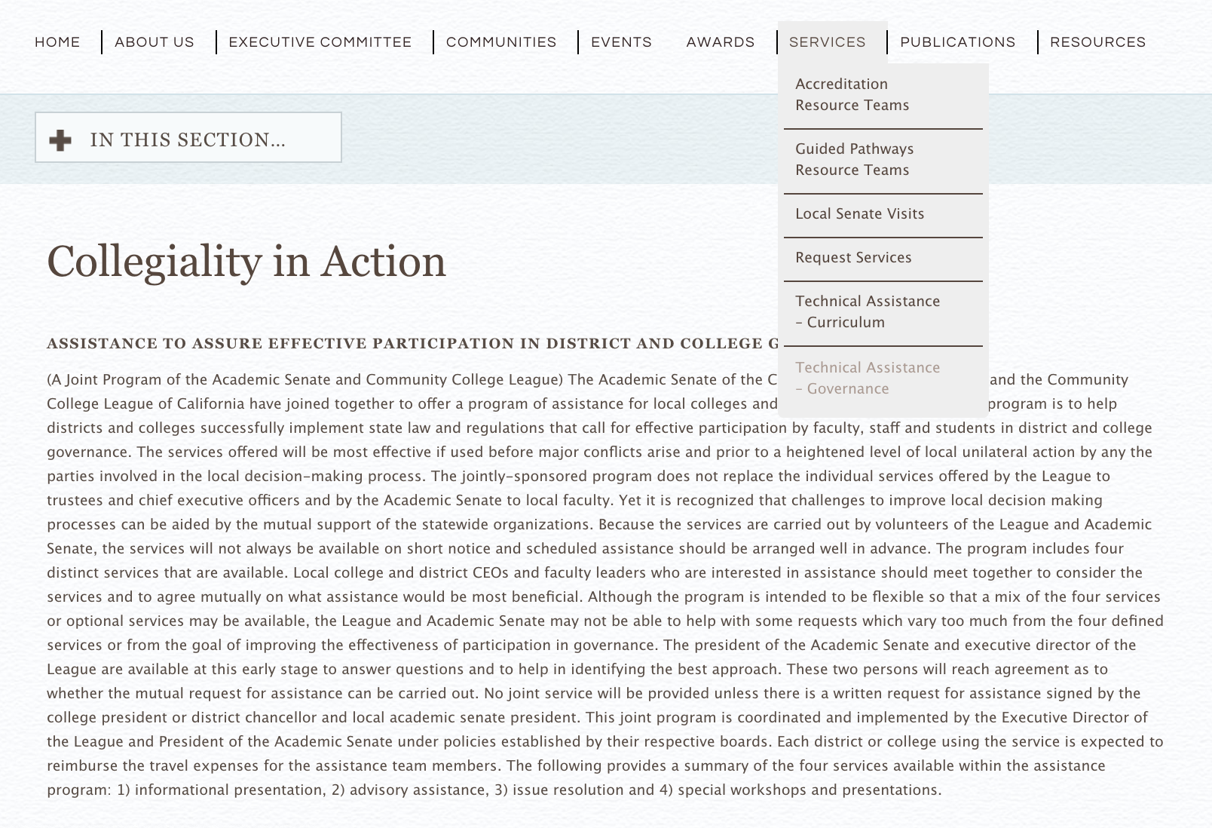
Local Senate Visits & Technical Assistance
Local Senate Visits
  Free of cost to colleges!
  ASCCC Representatives will cover wide range of topics e.g. AB 705, Guided Pathways, Curriculum, etc.
Collegiality in Action (technical assistance)
  Conducted with CCLC or CIO
  $1,000 cost to cover travel for representatives
  Curriculum or Governance
  Make request through info@asccc.org or online
  See website for more details

Slide 15






Common Acronyms
BOG
Board of Governors
5C: California Community Colleges Curriculum Committee (previously SACC).
DWM
PCAH:
The Program and Course Approval Handbook
OEI:
ASCCC
CCCCO:
THE INTEGRATED PLAN:
Basic Skills Initiative (BSI), Student Equity (SE), and Student Success and Support Program (SSSP)
http://asccc.org/content/build-your-lingo-acronym-bingo
http://asccc.org/acronyms
Notes:
Slides 6-10 are regarding new delegates. John S. need to let us know if these need any changes, since this is his 20-30 minute section of the breakout.

Slide 16

ASCCC Awards
Exemplary Program Award: Recognizes
outstanding community college programs.
  Deadline November 5, 2018 5pm
  Theme: Environmental Responsibility
The Hayward Award: Honors Outstanding
community college faculty who have a track record
of excellence both in teaching and in professional activities and have demonstrated commitment to their students, profession, and college.
  Deadline December 17, 2018 5pm
Stanback-Stroud Award: Honors faculty who have made special contributions addressing issues involving diversity.
  Deadline February 11, 2019 5pm
Notes:
Slides 6-10 are regarding new delegates. John S. need to let us know if these need any changes, since this is his 20-30 minute section of the breakout.

Slide 17

Questions?
Thank you,
and have a great plenary session!
Our Contact Information
LaTonya Parker: latonya.parker@mvc.edu
Krystinne Mica: krystinne@asccc.org

