Slide 1

Closing the Remedial Gap
Maureen Roe
    BSI Coordinator
    Writing Center Coordination
    English Department
At Santiago Canyon College

Slide 2

Who are the bridge builders?
The Basic Skills Task Force at SCC is a group that has been working for over seven years to implement programs to increase student success in basic skills (Academic Foundations) courses
Some of our goals: to ease the transition between high school and college; to prepare high school students for college-ready courses; to help bridge the gap between high school and college

Slide 3
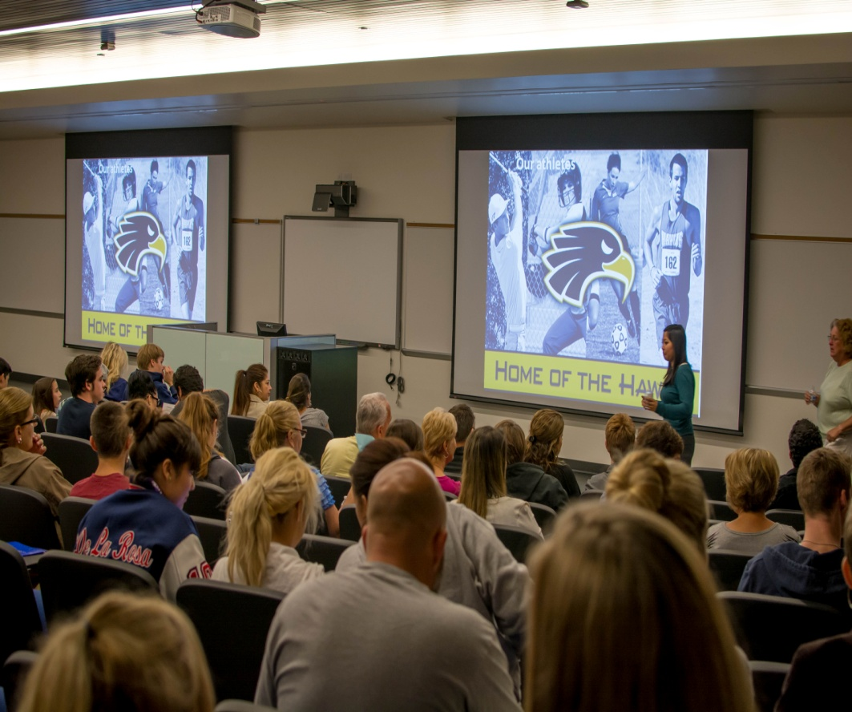
PLANK 1: SCC Family Night
Schedule in November, once annually
Invite all local high school seniors and their families
Work in conjunction with our HS Outreach office
Offer campus tours
Provide a Meet and Greet time with representatives from our clubs, ASG, Forensics team, MUN, STEM, Art, Music, Athletics
Present information about campus programs and services as well as WHY a Community College? And WHY SCC?
Specifically address the special services we have to ease students into college-level courses

Slide 4
The Evolution: Building Progress
 | Year 1 2012 | Year 2 2013 | Year 3 2014
Total Attendance | 170 | 298 | 340
Students Attending | 75 | 108 | 143
# of schools represented | 12 | 16 | 21

Slide 5

PLANK 2: The EW Program
Early Welcome
Register in December
Attend mandatory orientation in April
Get priority registration for fall AND spring

Slide 6

PLANK 3: CROSSroads
Santiago Canyon College

Slide 7

Origins of CROSSroads
Conceived after the State Chancellor’s 2-day EAP/Common Core Conference in Sacramento (May 2012)
Needed an acronym
Program’s Objective: “College Readiness” for “students” because it will “optimize” their chance for “success”
College Readiness Optimizes Student Success
Launched at our 1st November 14, 2012 Family Night

Slide 8
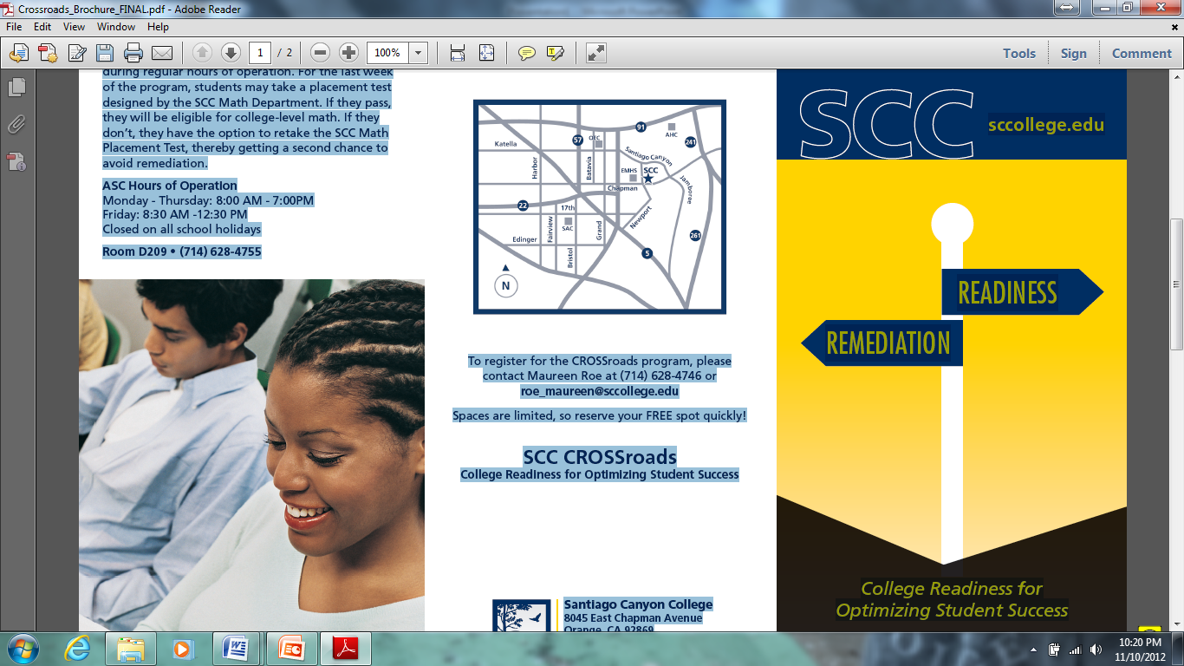
CROSSroads Program (Free)
Hard Fact:
Between 70-90% of students entering California community colleges each year require remediation in math, English, or both
At SCC, 66% test into pre-college math; 33% test into pre-college English
Our Goal:
To make incoming SCC students college-ready—providing them with fundamental math and English skills that will optimize their chances of placing into transfer-level courses.

Slide 9

English N60: Basics of Effective Writing
English 061: Intro to Composition
English N50: Intro to Written Communication
Stay on the straight path to success
Don’t do well on English placement test
SCC
English 101
Math 105, 140, 150, 219
Graduation with AA or Certificate
High School
Math 060: Elementary Algebra
Math 080: Intermediate Algebra
Math 06: Basic Math
Math N48: Pre-Algebra
Don’t do well on math placement test

Slide 10

Which students are served by CROSSroads?
High school seniors, coming to us in fall after graduation
They will have to take a placement test in math or English
They did not pass an AP test in English or math
They were identified as “Not Prepared” or “No Status” on the STAR/EAP test
They did not take math their senior year (but have completed at least Algebra 2)

Slide 11

What Taking the English Road Means
Students attend four workshops in our campus Writing Center to brush up on composition skills.
Then they are tested with a writing sample read by two English professors to determine if they are ready for 101.
They will be placed into Freshman Composition (101) or can retake the school’s placement test in March or April to get another chance to avoid extra remedial classes
CROSSroads English Workshops
SESSION 1: UNITY
SESSION 2: SUPPORT
SESSION 3: COHERENCE
SESSION 4: SENTENCE SKILLS

Slide 12

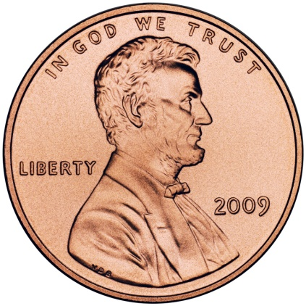
The Placement Test
1 hour essay
Two essay selections
  Saving the Penny
  Banning Toddler Beauty Pageants
Presenting an argument
Integrating evidence from the essay—quoting experts and referencing/paraphrasing facts/studies

Slide 13
English CROSSroads : Evolution
 | First Year 2013 | Second Year 2014 | Third Year 2015
Number of Students who Registered for CROSSroads | 53 | 88 | 76
Number of Students who attended at least 3 workshops & were eligible for the CROSSroads placement test | 41 | 53 | 46
Number of Students who Completed Writing Sample Placement Test | 35 | 38 | 41
Number of Students Recommended for English 101 | 26 | 32 | 35
Number of Students Recommended for English 061 | 9 | 6 | 6
Number of Students Recommended for English N60 or N50 | 0 | 0 | 0
Success Rate* | 74% | 84% | 85.4%

Slide 14
What Taking the Math Road Means
Program is called MyOpenMath (FREE!)
Modules are selected by the instructor
Students can pose questions about missed answers
Students can have online conversations with one another
Includes Instructional videos
Students attend a mandatory orientation to take a pre-test, register for our online program, and get instructions regarding the CROSSroads curriculum.
Students work through a series of online modules that will help them brush up on key concepts for college-level math.
Once they complete 70% the modules, they will be eligible to take a placement test.
If students do not place into college-level math, then they can also take the school’s placement test to avoid remediation.

Slide 15
Math CROSSroads 2014
62 students showed up for the mandatory orientation and took the diagnostic test
36 attempted modules
16 took the CROSSroads placement exam
15 successfully placed into a college level math
Class Placement | Percentage
Placed into 150 | 56%
Placed into 140 | 38%
Placed into 80 | 6%
Placement due to CROSSroads | Percentage
Placed at least 2 classes higher | 12.5%
Placed one class higher | 50%
No difference in placement | 37.5%
Placed lower | 0%

Slide 16
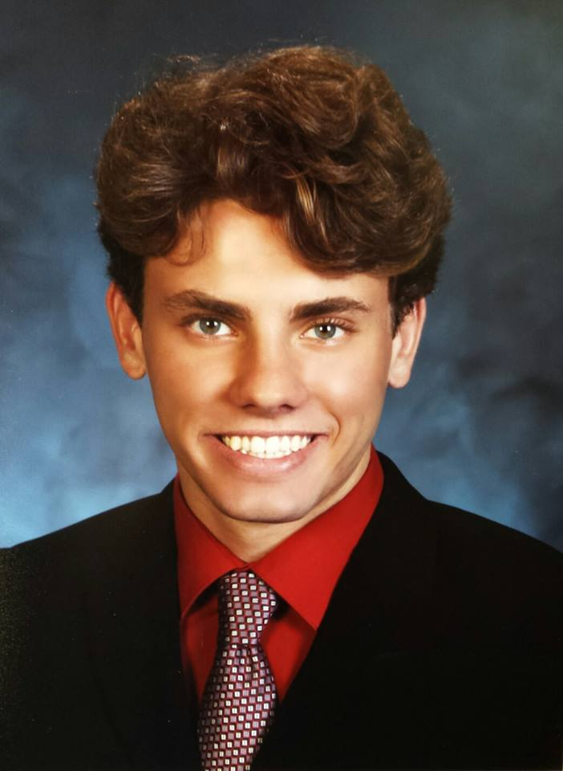
Math CROSSroads 2015
  From a CROSSroads participant:
  “I have forgotten a lot during my senior year, so it was helpful to get a review of some basic concepts. I never would have placed into college math without a brush-up course. It wasn’t easy, but I’m glad I did it!”

Slide 17

PLANK 4: ReTest
If students do not place into college-level math and or English with CROSSroads, they can take the college placement tests.
Higher score is counted.

Slide 18
PLANK 5: Mandatory Orientation
Students come for placement test results
Meet with counselors
Register for their fall courses

Slide 19
PLANK 6: SOAR (still free)
Strategies of Algebra Readiness
For students who place into Math 080 (most do)
Taught by math instructor (summer course)
August 3-14, Monday-Friday, 8AM-Noon
Provides math study skills, success strategies
Optimizes success with ONE attempt
Prepares for college-level math
Incentives: guaranteed text book (rental) for next math class; priority registration for next class in sequence

Slide 20
A Snapshot of SCC Bridge Efforts
You’ll see
Our campus
Our Family Night gathering
Our CROSSroads students
Our fantastic faculty and BSI reps

Slide 21
Attend FAMILY NIGHT
The Fully-Planked Bridge
November
Apply Online EARLY WELCOME
December
Complete CROSSroads
Jan.-Feb.
ReTest (if needed)
March-April
Attend ORIENTATION & ENROLL IN CLASSES
April
SOAR (if needed)
Early August
Become a Hawk START SCC
Late August
PLANK 7

Slide 22

Any questions?
Contact Maureen Roe
Roe_maureen@sccollege.edu
714-628-4746
Readiness

Slide 23


