Slide 1
SUPPLEMENTAL INSTRUCTION, LEARNING CENTERS, AND TUTORING PROGRAMS
Dianne Rowley, Mt. San Antonio College
Sam Foster ASCCC South Representative
La Tonya Parker, ASCCC Area D Representative
Stephanie Curry, ASCCC North Representative, ASCCC Curriculum Committee

Slide 2
Breakout Summary
Tutoring and supplemental instruction are an essential curricular and student support. This session surveys the current regulations and legislation regarding apportionment for tutoring programs.
Understand from examples types of credit and noncredit options for tutoring/supplemental/embedded instruction. With the mandated AB 705 implementation this fall, learn how supplemental instruction and similar programs can support student learning in a changed curricular environment.

Slide 3
What brings you to this breakout? What do you hope to learn?

Slide 4
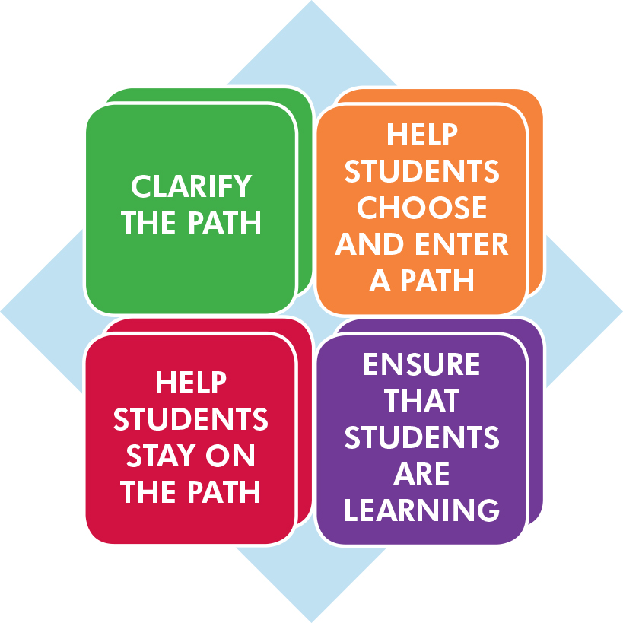
Where we are--AB 705 and Guided Pathways

Slide 5
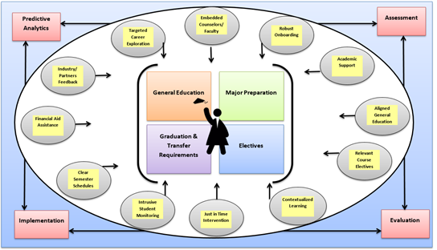
Guided Pathway
Focused, Holistic and customized support for students

Slide 6
What about AB 705?
All about placement processes
AB 705 (signed October 13, 2017) requires colleges to use one or more of the following when placing students into courses in math and English:
High School Coursework
High School GPA
High School Grades
If colleges are not able to obtain official transcript data, they can use self reported data or guided placement
Notes:
adult transcripts still have validity 10 years out for placement.

Slide 7
What about AB 705?
A community college district or college shall maximize the probability that a student will enter and complete transfer-level coursework in English and mathematics within a one-year timeframe
One year will be defined as two semesters
Currently, these two semesters are not required to be consecutive because colleges cannot force students into a specific behavior.
The “clock” will begin when the student enrolls in a course that is part of the sequence leading to transfer level. The initial course could be credit or noncredit.
Notes:
There is some discussion as to what noncredit courses can be construed as beginning the clock. Noncredit can still offer basic math and basic English for students wanting to improve in these areas. What the Chancellors doesn’t want to happen is credit students going to noncredit to do remedial work. Noncredit ESL and credit ESL boundaries still under determination.

Slide 8
What about AB 705?
The likelihood of students succeeding at the transfer level can be increased by offering some type of support (tutoring, SI, corequisite course)
AB 705 specifically permits colleges to implement corequisite models
A community college district or college may require students to enroll in additional concurrent support, including additional language support for ESL students, during the same semester that they take a transfer-level English or mathematics course, but only if it is determined that the support will increase their likelihood of passing the transfer-level English or mathematics course.

Slide 9
What about AB 705?
How are these corequisite support courses validated? Does the language in Title 5 §55003 need to be modified?
What data will need to be collected to ensure there is no disproportionate impact?
Will there be different levels of corequisite support for a single parent course? If yes, how can a placement model be developed to choose the “ideal” amount of support?
Notes:
AB705 has already said that noncredit could be used as a corequisite. The issue is that noncredit courses can not be required. For example, we are piloting a noncredit coreq where students can
choose to either take one level below transfer course (if that is where they were placed) OR start with the transfer level course with a noncredit co-req. Advantages of noncredit: no use of financial aid. Downside may affect units needed for financial aid. As far as the comment of parent course being at the transfer level, what is the difference if a student has SI in the course, or embedded tutoring, or visits the learning center.

Slide 10
TITLE 5- Regulations

Slide 11
Title 5 Regulations and Tutoring
§ 58168. Tutoring
A method of instruction in credit and noncredit that involves a student tutor who has
been successful in a particular subject or discipline
who has demonstrated a particular skill
who has received specific training in tutoring methods
who assists one or more students in need of special supplemental instruction in the subject or skill.
Notes:
Randy

Slide 12
Title 5 Regulations and Tutoring
§ 58170. Apportionment for Tutoring
Apportionment may be claimed for individual student tutoring only if all the following conditions are met
individual student tutoring is conducted through a designated learning center
designated learning center is supervised by a learning skills coordinator or instructor, or tutoring coordinator who meets the minimum qualifications (§ 53415)
ASCCC Curriculum Institute July 11-14, 2018 Riverside Convention Center
Notes:
Randy

Slide 13
Title 5 Regulations and Tutoring
§ 58170. Apportionment for Tutoring
Tutors successfully complete instruction in tutoring methods and the use of appropriate written and mediated instructional materials
All students are enrolled in a noncredit course carrying a TOP code 4930.09 titled “Supervised Tutoring
Aligns with noncredit “Elementary and secondary basic skills and other courses and classes such as remedial academic courses or classes in reading, mathematics, and language arts”
ASCCC Curriculum Institute July 11-14, 2018 Riverside Convention Center
Notes:
Randy

Slide 14
Title 5 Regulations and Tutoring
§ 58170. Apportionment for Tutoring
Students enroll after referral by a counselor or an instructor
An attendance accounting method is positive attendance
District does not claim state apportionment for tutoring services paid by state categorical funds
BOG considering change to allow for student referral
ASCCC Curriculum Institute July 11-14, 2018 Riverside Convention Center
Notes:
Randy

Slide 15
Title 5 Regulations and Tutoring
§ 58172. Learning Assistance
Apportionment for supplemental learning assistance in credit and noncredit dependent on whether:
It’s required for all students
or
or it’s optional and is provided through an open entry/open exit course
Notes:
Randy

Slide 16
Title 5 Regulations and Tutoring
§ 58164. Open Entry/Open Exit Courses
refers to courses in which students enroll at various times, and complete at various times or at varying paces
one unit of credit shall be awarded for approximately 48 hours of recitation, study, or laboratory work
to provide support for another course or courses, the COR for the OE/OE must identify the other course(s) it supports and the specific learning objectives and competencies
Notes:
Randy

Slide 17
Credit and Non Credit

Slide 18
Tale of the Tape: Side by Side Comparison
Credit and CTE
Generate apportionment; student fees apply
Fees
Unit granting
Degree applicable and non-degree applicable (basic skills)
Certificates of Achievement
Not designated as repeatable (except in limited circumstances)
Auto-approval and chaptering at the CCCCO
Noncredit
Generate apportionment—two levels (noncredit and enhanced noncredit)
No student fees
No units (positive attendance taken)
Certificates of Competency & Completion
Designated as repeatable
Requires CCCCO approval

Slide 19
Noncredit Basics

Slide 20
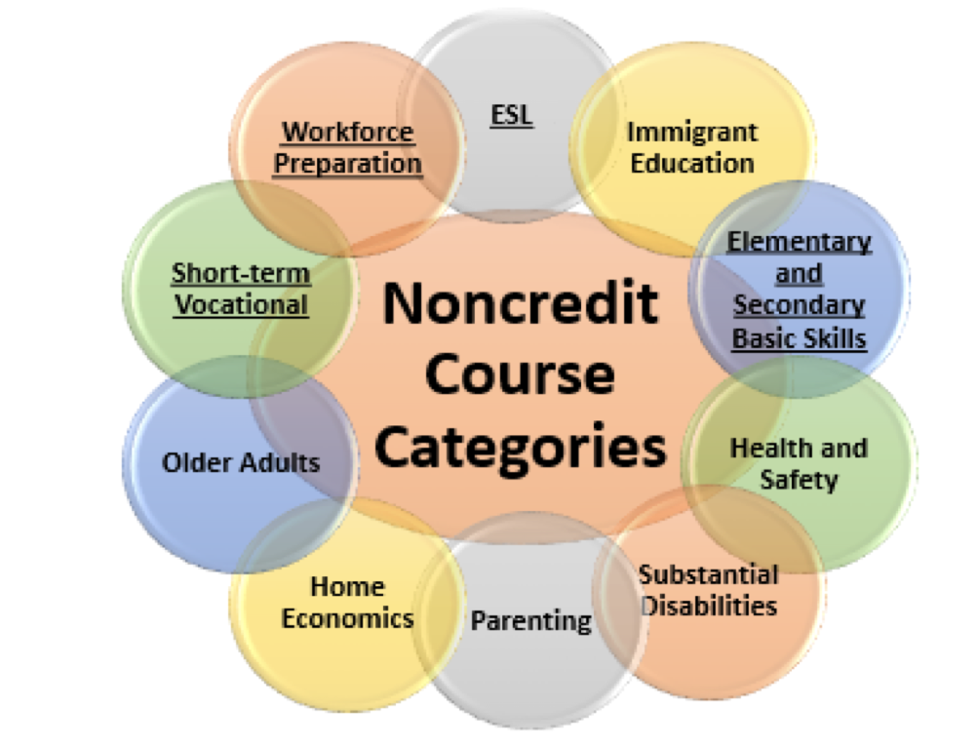
Noncredit Courses: Ten Categories
English as a Second Language (ESL)*
Immigrant Education
Elementary and Secondary Basic Skills*
Health and Safety
Substantial Disabilities
Parenting
Home Economics
Courses for Older Adults
Short-term Vocational*
Workforce Preparation*
*Areas (1), (3), (9), (10) are eligible for Enhanced Funding if associated with an approved noncredit program.

Slide 21
Career Development and College Preparation (CDCP)
Preparation for employment or success in college-level credit coursework
Four categories of courses (ESL, Basic Skills, Short-term Vocational, Workforce Prep) that, if combined into a noncredit certificate, can be eligible for apportionment funding equal to credit
Four categories: Overall Noncredit requirements established in Ed. Code 84760
Established uniform funding rate for noncredit courses and an enhanced rate for CDCP [EC 84750.5 (d)]
FY 2014-15, the California State Legislature approved the enhanced CDCP noncredit rate to be equivalent to the credit FTES funding rate, effective July 1, 2015
2015-16 budget included $49 million to fund the rate increase

Slide 22
CDCP Funding
 | 2006-07 | 2016-17 | 2017-18
Basic (Regular) Noncredit | $2626 | $2840 | $3050
Enhanced Noncredit (CDCP) | $3254 | $4724 | $5072
Credit | $4367 | $4724 | $5072
ASCCC Curriculum Institute July 11-14, 2018 Riverside Convention Center

Slide 23
Local Example

Slide 24
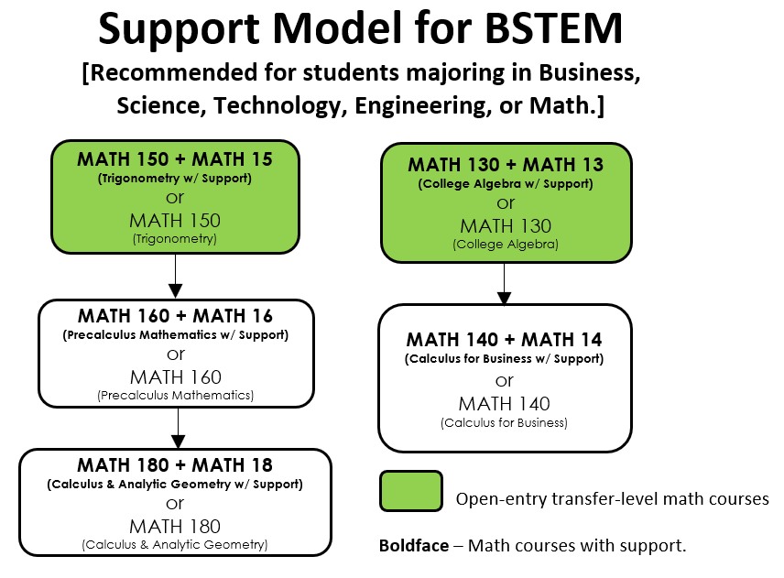
Scenario
Local Examples
Mt. San Antonio College offers both
credit and noncredit support course
options in English and math

Slide 25
Supplemental Instruction (SI), Embedded Tutoring (ET), Study Groups (SG), and Drop-inTutoring (DI):
A Case to Consider: Mt. San Antonio College
Notes:
Comparison between SI and Embedded
Slides Corequisite Remediation, Credit/ Non Credit, Seperate and Extended Courses
Online

Slide 26
Mt. San Antonio College - Request Options
 | Supplemental Instruction Leader (SI) | Embedded Tutor (ET) | Study Group (SG) Tutor | Drop-in (DI) Tutor
Attends class | x | x
Meets with Professor Weekly | 1 hour weekly | As needed not to exceed 1 hour weekly
Plans SI sessions | x
Leads group study sessions (outside of class time) | x | possibly* | x
Drop-in Hours | possibly* | possibly* | possibly* | x
* May be assigned respective hours depending on faculty request, subject-area needs, SI/Tutor availability, and availability of funding.

Slide 27
Supplemental Instruction (SI)
SI model originated at the University of Missouri-Kansas City. SI targets traditionally difficult courses with success rates lower than 70%.
In class, SI Leader acts as model student, takes notes, asks common questions, helps facilitate small group activities or works with individual students during hands-on practice, assists students to learn how to effectively utilize software, tools, etc.
Weekly meetings between professor and the SI are an opportunity for mutual feedback and to discuss student progress. SIs plan interactive sessions based on concepts taught in class as well as those discussed in weekly meetings with the professor.
SI sessions promote collaboration between students, problem-solving of course concepts, and study/college success skills. Skills learned in SI sessions are transferable to courses beyond the current course.

Slide 28
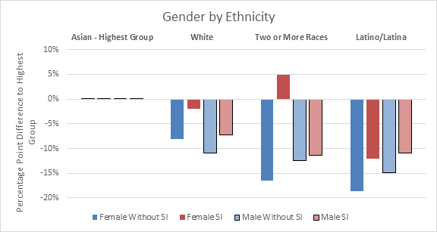
Benefits to Students
Mt. SAC Fall 2013-Fall 2017 SI data
Sample consisted of 3,963 students in SI courses whether they attended sessions or not
Students in sections with SI had a 7.3 percentage point higher course success than students in sections without SI (67.0% vs. 59.7%)
SI decreased the equity gap by gender and ethnicity

Slide 29
Embedded Tutoring (ET) Overview
Offer the perspective of an experienced student in class discussions
Help facilitate small group activities
Work with individual students during hands-on practice
Guide students, provide feedback, and answer questions during in-class hands-on practice
Assist students to learn how to effectively utilize software, tools, etc.
Take notes if leading study sessions outside of class time or if assigned drop-in hours (note: ETs do not usually work with students outside of class due to funding restraints)

Slide 30
Where are students in this process?
From Students
“The biggest reason why I have an A in this course is because I've been getting help at SI sessions.”
-Math student
“Having an SI helps students and the professor run class more smooth. [My SI] is a great SI because he understands what we need and helped us during class time to understand material.”
-Physiology student
“Gave me a whole new perspective on some topics and how to remember/retain more information.”
-Chemistry student
From Faculty
“In general, students who utilize this resource, [SI], obtain one letter grade higher than without.”
-Malcolm Rickard, Physics
“Unlike traditional tutoring which tends to focus just on the general ‘material’ a student doesn’t understand, our SI program can be altered and geared to the very specifics of a particular professor and particular course.”
-Timothy Revell, Biology
“I think the SI program does a wonderful job at training SIs.”
-David K. Beydler, Math

Slide 31
Whats Next?
Notes:
Ask Dolores regarding new leg or new regs

Slide 32
Legislation and Tutoring: Proposed Changes
Two bills focused on tutoring requirements--Failed
SB 1009 (Wilk) and AB 1935 (Irwin)
Did not pass or was vetoed by Governer
CCCCO is working on a non legislative approach to increase options for apportionment for tutoring

Slide 33
ASCCC Support for Supplemental Instruction
Resolution FA11 13.19 Supplemental Instruction and Student Success Task Force Recommendation 5.1
Resolution FA 11 13.20 Supplemental Instruction Survey and Glossary
Resolutions establish ASCCC support for Supplemental Instruction
“Supplemental Instruction Revisited” Rostrum, April 2018
info@asccc.org
www.asccc.org

Slide 34
Questions?

