Slide 1
Welcome: Empowerment, Leadership & Voice
Karen Chow, Noncredit & Basic Skills Committee Chair
Mayra E. Cruz, CTE Leadership Committee Chair
April 30, 2021 11:30 am-12:30 pm

Slide 2
Transforming CTE and Noncredit
and Basic Skills
Through An Equity and Antiracism Lens
Notes:
The California Community College system is committed to student success, equity and anti-racism. This session will provide the context for this year’s Institute, the role CTE and Noncredit faculty play in advancing inclusive and culturally responsive curriculum, student services and support. The session will kick-off this professional development and learning experience through amplifying the Noncredit and CTE students’ voices, and engage diverse student panelists to set the tone for the rest of the Institute.

Slide 3
Honoring Our Ancestors
Notes:
We begin today by acknowledging that we are holding our gathering on the land of the Nisenan Nations, the location of the ASCCC Office on One Capitol Mall, Sacramento, who have lived and continue to live here. We recognize the Nisenan Nations and their spiritual connection to the ocean and the land as the first stewards and the traditional caretakers of this area we now call Sacramento. As we begin, we thank them for their strength, perseverance and resistance. We also wish to acknowledge the other Indigenous Peoples who now call Sacramento their home, for their shared struggle to maintain their cultures, languages, worldview and identities in our diverse city. As we begin, we thank them for their strength, perseverance and resistance.
We invite you to research your area by texting this number (907 312 5085) with your city and state to see the Indigneous tribes and information about land acknowledgment or find your area at https://native-land.ca.

Slide 4
Session
Welcome by Chairs
Remarks by President Dolores Davison
Introduction of ASCCC Noncredit & Basic Skills & CTE Leadership Committees
Introduction of Student Panel and Moderator
Student Panel Interview
Closing Remarks
Agenda

Slide 5
Questions:
Use the Pathable platform for Chat

Slide 6
ASCCC President’s Remarks

Slide 7
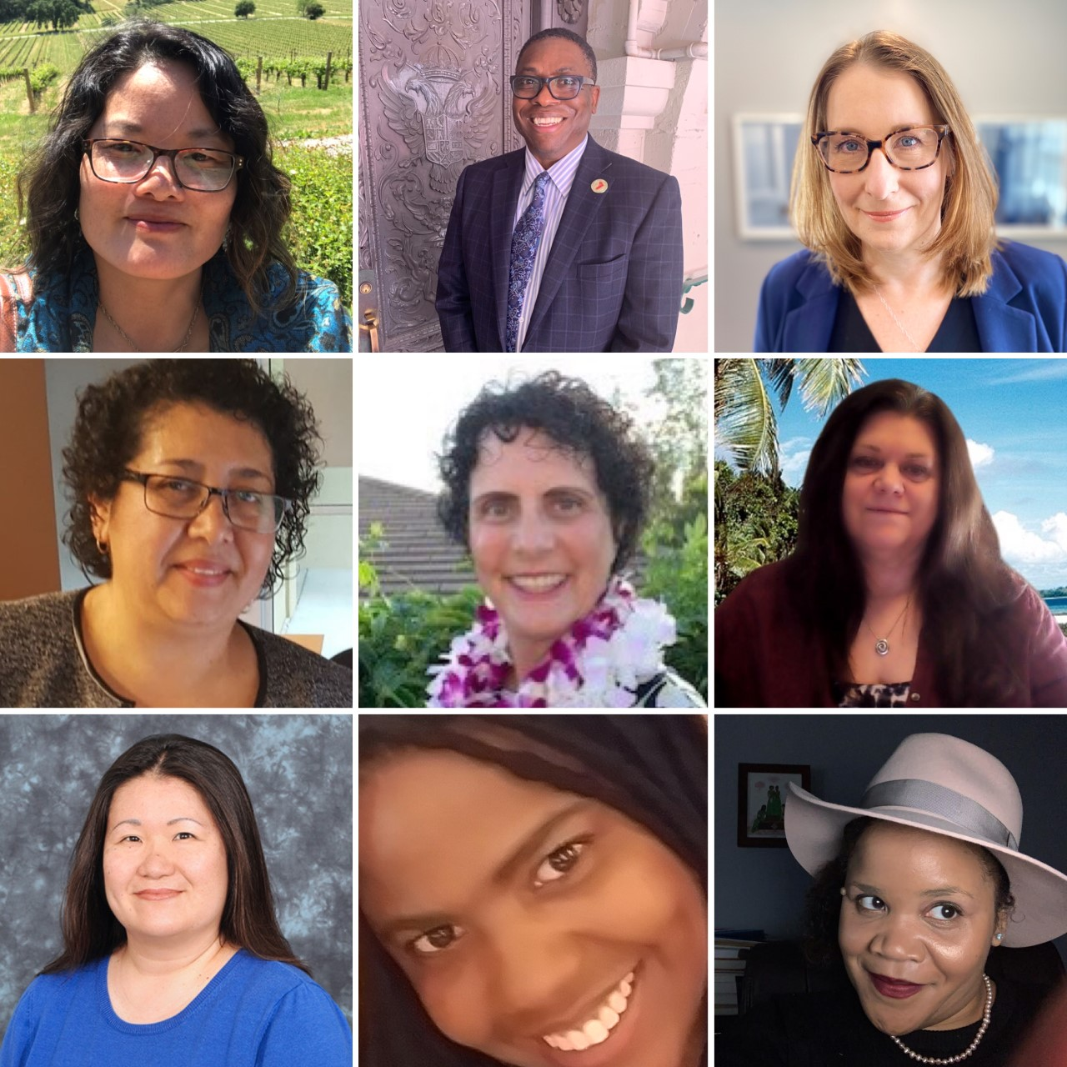
Meet the 20-21 Noncredit & Basic Skills Committee
Thank you!
Karen Chow, Chair
Samuel Foster, 2nd Chair
Wendy Brill-Wynkoop
Emma Diaz
Ingrid Greenberg
Mary Legner
Dana Miho
Kimberley Stiemke
Elizabeth Walker

Slide 8
Meet the 2021 CTE Leadership Committee
Thank you!
Mayra E. Cruz,Chair
Julie Oliver, 2nd Chair
Emilda Baghdaserians
Robert Bodden, Jr.
Jimmie Bowen
Christy Coobatis
Christie Dam
Olivia S. Herriford
Donald Laird
Don Mason
Tina McClurkin
Kristina Perkins
David Ramirez
Lynn Shaw
Violeta Wenger

Slide 9
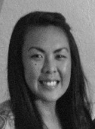
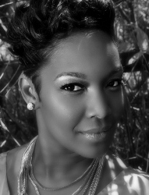
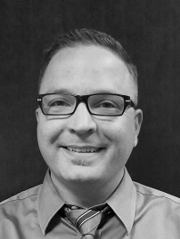
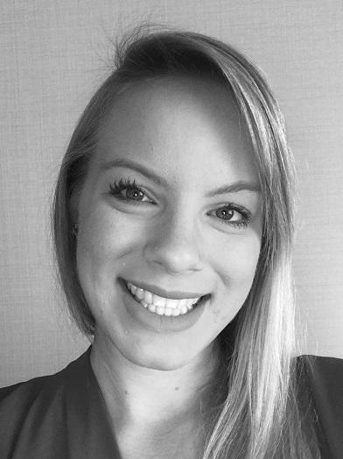
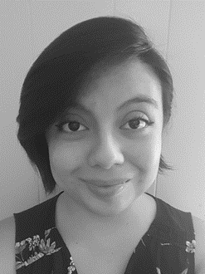
ASCCC Staff
Krystinne Mica
Executive Director
Tonya Davis
Director of Administration
Alice Hammar Director of Finance
Miguel Rother
Director of Grants & Initiatives
April Lonero Executive Assistant
Selena Silva
Program Manager

Slide 10
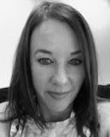
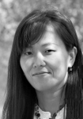
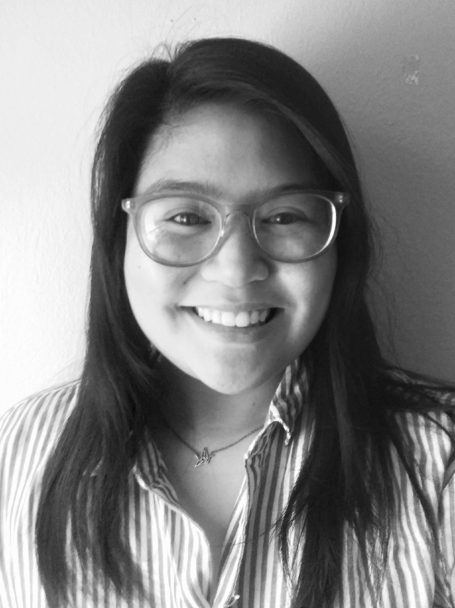
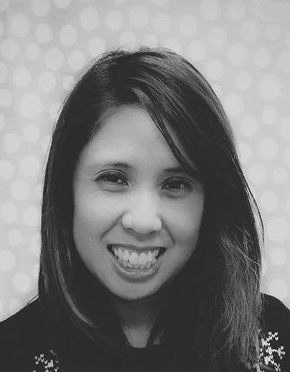
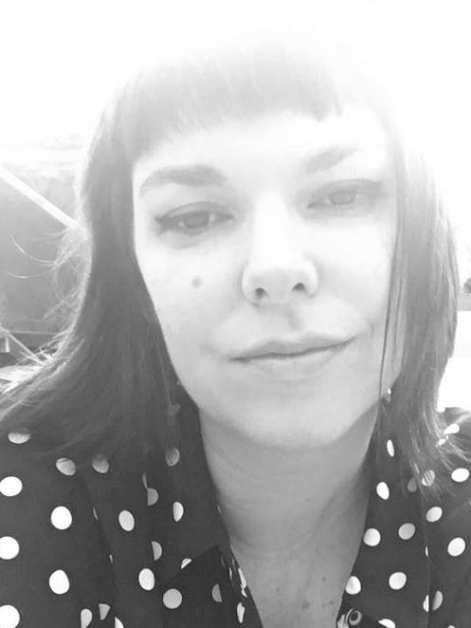
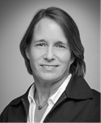
ASCCC Staff
Edie Martinelli Events Manager
Kyoko Hatano Administrative Assistant
Melissa Marquez Administrative Assistant
Meuy Rosales
Accounting Clerk II
Megan Trader Program Coordinator
Katie Nash
Visual Designer

Slide 11
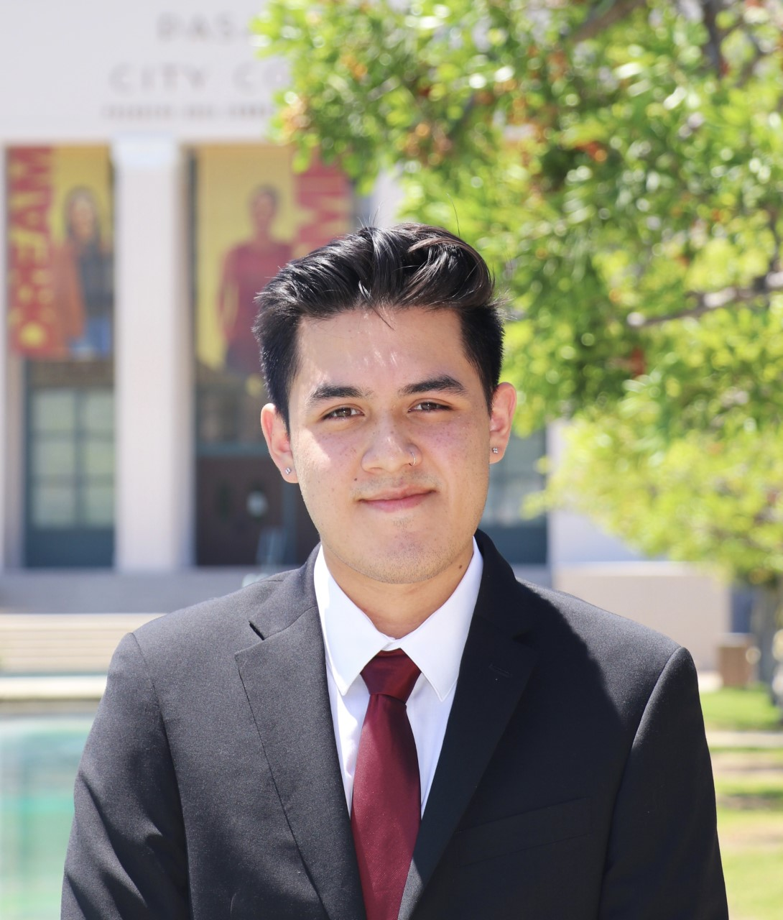
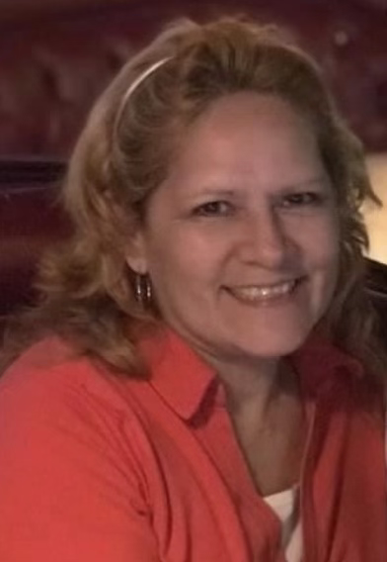
Meet Our Student Panel & Moderator
David Ramirez Tonia Hicks Teresa Rojas-Boltan
Sheneui Weber, Vice Chancellor Workforce and Economic Development, California Community Colleges Chancellor's Office (Moderator)

Slide 12
Panel Questions
1. Tell us about yourself. What brings you joy? What is your educational path or life experiences you would like to share?
3. What has been your path to the community college, what are looking for, and what expectations do you have in the journey?
3. How is the conversation on diversity, equity, inclusion and antiracism impacting your learning journey?
4. What is one advise that you want to share with faculty and other college personnel?

Slide 14
For Additional Information
Email ASCCC at info@asccc.org

Slide 15
Enjoy the Institute!

