Slide 1
Credit for Prior Learning
Dolores Davison, Vice President, ASCCC
Terence C Nelson, VETS Program Faculty Coordinator, Saddleback College
Kim Schenk, Senior Dean, Diablo Valley College
2018 Curriculum Institute
Riverside Convention Center

Slide 2
CPL Convergence in California
Various CCC projects looking for ways to uncover CPL opportunities for students
  Veterans and military students (AB 2462)
  Bachelor’s Degree Pilot
  Nursing and military students (SB 466)
  Workforce and Career/Technical
  (Doing What Matters for Jobs and the Economy)
  Online process to connect students with CPL opportunities (Online Education Initiative)

Slide 3

CPL Workgroups, Reports, & Advisories
CPL Workgroup
  Formed during Spring 2016
  CCCCO, ASCCC, Colleges, Faculty Advisory Committees, CACCRAO, Financial Aid, Statewide Initiatives
Report of Survey Findings
Chancellor’s Office Advisory on Awarding
Credit for Prior Learning:
AB 2462 (Military Experience)

Slide 4
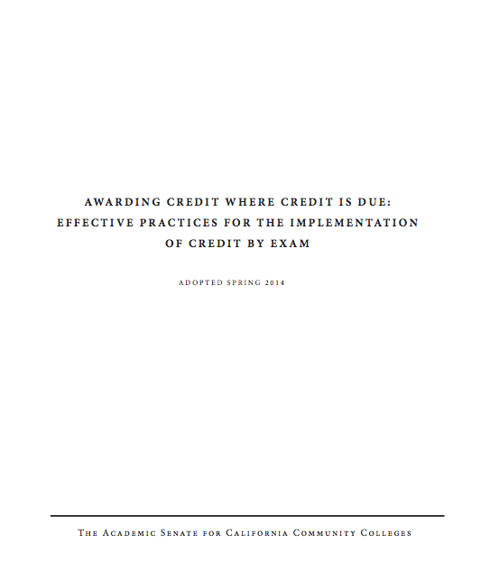
Leadership from ASCCC
Leverage prior work (2014)
ASCCC participation on Workforce
and OEI steering committees
Need active consultation and
collaboration of faculty leadership
ASCCC expertise and leadership
helps ensure success and participation

Slide 5
ASCCC: 7.01 S16 Costs Associated with Prior Military Experience Credit
Resolved, That the [ASCCC], in conjunction with the Chancellor’s Office and other system partners, research the costs of implementation of credit for prior military experience; and
Resolved, That the [ASCCC], in conjunction with the Chancellor’s Office and other system partners, work to secure sufficient and ongoing funding to cover the costs for colleges to ensure the timely implementation and
ongoing awarding of credit for prior military experience.

Slide 6
ASCCC: 7.02 S16 Awarding Credit for Prior Learning Experience
Resolved, That the [ASCCC] work with the
Chancellor’s Office and other interested stakeholders to develop effective practices for the awarding of credit for prior military learning and experience; and
Resolved, That the [ASCCC] work with the Chancellor’s Office and other interested stakeholders to explore the option of awarding credit for forms of prior learning and experience outside of those involving military
experience.

Slide 7
Methods to Assess Prior Learning
Credit by Exam
Military
Credit
Training
Credit
Portfolio
Credit

Slide 8





CPL Collaboration Across Stakeholders

Slide 9
Catalyst for the Conversation
AB 2462 (Block 2012)
Provisions established under § 66025.7 of the California Education Code:
    “…the Chancellor of the California Community Colleges, using common course descriptors and pertinent recommendations of the American Council on Education, shall determine for which courses credit should be awarded for prior military experience.”

Slide 10
CCCCO Survey – March 2016

Slide 11
CCCCO College Survey
113 colleges surveyed
3 surveys conducted Nov 2014 to Mar 2016
96 colleges participated
102 unduplicated courses reported
Units of Credit Awarded: 0.5 to 10

Slide 12

Course Identifiers and C-ID Descriptors
Colleges requested to specify the Course Identification Descriptor, if applicable
Top 3 Reported
  Physical Education
  Administration of Justice
  Information Technology

Slide 13

Course Identifiers – SOC Codes
Colleges requested to specify respective service members Opportunity College (SOC) Code, if applicable
Top 3 Reported
  Accounting
  Administration of Justice
  Automotive

Slide 14
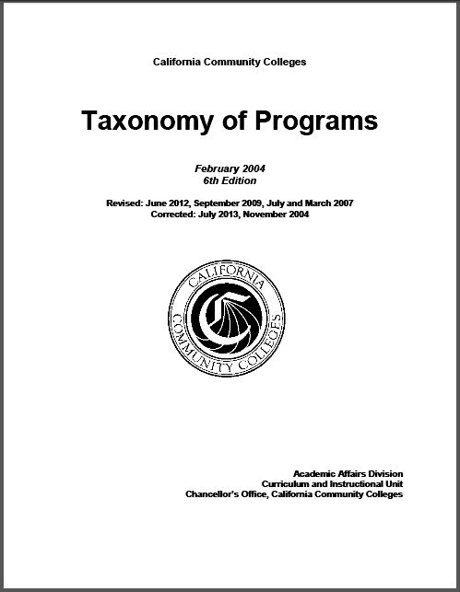
Course Identifiers – TOP Code
Courses classified according to their respective Taxonomy of Programs (TOP) Code
Top 3 Reported
  Physical Education
  Office Technology
  Automotive

Slide 15



Courses Frequently Reported Among C-ID, SOC, and TOP Codes
Administration of Justice
Business and Management
Information Technology

Slide 16
Top 10 Colleges Based on Average VMS Enrollment in 2015-16
Institution | VMS Enrollment
Solano | 7171
Palomar | 4880
San Diego Mesa | 3339
American River | 2985
San Francisco | 2588
Mira Costa | 2425
Southwestern | 2287
Mt San Jacinto | 2120
San Diego Miramar | 2107
Saddleback | 2091
Total: | 31,993
Notes:
Average based on Fall 2015 and Spring 2016 Enrollments- active duty and veterans
Total 31993 out of 106643 or 30%

Slide 17
Top 10 Instructional Program TOP codes for VMS System-wide, 2015-16
Instructional Program Codes | Program Awards
Transfer Studies – 490110 | 781
Administration of Justice – 210500 | 605
Biological and Physical Sciences (and Mathematics) 490200 | 541
Business Administration – 050500 | 518
Liberal Arts and Sciences, General – 490100 | 506
Social Sciences, General – 220100 | 331
Business Management – 050600 | 238
Fire Technology – 213300 | 189
Automotive Technology – 094800 | 183
Liberal Studies – 490120 | 162
Total: | 4,054
Notes:
The above instructional program TOPs are similar in content to the target colleges with high military and veteran populations with some variance in rankings. Specifically, the top instructional program codes for the target schools and the system are the same in:
Transfer Studies – 490110
Biological and Physical Sciences (and Mathematics) – 490200
Liberal Arts and Sciences, General – 490100
Fire Technology – 213300
Social Sciences, General – 220100
Liberal Studies – 490120
Administration of Justice - 210500
The system-wide common TOP instructional program codes for VMS include Business Management and Automotive Technology, which are not in the top ten TOPs for the target colleges. Paramedic and Psychology are included in the top ten VMS TOP instructional program codes for the target colleges but are not included in the system-wide top list.
Top ten TOP instructional program codes in Table 4 account for almost half of all VMS program awards (4,054 out of 8,310 total awards).
Even taking a conservative approach of analyzing the number of awards in traditional transfer programs (Transfer Studies, Liberal Arts and Sciences, General and Liberal Studies), the number of awards reflects 36% of the total top ten majors/concentrations. If Biological and Physical Sciences (and Mathematics), Business Administration, Social Sciences, General, and Business Management are also included, VMS reflects 76% of the total top ten instructional program TOPs.

Slide 18
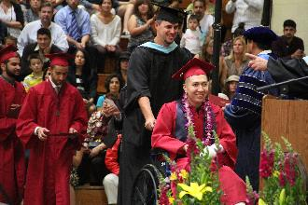
Innovation Award- Saddleback College
Veterans-Credit Articulation Track (V-CAT)
$2M over 5 years
Focus on faculty and regional needs
Award Goals:
  Increase knowledge of ACE and military training/coursework among faculty in CA CCs and CSUs
  Minimize CTE and transfer pathways for veterans to maximize use of VA benefits in the public CA systems
  Create online open source repository for articulated courses/MOSs
  Enhance Understanding of DoD Training and Experiences by IHLs and Workforce
  Build Trust Across IHL/ DoD Sectors

Slide 19
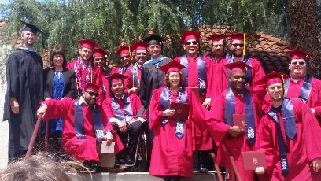
Innovation Award- Saddleback College
Veterans-Credit Articulation Track (V-CAT)
V-CAT Origins
Environmental Scan
  Veterans Services
  Existing CPL Initiatives
Region VIII Veterans Program Director Consortium
Regional CPL Collaboratives within National Veterans Space
Joint Advocacy and Professional Development
  V-CAT Benefits
35% of GI Bill users in CA at for-profit universities
Merely 36 months of GI Bill
Wasting faculty and student instructional time for potentially redundant curriculum

Slide 20
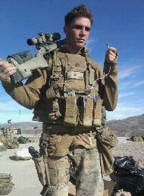
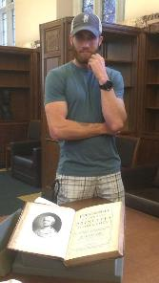
Innovation Award- Saddleback College
Veterans-Credit Articulation Track (V-CAT)
V-CAT Partners
Saddleback College
Cal Poly Pomona
Cal State Fullerton
Cal State Long Beach
Cal State University Chancellor’s Office
CCCCO
ACE/ Department of Defense
Faculty, Faculty, Faculty!!!
  10+1 Foundations

Slide 21
CA DoF
DoD
SOCCCD
Development of Best Practice for BP/Catalog Policy
Federal Agency & DoD Course/Occupation Reviews
Funding Source
ACE
IVC
Saddleback College
CCME
CCCCO
CPL Workgroup/State Recommendations and Guidance
CAEL
CSU Long Beach
CSU Fullerton
CSU Pomona
CSU Partners & Chancellor’s Office
National Organizations With Veteran CPL Focus
CSU
Office of the Chancellor

Slide 22

Innovation Award- Saddleback College
Veterans-Credit Articulation Track (V-CAT)
Process for faculty review
PI research
Course/MOS selections
Discipline faculty recruitment
Faculty training
Panel reviews and recommendations
PI review/feedback to panel in needed
Routing to AO for review
Submission to database
Repeat again for each term
Notes:
Routing to CSU or new panel is necessary

Slide 23
Innovation Award- Saddleback College
Veterans-Credit Articulation Track (V-CAT)
Notes:
ACE Website for review- http://www3.acenet.edu/militaryguide/CourseSearch.cfm

Slide 24
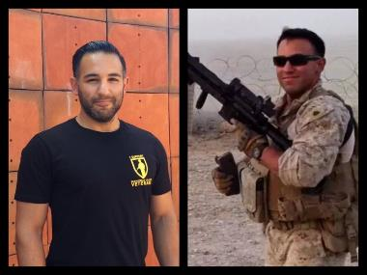
Innovation Award- Saddleback College
Veterans-Credit Articulation Track (V-CAT)
Successes to Date
Articulation Agreements
  Electronics Technology
  Languages
  Computer Sciences
JST Repository Project
Catalog Policy Proposed Research
Increased Collaboration
  Intersegmental
  National Organizations
Increased CPL Dialog in CCCC and CSU Systems

Slide 25

Innovation Award- Saddleback College
Veterans-Credit Articulation Track (V-CAT)
Revealing Gaps
Regionally accredited DoD coursework treated like non-collegiate coursework
Catalog policies and administrative regulations
  Vary tremendously
  Unit ceilings are far too low in some districts
  Credit is given upfront hurting many veterans
International students vs prior military
No dedicated funding/support for faculty or AOs to do this vital work for re-entry adult students

Slide 26
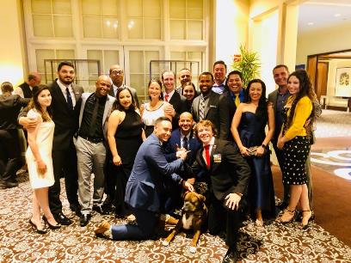
Innovation Award- Saddleback College
Veterans-Credit Articulation Track (V-CAT)
Our Progress
Follow Our Webpage:
  www.saddleback.edu/vets/pathways-completion-v-cat
Contact Us Directly
  tnelson14@saddleback.edu
  gbarnak@saddleback.edu
Nudge Your Local CC and CSU to Follow Our Progress and Consider Adding Articulation Pathways

Slide 27

Questions? Comments?

Slide 28
Thank you!
Dolores Davison davisondolores@fhda.edu
Terence Nelson tnelson14@saddleback.edu
Kim Schenk kschenk@dvc.edu

