Slide 1
CWE/Internships in the CA CC System
What they are, how they work,
and performing beyond the basics

Slide 2
Key Points
Why work experience?
What’s in a name?
How does CWE work?
What do model programs do?
On-going discussions/sticking points
Questions/Answers/Referrals

Slide 3
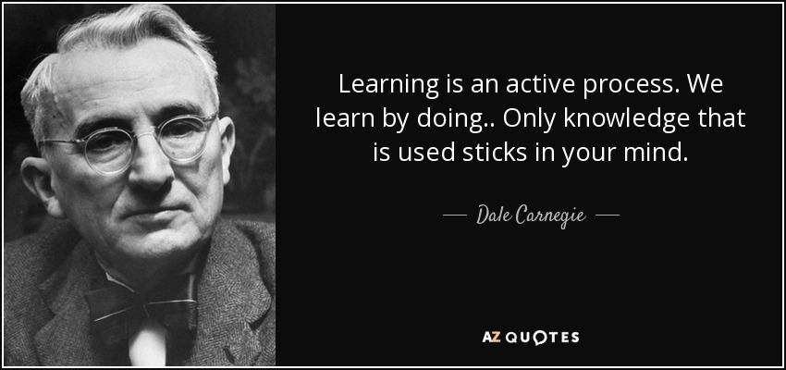

Slide 4
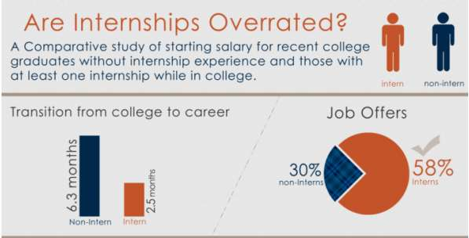
Benefits of Internships
Benefits for Students

Slide 5
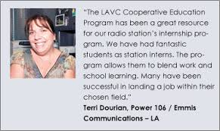
The most important element of internships is that they integrate classroom knowledge and theory with practical application and skills developed in professional or community settings. They also bring a wealth of benefits to students, both while completing a degree and when seeking a career path post-graduation.
Benefits to Employers

Slide 6
Benefit to the College
Data/outcomes
Certs/degrees earned
Increased earnings
Job placement
Community Connections
Alumni, Foundation, Board of Trustees, other donors
CTE Advisory Boards

Slide 7
Definitions
Work-based Learning
Internship
Cooperative Work Experience Education
Others (Externship/Practicum/Clinical/Apprenticeship)
Notes:
Small groups—come up with definitions/delineations
Confusing/not clear
Important to establish for your own campus/program
Important part of branding/selling

Slide 8
Work Experience Education Definition
Title 5 § 55250.3
Work-experience education authorized by this article includes the employment of students in part-time jobs selected and approved as having educational value for the students employed therein and coordinated by college employees.

Slide 9
Internships (CWEE) 101
Title 5—District Plan
Faculty Support
Site Development/Employer Relations
Marketing
Prepping Students
Teaching/Curriculum/Assignments
Monitoring Students

Slide 10
Program Types
Title 5 §55252:
General Work Experience Education
Occupational Work Experience Education
Almost 6000 active courses statewide—95% occupational

Slide 11
General Work Experience
Title 5 §55252
(a) General Work Experience Education is supervised employment which is intended to assist students in acquiring desirable work habits, attitudes and career awareness. The work experience need not be related to the students' educational goals. Student’s jobs need not be directly related to their educational goals.

Slide 12
Occupational Work Experience
Title 5 §55252
(b) Occupational Work Experience Education is supervised employment extending classroom based occupational learning at an on-the-job learning station relating to the students' educational or occupational goal.
Aligned with related CTE program TOPS code

Slide 13
CA State Labor Code
California Labor Code §3368:
For “students enrolled” in VOLUNTEER/ UNPAID General and or Occupational Cooperative Work Experience
School district is considered the employer and therefore responsible for worker’s compensation insurance for the student

Slide 14
Approved District Plan
Title 5 §55250
Any program of Cooperative Work Experience Education …shall conform to a plan adopted by the district. The plan adopted by the district shall set forth a systematic design of Cooperative Work Experience Education whereby students, while enrolled in college, will gain realistic learning experiences through work. This plan shall be submitted to and approved by the Chancellor.

Slide 15
Required Resources
The district/college demonstrates support by providing sufficient resources including:
budget,
records,
staff and
resources for workstations (employers)
to establish and operate a work experience program.
From: The Work-Based Learning Handbook, California Statewide Advisory Committee on Work-Based Learning & Student Employment

Slide 16
Unit Formula
Title 5 §55256.5
(b) The learning experience and the identified on-the-job learning objectives shall be sufficient to support the units to be awarded.
(1) Each 75 hours of paid work equals one semester credit or 50 hours equals one quarter credit.
(2) Each 60 hours of non-paid work equals one semester credit or 40 hours equals one quarter credit.

Slide 17
Instructor Role
(1) In-person meeting with employers or designated representatives to discuss students' educational growth on the job.
(2) Written evaluation of students' progress in meeting planned on-the-job learning objectives.
(3) In-person meeting with student to discuss students' educational growth on the job.

Slide 18
Employer/Site/Mentor Role
Expect to teach certain skills which can be more effectively learned on the job.
Serve as an extension of the instructional staff of the college.
Identify skills, knowledge and attitudes students should bring to the job.
Identify skills that can be more thoroughly learned on the job.
Direct the student's daily progress in reaching his/her stated objective.
Assist in the selection of appropriate learning objectives as well as providing the students with the time and materials necessary to achieve them.

Slide 19
Course Repetition
Title 5 §55253
(a) Students may earn up to a total of 16 semester credit hours or 24 quarter credit hours, subject to the following limitations:
General Work Experience Education: maximum of six semester credit hours or nine quarter credit hours
Occupational Work Experience Education: maximum of eight credit hours may be earned

Slide 20
CB09 SAM Priority Code
CTE Cooperative Workforce Experience Courses should always be:
B-Advanced Occupational
C-Clearly Occupational
D-Possibly Occupational
“A” is only for apprenticeship/work experience
If a school chooses “E” the course won’t be counted in the MIS data collection as a CTE course.

Slide 21
The Fine Print: Legalities
FLSA
Wage and Hour—DOL
CA Labor Code
Independent Contractors

Slide 22
Model Program Practices
Beyond the basics…

Slide 23
Funding Sources
Instructional vs. Student Services
Federal Perkins/Strong Workforce
Partnering with Foundation/Development Office
Grants
Employer Sponsorships

Slide 24
Getting Faculty On-board
Who is on your team?
Who else should be?
Recruitment of faculty
Curriculum Integration

Slide 25
Site Development/Employer Relations
Orientation Am I ready to Host an Intern
Internship Stages
Recruitment
Ensuring compliance
Expanding/Maintaining connections
Targeted groups/situations?
Recognition

Slide 26
Marketing
Marketing Plan
Materials/Modes/Messages
Various Audiences
Students, Faculty, Administrators/Institution, Employers
You Must do an Internship
Evaluation/revision

Slide 27
Preparing Students
Career prep/alignment
Readiness
Job prep
Finding/Creating an opportunity
Orientation Making the Most of Your Internship
Expectations/Paperwork/Projects/Learning Objectives

Slide 28
Teaching/Curriculum/Assignments
Setting objectives
Assessing student learning
Final Project sample
Grading

Slide 29
Unique Issues/Populations
Virtual Internships
Home-based Placements
International Students here in US
Students requiring accommodations

Slide 30
Common Dialogs
Paid vs. Unpaid
Internship Requirement by school/program
Rise of entrepreneurship-related opportunities
Posting policies
For credit/not for credit

Slide 31
Resources
CA Internship & Work Experience Association www.ciwea.org
Fall Summits
Spring Conference
On-going information/referral
CCCCO —Work-based Learning Handbook
Title 5
NACE/CEIA (National)

Slide 32
Thank you!
Brook Oliver
President, CA Internship & Work Experience Association
Counseling Chair, Sierra College
916.660.7482
boliver@sierracollege.edu

