Slide 1
Canvas 101
Michelle Pilati,
ASCCC Past President
Conan McKay,
Part-time Faculty Committee, Facilitator
2017 Summer Part-time Faculty Leadership Institute
August 4, Double Tree Anaheim, CA

Slide 2
Overview
Why Canvas?
Canvas Resources
Canvas Basics
Creating Accessible Content in Canvas
Getting Started in Canvas (Demo – Internet permitting)

Slide 3
Why Canvas?
What features do you want in a course management system?
What features do students want in a course management system?
What features would specifically appeal to a part-time faculty member?

Slide 4
Why Canvas?
Selected by the Online Education Initiative (OEI).
So?
106/114
Why did the OEI select Canvas?
Ease of use for students and faculty.
Mobile capability. (**NEW** “Canvas Teacher”)
Ease of integration – Canvas architecture simplifies the addition of various features.

Slide 5
Settings >> Apps
External Apps
Apps are an easy way to add new features to Canvas. They can be added to individual courses, or to all courses in an account. Once configured, you can link to them through course modules and create assignments for assessment tools.
See some LTI tools that work great with Canvas.

Slide 7
Installed Apps

Slide 8
106/114
Chances are, if you are teaching at various colleges, you may be teaching in various instances of Canvas.
Advantages?

Slide 9
Canvas Resources
Try Canvas for free - https://www.canvaslms.com/
http://www.onefortraining.org/ - facilitated online “Introduction to Teaching with Canvas”
http://www.onefortraining.org/node/785 - self-paced online course
Lynda training via the PLN - https://prolearningnetwork.cccco.edu/
The Canvas Community

Slide 10
Canvas Basics
Dashboard
Account > Settings & Notifications
Inbox
Modules

Slide 11
Dashboard – Card View

Slide 12
Dashboard – Recent Activity

Slide 13
Account
Profile – Image, contact, bio, links
*Settings – Ways to contact
*Notifications – What you want to be notified of – when and how
*Guide students to these…

Slide 14
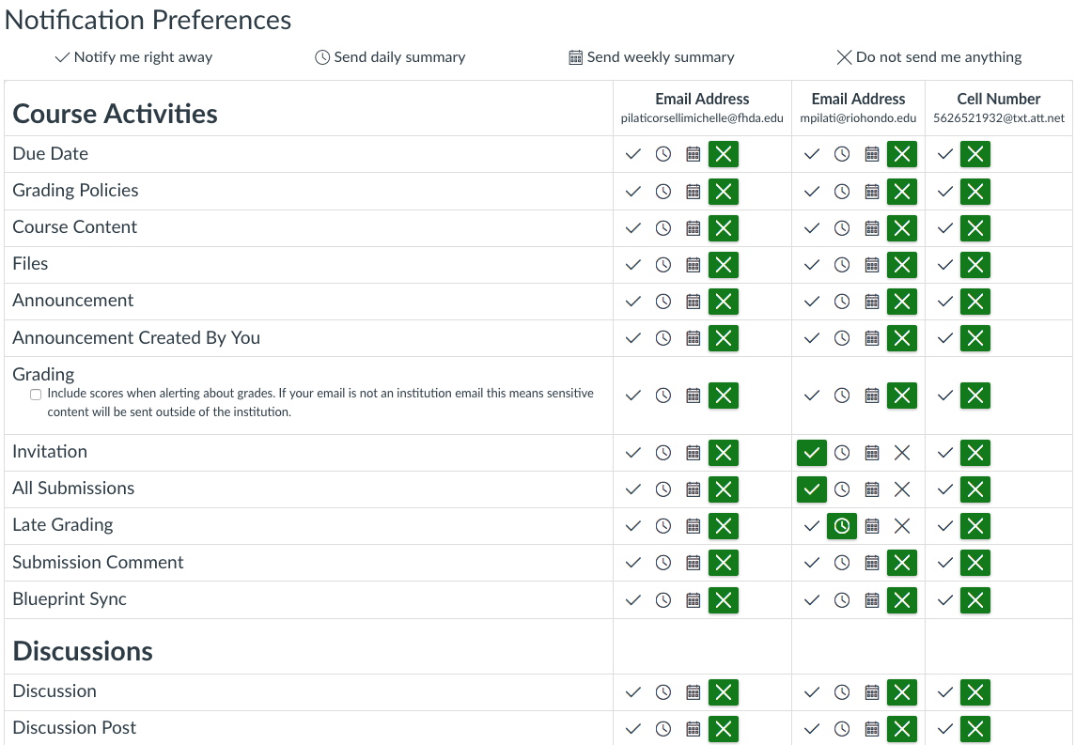
Notifications

Slide 15
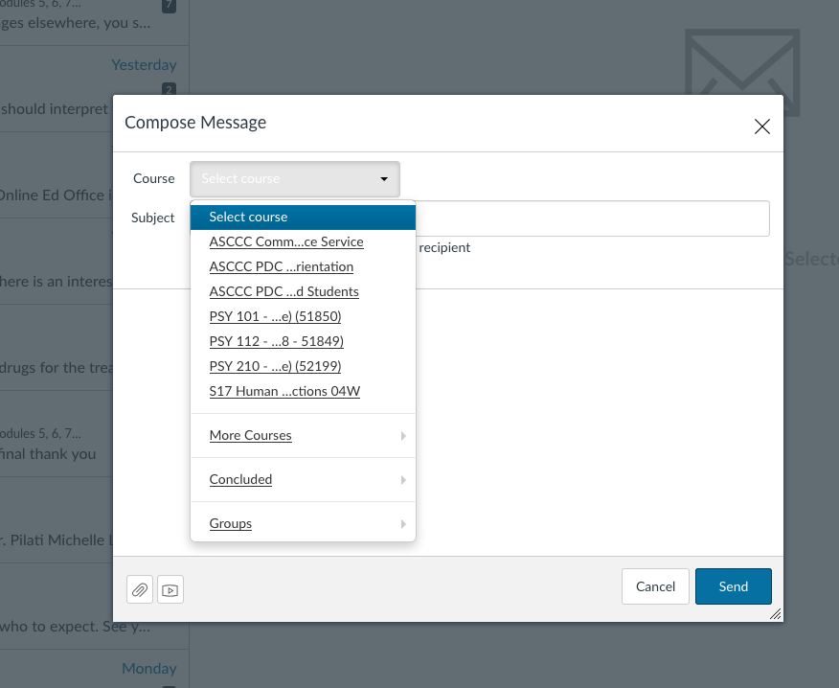
Inbox
Messages sent using “Conversations” can be received and responded to in your E-Mail.
All courses accessible from a single interface.

Slide 16
Messages can also be sent from Grades

Slide 17
And students can comment on assessments..
Allows for within assessment dialogue.

Slide 18
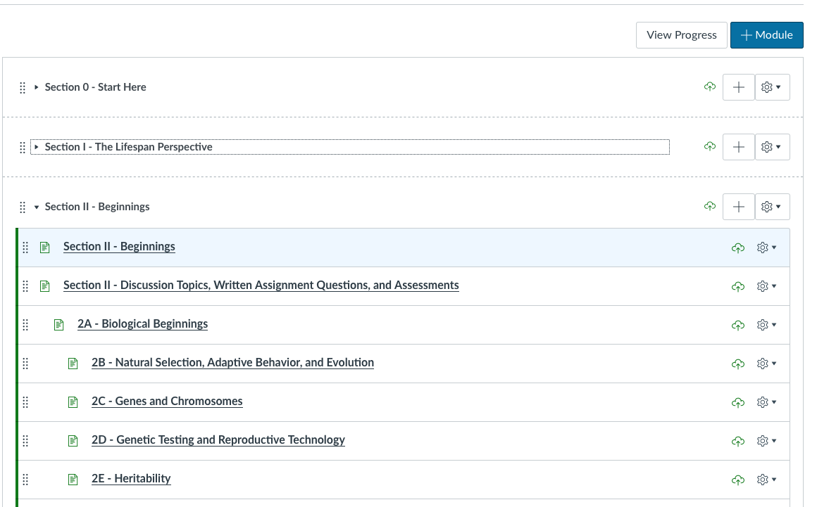
Modules

Slide 19
Students “Next” through a Module

Slide 20
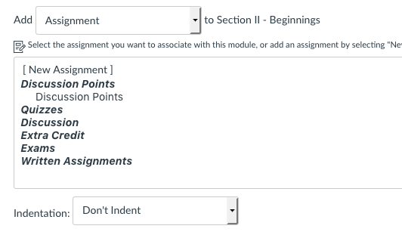
Creating Accessible Content in Canvas
When in Modules, new pages can be created by:
1. Clicking on “View all pages” >
+ Page
Allows for you to create a page – title and body – that you can then add to a Module
2. Clicking on the + symbol for a Module:

Slide 21
Creating a blank canvas

Slide 22
Add “Headers” using “Paragraph”

Slide 23
Create lists using options in menu

Slide 24
Adding Images

Slide 25
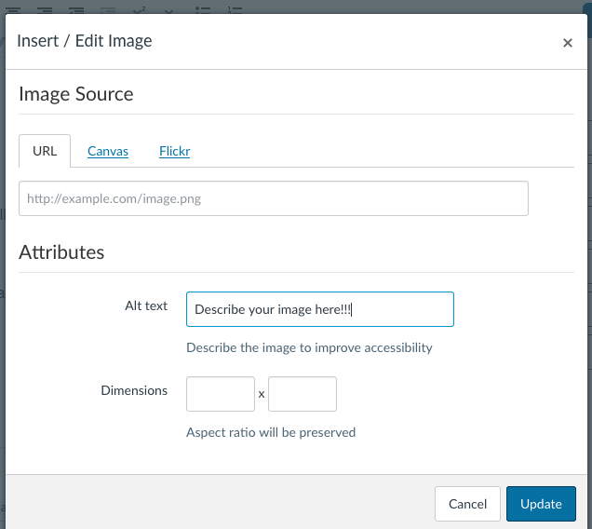
Embed Images Menu
Canvas default alt text is the file name – that’s bad!

Slide 26
Flickr – Creative Commons Images

Slide 28
Links Must be Meaningful
“Click here” means nothing to a screen reader.
Syllabus for XXX
Download PDQ

Slide 29
Getting Started

Slide 30
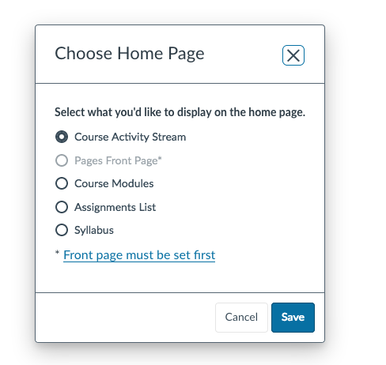
Choose Home Page…

Slide 31
What should be on the Home Page?
Is this an online course?
Is this supplements to a F2F?
How are you planning to use Canvas?

Slide 32
Questions and Discussion
Thanks!
mpilati@riohondo.edu

