Slide 1
Course Sequencing and Program Mapping: Implications Considering the Student Experience
Presenters:
Randy Beach, Jaguar Pathways, Southwestern College
Stephanie Curry, ASCCC Executive Committee, ASCCC Curriculum Committee
Michelle Sampat, Associate Dean of Instruction, Mt. San Antonio College
ASCCC Curriculum Institute
July 10-13, 2019

Slide 2
Outcomes
2
In this session, attendees will:
Explore course sequencing and program mapping
Consider impacts of sequencing and mapping on faculty and students
Examine course sequencing and mapping in relation to curriculum approval processes
Other?
ASCCC Curriculum Institute July 10 - July 13, 2019
San Francisco, CA

Slide 3
Description
Understanding student need and placing that at the center of our course sequencing is the best place to start when creating maps, and program mapping provides colleges with exciting possibilities for providing clear coursetaking patterns for their students to follow to promote completion. But how should faculty go about determining the right sequence for students to fulfill program requirements whether they be major courses, general education courses, electives, or the increasingly important transfer math and English courses? At this presentation, attendees can learn from colleges that have asked these same questions at various stages in the program mapping process.
ASCCC Curriculum Institute July 10 - July 13, 2019
San Francisco, CA

Slide 4
Overview
Why mapping?
Critical Curriculum Clean Up BEFORE Mapping
Setting the stage for successful mapping
Questions to Ask
Visualizing the end
Resistance? Faculty concerns
ASCCC Curriculum Institute July 10 - July 13, 2019
San Francisco, CA

Slide 5
Introductions
5
Check in…
How many of you are new Curriculum Chairs; Curriculum Specialists; Articulation Officers; Deans; CIO/VPI?
How many of you are new to the Curriculum Committee?
What would you REALLY want to be sure to get from this session?
ASCCC Curriculum Institute July 10 - July 13, 2019
San Francisco, CA

Slide 6
What is a Program Map?
An academic program map is a term-by-term sequence of courses required to complete the degree/certificate in
two years. This helps students understand how degree requirements can be translated into a term-by-term registration plan. A program map is intended to communicate to students the most efficient pathway that minimizes the time to degree and the courses they need to take to ensure a seamless completion or transfer.
ASCCC Curriculum Institute July 10 - July 13, 2019
San Francisco, CA

Slide 7
What is Program Mapping?
A process whereby discipline faculty, working with counseling faculty, create visual roadmaps for students that identify which courses should be taken and in what order as part of a two-year, four semester sequence. It’s a collaboration that poses
practical and philosophical questions around the design of a program in order to clarify for students the value and intended outcomes of a program.

Slide 8
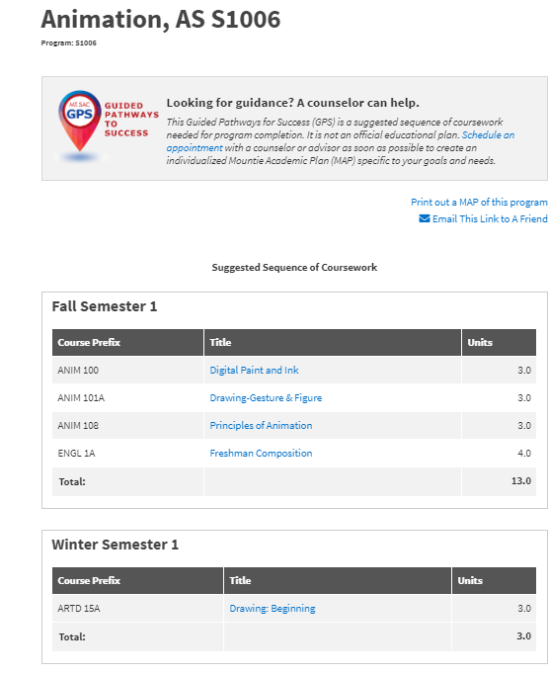
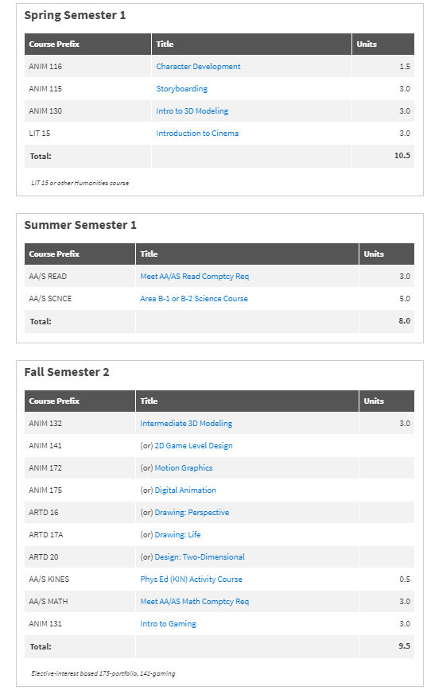

Slide 9
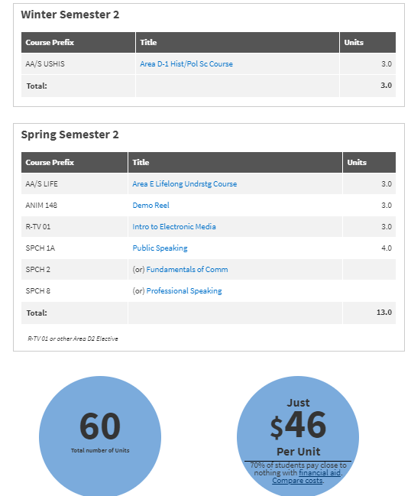
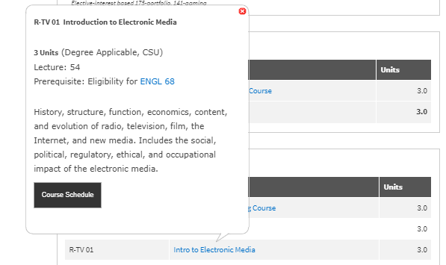
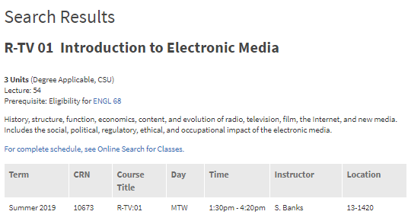

Slide 10
Why does a course belong in a specific semester?
Is the course a prereq for other courses?
Does the course rigor require preparation
Does the course represent a milestone in student progress?
Can students use the course to pursue other majors within a meta major if they change major?
Is the course a hook course meant to engage student interest or vet suitability?
ASCCC Curriculum Institute July 10 - July 13, 2019
San Francisco, CA

Slide 11
Why does a course belong in a specific semester?
Do you want English and Math in first semester?
funding formula
enrollment management
what are the potential unintended consequences
Conversations with faculty and administration
what about part-time students
ASCCC Curriculum Institute July 10 - July 13, 2019
San Francisco, CA

Slide 12
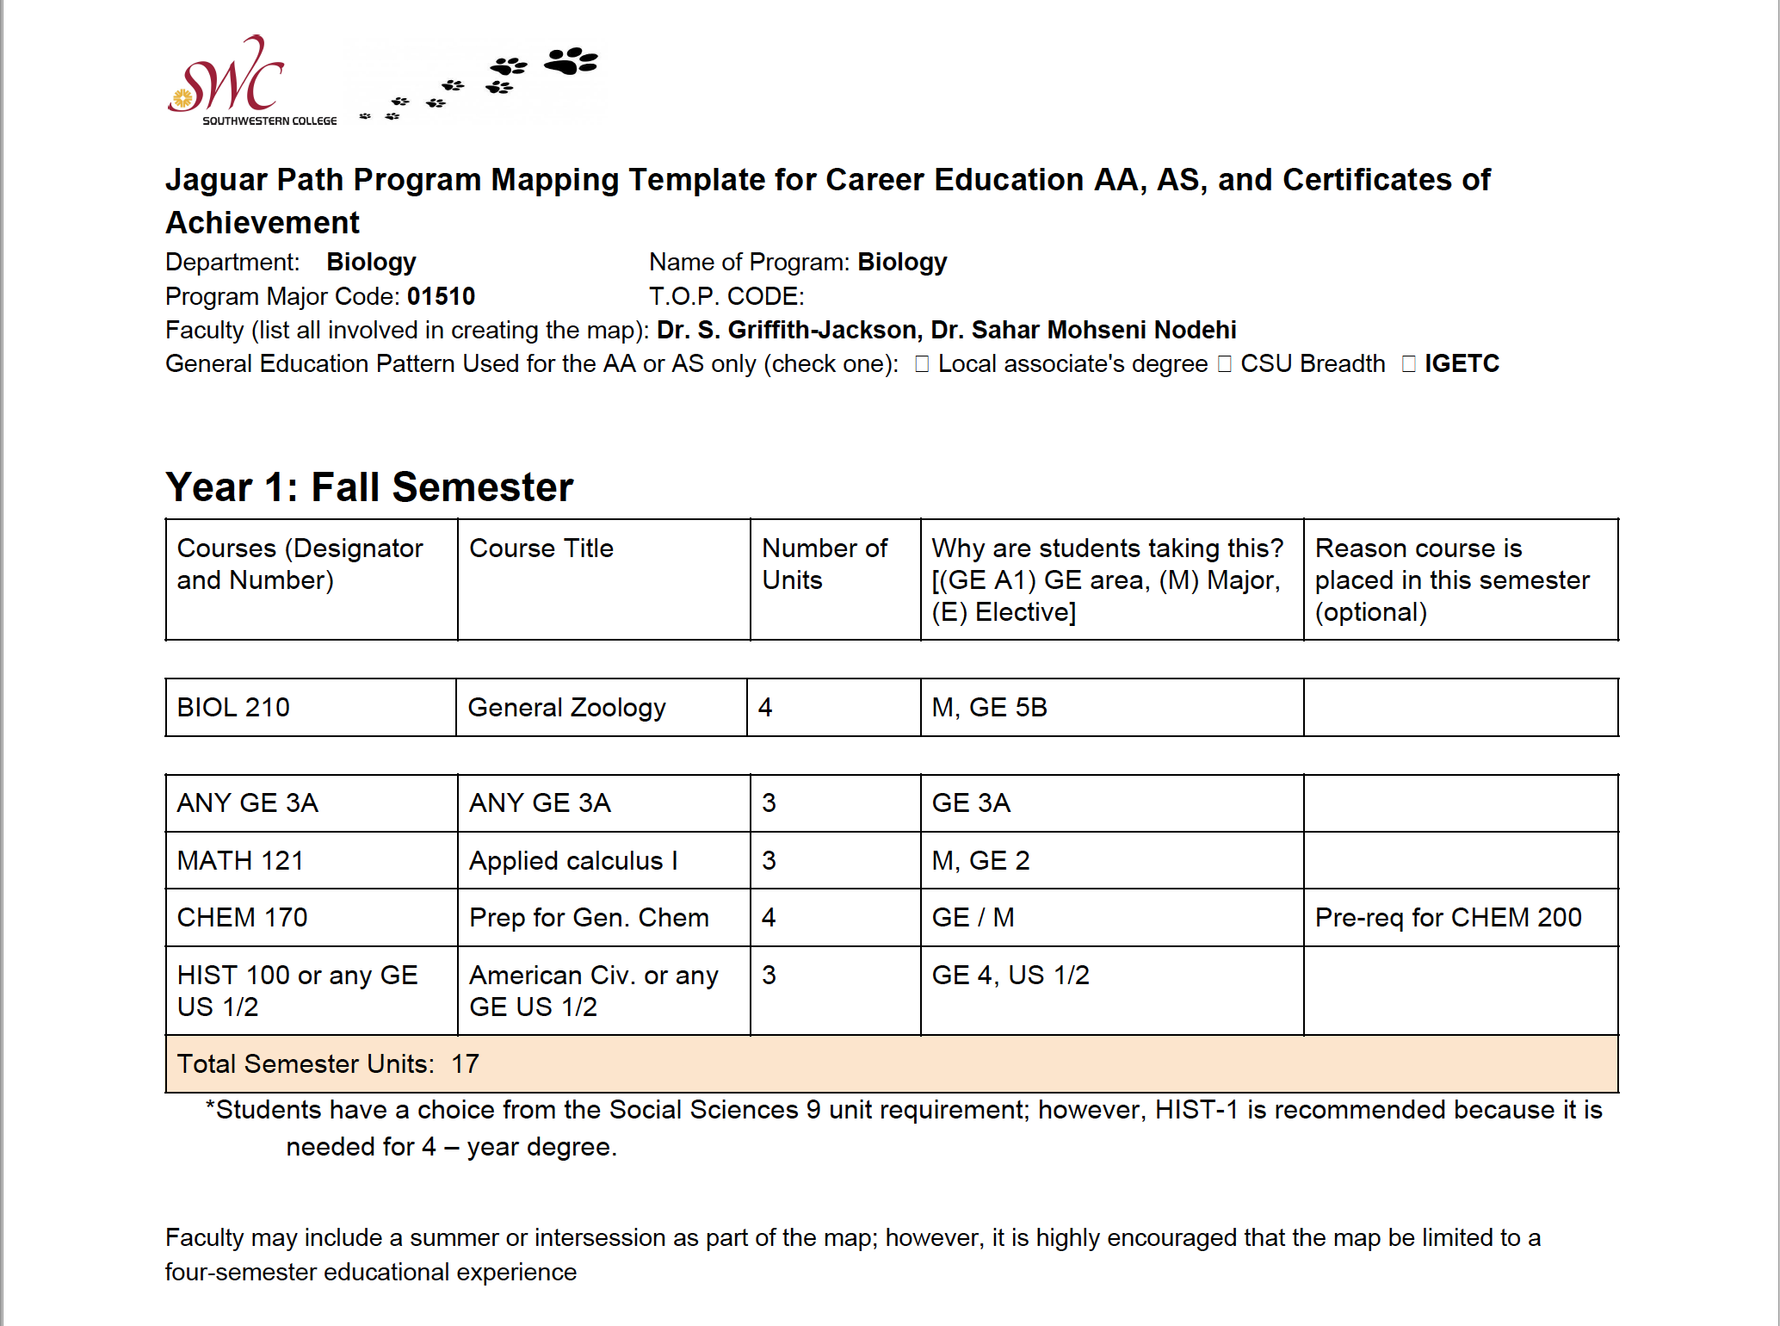
Notes:
Southwestern-Randy

Slide 13
Clean Up – What does that mean?
Curriculum and discipline experts examining data across the institution
Asking questions – lots of questions – across programs
Not jumping to conclusions
May (or may not) mean discontinuing certain awards, programs classes
May (or may not) mean creating new awards, programs, classes
May (or may not) mean re-designing
Does mean looking at the end – employment and transfer
ASCCC Curriculum Institute July 10 - July 13, 2019
San Francisco, CA

Slide 14
Curriculum Clean-Up Continued
Are there courses in your catalog that are never offered?
Are there programs in your catalog that have never existed – or no longer exist?
Are there certificate and/or degree options that have never been awarded?
Who is responsible for the “clean-up” decisions?
ASCCC Curriculum Institute July 10 - July 13, 2019
San Francisco, CA
Notes:
This is the result of scrolling to the program requirements

Slide 15
Setting the Stage
Begin with a plan (Southwestern College)
Set goals for mapping. Establish your process documents
Establish mapping priorities
Consider incentives for faculty
Clarify the Admin role
Approach as professional development
ASCCC Curriculum Institute July 10 - July 13, 2019
San Francisco, CA

Slide 16
Example of Mapping Design Principles
GP@RC MAPPING DESIGN PRINCIPLES
be visually appealing, straightforward and easy to navigate
be simple and confined to one page (supplemental pages can be given to the students later for more context/information)
allow students to can keep track of major milestones and their progress in their major
identify support programs and services
provide students with points of contact (Instructor/ Counselor)
include brief information on career and transfer opportunities
include a course from the major in the first year (preferably the first semester)
include appropriate English and math course in the first year
provide Advising/Action Notes for each semester
Identify potential stackable certificates in each program
semester loads should be balanced as much as possible
leave options in GE pattern to encourage guided exploration
ASCCC Curriculum Institute July 10 - July 13, 2019
San Francisco, CA

Slide 17
Questions to Ask: General Education?
Don’t rush into this decision
Often faculty understate and overstate GE
Consider creating a GE committee to facilitate dialog
Begin thinking early about how maps will be presented to students, and how your technology frees or limits
Emphasize student need and faculty purview to make GE recommendations
Know your faculty. Is this a hill to die on?
ASCCC Curriculum Institute July 10 - July 13, 2019
San Francisco, CA

Slide 18
Questions to Ask: General Education Patterns?
First step: ask where are your students going?
Take the time to educate faculty on GE patterns
Make your process generic enough that a map can be created for any pattern
Or create maps specific to each pattern
How closely do your three patterns align in their shared areas?
CSU Breadth
IGETC
LOCAL GE
ASCCC Curriculum Institute July 10 - July 13, 2019
San Francisco, CA

Slide 19
Questions to Ask: Focusing on Jobs
Mapping always begins with the end in mind
Include employability or crucial achievement milestones in your map
Many CTE programs have licensure milestones-- Celebrate them!
ASCCC Curriculum Institute July 10 - July 13, 2019
San Francisco, CA

Slide 20
Questions to Ask: What about Part-time Students?
Most CC students are part-time…
Maps should be based on a standard student profile
Beginning at transfer-level ENGL / MATH
Full-time attendance
Declared transfer institution (UC or CSU not a private)
Determine who will see/use these maps
Maps are tools, not replacements for counselors
Variety of maps can be developed down the road
ASCCC Curriculum Institute July 10 - July 13, 2019
San Francisco, CA

Slide 21
Focusing on Holistic Student Support Grounded in Equity
MAPPING WORKSHOPS
2 Hours Cross Functional Conversations on Programs including Instructors, Deans, Counselors, Support Faculty and Staff
Focus on most efficient path for students to complete program including GE where applicable
Review potential support services and activities to support student success and engagement
ASCCC Curriculum Institute July 10 - July 13, 2019
San Francisco, CA

Slide 22
Focusing on Holistic Student Support Grounded in Equity
MAPPING WORKSHOPS
Identify potential roadblocks or bottlenecks for students
Give students the information they need to make informed choices
Reviewing Achievement Data and Number and Types of Degrees and Certificates and Stackability
ASCCC Curriculum Institute July 10 - July 13, 2019
San Francisco, CA

Slide 23
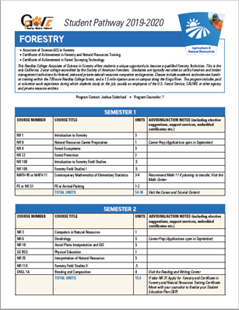
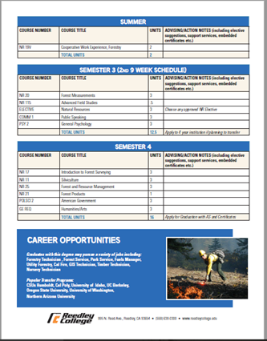
Mapping Outcomes
•95% said they were satisfied with the Mapping Sessions
•97% said they had a better understanding of the role of Counseling
•100% said they had a better understanding of their program
•100% said they thought the maps would be helpful to students
ASCCC Curriculum Institute July 10 - July 13, 2019
San Francisco, CA

Slide 24
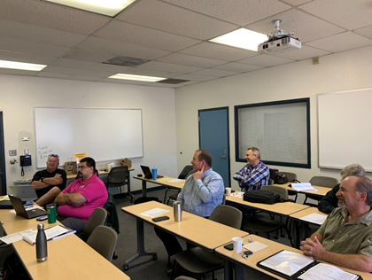
What They Said--COLLABORATION
•“The collaboration between discipline faculty and counselors was much needed and helped to clarify the importance of scheduling certain courses in particular semesters. Overall, I think we are moving in the direction GP suggests: collaborative efforts across campus personnel (success teams) to promote student success.”
•“One of the highlights of the mapping process is the collaboration and the different perspectives of all staff members, working together to develop plan that focus on student success”
ASCCC Curriculum Institute July 10 - July 13, 2019
San Francisco, CA

Slide 25
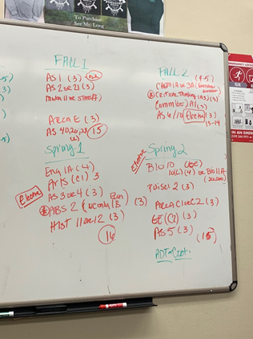
What They Said--COLLABORATION
“The collaboration between faculty and counseling. I think both learn quite a bit from one another. I hope this collaboration continues”
ASCCC Curriculum Institute July 10 - July 13, 2019
San Francisco, CA

Slide 26
Resistance to Mapping?

Slide 27
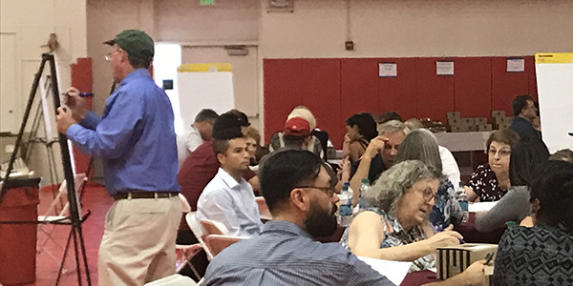
Opportunities for Faculty Dialog
Lean into skepticism, don’t avoid it
Encourage your committee to be flexible and open
Have a data plan for collecting validating data for future iterations
Transparency! Transparency! Transparency!
Emphasize maps as communication tools, not commandments
Envision mapping as an opportunity to break down silos
ASCCC Curriculum Institute July 10 - July 13, 2019
San Francisco, CA

Slide 28
What do Students Want?
Exploring is easier when you have
&

Slide 29
Questions and Comments

Slide 30
Contact
For more info, please contact info@asccc.org
Randy Beach, Jaguar Pathways, Southwestern College, rbeach@swccd.edu
Stephanie Curry, ASCCC Executive Committee, ASCCC Curriculum Committee, stephanie.curry@reedleycollege.edu
Michelle Sampat, Associate Dean of Instruction, Mt. San Antonio College, msampat@mtsac.edu
ASCCC Curriculum Institute July 10 - July 13, 2019
San Francisco, CA

