Slide 1
Creating and Revising Curriculum: The Role of Program Review
Virginia Guleff, Vice President, Education and Student Services, Mendicino College
Randy Beach, ASCCC Executive Committee
ASCCC Curriculum Institute, July 6-9, 2016

Slide 2
Description and Objectives
Course and program self-assessment should be the heart of an academic program review, which can lead faculty to a thoughtful, data-informed evaluation of their courses and course sequences leading to certificates and degrees. In this breakout session, participants will discuss how program review can facilitate those conversations and decisions, what elements should be present in a program review process to make it useful for curriculum review, and how accreditation standards are an important consideration.
Objectives: Participants will understand aspects of program review that drive curriculum and discuss meaningful goals for the process.

Slide 3
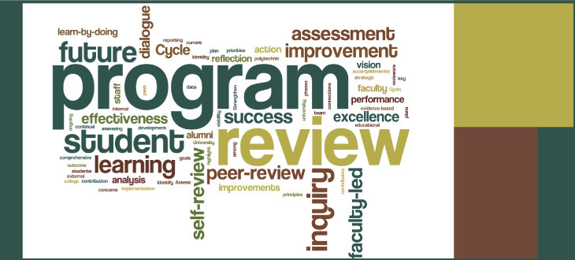
Why Do Program Review?
Self-evaluation and assessment
Resource allocation (budget planning)
Master planning (facilities, technology, education, etc..)
Other long and short-term planning and institutional effectiveness, grants
Accreditation compliance

Slide 4

Curriculum and Program Review: Benefits
Provides a structured approach to self-evaluation of curriculum
Integrates data, including SLO data, into curriculum discussions
Provides a way to support curriculum decisions with resource allocation
Connects curriculum development to long term strategic and educational master planning

Slide 5

Curriculum Components in Program Review
Listing of courses and programs
Last date of course and program review/revision
Listing of course and program outcomes
Completion rates for programs and courses
Student program/course achievement data disaggregated demographics
Student learning outcomes data disaggregated by demographics
Student learning outcomes data disaggregated by course/section attributes

Slide 6

Questions to Ask: Student Achievement
What percent of students are completing your courses?
How many are completing the programs?
Is there a demographic angle to completion?
How diverse is your student population (gender, ethnicity, fulltime vs. part-time)?
Is there a difference in completion rates for online vs. on-ground?
What is your baseline for “good enough”?

Slide 7
Outcomes in Program Review
ER 11: Student Learning and Achievement
“...The institution publishes for each program the program’s expected student learning and any program-specific achievement outcomes. Through regular and systematic assessment, it demonstrates that students who complete programs, no matter where or how they are offered, achieve the identified outcomes...”

Slide 8
Outcomes in Program Review
IB1 “The institution demonstrates a sustained, substantive and collegial dialog about student outcomes, student equity, academic quality, institutional effectiveness, and continuous improvement of student learning and achievement.”
IB2 “The institution defines and assesses student learning outcomes for all instructional programs and student and learning support services.”
IB5 “The institution assesses accomplishment of its mission through program review and evaluation of goals and objectives, student learning outcomes, and student achievement. Quantitative and qualitative data are disaggregated for analysis by program type and mode of delivery.”

Slide 9

Why Outcomes Assessment in Program Review?
Outcomes assessment incorporates the students’ voices and needs
Strengthens curriculum changes and resource allocation justification with data; serves as a narrative for budget development
Ties program improvements to quantifiable data; allows for short or long-term action plans based on outcomes data
Provides important evidentiary documentation for accreditation
Notes:
Not sure of the thought behind this slide.

Slide 10
Outcomes Analysis in Program Review
Are your outcomes consistent with the intent of the programs and courses you’re teaching?
What assessment tool(s) is used to assess program or course SLOs?
Does the SLO accurately reflect exit expectations of students enrolled in the course? The program?
How do the CSLOs map to your course objectives in core program courses?
How do your PSLOs capture the breadth and depth of the program? Are the PSLOs aligned to ISLOs? How are CSLOs aligned to PSLOs?
Has your discipline developed a rubric to measure student proficiency in this SLO?

Slide 11
Program Review & the 2-Year CTE Review
CTE programs required to review every two years per ED Code 78016(a)
78016. (a) Every vocational or occupational training program offered by a community college district shall be reviewed every two years by the governing board of the district to ensure that each program, as demonstrated by the California Occupational Information System, including the State-Local Cooperative Labor Market Information Program established in Section 10533 of the Unemployment Insurance Code, or if this program is not available in the labor market area, other available sources of labor market information, does all of the following

Slide 12
Program Review & the 2-Year CTE Review
(1) Meets a documented labor market demand.
(2) Does not represent unnecessary duplication of other manpower training programs in the area.
(3) Is of demonstrated effectiveness as measured by the employment and completion success of its students.
(b) Any program that does not meet the requirements of subdivision (a) and the standards promulgated by the governing board shall be terminated within one year. (c) The review process required by this section shall include the review and comments by the local Private Industry Council … which review and comments shall occur prior to any decision by the appropriate governing body.

Slide 14
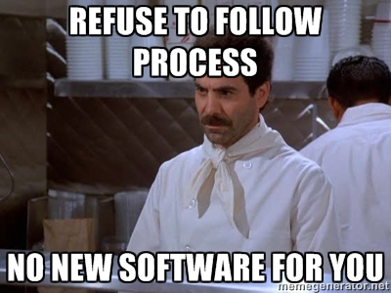
Program Review Processes
If process is prohibitive or convoluted, where is the value?
Are you using an electronic process? Pencil and paper?
How much human resources are devoted to program review processes?
Do you have a successful software solution you can share?

Slide 15
Next Steps…
Know your processes
Where does your program review information go?
How does it get prioritized and included in the planning and budgeting process?
What is the reporting back structure?
Contribute to improvement
What committee(s) oversee the process on your campus?
Does your curriculum committee have a mechanism to provide input?

Slide 16
“
QUESTIONS?

