Slide 1
Curriculum and Instruction for the Disproportionately Impacted Students - A Pathway to Higher Education
Dolores Davison, ASCCC Vice President Silvester Henderson, ASCCC At-Large Representative Kerry Ybarra, Fresno City College
Hyatt San Francisco Hotel 1333 Old Bayshore Highway Burlingame, California 94010 July 10-13, 2019
,

Slide 2
Breakout Description
Instructional relevance is a critical component for the support of our disproportionately impacted students throughout the California Community College system. By highlighting the importance of our students’ cultural heritage via cultural sensitivity and appreciation, our impacted students can begin to connect their human experiences with our current institutional and curricular requirements. Please come and experience hands-on teaching methods that will equalize the science of teaching for our diverse students The primary goal of this session is to heighten our equity-focused teaching skills and reshape our curricular methods for the benefit of our impacted students.

Slide 3
Presentation Highlights
What is the definition of a “Disproportionately Impacted Student”? Who are they?
Consider the Academic 4 A’s of Instruction
Culturally Responsive Instructional Strategies for our Students – “Designing flexible teaching modules”
The Creation of an Inclusive and Inventive Classroom: Cultural Sensitivity
Culturally Sustaining Pedagogy – “The support of one’s heritage”
Career focused instruction – A tool for enhancing and developing employment soft skills for our students?
The Modern Classroom and Mobile Devices
Could innovative “Ethno – Relativist” curricular structures creating academic employment for faculty? If so, how?
Questions and Comments?

Slide 4
What is the definition of a “Disproportionately Impacted Student”? Who are they?
“A college education that fails to ensure that students learn is not worth the cost at any price. High cost plus poor quality equals low value. The answer is not throwing money at problems. Societies must take steps to improve the quality and quantity of learning, changing the very culture of higher education as a whole.”
https://yaleglobal.yale.edu/content/higher-education-learning-crisis

Slide 5
When Does This Occur?
Disproportionate impact occurs when “the percentage of persons from a particular racial, ethnic, gender, age or disability group who are directed to a particular service or placement based on an assessment instrument, method, or procedure is significantly different from the representation of that group in the population of persons being assessed, and that discrepancy is not justified by empirical evidence demonstrating that the assessment instrument, method or procedure is a valid and reliable predictor of performance in the relevant educational setting.” [Title 5 Section 55502(d)]

Slide 6
The 80% Rule
The 80% Rule states that: “A selection rate for any race, sex, or ethnic group which is less than four-fifths (4/5) (or eighty percent) of the rate for the group with the highest rate will generally be regarded by the Federal enforcement agencies as evidence of adverse impact, while a greater than four-fifths rate will generally not be regarded by Federal enforcement agencies as evidence of adverse impact.” [Section 60-3, Uniform Guidelines on Employee Selection Procedure (1978); 43 FR 38295(August 25, 1978)]
https://www.gcccd.edu/research-planning/KeyPerformanceIndicators/section1/Section_01c.html

Slide 7
Consider the Academic 4 A’s of Instruction
Availability: this implies that good quality education must be made available to all by eliminating all barriers, be they financial, physical, or institutional/systemic
Accessibility: the ‘available’ education must also be made accessible to all, by eliminating all forms of discrimination and through installing flexible modes of education, particularly for the most vulnerable and marginalized who otherwise may not be reached by conventional modes.
Acceptability: it is not enough that learning opportunities are accessible; they must also be acceptable in terms of quality and relevance to the learners’ experiences and environment, and respectful of their circumstances and culture if learners are to truly benefit from education. This means ensuring that education meets the minimum standards set by governments, including the medium of instruction, curriculum and teaching methods.
Adaptability: finally, education programme must be adaptable to the various needs of the learners rather than expecting learners to fit in with a prescribed syllabus, uniform pedagogical style or system. This is particularly important when dealing with marginalized and vulnerable students.
http://www.unesco.org/new/fileadmin/MULTIMEDIA/HQ/ED/pdf/Tang-speech.pdf

Slide 8
Culturally Responsive Instructional Strategies for Our Students – “Designing flexible teaching modules”
Evaluate your students' writing and comprehension abilities.
Consider classroom interactive group assignments as part of the overall teaching unit.
Ask your students to come to your office and seek one on one assistance.
Work with your campus student service support leaders and promote tutoring, organizational reinforcement and the study skill development.
When possible, remember to reinforce classroom instruction via: visual aides, auditory tools and kinesthetic teaching guides (three teaching approaches)
Promote classroom mentorships (students helping students)
Integrate equity focus examples as part of all of your questions, assignments, special projects & etc.

Slide 9
Culturally Responsive Pedagogy

Slide 10
The Creation of an Inclusive and Inventive Classroom: Cultural Sensitivity
Curricular innovators are skilled in the following:
− identifying compelling reasons for change
− building shared goals and setting direction
− creating a climate of professional inquiry
− empowering and developing others
− being imaginative and systematic
− embedding and sustaining change
Source:
http://apps.nationalcollege.org.uk/resources/modules/curriculum/Leadership/Entries/2013/1/1_Why_Curriculum_Innovation_Matters.html

Slide 11
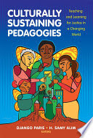
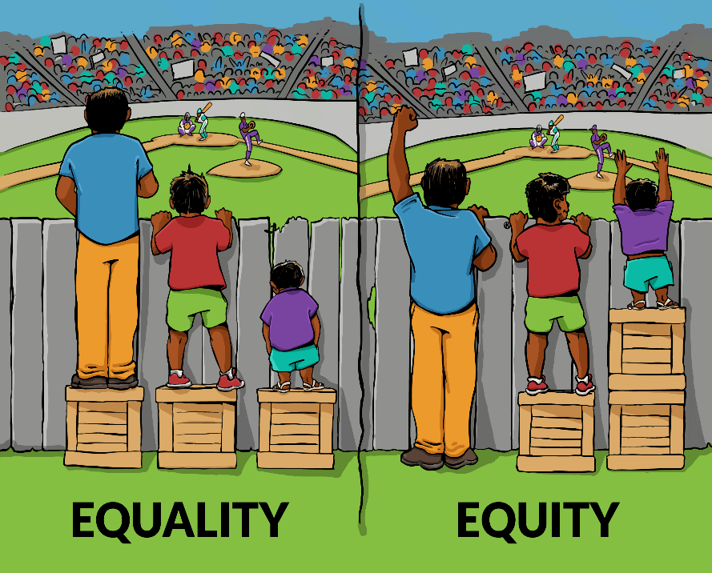
Culturally Sustaining Pedagogy – “The Support of One’s Heritage”
“Culturally Sustaining Pedagogy” challenges us to promote, celebrate, and even critique the multiple and shifting ways that students engage with culture. Dr. Django Paris, associate professor of language and literacy in the College of Education at Michigan State University, developed culturally sustaining pedagogy to extend asset-based teaching approaches such as culturally relevant pedagogy for the 21st century. His approach challenges us to go beyond acceptance or tolerance of students’ cultures and to move instead toward explicitly supporting aspects of their languages, literacies, and cultural traditions. Culturally sustaining pedagogy also encourages us to consider the term “culture” in a broader sense, including concepts such as popular, youth, and local culture alongside those associated with ethnicity.
https://www.literacyworldwide.org/blog/literacy-daily/2017/05/31/culturally-sustaining-pedagogy-in-the-literacy-classroom
/

Slide 12
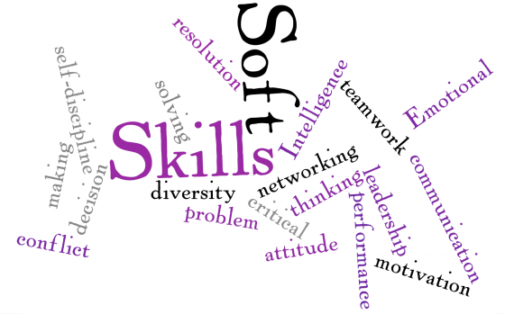
Career focused instruction – A tool for enhancing and developing employment soft skills for our students?
Top 10 Qualities and Skills Employers are Looking For
Communication Skills. ...
Honesty. ...
Technical Competency. ...
Work Ethic. ...
Flexibility. ...
Determination and Persistence. ...
Ability to Work in Harmony with Co-Workers. ...
Eager and Willing to Add to Their Knowledge Base and Skills.
Problem Solving Skills
Loyalty
https://employmentnorth.com/top-10-qualities-and-skills-employers-are-looking-for/
/
Employers want college graduates who have “soft skills,” such as being a good listener or thinking critically, but they have difficulty finding such candidates, according to a new report.
https://www.insidehighered.com/quicktakes/2019/01/17/survey-employers-want-soft-skills-graduates

Slide 13
The Modern Classroom and Mobile Devices
The Academic Mobile Devices
Laptops
IPad
Cell Phones & Smartphones
"Using portable computing devices (such as iPads, laptops, tablet PCs, PDAs and smartphones) with wireless networks enables mobility and mobile variation related to instructional approaches, disciplines, learning goals and technological tools."
Mobile technology has revolutionized how colleges build and maintain brand reputation. Today, developing a strategy that considers mobile activity is critical to attracting and retaining students. Many institutions are using smartphone apps to connect with existing and prospective learners via social media, which paints them as exciting, interactive and futuristic centers of higher education.
“Two years ago, four instructional designers in the University of California System decided to undertake a research project on “mobile learning.” Their first order of business: figure out what that is.”
/
https://blog.fullfabric.com/five-ways-higher-education-is-making-use-of-mobile-technology
https://www.insidehighered.com/digital-learning/article/2019/02/27/mobile-devices-transform-classroom-experiences-and

Slide 14
Questions & Comments
Please feel free to contact each of us for more information.
Dolores Davison davisondolores@fhda.edu
Kerry Ybarra kerry.ybarra@fresnocitycollege.edu
Silvester Henderson shenderson@losmedanos.edu

