Slide 1
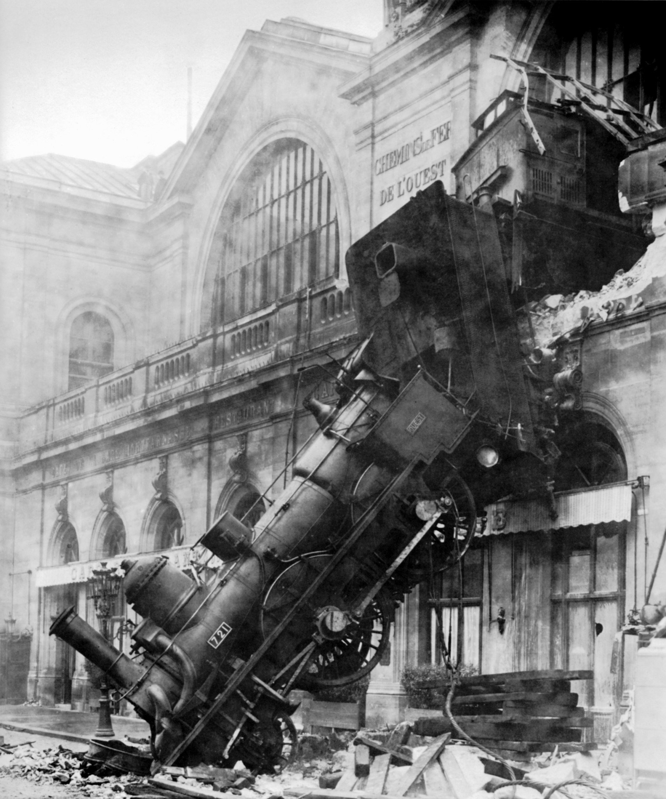
Avoiding a Train Wreck: Ensuring Meetings are Effective and Productive
Cheryl Aschenbach, Representative At Large
Craig Rutan, Area D Representative
2015 ASCCC Leadership Institute

Slide 2
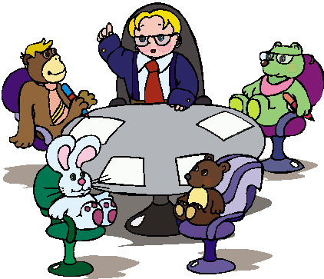
Introductions
Who are we?
Who are you?
What has brought you to this session?

Slide 3
Ineffective Meetings
As difficult as it is to believe, there are many meetings that do not accomplish their intended goals.
Each one of these meetings began with good intentions, but something caused them to become ineffective.
What are some things that make a meeting ineffective?

Slide 4
Relationships
As a faculty leader, your greatest assets are the relationships that you have built with your colleagues.
These relationships can help you anticipate challenging conversations, address possible issues prior to a meetings, and to regain control of a meeting if things start to go badly.

Slide 5
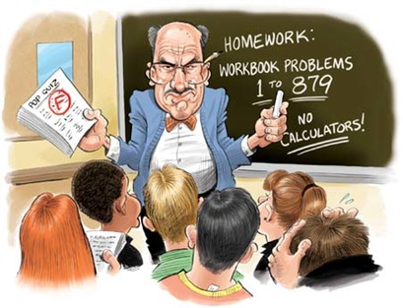
How Would You Handle This?
College administration met over the summer to discuss college reorganization. When faculty returned in the fall, they were presented with a draft plan which merged discipline departments into new divisions. The merged division offices were to be separated into two locations. In one location would be the classified staff and the faculty mailboxes and in the other location would be the offices of the division deans. The stated purposes of the draft plan were to 1) enable student services and instruction to work together in an integrated fashion, 2) commingle faculty from the general education and CTE disciplines, and 3) balance the workload of the division deans.

Slide 6
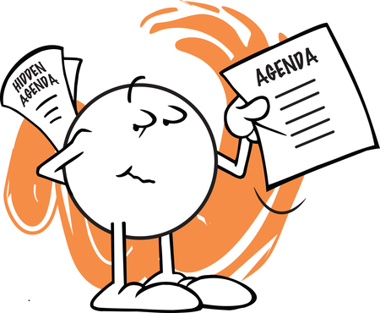
Creating An Agenda
Who is responsible for creating the agenda?
How much information do you include for each agenda item?
Do you give a specific amount of time for discussion on each item?

Slide 7
Effective Agendas
Effective agendas should include the background of all discussion items and not just a series of attached files.
Including information like who, what, when, where, how, and why will minimize the time spent getting everyone on the same page during a meeting and will minimize confusion about why topics are being discussed.

Slide 8
How Would You Handle This Situation?
Your district chancellor is finalizing a contract with a college in Saudi Arabia to provide educational consulting. Upon hearing about the possible contract, many college faculty are calling for the chancellor’s dismissal. How would you list the Saudi Arabia on an agenda for discussion? What information would you include with the agenda?

Slide 9
Managing the Meeting
Even with all of your previous preparation, a meeting can still be a challenge
Have a set of adopted rules (like Robert’s Rules) that govern how the meeting will run
How do you ensure that everyone gets to participate in the discussion?

Slide 10
How Would You Handle This?
A faculty member unhappy with her assignments for the following year decides to show up to the Academic Senate meeting to complain. She interrupts the beginning of the meeting to voice her complaint and continues to insert comments into discussions on unrelated items throughout the meeting while claiming that her load is an academic and professional matter.

Slide 11
Managing the Meeting
What do you do if the discussion is getting off topic?
How can you regain control when emotions run high?
Can the chair/president take a position during the discussion?

Slide 12
When Meetings Go Wrong
Things can go terribly wrong for both new and experienced leaders.
Always try to remain calm. Everyone is looking for you to lead them and losing your temper will not help.
Heated arguments and circular discussions happen to all of us.

Slide 13
Suggestions
Properly preparing before the meeting can help you manage the tough situations
Meet with folks before the meetings. See where they are coming from so you know what to expect.
Include some details on your agenda. Some background information will make it clear why you are having these discussions now.
Have established rules that allow you to regain control if things start to go south.

Slide 14
Questions??
Thank you for joining us.

