Slide 1
Empowered Voices at the Academic Senate Table: Utilizing Strategy, Intention, and Personal Power to Impact Change Thursday, April 15 at 4:15pm – 5:30pm

Slide 2
Session Description
Join us for this interactive session lead by colleagues who have interrogated systems and embraced strategies to include BIPOC (Black, Indigenous, People of Color) voices at their colleges, in their senates, and at the state level. We will engage in group discussions and share models and effective strategies to diversity your senate and senate committees, as well as discuss ways ASCCC has addressed diversification of committee selections.

Slide 3
Presenters
Karla Kirk, Fresno City College
Michael Takeda (he/him/his), Fresno City College
María Figueroa (she/her/ella), MiraCosta College
Edward (Ekiwaka) Pohlert (he, him), MiraCosta College
Michelle Velasquez Bean (she/her/hers), ASCCC At-large Representative

Slide 4
Today, we will . . .
Use Padlet to check in and reflect
Engage in small group discussion
Report back to the collective group
Create community dialogue with panelists’ stories
Hear how to commit to being an ally, accomplice, and co-conspirator
Reflect on how to model decolonization
Notes:
Karla will DJ at the start of the meeting.
Michelle (1 min--objectives of day)

Slide 5
Land Acknowledgment
We begin today by acknowledging that we are holding our gathering on the land of the Nisenan Nations, the location of the ASCCC Office on One Capitol Mall, Sacramento, who have lived and continue to live here. We recognize the Nisenan Nations and their spiritual connection to the ocean and the land as the first stewards and the traditional caretakers of this area we now call Sacramento. As we begin, we thank them for their strength, perseverance and resistance. We also wish to acknowledge the other Indigenous Peoples who now call Sacramento their home, for their shared struggle to maintain their cultures, languages, worldview and identities in our diverse city.
Notes:
Michelle (1min with intro)
Others--acknowledge your land as you begin to speak.

Slide 6
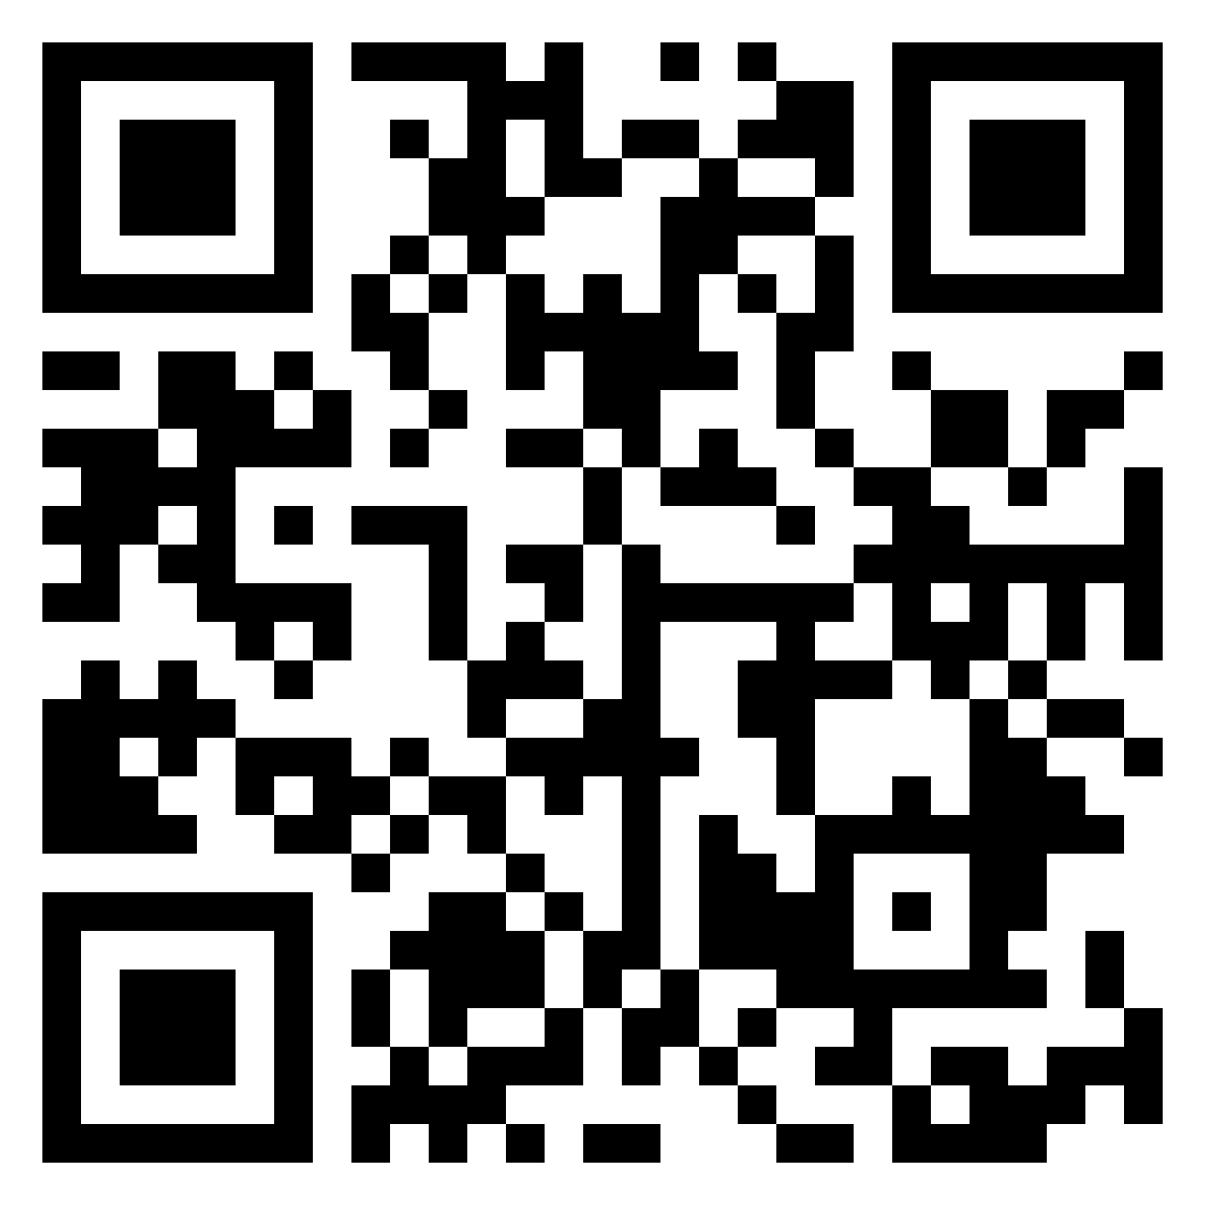
Using Padlet
COLUMN #1:
How are you today—
a year later into the pandemic?
Name ONE POSITIVE thing you’ve learned this year OR
HOBBY you have enjoyed OR
SKILL or PRACTICE you have developed over the year of being quarantined
Notes:
Michelle to moderate--3 minutes (as participants enter).
Scan the QR code with your phone--give it a second to load.
USE THE PLUS SIGN to add your comment to the Padlet.
Padlet link for CHAT: https://padlet.com/ProfessorBean/hfenrf8fp40g1q71

Slide 7
Breakout Rooms: Naming It!
What is the culture of your campus senate?
How can your traditions and lived experiences shape the culture within your academic senate?
Notes:
Edward (3 minutes) Land Acknowledge: Introduction--to frame decolonization and modeling culturally relevant practices. Discussing the session description. Share colonial testimonio history; use examples from Senate, DEqCC, other committees (Umoja, ASCoaches).
Michelle--give directions (1 minute):15 minutes total in breakout rooms:
Small groups of 3-5 (5 leaders check in)
Person goes first: Who has the longest sleeves?
Each person in 1 min or less answer 2 questions.

Slide 8
Share Out: Volunteers
One to GLOW ON
One to GROW ON
Notes:
Karla (10 minutes)
In 1 minute or less: Raise your hand and be ready to share:
One to glow on: What you are most proud of OR have done well.
One to grow on: What you can do better OR want to start when you get to “campus” on Monday.

Slide 9
Panel Stories and Experiences
Local Senates: Getting out of the bleachers
Caucuses: Start one!
Affinity Groups: A place of refuge
State Senate: What’s still needed
Notes:
Transition slide--Michelle (1 min)
Diversifying your Local Senates--getting people out of the bleachers with succession planning (Karla)
ASCCC Caucus support and how to start one! (Michael)
Affinity Groups--as a place of refuge for BIPOC faculty (Edward)
Looking at the State Senate--and what changes are still needed (Maria)

Slide 10
Getting Out of the Bleachers: Succession Planning
Keys to Successful Succession Planning
Relationships
Collegiality within Senate Exec
Be Accessible (Even during COVID!)
Mentorship
Supporting State and Local Initiatives: The Coalition of the Willing
Local Senate Priorities: Personalizing the 10+1
Food
Yes! This Works!
Notes:
Karla (5 minutes)

Slide 11
Caucuses and How to Start One
2020/2021 ASCCC Caucuses
Small or Rural College Caucus
LGBTQIA+ Caucus
Latinx Caucus
Womyn’s Caucus
Black Caucus
Asian Pacific Islander Caucus
For more information about ASCCC Caucuses, go to: https://www.asccc.org/node/184082/
Notes:
Michael (5 minutes)

Slide 12
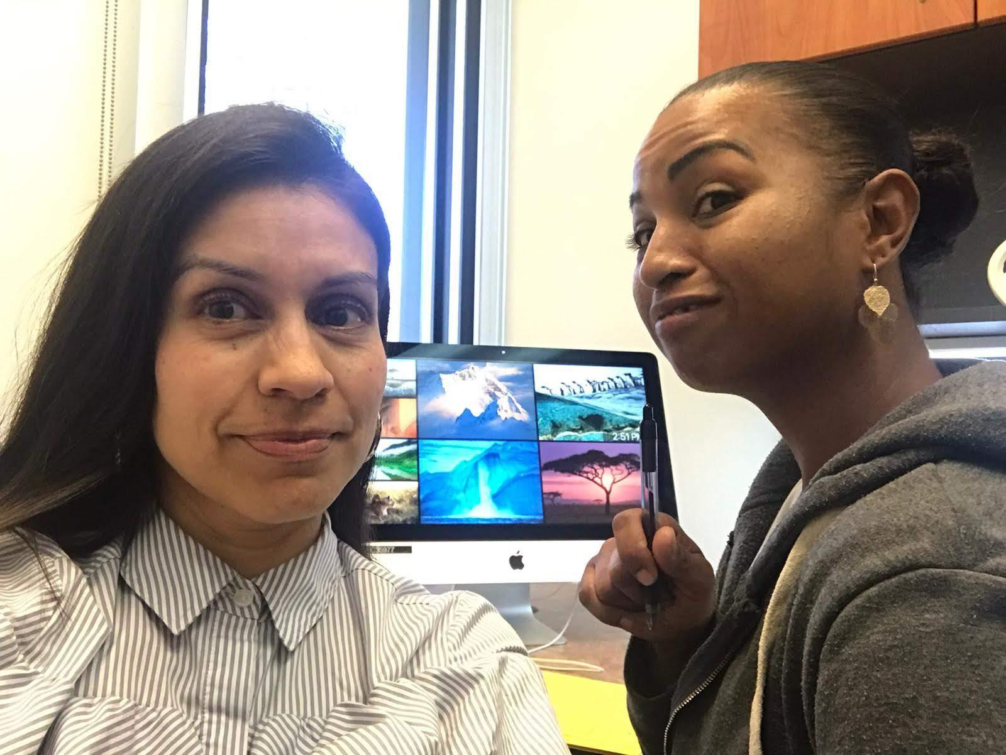
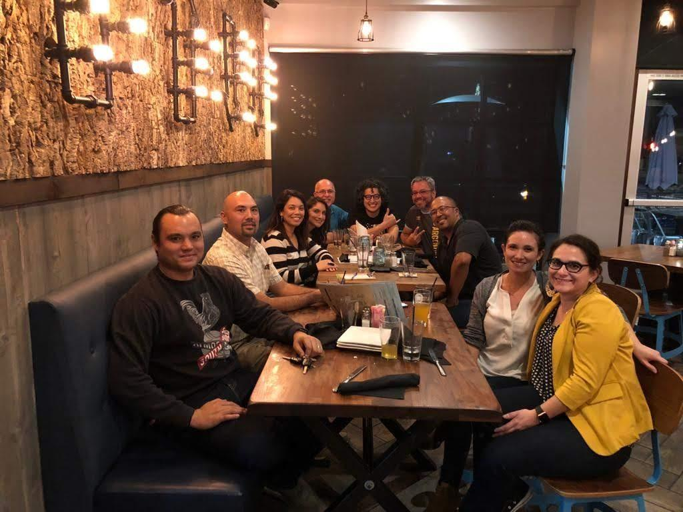
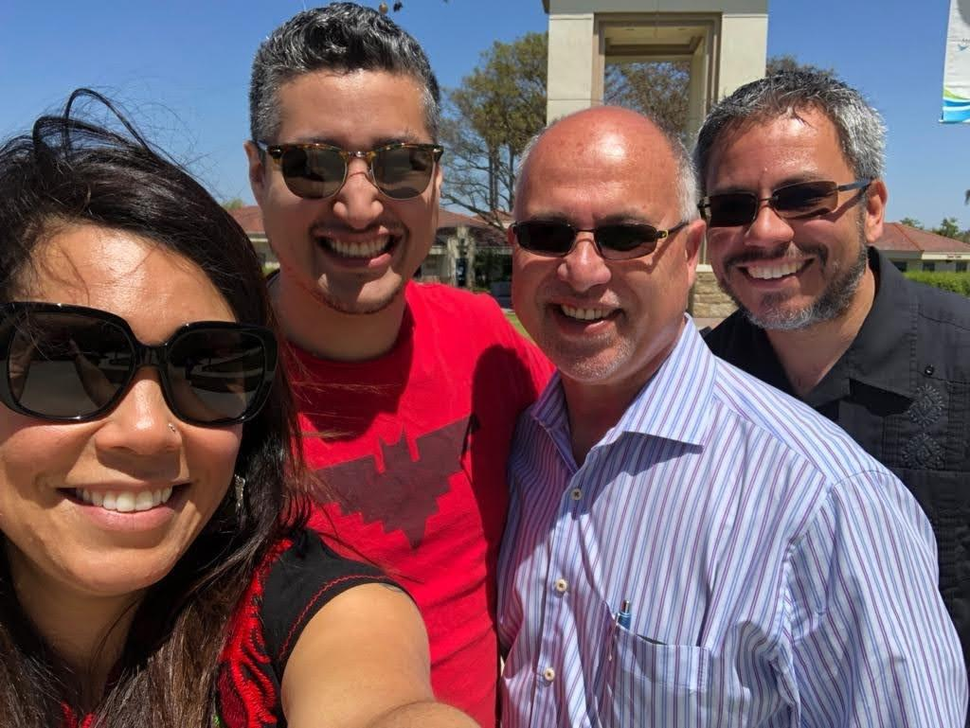
A Place of Refuge: Affinity Groups
Notes:
Edward (5 minutes) Spontaneous office visits, meeting at the quad in traffic, intentional gathering

Slide 13
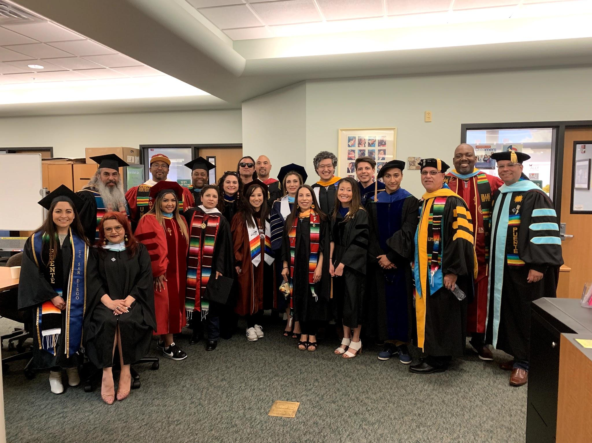
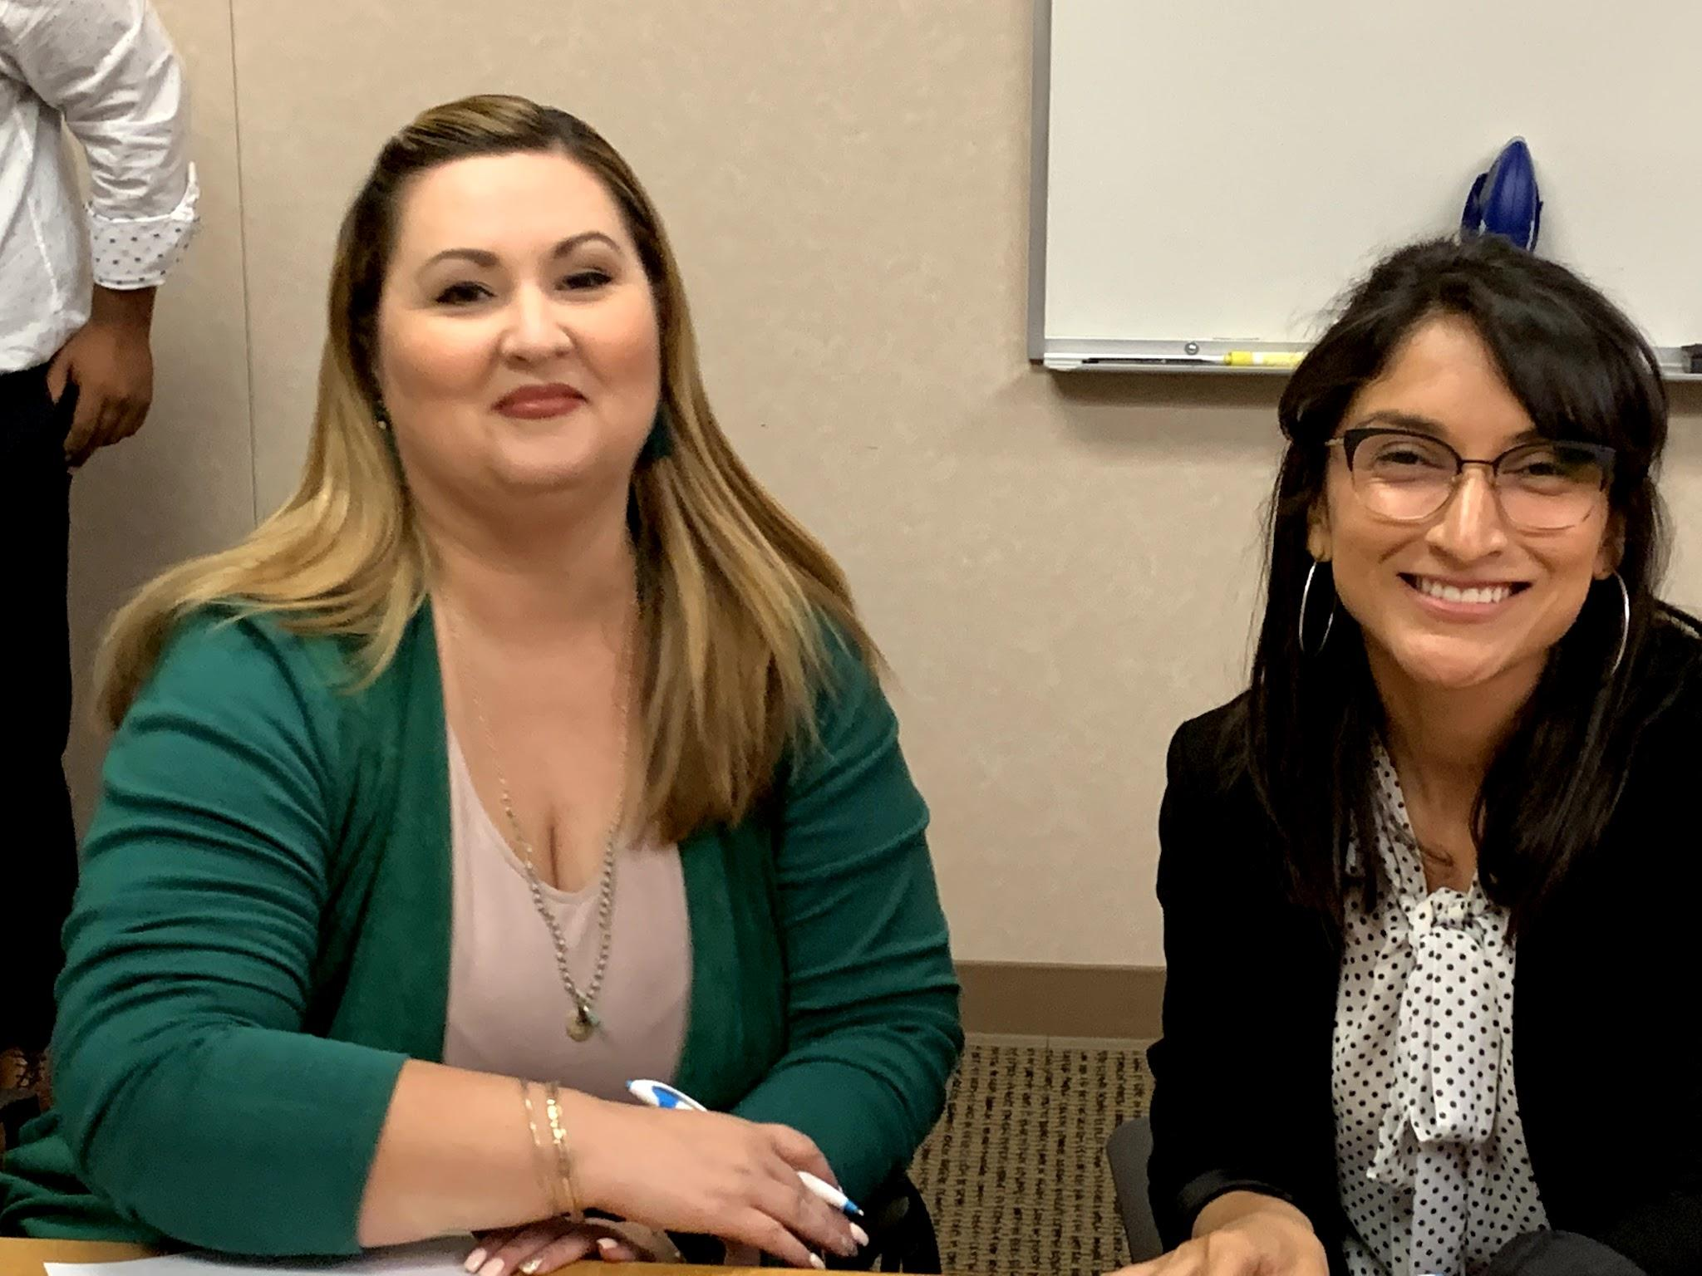
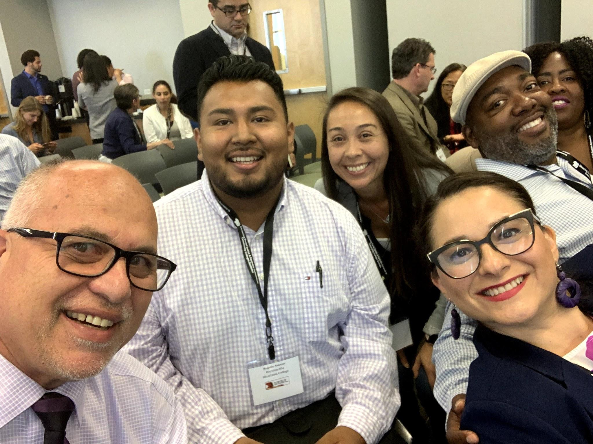
Notes:
Documentary project, conference community, acknowledging our survival and excellence

Slide 14
Community College Statewide Needs
THE REPORT
Notes:
Maria (5 minutes)

Slide 15
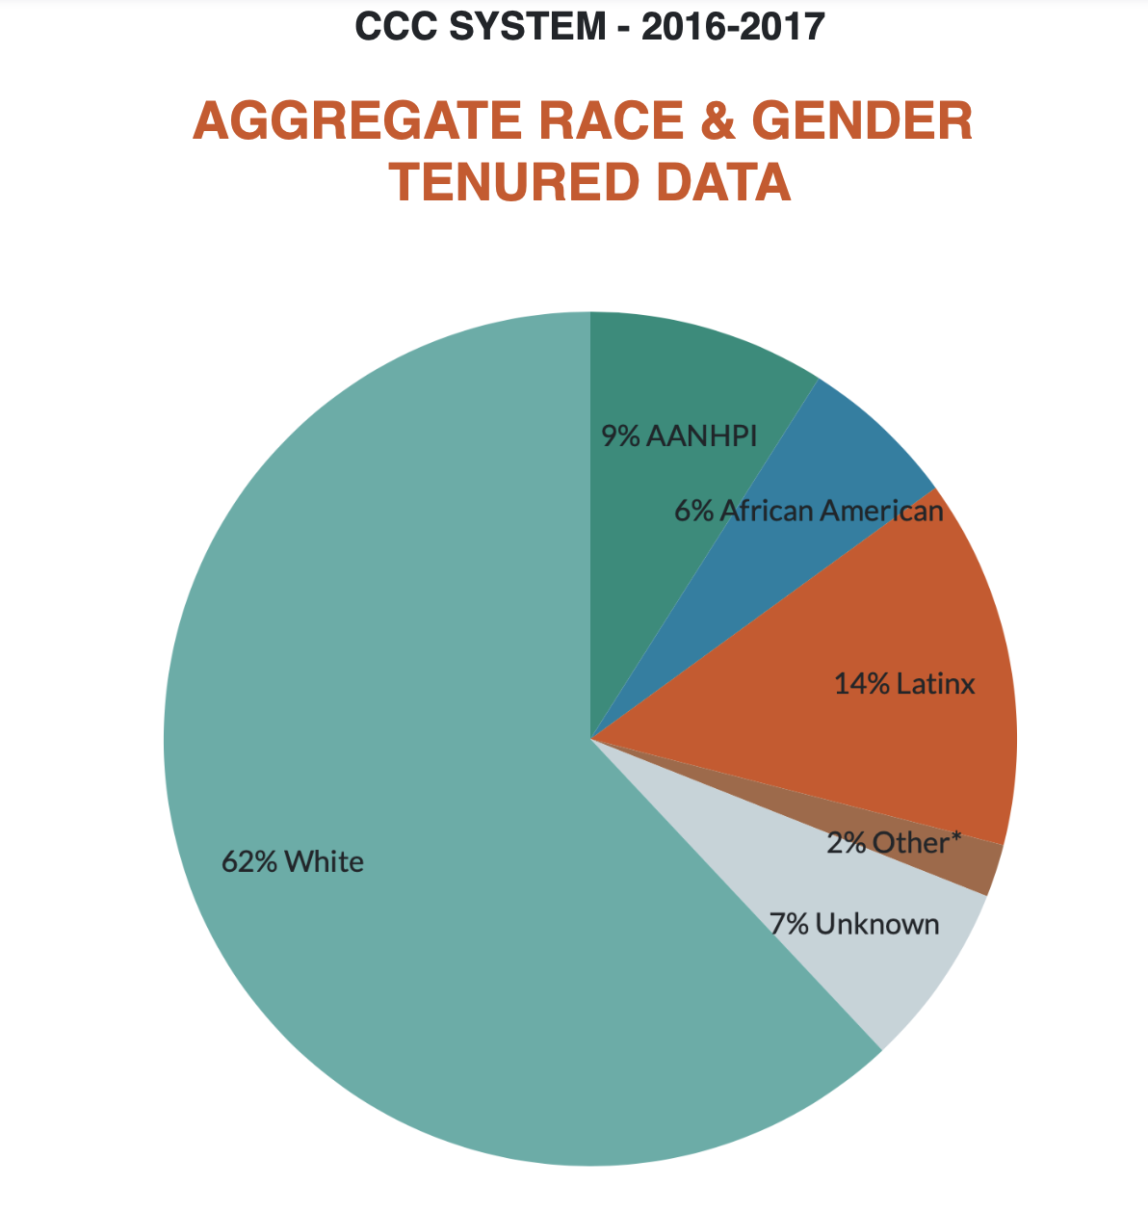
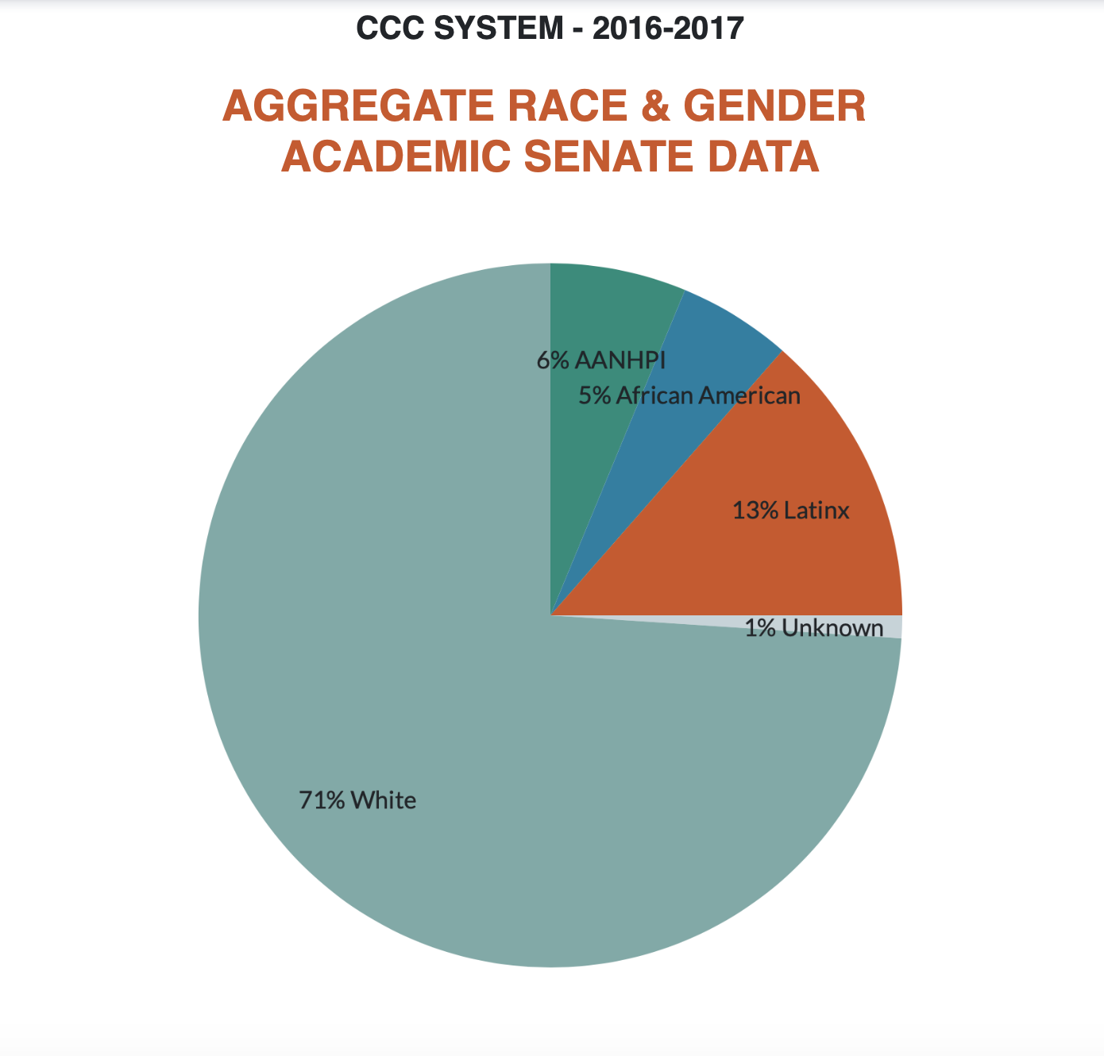
Comparatively CA CC System

Slide 16
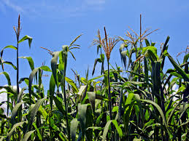
Nurturing the Field for La Milpa To Grow

Slide 17
Positions of Privilege
Allyship - The Ally Continuum
Be the cover!
Accomplice and Co-conspirator
Use your political capital
Put your privilege on the line
No hoarding of the chips
Notes:
Edward (5 minutes) Briefly present Allyship chart 1-2 min. and tell the spy story...

Slide 18
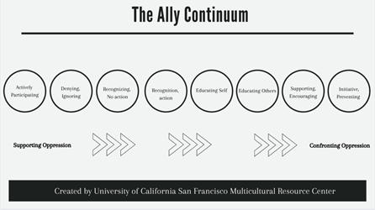
The Allyship Continuum
Being an ally requires us to be uncomfortable, persevere, stay true to our core values, and hold space for those that are not in the room. The Ally Continuum is a tool to gauge our collective work in battling oppressive systems, behaviors, and actions.
Notes:
The Ally Continuum

Slide 19
AllyShip
Individual Actions against Allyship
Actively Participating: Is an active participant in discriminative behavior such as verbal or physical actions; avoids target group members; and ignores oppressive systems and actions.
Denying: Denial that oppression exists of target group members. Stays silent and does not recognize oppressive behavior/actions, thus creating complicity with oppression.
Recognizing, No Action: Recognizes oppressive actions within self and others but lacks courage to act against oppression; Is uncomfortable with potential self-conflict and fears communication/contact with individuals and group members.
Recognizing, Action: Understands oppressive behaviors and actions; takes concrete active steps to dismantle oppressive actions.
Individual Actions for Allyship
Educating Self: Read books that address social justice and equity; discuss critical self-reflections with colleagues; Attend online trainings and webinars; Check your own biases (take the Harvard Implicit Associations Test https://implicit.harvard.edu/implicit/takeatest.html)
Educating Others: Initiate dialogue with others, listen, and respond to oppressive behavior/actions. State why behaviors/actions are oppressive. Be courageous and address bias and microaggressions; Share insights and invite others to participate in trainings/webinars/discussions.
Supporting, Encouraging: Explore ways to support your colleagues/peers from underrepresented backgrounds; Support businesses and artists economically who are engaged in social justice/equity work. Help organize and support coalition building, grow an allies network, and orient new allies to critical resources.
Initiating, Preventing: Create dialogue for institutional systemic change; Examine and build an infrastructure to change policies that discriminate against target group members, introduce legislation that protects target group members from discrimination, invite and nurture target group members as full participants in organizations and/or groups. Build resilience amongst like identities and center the voices and needs of target group members.
Adams, M., Bell, L., & Griffin, P. (1997). Teaching for diversity and social justice: A sourcebook. New York: Routledge. Adapted from the UCSF Multicultural Resource Center https://mrc.ucsf.edu/allyship; Black Community Ally Training, MiraCosta College; and UC Berkeley Centers for Educational Justice and Community Engagement https://cejce.berkeley.edu/geneq/resources/lgbtq-resources/allyship
Notes:
Brief overview citing 2+2

Slide 20
Modeling Decolonization
Demonstration and modeling: Today’s activities
Praxis: Intentionally inviting more voices to the table
Notes:
Michael (5 minutes)
(From Karla) Michael and I talked about this last night- is this a time that we could share how we have demonstrated decolonization in our courses and/or our local Senate practices?

Slide 21
Reflection and Action: Padlet
COLUMN #2:
STATE ONE ACTION you will take to CHANGE the CULTURE of your senate and to empower more voices.
Notes:
Maria (3 minutes)
Padlet link: https://padlet.com/ProfessorBean/hfenrf8fp40g1q71

Slide 22
Email info@asccc.org
Contacts:
mbean@riohondo.edu
michael.takeda@fresnocitycollege.edu
epohlert@miracosta.edu
karla.kirk@fresnocitycollege.edu
mfigueroa@miracosta.edu
Notes:
Closing--Michelle (1 minute)

