Slide 1
REV IT UP Reentry Education Venture Instructional Training for Underserved Populations
Presenters:
Don Hopkins, REV IT UP Project Coordinator, Folsom Lake College
Dr. Robert “BJ” Snowden, Interim Dean of Instruction, Folsom Lake College
Morice Mabry, Adjunct Business Professor, Folsom Lake College

Slide 2
Statewide Background
Presented by: Dr. Robert “BJ” Snowden

Slide 3
CDCR POPULATION HIGHLIGHTS
The design bed capacity of CDCR institutions and camps on December 31, 2010, was 83,981. The population was 174.7% of the design capacity.
During 2010, 120,401 offenders were admitted to an institution as a new admission or a parole violator and 123,578 offenders were paroled, discharged or otherwise released from custody
During calendar year 2010, there were 361,051 departures from CDCR institutions, including 210,753 intra-institutional transfers.
120,719 offenders paroled. Of these: 61,534 were felons first released to parole.
58,407 felons were re-paroled.
778 civil narcotic addicts were released to outpatient status.

Slide 4
Recidivism
(CDCR) measures recidivism by tracking arrests, convictions, and returns to State prison. The CDCR uses the latter measure, returns to prison, as the primary measure of recidivism for the purpose of this report because it is the most reliable measure currently available and is well understood and commonly used by correctional stakeholders
Overall CDCR Recidivism Rates ➢ The total three-year recidivism rate (returns to State prison) for all felons released during fiscal year (FY) 2008-09 is 61.0 percent.
Most felons who recidivate return to prison within a year of release (74.1 percent).

Slide 5
What Can Education Do to Reduce Recidivism?
3 Stories
https://vimeo.com/156039167
https://vimeo.com/156039166
https://vimeo.com/156039080
For individuals who participate in any type of correctional education program, their risk of being re-incarcerated drops by 13 percentage points. For those who participate in college programs, they’re half as likely to be re-incarcerated upon release.
" RAND research on correctional education”

Slide 6
Instructor Prep
Presented by: Professor Morice Mabry

Slide 7
Re-Entry: Getting To Know Yourself
Apply Keirsey Temperament Sorter (KTS-II)
Keirsey Temperament Sorter (KTS-II) is the most widely used personality instrument in the world. It is a powerful 70 question personality instrument that helps individuals discover their personality type.

Slide 8
Re-Entry: Applying 21st Century Skills
21st Century Skills are considered by industry leaders, HR professionals, and educators to be the knowledge, work habits, and character traits necessary for workers to succeed in today’s rapidly changing work environment.
Adaptability Communication Empathy Self-Awareness Social Diversity Awareness | Analysis/Solution Mindset Collaboration Digital Fluency Entrepreneurial Mindset Resiliency

Slide 9
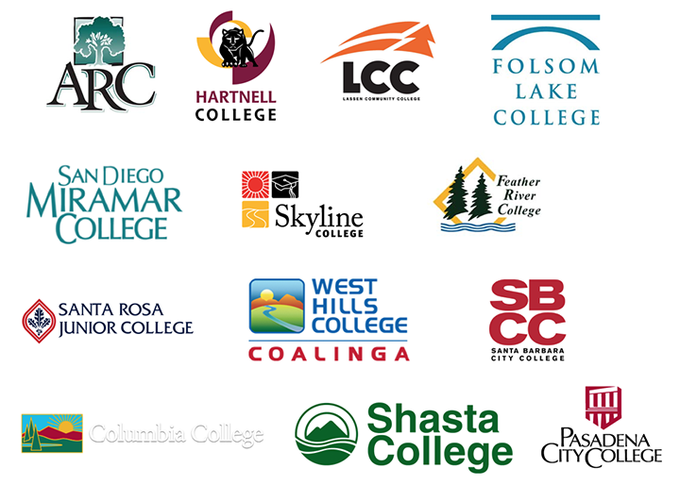
California Community Colleges that have been
trained to teach 21st Century Skills include:

Slide 10
Re-Entry: Putting It All Together
Understand personal strengths and areas of development.
Work in teams to learn how to collaborate.
Write to provide analysis and share perspective.
Share experience

Slide 11
Program Overview
Presented by: Don R. Hopkins
Project Coordinator

Slide 12
Develop a Campus Infrastructure for the Reentry Students
Build your campus support team
Identify a primary and secondary contact person with all stakeholder areas on your campus
Student Services
Student Success
EOPS
DSPS
Campus Medical staff
Financial Aid
Tutoring
Etc.

Slide 13
Counseling
Recruit your counselors from within that have a passion for helping this type of student
The Counselors selected should be the same counselors that visit the institutions and provide services in the institutions for your Face-to-Face program.
Counselors have attended our training and CEDCR training to better prepare them for the uniqueness of the population

Slide 14
Make Your Presence Known
Create a single point of contact for Reentry Students
Telephone number: 916-609-6996
Email: revitup@flc.losrios.edu
Room: PAC 2240 (Upstairs in the Harris Center)
Place signs in A&R announcing your program
Place signs at all campus or center sites to ensure inclusion

Slide 15
Web Presence
Work with your campus web support team to have a specific link to services offered to reentry students
When they start to register offer a “self identify” option for direct contact to your program
Detail the support you offer to the students with links to those services
Develop a step by step guide for the students through the process
Develop a list of resources available to the students with direct contact information
Look at what Santa Rosa Junior College web site for a great example (we are still building ours)
https://student-services.santarosa.edu/formerly-incarcerated-students

Slide 16
Mentoring Program
Develop a mentoring program for formerly incarcerated students
We all have formerly incarcerated students on our campus who are succeeding, work with them in developing a support group for the newly released students.
Keep in contact with your students and assure them you are there for their success.

Slide 17
You Can’t Do It All
Develop a program support staff/clerical/classified person to ensure things are continuing.
You must rely on all of your team to do their part.
You will direct/take them to the services they need.
You can only imagine some of the challenges this student population has faced in their lives. Listed and help like you would any other student but realize they probably come from a very different place than other students on campus.
Prepare them for their future

Slide 18
Their future
Develop a relationship with a CSU based system for formerly incarcerated students.
We have partnered with Project Rebound at CSU Sacramento
Our program uses some of the same concepts used by Project Rebound so the transition from FLC to CSUS will be smooth. With Project Rebound at 9 CSU’s in the state the student will find an easy transition once they reach one of these schools.
Remember the word PATHWAYS that we all use in education, well we can and do create PATHWAYS from the institution through the Community College system on to the University system if we create the right infrastructure and support for the student.

Slide 19
Questions? REV IT UP 916-608-6996 email REVITUP@flc.losrios.edu

