Slide 1
FACULTY DIVERSIFICATION: SETTING THE LOCAL AGENDA FOR NEXT YEAR
Cheryl Aschenbach, Secretary ASCCC
Mayra Cruz, Area B Representative ASCCC
John Stanskas, President ASCCC
Notes:
Mayra

Slide 2
Overview
A strategic and purposeful agenda for faculty diversification
Understanding the data and going deeper
Framework for action at the local level
Notes:
Faculty Diversification has been adopted as one of the priority areas for ASCCC. To advance faculty diversification, local senates are asked to establish a local strategic and purposeful agenda. Diversification begins with a theory of change model or framework for action. This model or framework is a blueprint for change. What would a theory of change or framework for action look like at the local level? Senate leaders will explore a theory of change model to achieve greater impact on faculty diversification.

Slide 3
Data Inquiry & Curiosity
Establish guiding principles:
Using longitudinal data
Use data in context
Look for direct and indirect data
Consider aggregated and disaggregated data
Focus on data that is actionable

Slide 4
Student Equity Gaps
Notes:
A critical data point is to study locally the student equity gaps.
The Vision for Success Goal 5, calls for a reduction and elimination of the Equity gaps (reduction of 40% over 5 years and elimination over 10 years.
Colleagues, for how long have we been addressing this equity gap? Has the needle moved? And it is time.
The 2017 State of the System Report presents this data on the screen. The rates of completion must be improved for Latinx, African American and American Indians. Locally identified gaps in other groups that must be addressed too.
The local disaggregation of the student data by race and ethnicity as well as by gender is adopted as an ongoing practice in the cycle of continuous improvement.
Resource: Student equity data 2017 SOS Report http://californiacommunitycolleges.cccco.edu/Portals/0/Reports/2017_SOSReport_ADA-final.pdf

Slide 6
CCCs – Faculty & Students
FT FACULTY | Fall 2018 | STUDENTS
55% | Female | 54%
5.88% | African American | 5.59%
16.63% | Hispanic | 46.21%
0.64% | Native American | 0.45%
0.48% | Pacific Islander | 0.39%
Notes:
https://www.cccco.edu/Data.aspx

Slide 7
CCCs – FT & PT Faculty
FT FACULTY | Fall 2018 | PT Faculty
55% | Female | 52%
5.88% | African American | 5.40%
16.63% | Hispanic | 15.27%
0.64% | Native American | 0.60%
0.48% | Pacific Islander | 0.47%
Notes:
https://www.cccco.edu/Data.aspx

Slide 8
CCCs & Community
FT FACULTY (FALL 2018) |  | CENSUS ESTIMATE (JULY 2018)
55% | Female | 50.3%
5.88% | African American | 6.50%
16.63% | Hispanic | 39.10%
0.64% | Native American | 1.60%
0.48% | Pacific Islander | 0.50%
Notes:
https://www.census.gov/quickfacts/fact/table/ca#

Slide 9
What parts of this data catch your attention?
What does the data tell us? What does the data NOT tell us?
 | FT FACULTY (FALL 2018) | STUDENTS (FALL 2018) | PT FACULTY (FALL 2018) | CENSUS ESTIMATE (JULY 2018)
Female | 55% | 54% | 52% | 50.3%
African American | 5.88% | 5.59% | 5.40% | 6.50%
Hispanic | 16.63% | 46.21% | 15.27% | 39.10%
Native American | 0.64% | 0.45% | 0.60% | 1.60%
Pacific Islander | 0.48% | 0.39% | 0.47% | 0.50%

Slide 10
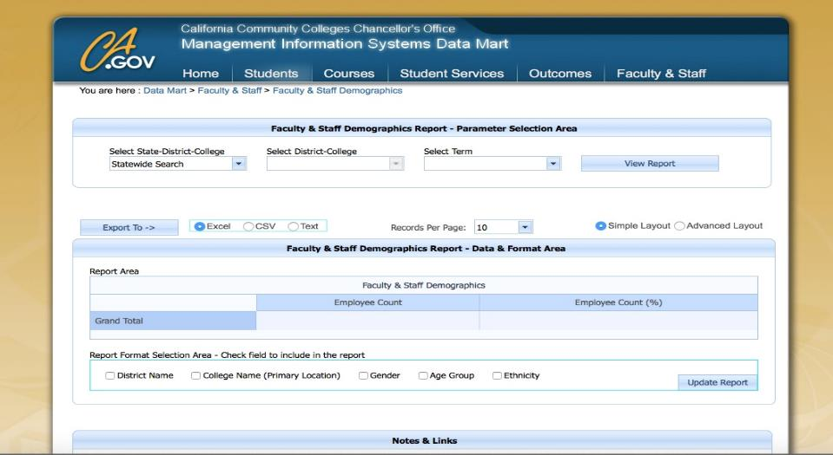
Review Local Data
https://datamart.cccco.edu/Faculty-Staff/Staff_Demo.aspx
https://datamart.cccco.edu/Faculty-Staff/Staff_Demo.aspx
Notes:
In the Fall of 2018, the CCCO and IEPI conducted a one day session on Building Diversity (Part 1)-Using Data for Hiring. One of the sessions focused on analyzing longitudinal data in Datamart. The Chancellor’s Office and the Statewide EEO and Diversity Advisory Committee developed a guide for the use of local EEO data.
Longitudinal data is defined as a dataset that tracks the same information over a period of time. The longitudinal data can help us identify patterns and measure change. An analysis of college recruitment, hiring, retention and promotion data over a period of time may help identify when non job-related factors result in the significant underrepresentation of a monitored group. Longitudinal data helps us ensure policies and procedures do not have an adverse impact on protected class of individuals.

Slide 11
How does this data make you feel?
How do you feel about leading this conversation on your own campus?

Slide 12
Making Meaning of the Faculty Diversification Data
Conduct an underrepresented group analysis
Index = actual representation (%) / projected representation (%)
If the Index < 80% then the group is significantly underrepresented
If the Index > 80% then the group is not underrepresented
Questions to discuss when reviewing the longitudinal data:
Did you find any significant underrepresentation?
What trends did you observe in the longitudinal data?
How would you share this information with colleagues?
How would you approach having a conversation focused on achieving a greater impact on faculty diversification?
Notes:
Title 5 (section 53003) requires that each District/College EEO Plan include “A process for gathering information and periodic, longitudinal analysis of the district/college employees and applicants, broken down by (monitored group status and job categories) to determined whether additional measures are required...and to implement and evaluate the effectiveness of those measures.”
Determine significant underreprentation.
Significant underrepresentation is defined as “any monitored group for which the % of persons from that group employed by the district in any job category….is below 80% of the projected representation for that group in the job category in question.” Title 5 Section 53001(l).

Slide 13
Challenges to Promoting Faculty Diversity
Cost of Living
Rural communities with a lack of diversity in hiring pools
Lack of current faculty diversity to serve on hiring committees
Inadequate training
Culture that hinders the conversation of diversity
Concerns about reverse racism
Reluctance to discuss racial and ethnic diversity and only use diversity in the broadest sense.
Difficulty implementing hiring manual recommendations without unduly burdening existing faculty of color.
Lack of opportunity for meaningful dialogue
Faculty backlash for focus on diversity
Leadership perceives diversity as race alone

Slide 14
Faculty Diversification: Role of Theory of Change and Action Thinking and Steps
Identify the Problem
Convene Faculty Leaders, the local Academic Senate and key stakeholders to address the problem
Conduct research to better understand the problem and how to achieve greater impact
Establish guiding principles
Set initial goals
Team building and forging collaboration
Begin Planning by identifying outcome areas and developing outcome statements
Develop an action plan
https://www.theoryofchange.org/what-is-theory-of-change/how-does-theory-of-change-work/when-to-use/
Notes:
ToA is “a powerful tool to surface assumptions and support critical thinking and reflection while also strengthening planning processes and sharpening strategies. It also provides a framework for monitoring and evaluation, by focusing efforts on the outcomes that need to be tracked and documented.”
https://actionevaluation.org/theory-of-actiontheory-of-changebasicsteps/

Slide 15
A Start … Evaluating the Hiring Process
Determining hiring needs
Criteria for hiring faculty
The Job announcement
Recruitment
Selection Committee
EO training
Implicit Bias training
MQs, Preferred Quals & Equivalency
Second Required MQ
Application review
Screening candidates
Interview - questions
Recommendations/s to President
Final interview with President
Selection
Onboarding of new faculty
Supporting new faculty
Notes:
Pre-hiring: The college district must demonstrate that it has adopted board policies and resolutions that evidence a commitment to diversifying hiring processes and procedures.
In hiring: The district has established processes and procedures for addressing diversity throughout all steps and levels of the hiring processes. This measure includes such matters as the creation of the screening committee, the steps for job announcements, and interview processes, among others.
Post hiring: The college district provides professional development focused on diversity.
The college district ensures that diversity is incorporated into the employee evaluation and tenure processes.
The college district actively pursues the creation of “grow your own” programs seeking to hire students who attended California community colleges.
Resource: A Re-Examination of Hiring Policies and Procedures. Spring 2018: ASCCC

Slide 17
Resources
ASCCC Data 101: Guiding Principles for Faculty
https://www.asccc.org/papers/data-101-guiding-principles-faculty
Theory of Change
https://www.theoryofchange.org/what-is-theory-of-change/how-does-theory-of-change-work/when-to-use/
Chancellor’s Office Datamart
https://datamart.cccco.edu

Slide 18
For more information contact:
Cheryl Aschenbach, Secretary ASCCC
caschenbach@lassencollege.edu
Mayra Cruz, Area B Representative ASCCC
cruzmayra@deanza.edu
John Stanskas, President ASCCC
jstanskas@valleycollege.edu
Thank You!

