Slide 1
The Changing Federal Landscape of Accreditation
Julie Bruno, ASCCC President
Cindy Miles, Chancellor, Grossmont-Cuyamaca CCD
Craig Rutan, ASCCC Accreditation Chair
Richard Winn, Interim President, ACCJC

Slide 2
Overview
Accreditation Under Pressure
New metrics: College Scorecard
Focus on Graduation Standards
Accreditation Reform and Enhanced Accountability Act of 2016
What might happen in 2017?

Slide 3
Accreditation Pressures
⬇State funding, ⬆For-profits
⬆Tuition, ⬆Student debt, ⬆Political ill will
⬆Accountability
⬆Regulation
Threats to century-old standard of nongovernmental, voluntary peer-review model of academic self-regulation
mainstay for college quality assurance and institutional improvement in the U.S.
Accreditation challenges linked to woes of higher education
privatization” of higher ed
Rise and fall of for-profits
New metrics
student default rates
repayment rates
gainful employment
Accreditation in the Policy Crosshairs -Barmak Nassirian –AASCU Fall 2016

Slide 4
Is Accreditation Broken?
Evidence of waste, fraud, predatory practices of accredited colleges
student loan debt > $1.3 trillion
low college graduation rates
customer complaints, lawsuits, federal investigations
Corinthian, ITT Tech, ACICS
Charges of being unreliable gatekeepers of federal financial aid:
“watchdogs that don’t bite (Sec. of Ed, Arne Duncan)
“asleep at the switch” (Under Sec. of Ed, Ted Mitchell)
“too often the accreditation means nothing” (Sen. Brian Schatz- D, HI)
“higher education cartel” blocks innovative providers (Sen. Marco Rubio, House Speaker Paul Ryan)

Slide 5
2016 - Pivotal Year for Accreditation – Judith Eaton, CHEA
Two fundamental shifts:
Federal government (USDE) consolidated authority over accreditation
Agreement that primary task of accreditation is public accountability (i.e., student completion and economic gain)
TRENDS…
Education = “mass consumer service”
USDE College Scorecard, College Navigator, College Results Online
Google plans to show College Scorecard data (graduation rates, earnings, tuition) when people search for a college/university.

Slide 6
Integrated Postsecondary Education Data System (IPEDS) database of mandatory information from every college or university that participates in the federal financial aid system
IPEDS includes:
Student demographics
Unduplicated Headcount
Retention Rates
Degree and Certificate Programs
Graduation Rates – FIRST TIME, FULL TIME, 3 YEARS

Slide 7
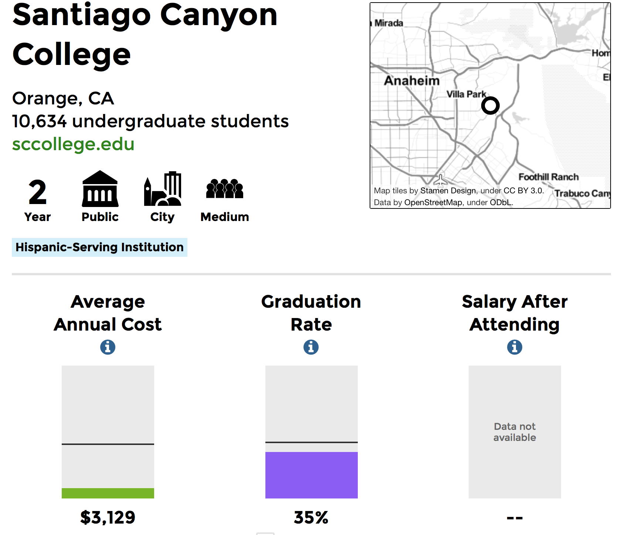
College Scorecard
collegescorecard.ed.gov
graphically displays comparative data from IPEDS about colleges and universities

Slide 8
Graduation Rates
The California Student Success Scorecard, like the federal College Scorecard is used by researchers, legislators, media, public to compare colleges
September 2016 - Council of Regional Accrediting Commissions (C-RAC) focus on colleges w/ IPEDS graduation rates at or below 50 % of their sectors
< 25% percent for four-year institutions
< 15% for community colleges

Slide 9
The Accreditation Reform and Enhanced Accountability Act
2016 bill by leading Democratic senators (Warren, Durbin, Schatz)
to hold accreditors accountable
to protect students and inform the public
20 changes to accreditation
Bill in committee – future not clear
It provides a blueprint for change in accreditation for the next Congress, future reauthorization the Higher Education Act

Slide 10
Warren bill - Proposed Reforms
Uniform Standards for Student Achievement
Currently set locally, submitted to ACCJC - annual Institutional Self Evaluation Report
Proposed standards set by Secretary of Education (retention, graduation, course completion, cohort default, repayment, transfer, student earnings after graduation, job placement, and professional/vocational certification, licensing examination pass rates.
Expanded Powers - USDE (Secretary of Education)
require accreditors to require specific criteria in their review of institutions
Initiate performance-based reviews of accreditors
Sanctions for non-performers, including fines to be paid equally by all institutions under the accrediting agency

Slide 11
Array of Accreditation Reform Proposals
Sens. Warren, Durban, Schatz- make colleges directly responsible to USDE, which sets standards
Center for American Progress – independent third-party accreditors
Sens. Marco Rubio (R-Fla), Michael Bennet (D-Colo) – non-college education providers eligible for Title IV (classes from hospitals, unions, churches, etc.) based on outcomes
NCHEMS –
Independent public/private oversight agency
Risk-based review cycles
Do away w/regions
Dashboard of indicators
Sen. Michael Lee (R-Utah) – states develop their own systems of accreditation
American Council of Trustees & Alumni - separate accreditation & federal student aid
Jerry Falwell, Jr. Presidential Taskforce on Higher Ed reform
GAO studies underway:
Transfer of credit
Rule of construction re: who can set learning standards

Slide 12
Other National Trends with Potential Impact on Higher Education Accreditation
Blurring of the traditional lines between
Private & Public (“Public in Name Only” [PNO] to counter loss in state revenue); seeking greater autonomy from state controls
Profit & Non-Profit
Increasing acceptance of non-institutional providers of educational experiences, some of which are seeking accreditation
The “Quality Assurance Commons”
Unbundling, outsourcing of college functions to non-institutional providers, including academic offerings
StraighterLine relationship with 107 accredited colleges and universities
Courses are approved for transfer by ACE CREDIT

Slide 13
The Palpable Angst in Washington
High student debt (>$1 trillion), heavy impact of middle-class families, and high loan default rates – 3x higher for non-completers
“Accreditors are the watchdogs that allow schools to soak up billions of taxpayer dollars while not delivering a quality education.”
Federal focus on quality:
COMPLETION. A quantitative proxy for quality, measured as graduation and loan default rates
EMPLOYER SATISFACTION. A qualitative proxy for quality, indicated by student learning outcomes at the program level

Slide 14
Comments by Virginia Foxx (R-NC), Chair, House Committee on Education and the Workforce January 30, 2017, at CHEA Conference, Washington, DC
Principles in Reauthorization of the Higher Education Act (a “priority”)
Empower student decisions: Information to inform college choices (like the College Scorecard)
Simplify the student aid process: Goal: 1 grant program; 1 loan program; 1 work-study program; few forbearance programs (<32)
Innovation, Access, and Completion: Cut back on compliance costs; repeal many unnecessary regulations “imposed by the former administration” (e.g. “credit hour definitions”)
Keep current accreditation system: With increased focus on educational quality and learning outcomes
“Under Trump, and with DeVos at the helm, we will be in good hands.”

Slide 15
Things to Keep an Eye On
While the Accreditation Reform and Enhanced Accountability Act of 2016 isn’t going forward, Senator Warren has already promised to bring similar legislation forward in 2017.
It is not clear whether legislation like this will be passed, but it is clear that accreditation could be facing major changes.

Slide 16
Thank You for Coming
Do you have any questions?
Julie Bruno (jbruno@sierracollege.edu)
Cindy Miles (cindy.miles@gcccd.edu)
Craig Rutan (rutan_craig@sccollege.edu)
Richard Winn (rwinn@accjc.org)

