Slide 1
The Legislative Landscape and You:
Using Authentic Voices and Experiences as Impactful Advocacy Efforts Juan Arzola, ASCCCC At-Large Representative
Cheryl Aschenbach, ASCCC Vice President
Angela Echeverri, ASCCC Legislation and Advocacy Committee
Ric Epps, ASCCC Legislation and Advocacy Committee
Notes:
Cheryl

Slide 2
Session Description
When Sacramento passes legislation, the impact on local colleges is undeniable. Academic senate leaders and faculty are tasked with shaping local implementation, particularly when the legislation involves the 10+1 or academic and professional matters. Consequently, it should be of great importance for faculty to be informed of bills being considered in Sacramento and to strategize advocacy efforts that center the authentic and lived experiences of students and faculty in the stories shared with legislators. Presenters will reflect on a few of the bills signed into law during the 2022 legislative session as well as share strategies for increasing faculty awareness and expanding wide-spread involvement in local and statewide advocacy.

Slide 3
Session Overview
Overview of Legislative Actions Related to 10+1
Key bills: 2022 Legislation Session
“I’m Just A Bill”: Legislative Basics
“The Times They Are A-Changin’”: Legislative Turnover
Building Connections with Legislators
Sharing Stories: Authentic Voices and Experiences
Collaborate!

Slide 4
Legislation and 10+1: History 2010-2017
2010: SB 1440 (Padilla) Transfer (Associate Degrees for Transfer)
2012: SB 1456 (Lowenthal) Seymour-Campbell Student Success Act of 2012 (Ed Plans and Success Metrics)
2013 SB 440 (Padilla) Student Transfer Achievement Reform Act (ADT if a local Associate degree)
2013 AB 86 Education Trailer Bill (Adult Ed Block Grants)
2014 SB 850 (Block) Baccalaureate Degree Pilot Program (no more than 15 colleges)
2017 AB 705 (Irwin) S-C Student Success Act of 2012: Matric: assessment
2017 SB 85 Education Budget Act (CA Guided Pathways Grant Program)
Notes:
Cheryl

Slide 5
Legislation and 10+1: History 2018-2022
2018 AB 1809 Higher Education Trailer Bill (Student Centered Funding Formula, Student Equity & Achievement Program, California Online Community College)
2021 AB 927 (Medina) Statewide Baccalaureate Degree Program
2021 AB 928 (Berman) Student Transfer Achievement Reform Act 2021
2021 AB 1111 (Berman) Common Course Numbering
2022 AB 1187 (Irwin) Community Colleges: Tutoring
2022 AB 1705 (Irwin) S-C Student Success Act of 2012: Matric: assessment
What is next?!
Notes:
Cheryl

Slide 6
I’m Just A Bill: Legislative Basics
It’s important to have some understanding of legislative process to maximize advocacy efforts
Bill development process
Legislative calendar
Life Cycle of a Bill
Two ways legislators enact actions for us:
Bills generated by legislators in senate and assembly
Budget, including Budget Act and Trailer Bills
Notes:
Ric

Slide 7
I’m Just A Bill: Bills, Bills, Bills
Creation:
Bill sponsor’s idea is put into draft language by the Legislative Council and is introduced into the house or origin by the legislative author
Sponsor = Individual, advocacy group, or organization will a bill idea
Author = Elected representative in CA Senate or Assembly
How Many Bills Are Possible in a Two-Year Session?
Assembly members = 50 bills max/2-yr session (Assembly Rule 49)
Senate members = 40 bills max/2-yr session (Senate Rule 22.5)
5,600 bills possible in 2-yr session (4,000 + 1,600)
Notes:
Ric

Slide 8
I’m Just A Bill: Bills, Bills, and More Bills
2021
2,379 Bills introduced, including 203 pertinent to CCCs
836 Bills made it to Governor’s desk.
91 new CCC-related bills
2022
2,353 Bills introduced, including 240 pertinent to Higher Ed. (>80 CCCs)
1,166 Bills made it to Governor’s desk; 997 signed into law
99 new CCC-related bills
Notes:
Ric

Slide 9
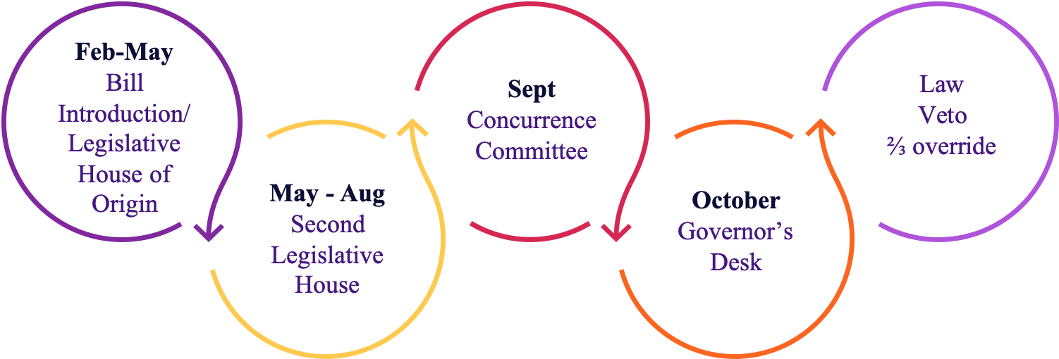
I’m Just A Bill: Legislative Calendar
Bills that pass both houses enter the concurrence process to reconcile amendments and then are sent to the Governor’s desk . The bill will then become law (with or without the governor’s signature) or possibly be vetoed and sent back to the legislature with a message from the executive office. The legislature can override the Governor’s veto with a vote of the super majority.
Notes:
Ric

Slide 10
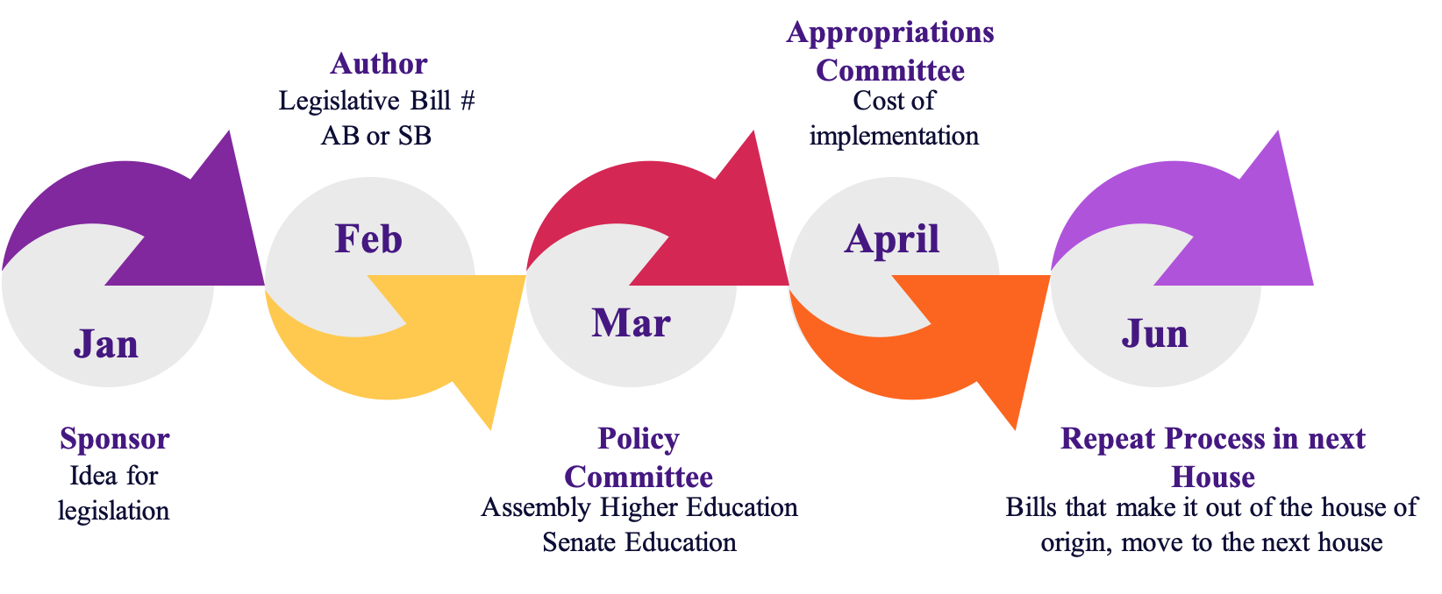
I’m Just A Bill: Life Cycle of a Bill
Bills originating in the Assembly as house of origin will begin with AB and conversely bills with SB originate in the Senate. If a bill makes it out of the house of origin it will be run through the same process in the second house.
Notes:
Ric

Slide 11
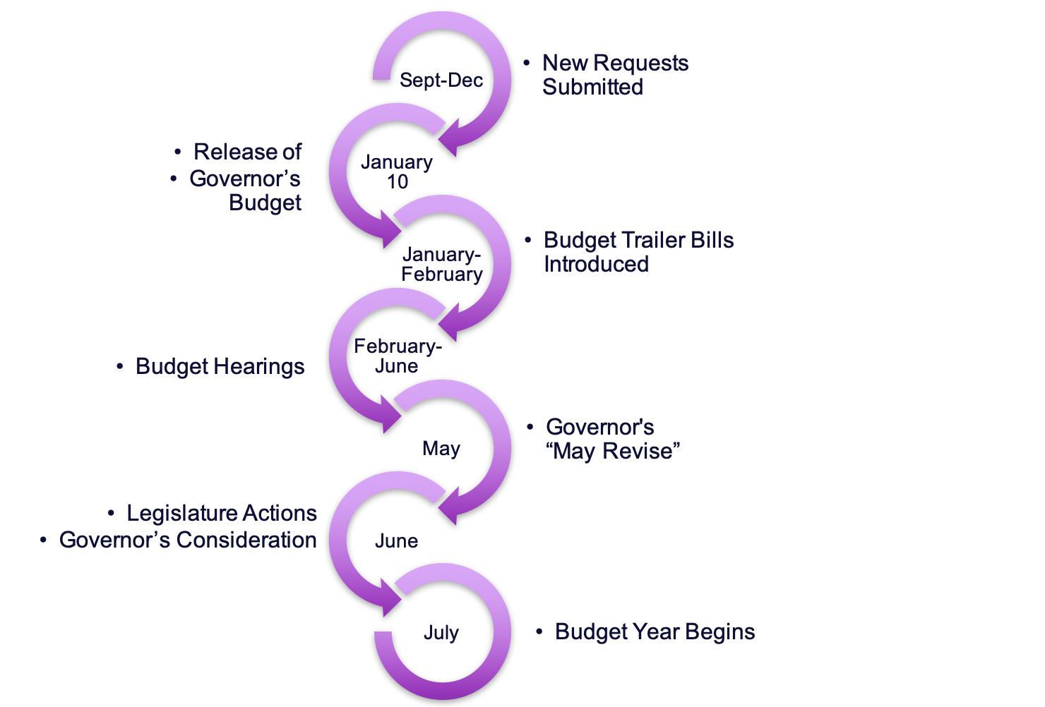
I’m Just A Bill: Legislative Budget Process
Notes:
Ric

Slide 12
The Times They Are A-Changin’: Legislative Turnover
Factors influencing legislative turnover
Prop 28 (2012) Legislative Term Limits = 12 years max combined (previously 8 yrs Senate & 6 yrs Assembly)
Post-2020 Census Redistricting = New Electoral Districts
Legislators seeking other opportunities
After 2022 November election, at least 33 of 120 legislators will be new
This is an opportunity to build new relationships and engage in advocacy!

Slide 13
Building Connections
with Legislators & Staff
Know who your representatives are (at college, at home)
Attend a legislator’s event (town halls, district meetings, special events)
Arrange one-on-one meetings at district office
Invite legislator and staff to a faculty meeting or campus event
Ask how you can assist the legislator
Express support and opposition for bills; share potential impacts, offer ideas for amendments
Progress may be subtle. Keep advocating. Aim for the tip of the iceberg.

Slide 14
Sharing Stories: Authentic Voices and Experiences
Stories: faculty and student voices and experiences can be powerful in advocacy
Stories add credibility to a problem or solution
Stories connect a person - face, name - to a problem or solution
Stories stir compassion and create heartfelt connections
Stories can move people to act in ways logic or credibility may not
Share or find personal stories that demonstrate the impact or importance of the change you seek
What is your goal? What do you want to accomplish?
What type of story best illustrates the goal? From whose perspective?
Whose stories will meet the goal? Whose stories will have the most impact?

Slide 15
Collaborate! Share Efforts
Senate presidents, appoint a legislative liaison to serve as point person
Include legislation info in reports to board
Faculty, offer to be the legislative liaison
Faculty unions
Discuss positions
Consider combining efforts on shared positions
Administrators
Discuss pending legislation & potential impacts
Discuss district & statewide organization positions
Notes:
Angela example - being asked to speak to board about AB1705 concerns and impacts.

Slide 16
Collaborate! Leverage Relationships
Connect with student government
What advocacy are they doing?
Do you share the same positions on a bill?
Ask about college and district advocacy efforts
Communicate regularly with administrators about legislation
Engage with board members about pending legislation
How can faculty and students contribute to district efforts?

Slide 17
Collaborate! Utilize Resources
Chancellor’s Office Tracked Legislation
Community College League of California (CCLC) Legislative Actions
ASCCC Legislative Positions and Resolutions
Faculty Association of CCCs (FACCC) Legislative Priorities and Current Legislation
Community College Association (CCA) Legislative and Political Action
California Federation of Teachers (CFT) Legislative Updates
Bill Info (Leginfo)
California Education Code
California Code of Regulations

Slide 18
Find Your Legislators:
Legislation Info & Contacts
Find your California Representatives
Senate
California State Senate
Senate Roster
Senate Committee on Education
Senate Budget and Fiscal Review and Subcommittee 1 on Education
Streaming Info for Senate Floor Sessions and Committee Hearings
Assembly
California Assembly
Assembly Roster
Assembly Committee on Higher Education
Assembly Budget and Subcommittee 2 on Education Finance
Streaming info for Assembly Floor Sessions and Committee Hearings

Slide 19
Resources for Advocacy
CA State Senate Publication: The Legislative Process: A Citizen’s Guide to Participation
ASCCC/FACCC Advocacy & Legislative Training Webinar: Sp22 Recording | Powerpoint
ASCCC Rostrum Article (Feb. 2019): Why Legislative Advocacy Matters
ASCCC Rostrum Article (Nov. 2013): Advocacy at the Local Level: What Your Senate Can Do to Stay Informed and Active

Slide 20
Thank you!

