Slide 1
Understanding the False Dichotomy of Theory and Praxis: Delightful Enigmas Facing Part-Time Faculty Friday, February 19 at 10:30-11:30 a.m.

Slide 2
Presenters
Chelsea Hull, ASCCC Part-Time Committee participant, Santa Monica College (she/her)
Mayra E. Cruz, ASCCC Treasurer, Career & Technical Education Leadership Committee Chair, De Anza College (she/her/ella)

Slide 3
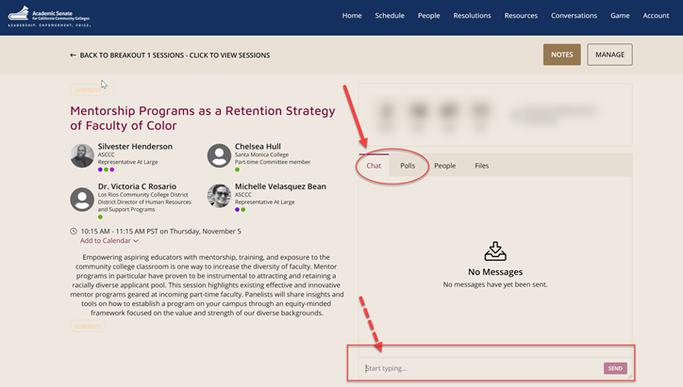
Questions
Use the Pathable platform CHAT box

Slide 4
Session Description
The concept of the false dichotomy centers around disproving the “either / or” idea. How many times have you found yourself in “either / or” situations? Should you finish grading or sleep? Should you take the longer commute for a slightly better pay or should you do volunteer for academic governance and try to get a publication? Part-Time faculty members are constantly being thrown into “either / or” situations, and this session discusses how we can navigate the ambiguity of our field with clarity.

Slide 5
What is a false dichotomy?
“False Dilemma”
Two alternative points are presented as the only options, but others are available
“Either / Or”
Remember the grey areas.
Reflect
What either-or scenarios do you encounter in your profession?
Remind yourself of your humanity
Don’t push yourself into these conditions
Notes:
also called the “false dilemma” // This is looking at perspectives as either-or scenarios.

Slide 6
Understanding our Delightful Enigmas
Enigmas: people or things that are mysterious or mystifying
Our delightful enigmas include adjunct faculty contracts, getting a full-time position, or institutional practices

Slide 7
Humanizing the adjunct experience
Don’t think of yourself as “just an adjunct” - are you a highly trained and skilled instructor. Know your worth as a teacher and academic.
Develop a wide network of adjunct faculty friends, full-time colleagues, and non-academic that you trust to discuss your job with.
Take time to yourself and remember that your profession is not a reflection of you as a human being.
Notes:
We dominate hiring percentages in California and across the U.S. simply because the labor is cheap. Don’t think of yourself as “just an adjunct” - are you a highly trained and skilled instructor. Know your worth as a teacher and academic.
We often have little support and are contingent. Develop a wide network of adjunct faculty friends, full-time colleagues, and non-academic that you trust to discuss your job with.
We’re stretched thin with course loads and extra scholarship. Take time to yourself and remember that your profession is not a reflection of you as a human being.
California CC- 43.99 % (Academic Temporary employees) of faculty are part-time vs. 20.91% FT (Academic-Tenured Track). Fall 2020 Data Mart
Hystorical Note:
October 1998 Rostrum article “Overuse and Undercompensation of Part-Time Faculty in the California Community Colleges
Part-time faculty are generally compensated only for direct classroom contact hours, the many other duties of a professional faculty member are either left to the full-time faculty or performed by the part-time faculty member with little or no compensation.
”https://www.asccc.org/content/overuse-and-undercompensation-part-time-faculty-california-community-colleges#:~:text=In%20California%2065.6%25%20of%20faculty,the%20total%20equivalent%20instructional%20load.&text=Nationally%2C%20full%2Dtime%20faculty%20teach,62.0%25%20of%20the%20total%20load.&text=In%20California%20part%2Dtime%20faculty,rate%20of%20%2435.82%20per%20hour.

Slide 8
Group Exercise!
Click on the GoogleDoc link in the Pathable Chat or type in this link in your browser:
https://tinyurl.com/ASCCCExercise

Slide 9
Scenario 1
As a part-time faculty member, I need to attend all department meetings and professional development. If I don’t put in “face time,” I won’t get offered classes frequently.

Slide 10
Reality
Know your contract
Curriculum assignments are a part of your contract; however, department meetings usually aren’t.
How did you all ground yourselves?
Write your reply in the GoogleDoc
Do professional developments, skip the meetings, and understand that class assignments aren’t personal

Slide 11
Scenario 2
I’ve applied for several full-time, tenure track positions at my home campus but have never been hired. In most cases, I never get an interview. There’s something wrong with me as an applicant.

Slide 12
Reality
Structural inequity exists!
Tenure hiring is rooted in inequity. Don’t gaslight yourself because of the campus’s lack of an internal pipeline for hiring, mentorship, or mystifying hiring processes.
How did you all ground yourselves?
Write your reply in the GoogleDoc

Slide 13
Scenario 3
I care deeply about my students, to the point where I’m being emotionally burnt out. If I don’t don’t check my emails constantly, or work on the weekends to catch up, I’m failing them.

Slide 14
Reality
Heart versus mind
You, just like your students, are human beings. Take breaks, encourage your students to reach out when they need help without overextending yourself.
How did you all ground yourselves?
Write your reply in the GoogleDoc
Practice setting work & time boundaries
Implement self-care techniques to avoid burnout

Slide 15
Scenario 4
I need to teach at least five classes to pay my bills. This semester, I’ve been offered seven classes total. If I don’t take those two courses, the campus will think I’m not interested and won’t offer me more classes in the future.

Slide 16
Reality
Money versus Sanity
Extra paychecks are good, but so is your personal time
How did you all ground yourselves?
Write your reply in the GoogleDoc
I get it, no one wants to financially struggle
Prioritize yourself financially but try to maintain a work balance
Stay in the adjunct faculty pool, communicate with the chair, and explore short-term or online options

Slide 17
Sustaining the Conversation
History
The trends we’re seeing now have been discussed for 20 years.
Know how we got here to understand what we can do.
Systemic Change
How have greater inequities been created?
Equitize the adjunct contract with the full-time contract.
Plan
What can we do?
What can full-time faculty do?
What should the ASCCC advocate?
How can unions help?
Notes:
Adjunct faculty contracts need to be equitized with full-time faculty contracts to prevent feelings of exploitation
Ask yourself: In what ways have we created greater inequities?
The entire academic system needs to change. What can you do, as adjunct faculty? What should full-time faculty do? What should the ASCCC advocate?
Get a quote or video from a union leader; follow up with Debbie to explore.
Define “equitize contract”- AFT 2002 Publication
https://www.aft.org/sites/default/files/standardsptadjunct02.pdf
How are we “fairing” in 2021?
-Part-time/adjunct faculty should be paid a salary proportionate to that paid full-time tenured faculty of the same qualifications for doing the same work.
-Part-time/adjunct faculty should receive proportionate healthcare and pension benefits.
-Part-time/adjunct faculty should receive proportionate healthcare and pension benefits.
-Part-time/adjunct faculty should be paid for holding office hours for student conferences.
-In the absence of full pro rata pay, part time/adjunct faculty who participate in institutional committee work should be compensated for doing so.
-Part-time/adjunct faculty should have unemployment insurance available to them when they are not on the college payroll.

Slide 18
Questions & Discussions
We’ll take questions from the Pathable chat during the remainder of our time.

Slide 19
Continuing the Conversation
Don’t forget
Social Networking following this session
Sign up for Google listserv

Slide 20
For Further Information and Support
Email info@asccc.org
Contact Info:
Chelsea Hull: hull_chelsea@smc.edu
Mayra Cruz: cruzmayra@fhda.edu

