Slide 1
General Session 2 Friday February 25, 2022 ǀ 12:30pm – 2:00pm ACCJC Updates, the Formative/Summative Process, and the “New Standards”

Slide 2
Today’s Panel
Kevin Bontenbal, ACCJC Vice President
Stephanie Curry, ASCCC Area A Representative
Virginia “Ginni” May, ASCCC Vice President
Catherine Webb, ACCJC Vice President
Facilitator: Christopher J. Howerton, ASCCC Accreditation Committee Chair

Slide 3
Topics:
Introductions/Opening Questions
Overall update and recent changes with ACCJC
Process of developing the next set of accreditation standards and how are faculty included in the development.
Update on the roll-out of the formative/summative assessment process
Additional trainings/resources that are provided by ACCJC
The impact on the accreditation process due to increased number of baccalaureate degrees offered by CA community colleges
Some of the opportunities/challenges around accreditation considering the last 2 years

Slide 4
Introductions
Notes:
Opening Questions for the Panelist
How did you get introduced to accreditation work?
What has been your experience with accreditation?
What is it about accreditation work that you enjoy?
What would you say to those new to accreditation work?

Slide 5
General ACCJC Update
Notes:
Additional updates not including the F/S or the development of the new standards as they are covered later in this presentation.

Slide 6
Development of Updated Standards
Who is involved in developing the standards and how are they vetted?
How specifically are faculty included in this process?
What is the timeline for this development and when will colleges be reviewed with these updated standards?
What type of trainings will be done to prepare colleges and teams in preparation for using the updated standards?
Notes:
Standards Review Leadership Team
The ACCJC Standards Review Leadership Team is the steering council for the Standards Review process. The Leadership Team advises on the Standards Review process and helps facilitate dialogue between the Field, the Commission, and ACCJC staff.
Members ACCJC
Dr. Keith Curry – CEO, Compton College Dr. Lori Gaskin – Commission Vice Chair
Dr. Erika Endrijonas – CEO, Pasadena City College Dr. Catherine Webb – Vice President
Dr. Janet Fulks – Retired Faculty, Bakersfield College
Dr. Rachel Solemsaas – CEO, Hawai’i Community College

Slide 7
Standards Review Timeline

Slide 8
Formative/Summative Comprehensive Review Process
In addition to the update of the standards, ACCJC has also been piloting a new comprehensive review process.
Overview of the process
Any initial findings from conducting the pilot?
What has been some of the experiences for those that have served on the pilot teams?

Slide 9
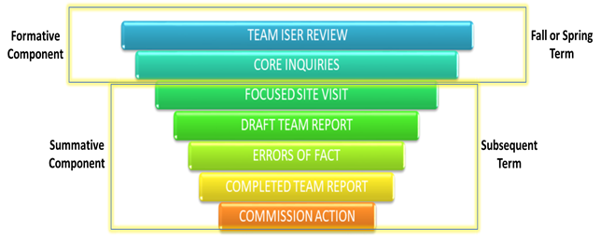
Formative/summative Comprehensive Review
Notes:
If possible, highlight the idea of core inquiries and focused site visit

Slide 10
Additional Trainings/Resources - ACCJC
ACCJC Educational Series
Accreditation Basics
Preparing the ISER
Peer Reviewers
How-To
ACCJC Webinars

Slide 11
Additional Trainings/Resources -ASCCC
Accreditation Resource Teams

Slide 12
Baccalaureate Degrees
What do you see as an impact on the accreditation process for those community colleges that have added new baccalaureate degree programs/curriculum?
AB 927 – Public postsecondary education: community colleges: statewide baccalaureate degree program
Notes:
If time also ask if the implementation of AB927 – expansion of the ability for CA community colleges adding baccalaureate degrees

Slide 13
Opportunities/Challenges
With the impact of the pandemic to higher education over the last two years, what are some of the unexpected opportunities or challenges you have seen to accreditation work?

Slide 14
Finally….
Any last words of advice for colleges who are working on their self-studies or preparing for an accreditation visit?

Slide 15
Notes:
Remind attendees that there is a follow-up breakout session if you would like to discuss any of these concepts further, or if there are other questions you would like to ask participants of this panel.

