Slide 1
Guided Pathways Webinar - English and Math Pathways and Noncredit Development Wednesday, May 6, 2020 - 12:00pm to 1:00pm

Slide 2
Housekeeping and ASCCC Resources
ASCCC GP Canvas - https://tinyurl.com/CCC-GP2018
ASCCC Guided Pathways RESOURCES https://www.asccc.org/guided-pathways
Welcome! We’ll be with you shortly
The chat will be used for questions and input
All attendees will be muted
Notes:
Janet

Slide 3
Presenters Today’s Plan
Joe Davis, Adjunct Professor, Mt SAC Adult Basic Education
Janet Fulks- ASCCC Guided Pathways Faculty Lead
Lesley Johnson, Mt SAC Director, Adult Basic Education
Ty Simpson – Counselor San Bernardino Valley College
JanYoung – Noncredit Glendale College
Graciela Vasquez – Noncredit Cerritos College
English and Math Pathways and Noncredit Development -
While co-requisites are showing promise for some student populations, the data clearly shows that this is not the case for all student populations. Students, faculty, and administrators have voiced loud concerns regarding high-unit co-requisite coursework that may or may not address the skills students need. This webinar discusses no-unit coursework and customized time to learn skills relevant to success delivered through noncredit. Innovative ideas and strategies will be explored.
Notes:
Janet

Slide 4

Questions for you
Who are you Faculty, credit or noncredit, full-time or part-time, mathematics, English or ESL?
Notes:
TY

Slide 5
Educational Attainment
Highest level of education among people aged 25 years and older.
2017
United States
N = 4.57M
Notes:
Jan – quite a few students who need basic skills and noncredit education as a bridge into credit

Slide 6
Default Rules for English
High School Performance Metric for English | Recommended AB 705 Placement for English
HSGPA ≥ 2.6 Throughput rate of 79% | Transfer-Level English Composition No additional academic or concurrent support required
HSGPA 1.9 - 2.6 Throughput rate of 58% | Transfer-Level English Composition Additional academic and concurrent support recommended
HSGPA < 1.9 Throughput rate of 42% | Transfer-Level English Composition Additional academic and concurrent support strongly recommended
Notes:
Janet
Using the predicted throughput rates, even using best case scenarios (which is not what colleges are reporting) we must admit that in the bottom tier 58 % and in the middle tier 42% of student will fail. What happens to these students? Is doubling down and teaching them the skills they need to succeed while they are taking college level courses the best way? Are we okay with 50% pass rates? What happens to the students who fail? What about the ones that never start? We know long sequences of basic skills classes did not produce throughput, but does throwing them in the deep end optimize student learning? We are going to examine some successful and innovative ways to contribute to student higher education success.

Slide 7
Data from one district AB 705 Implementation Fall 2019
Notes:
These concerns are especially true as we consider that some colleges are reporting larger equity gaps. (Eng 28 is integrated reading and English one level below; Math 125 Int Algebra one level below transfer passing in HS with a C- bypasses this course; Math 227 was Stats with Support)
English 101 Outcomes: English 101 is an associate degree graduation requirement and the transfer-level English course that most LACCD students take. Enrollment for English 101 grew by 6008 students, but the success rate dropped by 10.7% in Fall of 2019. The net result was that 2,371 of these additional English 101 students successfully completed the course, but the remaining 3,637 students were not successful (a ratio of 1.5 to every 1 success). In other words, for every two additional students who attempted and successfully completed English 101 in Fall 2019, another three were unsuccessful.

Slide 8
What is Concurrent Support?
The initial guidance from the Chancellor’s Office mentions offering and possibly requiring students to participate in some form of concurrent support.
There are several different types of concurrent support that colleges are offering or are considering to offer to students. These include:
  Redesigned Credit Course
  Corequisite Credit Course (lecture or lab)
  Corequisite Noncredit Course
  Increased Access to Learning Centers
  Embedded Tutoring
  Supplemental Instruction
  Writing Centers/Math Labs
  Directed Learning Activities
But there are “time issues” for students if you do it concurrently.
Today we will learn about other options for supporting AB 705 students and optimizing success.
Notes:
Janet

Slide 9
How can noncredit help – student input
Notes:
Janet

Slide 10
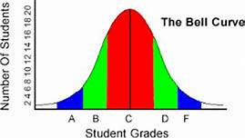
How do we learn? Who decided 16-18 weeks is perfect?
The controlling variable is time – the length of the semester or term.
The controlling accomplishment of outcomes; some shorter, some longer
Notes:
Janet - Achievement of your SLOs; With credit students are graded at the end of a semester based on the content delivered and controlled by the length of the semester. With noncredit, the controlling variable is the achievement of student learning outcomes. The student can spend as much or as little time on the content as they need to understand it. Not all students learn in the same time frame, not all topics CAN be learning in the same time frame. Our noncredit research actually showed that many students complete the student learning outcomes sooner than the semester time constraints. In noncredit - Time is not the controlling variable

Slide 11
Questions for you
What do you know about Noncredit?
Notes:
Insert question for response

Slide 12
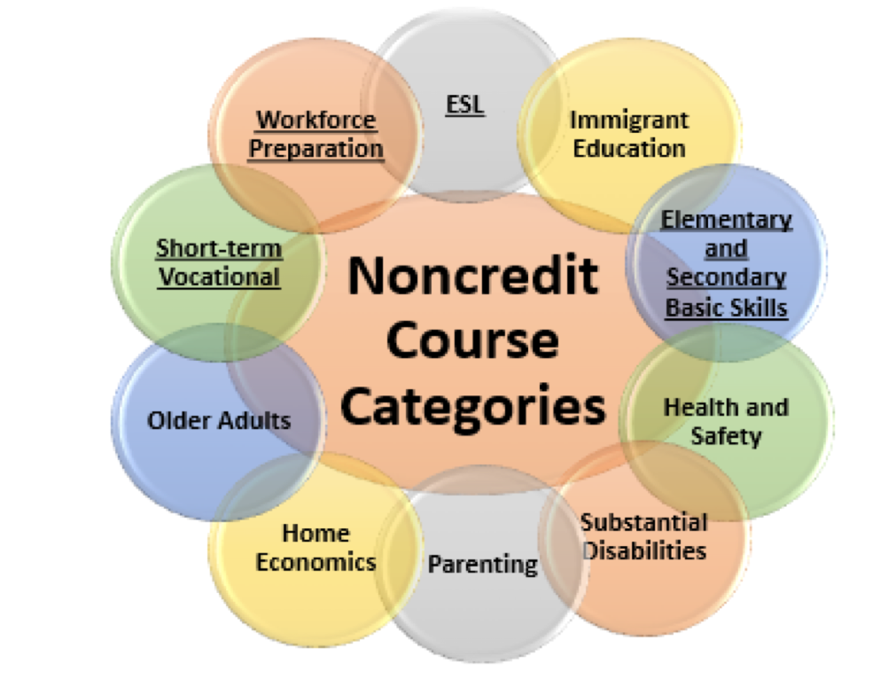
Eligible Noncredit Courses: Ten Categories
English as a Second Language (ESL)*
Immigrant Education
Elementary and Secondary Basic Skills*
Health and Safety
Substantial Disabilities
Parenting
Home Economics
Courses for Older Adults
Short-term Vocational*
Workforce Preparation*
*Areas (1), (3), (9), (10) are eligible for Enhanced Funding if associated with an approved noncredit program.
Notes:
Jan

Slide 13
Why Noncredit?
Tuition is free - No financial aid necessary
Risk free – will not affect GPA
Available for all students
Open entry/open exit format versus managed enrollment.
Flexible scheduling
Integration of counseling
Notes:
Jan

Slide 14
Why Noncredit?
Focus on skill attainment, not grades or units
Repeatable and not affected by 30 unit basic skills limitation
Elementary level skills to pre-collegiate skills
Prepare for employment or credit programs
CTE: preparation, practice, and certification
Bridge to other educational/career pathways
Allows returning adults to develop self efficacy, low risk environment
Notes:
Jan

Slide 15
Why Noncredit? Faculty Perspective
More freedom to tailor course to the student’s pace
Focus on skills attainment, not units
Courses have immediate impact on students’ lives and communities
Lower stress environment
Opportunity for students to repeat a course, practice skills, and become more proficient.
Notes:
Jan – Asks credit faculty what the ideal student would look like

Slide 16

Why Noncredit? Faculty Equity Perspective
Opens the equity door—provides access to underserved students
Most noncredit students are our Disproportionately Impacted students
Opportunity for students to start/prepare for a career path
Option for students needing review courses in math and English.
Notes:
Jan – From an equity lens it is important to acknowledge that this provides a great student option that eliminates some key barriers
Care $ are not available for the noncredit students, what funds will noncredit use and these are the ones that need it most

Slide 17
CREDIT VS. NONCREDIT
Degrees and Certificates of Achievement | Certificates of Completion or Competency
Unit bearing | Hour bearing
Designated lecture & lab hours | No lecture or lab designation
Grades (A-F or P/NP) | Grades dependent on district (P/SP/NP, A-F)
Transcript | Some schools transcript noncredit courses
Generated Apportionment | Generates apportionment CDCP or regular noncredit
Student fees apply | No student fees
Not repeatable | Repeatable
Notes:
Jan

Slide 18
Effects of Student Centered Funding Formula
Credit – $3,727/FTES For 2019-2020 (65% FTES) + Supplemental (low income metrics 20%) + Student Success Metrics (10%)
Regular Noncredit – $3,347/FTES
Career Development College Preparation (CDCP) Noncredit – $5,457/FTES
The areas of noncredit instruction qualifying for CDCP funding
Elementary and secondary basic skills and other courses and classes such as remedial academic courses or classes in reading, mathematics, and language arts.
English as a second language.
Short-term vocational programs with high employment potential.
Workforce preparation classes in the basic skills of speaking, listening, reading, writing, mathematics, decision-making and problem-solving skills, and other classes required for preparation to participate in job-specific technical training.
Notes:
Jan – more bang for the buck

Slide 19

Approximately 19% of the students are noncredit
Located in the South East section of Los Angeles County
Notes:
Graciela -

Slide 20
CERRITOS COLLEGE NONCREDIT
Skills Support Courses: Prep Math, College Readiness - Math Review Boot Camps, College English Skills, PreGED and GED, CTE skills attainment
Support Courses along the pathway
  Intervention; skills development; supplemental support
Alignment of noncredit and credit ESL courses
Collaboration with noncredit and credit programs to develop contextualized basic skills courses
Cerritos Complete (College Promise)
  Transitioning noncredit to credit
Providing a safety net
Notes:
Graciela
Not one way to do a noncredit pathway. Heavy student support weaved it. How the CO can support it is to include NC student journey and milestones in Vision for Success and GP metrics. That will incentivize colleges to include noncredit and adult ed into their pathways and maps
LCP – pilot Learning Career Pathways include noncredit support throughout math and English courses

Slide 21
GUIDED PATHWAYS
3 Weeks Noncredit Math Support + 15 Weeks Credit Statistics
18-Week Course Schedule
 | Monday | Tuesday | Wednesday | Thursday
8:00 | AED/MATH 112 Statistics (4 units) | AED/MATH 112 Statistics (4 units) | AED/MATH 112 Statistics (4 units) | AED/MATH 112 Statistics (4 units) | 8:00
8:15 |  |  |  |  | 8:15
8:30 |  |  |  |  | 8:30
8:45 |  |  |  |  | 8:45
9:00 |  |  |  |  | 9:00
9:15 |  |  |  |  | 9:15
9:30 | MATH SUPPORT Noncredit Support for Statistics | MATH SUPPORT Noncredit Support for Statistics | MATH SUPPORT Noncredit Support for Statistics | MATH SUPPORT Noncredit Support for Statistics | 9:30
9:45 |  |  |  |  | 9:45
10:00 |  |  |  |  | 10:00
10:15 |  |  |  |  | 10:15
10:30 | ENGL 100 (4 units) |  | ENGL 100 (4 units) |  | 10:30
10:45 |  |  |  |  | 10:45
11:00 |  |  |  |  | 11:00
11:15 |  | GE Course |  | GE Course | 11:15
11:30 |  |  |  |  | 11:30
11:45 |  |  |  |  | 11:45
12:00 |  |  |  |  | 12:00
12:15 |  |  |  |  | 12:15
12:30 | ENG Support Noncredit Support for English |  | ENG Support Noncredit Support for English |  | 12:30
12:45 |  | COUNS 100 |  | COUNS 100 | 12:45
1:00 |  |  |  |  | 1:00
1:15 |  |  |  |  | 1:15
1:30 |  |  |  |  | 1:30
Noncredit Math
Math Support Statistics
Math Support College Algebra
Pre-Algebra
Prep Math – Basic Math Skills
Noncredit English
Pre College English Support
College English Skills

Slide 22
ENGLISH AS A SECOND LANGUAGE PATHWAY
ADULT SCHOOL
COLLEGE NONCREDIT
COLLEGE CREDIT
ESL
Low to Intermediate
NonCredit Transition Course
ESL Low Advanced
ESL 5/NonCredit Mirrored Course
High Advanced/Basic Comp
ESL 120 – Composition Beginning
ESL 152 – Composition Intermediate
ENG 100 – Freshman Comp
Notes:
Graciela

Slide 23

Cerritos Complete - 2 Years Tuition Free
for noncredit and adult school students
Noncredit students completing High School Equivalency Certificate Programs
Successful completion of HS Equivalency exam or HS diploma credits at Adult Schools
  All CAEP consortium partner members included
Incentivizing students toward completion of HS diploma program/equivalency
Supportive academic programs and student services
Two-year free tuition (in-state rates only)
Two-year priority enrollment
Step by step assistance
One-on-one counseling and advisement
Personalized schedule for Fall and Spring semesters
Tracking student progress and success
Actions in program development should reflect our equity values
Notes:
Graciela

Slide 24
Questions??: gvasquez@Cerritos.edu
Graciela Vasquez

Slide 25
Academic Intervention in Support of Transfer-Level Math and English
Notes:
Joe and Lesley

Slide 26
Use Of Data In Developing AIME Courses
Noncredit faculty worked with credit faculty to develop curriculum targeting areas of student need
Two noncredit math courses recently approved to address competencies needed in BSTEM and Statistics
Courses are offered several times per year
Direct instruction which includes intrusive (embedded) counseling and tutoring
Notes:
Joe and Lesley
Asked faculty what students need to know to be successful in English and math
Data showed that more students are taking stats so there was a need to develop a separate course

Slide 27
Summary of AIME Course Content
BS EPCS (English Preparation for College Success) | BS MPS (Math Preparation for Statistics Success) | BS MPSTM (Math preparations for BSTEM Success)
Close reading and critical analysis of texts Strategies for revision Thesis development Expository writing Argumentative writing | Ratios, fractions, decimals, percentages Measures of central tendency Measures of dispersion Dot plots, histograms, boxplots Probability Graphing skills Calculator Skills | Functions, function notation, graphing basic functions Factor and graph absolute value equations and inequalities Quadratic and other polynomial functions Properties of exponential functions, fractional exponents, radicals Systems of equations

Slide 28
AIME English Enrollments and Transfer Level Success 2018-19
AIME English Enrollments and Transfer Level Success 2018-19
 | 2018-19 Total AIME Enrollment | Attempted ENGL 1A After Taking AIME* | % Attempted ENGL 1A After Taking AIME | Successful in ENGL 1A After Taking AIME | Success Rate of Students Who Took ENGL 1A After AIME
AIME English Students | 133 | 79 | 59% | 56 | 71%
*unduplicated number of students
Notes:
Joe and Lesley

Slide 29
AIME Math Enrollments and Transfer Level Success 2018-19
AIME Math Enrollments and Transfer Level Success 2018-19
 | 2018-19 Total AIME Math Enrollment | Attempted Transfer Math After Taking AIME* | % Attempted Transfer Math After Taking AIME | Successful in Transfer Math After Taking AIME | Success Rate of Students Who Took Transfer Math After Taking AIME
AIME Math Students | 214 | 61 | 29% | 43 | 70%
*unduplicated number of students
Notes:
Joe and Lesley

Slide 30
Numbers are only one piece of the story!
Check out this video AIME Student Video
Notes:
Joe and Lesley

Slide 31
Student Quotes About AIME
“I would recommend this course”
“This course was very helpful”
“Gave me a chance to practice my writing”
“Helped me improve because English is my second language”
“Good refresher”
“Helped me prepare for English 1A”
“Very good program”
“Helped me prepare for higher level math”
“Helped build my confidence in math”
“It’s been 25 years since I have done this kind of math and this course helped me”
Notes:
Joe and Lesley

Slide 32

Joe Davis, Adjunct Professor, Adult Basic Education
jdavis4@mtsac.edu
Lesley Johnson, Director, Adult Basic Education
ljohnson@mtsac.edu
Notes:
Joe and Lesley

Slide 33
Over 211 Noncredit Courses in Mathematics and English but only 11 correctly coded With CB26
COLLEGE | TITLE (CB02) | Support Course Status (CB26) | TOP CODE (CB03)
CHAFFEY | Mathematical Foundations | S | 1702.00 Mathematics Skills
CHAFFEY | Skill Building for Math 420 | S | 1702.00 Mathematics Skills
CHAFFEY | Skill Building for Math 450 | S | 1702.00 Mathematics Skills
CHAFFEY | Skill Building for Stat 10 | S | 1702.00 Mathematics Skills
CHAFFEY | Skill Building for Math 25 | S | 1702.00 Mathematics Skills
COMPTON | Supervised Tutoring: Mathematics | S | 4930.09 Supervised Tutoring
FOOTHILL | English Bridge | S | 1501.00 English
FOOTHILL | Bridge to Transfer English | S | 1501.00 English
FOOTHILL | Critical Thinking: Student Managed Portfolio Development | S | 1501.00 English
FOOTHILL | Critical Thinking: Portfolio Management and Publication | S | 1501.00 English
PALO VERDE | Preparatory Mathematics | S | 1702.00 Mathematics Skills
Notes:
Janet Over 613 sections/over 175 noncredit courses of TOP Code 1501 or 1701 & 1702 but only 11 coded appropriately as support. A full list of the courses is posted with all the colleges at the ASCCC website. Check your coding.
Ventura CCD Moorpark MATHM905S CCC000603784 Support for College Algebra- Mathematics Skills-170200 Noncredit Not transferable
Peralta CCD Laney ENGL 508A CCC000602205 Academic Composition Skills English-150100 Noncredit Not transferable

Slide 34

Guided Pathways
Noncredit is more than onboarding.
Notes:
Jan

Slide 35
Questions for you
What is the most significant thing you learned about Noncredit?
Where do you see Noncredit opportunities and bridges working at your college?
Notes:
Ty

Slide 36

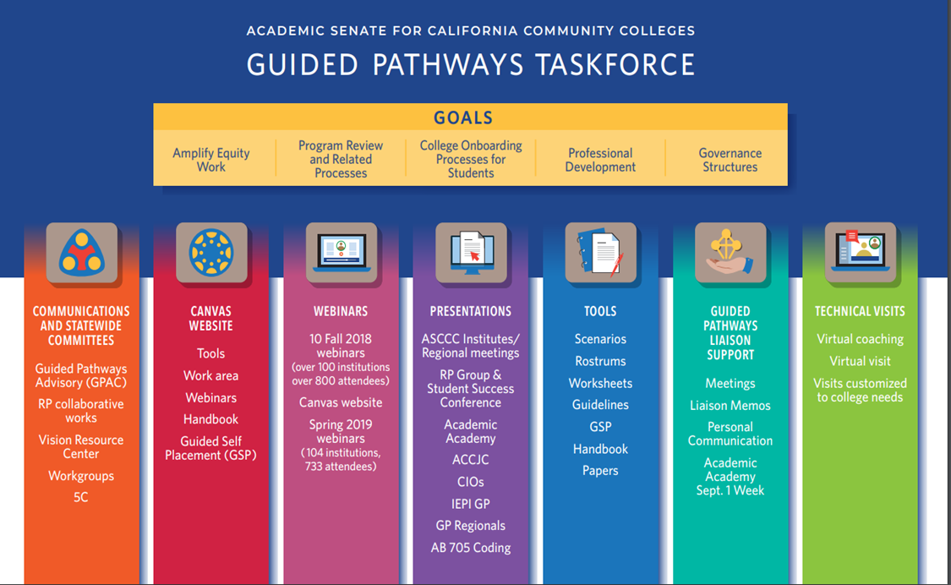
Notes:
Janet

Slide 37
Resources
Noncredit Instruction: Opportunity and Challenge https://asccc.org/sites/default/files/Noncredit_Instruction.pdf
Questions?? Email info@asccc.org
ASCCC GP Canvas - https://tinyurl.com/CCC-GP2018
ASCCC Guided Pathways RESOURCES https://www.asccc.org/guided-pathways
ACCE website acceonline.org (Association of Community and Continuing Education)
Presentations: ​Utilization of Noncredit in Implementing AB 705 to Increase Success for All Students
by ​Dr. Allison Tom-Miura, West LA College
Webinars: 12 First Friday webinars on noncredit topics

