Slide 1
Including Part-Time Faculty
Dolores Davison, Foothill College
Arnita Porter, West Los Angeles College

Slide 2
Some Terminology
Most nationwide statistics include graduate students and non-tenure track full-time faculty among “contingent” numbers, which can be misleading.
Some colleges use adjunct, some use part-time, some use contingent; all of these terms in the CCCs are used to refer to faculty who teach 67% or less of a full-time load

Slide 3
Some Quick Statistics
Full-time Faculty make up approximately 18,000 of the total faculty employed by the state, while part-time faculty total 38,000
Women make up a slightly lower percentage of the part-time faculty ranks compared to their male counterparts
The average age of part-time faculty is virtually identical to that of full-time faculty, as is ethnic information.
All statistics taken from the FACCC report on Part-Time and Full-Time faculty, located at http://www.faccc.org/wp-content/uploads/2014/11/2012facprofile_report_final.pdf

Slide 4
Given This, Why Are Part-Time Faculty More Involved?
Lack of invitations
Time/Freeway Flying
Interest
Feeling disenfranchised from the full-time faculty or the college as a whole

Slide 5
And Yet They Bring…
Experience
Alternative Perspectives
New methodologies
Information from a wide range of sources

Slide 6
And…
They are often the faculty teaching the courses in the first part of the sequence
They are the first faculty many students encounter
They will be applying for full-time jobs not only at your college but at others around the state

Slide 7
What Can Faculty Leaders Do?
Make sure that opportunities are presented to part-time faculty
Schedule activities at times that part-time faculty will be able to attend
Be certain to invite part-timers specifically
Involve them in more than just departmental activities (although definitely do that!)
Hold orientations and other activities that include part-timers
Open positions to them (compensated or not) and allow them to gain experience

Slide 8
ENJOY what we do
ENGAGE with students, colleagues, campus
EXPLORE/INCREASE career opportunities
HOW CAN WE REDEFINE OUR EXPERIENCE?

Slide 9
CHALLENGES
Parity vs. Equity (Equal Pay for Equal Work)
Job Security / Health Benefits
Shared Governance

Slide 10
I Am My Part-Timers Keeper

Slide 11
How Part-timers Can Help Each Other
Build Community
Get involved. Stay informed.
Communicate Professionally
Collaborate on Professional Development
Provide Support

Slide 12
Increase Career Opportunities
Discover what happens beyond the classroom
Join a committee on campus / attend as a guest
Join a FIG / create one
Contact your PD Coordinator for information on workshops and seminars on campus and in your district.
Volunteer for ASCCC committees
Learn the process
Seek administrative assignments on campus
Consider Grant writing
Get familiar with MQs in your district and beyond Know what you are qualified to teach
Consider becoming a faculty advisor to a student club
Expansion: Local, District, Statewide

Slide 13
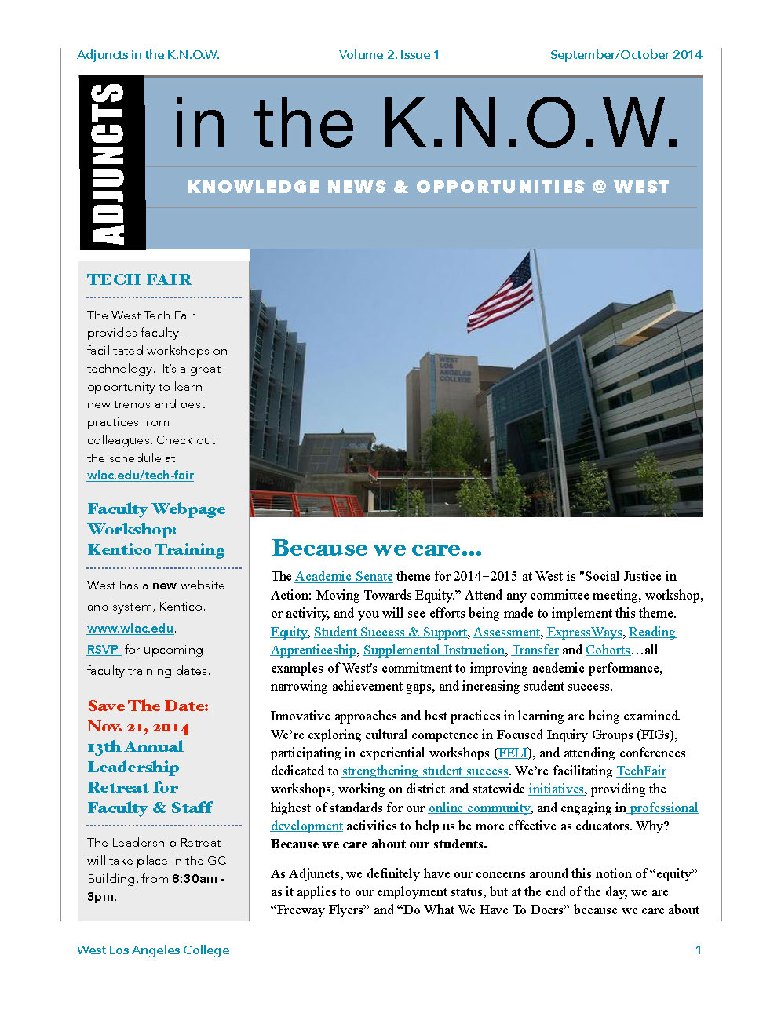
ADJUNCTS in the K.N.O.W.
KNOWLEDGE
NEWS
OPPORTUNITIES
@ WEST (Where YOU work)

Slide 14
Resources
AdjunctNation.com
California Part-time Faculty Association (CFPA)
Pacific Standard Online Magazine: http://www.psmag.com/series/the-state-of-adjunct-professors
The Adjunct Project
ASCCC

Slide 15
Thank You!
Dolores Davison (davisondolores@foothill.edu)
Arnita Porter (porterAE@wlac.edu)

