Slide 1
Designing Curriculum to Increase Participation and Engagement of Disproportionately Impacted Students in STEM
Lara Baxley, Cuesta College
Jamar London, Santa Monica College
Eric Wada, Folsom Lake College
2019 Curriculum Institute

Slide 2
Session Description
This session explores some of the barriers African American, Latinx, Native American, and Pacific Islander students face when pursuing STEM degrees or certificates. Given these barriers, how can STEM curriculum be structured with an equity focus? What types of curriculum-based support structures are possible to improve persistence and retention of disproportionately impacted student populations? Please come and discuss the social, economic and cultural implications of increased participation and engagement for students of color in the STEM disciplines.

Slide 3
Outline
Introduction: Who’s here
Equity gaps
STEM Curriculum and making it culturally relevant
Equity in the syllabus
Student Instructional Support
Math
Science

Slide 4
Data Sources to Find Equity Gaps
CCCCO Data Mart
Provides numbers, but not much context
Local or District Research Office
Work with researchers to design effective surveys
Get to know your DI populations
Service area
Classroom demographics

Slide 5
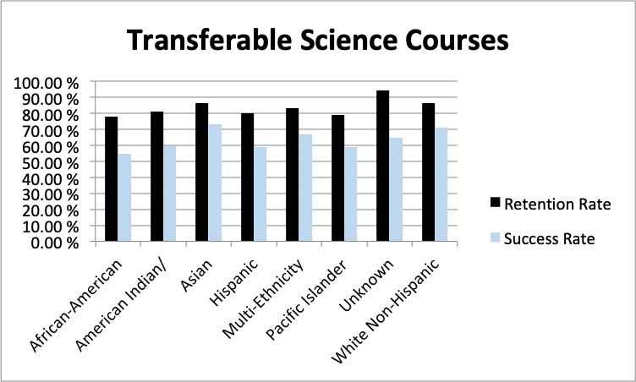
Retention and Success Statistics
Source: Data Mart
Fall 2018 Transferable, Non-Distance education courses in
Biology and Physical Science TOP Codes

Slide 6
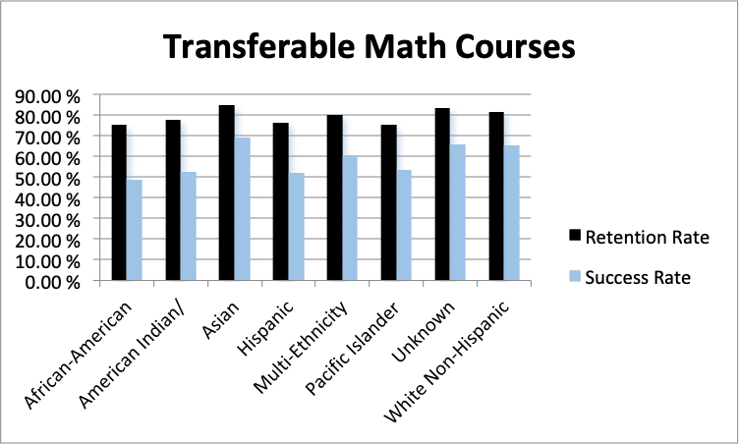
Retention and Success Statistics
Source: Data Mart
Fall 2018 Transferable, Non-Distance education courses in MathTOP Code

Slide 7
Equity Gaps
Students’ responsibilities
Working
Family responsibilities
No role model in the family or in the classroom
Unit value of STEM courses
Units for a degree or certificate
GE patterns and unit values
Scheduling STEM courses
Teaching modality
Textbook costs
Ancillary costs (field trips, disposables/consumables)

Slide 8
STEM Curriculum
What must/should STEM curriculum include?
Instructor interests
Student interests
What are some of the challenging aspects of STEM curriculum?
Instructor view
Student view

Slide 9
Culturally Relevant Curriculum in STEM
Instructional examples that are relevant to students
Achievements of underrepresented STEM figureheads
Assessments that are culturally relevant
Consider how questions are worded
Projects with social justice implications
Framing assessments with the goal of identifying inequities and with the goals of developing thought processes to promote social justice.
STEM students are training to be innovators and problem-solvers!

Slide 10
Building Equity Through Your Syllabus
Some students, particularly members of groups underrepresented in STEM fields, cite an unwelcoming atmosphere from faculty as a reason for their departure .” (President’s Council of Advisors on Science and Technology (PCAST) 2012).
We can use language and practices that reduce confusion and make them feel welcome and to promote their success in our classes.
The syllabus provides students with a first impression of you as a teacher and how welcoming, or unwelcoming, you are.

Slide 11
Direct vs Warm Syllabus
A study by Harnish and Bridges determined that “a syllabus written in a friendly, rather than unfriendly, tone evoked perceptions of the instructor being more warm, more approachable, and more motivated to teach the course.”
Developing a warm syllabus is NOT
copying from the ‘good’ syllabus
removing rules or making the class easier
https://ctl.yale.edu/sites/default/files/basic-page-supplementary-materials-files/effect_of_syllabus_tone_student_perceptions_of_instructor_and_course_spe_2011_0.pdf

Slide 12
Examples of Direct vs Warm Syllabus Language
 | Direct | Warm
Office Hours | If you need to contact me outside of office hours, send email, call my office, or contact the department and leave a message. | I welcome you to contact me through Canvas, email, calling my office, or you can contact the department and leave a message.
*Equity Tip: Consider renaming your office hours “Student Help Hours” to be more clear to students about their purpose.
https://ctl.yale.edu/sites/default/files/basic-page-supplementary-materials-files/effect_of_syllabus_tone_student_perceptions_of_instructor_and_course_spe_2011_0.pdf

Slide 13
Examples of Direct vs Warm Syllabus Language
 | Direct | Warm
Course objectives | Because you are not yet a critical consumer of information about mental processes and behavior, it is important to complete all of the course activities. | Completing the course activities is important in helping you become a critical consumer of information about mental processes and behavior.
https://ctl.yale.edu/sites/default/files/basic-page-supplementary-materials-files/effect_of_syllabus_tone_student_perceptions_of_instructor_and_course_spe_2011_0.pdf

Slide 14
Review Statement #1
What is your reaction to this portion of a syllabus:
Can this statement be made to be more student focused while retaining the same rules?
How might a student who worries whether or not they belong in the class react to this statement?
Electronic Devices:
Electronic devices including cell phones, computers, tape recorders, iPods, etc. must be turned off and out of sight. They are not to be used in the classroom for any reason, without the permission of the instructor. Deliberate violation of this policy could result in removal from the course.

Slide 15
Review Statement #2
What is your reaction to this portion of a syllabus:
How might a student who worries whether or not they belong in the class react to this statement?
Homework
Research shows that working out physics problems, especially in small groups of three or four people, helps you learn the material better than any other activity we can do. Therefore, I’ll assign homework almost daily.
*Equity Tip: Inform your students that the purpose for having certain policies is to help them to succeed!

Slide 16
Syllabus Review:
Review your syllabus for each of these 4 equity-minded practices:
Demystifying college policies and practices: helping first-year students make sense of college
Welcoming students and creating a positive learning environment where students know you care
Validating students’ ability to be successful
Representing a range of racial/ethnic experiences and backgrounds in assignments and readings

Slide 17
Considerations When Reviewing a Syllabus
Count the number of sections in your syllabus that are: Demystifying, Welcoming, Validating, and Representing
Can you improve the language of your syllabus to be more welcoming and supportive to reduce equity gaps?
Review the Course Description from the COR. Does it use jargon that might alienate beginning students who don’t understand the words? Consider editing the COR.
*Equity Tip: Start the syllabus with a Welcome statement introducing yourself and expressing your excitement for the course.

Slide 18
Student Instructional Support
Goal: Increase the use of instructional support services by students enrolled in mathematics courses. In particular, increase participation and engagement of disproportionately impacted students in STEM (men of color and women)
Targeted Services
Mathlab Visitations
Embedded Tutoring
Embedded Counseling

Slide 19
Math Lab Visitations
Overview
Throughout a given semester SMC Mathematics professors have the opportunity to take their entire class to the Math Lab for 30 – 45 minutes during a regularly scheduled class meeting.
During these Math Lab visitations, students will both become acquainted with and access services provided by the Math Lab.
Through direct (mandatory) engagement with the Math Lab, students will master course content and gain valuable college success skills necessary to successfully complete transfer level mathematics college courses.

Slide 20
Potential Outcomes of Math Lab Visitations
Students
Learn course content and gain valuable college success skills necessary to successfully complete both mathematics and other college courses
Increased motivation to seek out other student instructional support services.
Math Faculty
Gain an increased familiarity with services provided by the Math Lab
Increases dialogue with Math Lab staff
The Math Lab
Increased familiarity with course content
increases dialogue with Math faculty

Slide 21
Embedded Tutoring
An embedded tutor is a SMC student selected by the Math Department who
has previously completed the course successfully.
is embedded in one section of a particular course.
provides in class assistance to students enrolled in the section either individually or within a group.
attends class regularly.
holds regular tutoring hours in the Math Lab and gives priority to students enrolled in the tutor’s assigned section.
promotes tutoring services and encourages their use.
Embedded tutoring and corequisite courses
An embedded tutor will be assigned to each corequisite course.

Slide 22
Embedded Counseling
Each instructional faculty member teaching a corequisite course will be paired with a counseling faculty member (embedded counselor) to help meet the needs of students enrolled in the course.
The paired faculty members will work together to determine appropriate periods during the semester for embedded counselor to visit the classroom to assist students in such areas as:
accessing services offered by the College
ensuring correct course placement
In the classroom, embedded counselors also
assist with the implementation of Affective Domain Activities
bridge minor communication gaps between faculty and student
provide elements of intrusive counseling when appropriate

Slide 23
College Success Skills and Non-cognitive Skills
Begin to address the misconception STEM majors arrive at a community college possessing all the necessary college success skills (study skills) and non-cognitive skills needed to succeed in STEM courses
Write these skills into the COR of concurrent support courses for STEM majors

Slide 24
Professional Development
To assist in enabling both effective and innovative curriculum design faculty will be encouraged to take part in professional development:
Professional Learning Communities
Promote Collaborative/active learning
Promote innovative teaching techniques and use of technology
Develop a team approach to teaching “It takes a village”
Providing safe spaces for faculty to discuss student equity issues without having any fear of being negativity labeled

Slide 25
Science Support Services
Science Center
Embedded lab tutors from DI groups
Also includes tutoring through the Learning Center
Study Skills courses or workshops
Employ students from diverse backgrounds to be mentors
Summer Research at a four-year college
Hands-on science activities led by faculty to engage students at various stages of their studies

Slide 26
Any Questions?
Thank you for attending this session!

